Slide 1

Individual-based models & Spatially explicit individual-based models with NetLogoR
21-22 Juin 2021
Sarah Bauduin - Chargée de recherche à l’OFB
Équipe Loup-Lynx, Unité Prédateurs Animaux Déprédateurs et Exotiques

Slide 2
Lynx model: Integrating statistical and individual-based models

Slide 3
Lynx model
Real case study
ERC-Lynx project (“Éviter, réduire, compenser”)
Predict lynx viability while including road mortality and habitat preferences
Based on data
Lynx-vehicule collisions
Road network characteristics
Lynx presence
Land cover
Lynx population distribution
Lynx ecology

Slide 4
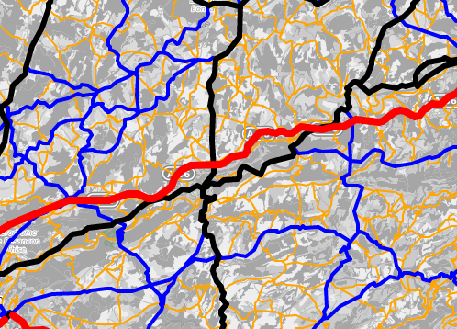
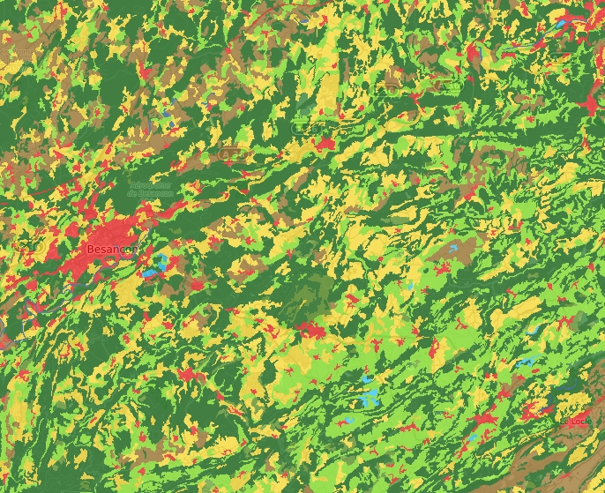
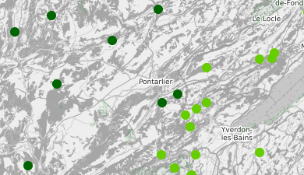
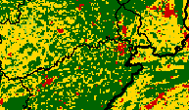
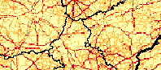
Lynx model
Road network
Land cover
Lynx populations
Lynx ecology
Reproduction
Mortality
Dispersal
Territory establishment
Collision model: glm
Habitat model:
occupancy model
Collision probabilities
Lynx habitats
SE-IBM
Lynx viability metric

Slide 5
Lynx SE-IBM
Age = age + 1
Age = age + 1
Lynx population
Collision probabilities
Non-residents
>= 1 year
Spatial annual mortality
Residents
Dispersers
Fixed annual mortality
Lynx
habitats
REPRODUCTION
DISPERSAL
+ mortality
Collision probabilities
TERRITORY SEARCH
Lynx
habitats
365 repeats
= 1 year
Did not find a territory
Found a territory

Slide 6
REPRODUCTION
Resident female ≥ 2 years old
Resident male on the same territory ≥ 2 years old
Reproduction probability = 0.80 (Breitenmoser et al. 2007)
1 or 2 youngs produced surviving until first dispersal

Slide 7

DISPERSAL
1 km²
Territory not found
Habitat types:
“Breeding”
“Dispersal”
“Matrix”
“Barrier”
Selection of next habitat: or
Prob. = 0.03
Lynx habitats
Movement correlation
Prob. = 0.5
Collision probabilities
Spatial mortality
1 to 45 steps per day
Choice of a cell
SEARCH OF A TERRITORY
Memory:
Going back to the last
visited after 10th consecutive
Fixed daily mortality
Survived
New location

Slide 8
SEARCH OF A TERRITORY
DISPERSAL
DISPERSAL
Dispersing female
Dispersing male
Lynx habitats
« Breeding »
habitat?
No
Territory with a single female?
Yes
No
Territory size between 70 and 150 km²
Big enough
non-occupied
« breeding » habitat?
Yes
No
Resident male with partner
Yes
Resident
female
Adjacent territories with single females?
Adjacent territory with available male?
Yes
Yes
Resident male with max. 3 partners
Resident female with partner

Slide 9
Testing the impact of management actions
Road network
Land cover
Lynx populations
Lynx ecology
Reproduction
Mortality
Dispersal
Territory establishment
Collision model: glm
Habitat model:
occupancy model
Collision probabilities
Lynx habitats
SE-IBM
Impact of:
- … ?
Lynx viability metric

Slide 10
Testing the impact of management actions
Road network
Land cover
Lynx populations
Lynx ecology
Reproduction
Mortality
Dispersal
Territory establishment
Collision model: glm
Habitat model:
occupancy model
Collision probabilities
Lynx habitats
SE-IBM
Impact of:
- road removal?
Lynx viability metric

Slide 11
Testing the impact of management actions
Road network
Land cover
Lynx populations
Lynx ecology
Reproduction
Mortality
Dispersal
Territory establishment
Collision model: glm
Habitat model:
occupancy model
Collision probabilities
Lynx habitats
SE-IBM
Impact of:
- road removal?
Lynx viability metric

Slide 12
Testing the impact of management actions
Road network
Land cover
Lynx populations
Lynx ecology
Reproduction
Mortality
Dispersal
Territory establishment
Collision model: glm
Habitat model:
occupancy model
Collision probabilities
Lynx habitats
SE-IBM
Impact of:
- road removal?
Lynx viability metric

Slide 13
Testing the impact of management actions
Road network
Land cover
Lynx populations
Lynx ecology
Reproduction
Mortality
Dispersal
Territory establishment
Collision model: glm
Habitat model:
occupancy model
Collision probabilities
Lynx habitats
SE-IBM
Impact of:
- road removal?
Lynx viability metric

Slide 14
Testing the impact of management actions
Road network
Land cover
Lynx populations
Lynx ecology
Reproduction
Mortality
Dispersal
Territory establishment
Collision model: glm
Habitat model:
occupancy model
Collision probabilities
Lynx habitats
SE-IBM
Impact of:
- habitat restoration?
Lynx viability metric

Slide 15
Testing the impact of management actions
Road network
Land cover
Lynx populations
Lynx ecology
Reproduction
Mortality
Dispersal
Territory establishment
Collision model: glm
Habitat model:
occupancy model
Collision probabilities
Lynx habitats
SE-IBM
Impact of:
- lynx reintroductions?
Lynx viability metric

Slide 16

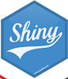
Lynx model
Built with local stakeholders
Included in a user-friendly interface, also built with local stakeholders
Interactive interface to easily create a management scenario:
Combine different actions on the road network, land cover and lynx populations
Simulations of lynx populations in this new environment
Viability metrics comparing populations simulated in the modified environment with those simulated in the original environment
Positive, null or negative impact on the lynx viability metrics
Models coded in R using NetLogoR
Interface coded in R Shiny
Interface public
https://sites.google.com/view/erclynx

