Slide 1


SMART IOT FIRE & SMOKE DETECTION SYSTEM
Early Warning & Automated Mitigation
Supervisor: Eng. Rahma Khaled

Slide 2



INTRODUCTION & PROBLEM STATEMENT
The Problem
The Solution
Fire and smoke accidents pose significant risks to lives and property.
▹
An integrated IoT system for early warning and mitigation.
▹
Delayed detection often leads to catastrophic consequences.
▹
Real-time sensor fusion using ESP32 and multi-point sensing.
▹
Traditional alarms lack remote monitoring and automated ventilation.
▹
Automated response including fans, buzzers, and web alerts.
▹

Slide 3

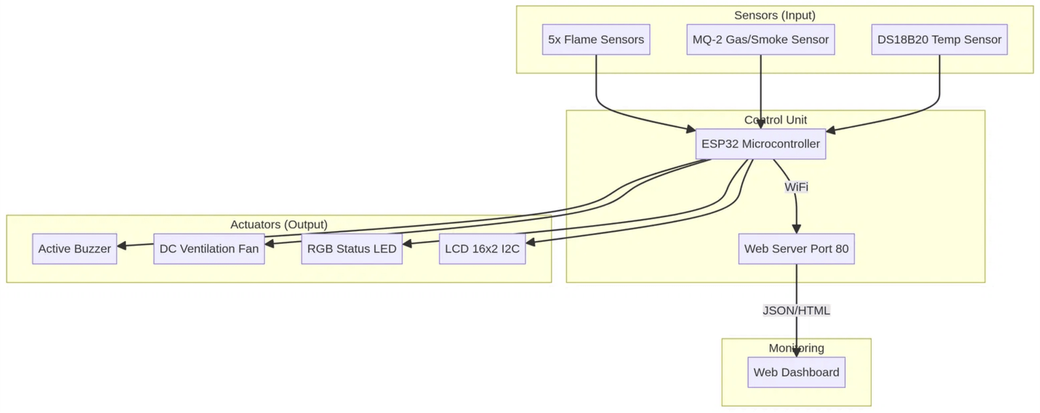
SYSTEM ARCHITECTURE OVERVIEW
Input Layer
Processing Layer
Output Layer
Sensors gather environmental data
ESP32 analyzes sensor fusion data
Automated triggers activate actuators
(flame, gas, temperature) and send it to
against safety thresholds to determine
and update the real-time web dashboard.
the ESP32.
system state.

Slide 4






HARDWARE COMPONENTS & DESIGN
Control
Sensing
ESP32 DevKit V1
Flame Sensors (x5)
Dual-core CPU, Wi-Fi stack, and GPIO management.
IR-based detection for 360° fire monitoring.
Sensing
Sensing
MQ-2 Gas Sensor
DS18B20 Sensor
Analog detection of smoke and LPG concentrations.
OneWire digital temperature monitoring.
Actuation
Interface
DC Fan & L298N
LCD 16x2 I2C
PWM-controlled ventilation for smoke extraction.
Real-time local data visualization and status.

Slide 5

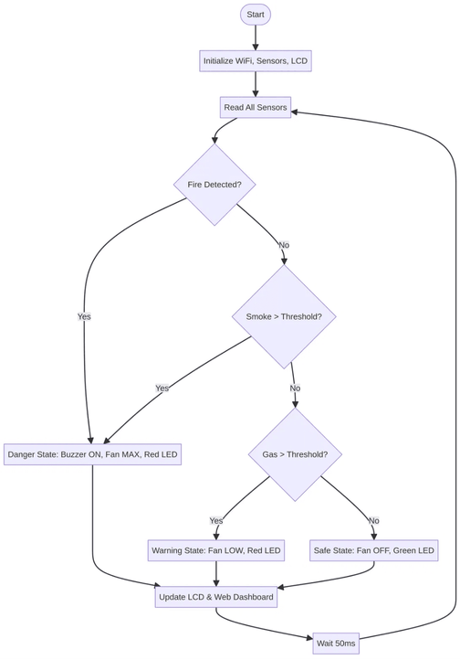
SYSTEM LOGIC & WORKFLOW
SYSTEM STATE
CONDITION & RESPONSE
SAFE
No fire or smoke detected.
▹ Green LED ON | Fan OFF | Buzzer OFF
WARNING
Low-level gas/smoke detected.
▹ Red LED ON | Fan LOW Speed | Buzzer OFF
DANGER
Fire or high smoke density detected.
▹ Red LED ON | Fan MAX Speed | Buzzer ON
The ESP32 executes this logic loop every 50ms, ensuring near-instantaneous response to environmental changes. Data is simultaneously pushed to the web dashboard via JSON.

Slide 6




WEB MONITORING DASHBOARD
JSON DATA ENDPOINT
{
"fire"
:
true
,
"gasVal"
:
2450
,
"temp"
:
28.5
,
Real-Time Updates
"motor"
:
255
,
"danger"
:
true
,
"status"
:
"ACTIVE"
}
Asynchronous fetching updates sensors every 2s without reload.
Color-coded alerts: Green = safe, Red = emergency for immediate recognition.
Responsive Interface
Mobile-first layout supports phones, tablets and desktops.
Cloud Ready
Exposes a compact JSON endpoint for easy IoT integration.

Slide 7







TESTING SCENARIOS & RESULTS
TEST SCENARIO
SYSTEM RESPONSE
STATUS
No Fire or Smoke
Normal state maintained; Green LED active.
PASS
Smoke Detected
Fan activated (Low); Red LED active; Warning on Web.
PASS
Fire Detected
Fan at MAX; Buzzer active; Danger alert on Web.
PASS
Instant Response — Flame sensors responded immediately.
Reliable Connectivity — Dashboard kept stable sync.
Sensor Accuracy — MQ-2 & DS18B20 consistent across cycles.
Fail-Safe Operation — System returned to safe state post-hazard.

Slide 8



CONCLUSION & FUTURE SCOPE
Project Summary
Future Enhancements
Successfully developed a responsive IoT safety system using the ESP32 platform.
▹
Cloud Integration: Implement Firebase or AWS IoT for long-term data logging and analytics.
▹
Integrated multi-sensor fusion for reliable fire, smoke, and temperature monitoring.
▹
Mobile Alerts: Add push notifications via Blynk or IFTTT for instant emergency updates.
▹
Implemented automated mitigation via ventilation fans and audible alarms.
▹
Active Suppression: Integrate a relay-controlled water pump or CO2 release system.
▹
Established a real-time web dashboard for remote monitoring and data access.
▹
AI Diagnostics: Use machine learning to predict fire risks based on historical sensor data.
▹

Slide 9




THANK YOU
Any Questions?
GitHub:
https://github.com/SarahGamalKotb/Fire-Smoke-Detector-IOT
Portfolio:
http://10.250.7.121/
Email:
sarakotp44@gmail.com

