Slide 1
FINAL YEAR PROJECT PRESENTATION
WEB-BASED FEE TRACKING AND REMINDER SYSTEM
A focused fee management, receipt, reporting and parent communication platform for Mbonea Secondary School
Presented by
Supervisor
Innocent Richard Mkumbo · 2024-02-00404 Sarah George Gordon · 2024-02-00133 Charles Dani Chaula · 2024-02-00080
Sir Paul Haule
College of Information and Communication Technologies Department of Computer Science and Engineering
Diploma in Computer Science
July 2026

Slide 2
UNIVERSITY OF DAR ES SALAAM
02
Project background
Why Mbonea Secondary School needed a focused fee information system
The existing environment
1
Paper records
• Fee records were spread across receipt books, notebooks and separate spreadsheets.
• Staff repeatedly searched and reconciled records to establish a student's current balance.
• Parents often depended on students, phone calls or school visits for payment information.
• As transactions increased, inconsistent balances and delayed communication became more likely.
Slow search
2
Separate files
Different balances
3
Informal messages
Delayed parent updates
4
Central system
Project response: one web application for students, fees, payments, receipts, reports and parent communication.
Reliable information
Final Year Project Report & implemented system · July 2026
2

Slide 3
UNIVERSITY OF DAR ES SALAAM
03
Problem statement
Fragmented records affected accuracy, workload, reporting and parent trust
No single source of truth
Manual calculation workload
Payment information could exist in several places, leaving balances out of date.
Bursars spent time searching, combining and recalculating fee records.
Slow parent communication
Weak access and traceability
Deadlines, confirmations and outstanding balances were not always delivered directly.
Paper files offered limited role control, ownership checks and message history.
Need identified
An integrated, secure and easy-to-use system that records payments, updates balances, issues receipts, reports to management and communicates directly with parents.
Final Year Project Report & implemented system · July 2026
3

Slide 4
UNIVERSITY OF DAR ES SALAAM
04
Objectives and project scope
MAIN OBJECTIVE
Design, develop and document a web-based fee tracking and reminder system for Mbonea Secondary School.
1
Study
2
Design
3
Implement
4
Validate
Analyse the existing fee process, users, information and controls.
Create a secure database, workflows and role-based system structure.
Deliver registration, fees, payments, receipts, reports, reminders and parent access.
Test the completed workflows and prepare clear technical documentation.
Included
Outside current scope
• Fee structures, payments, receipts and balances
• SMS/email reminders and parent portal
• Reports, bank evidence and clearance certificates
• Examinations, attendance and timetables
• Full academic / learning management
• Public production hosting in this project phase
Final Year Project Report & implemented system · July 2026
4

Slide 5
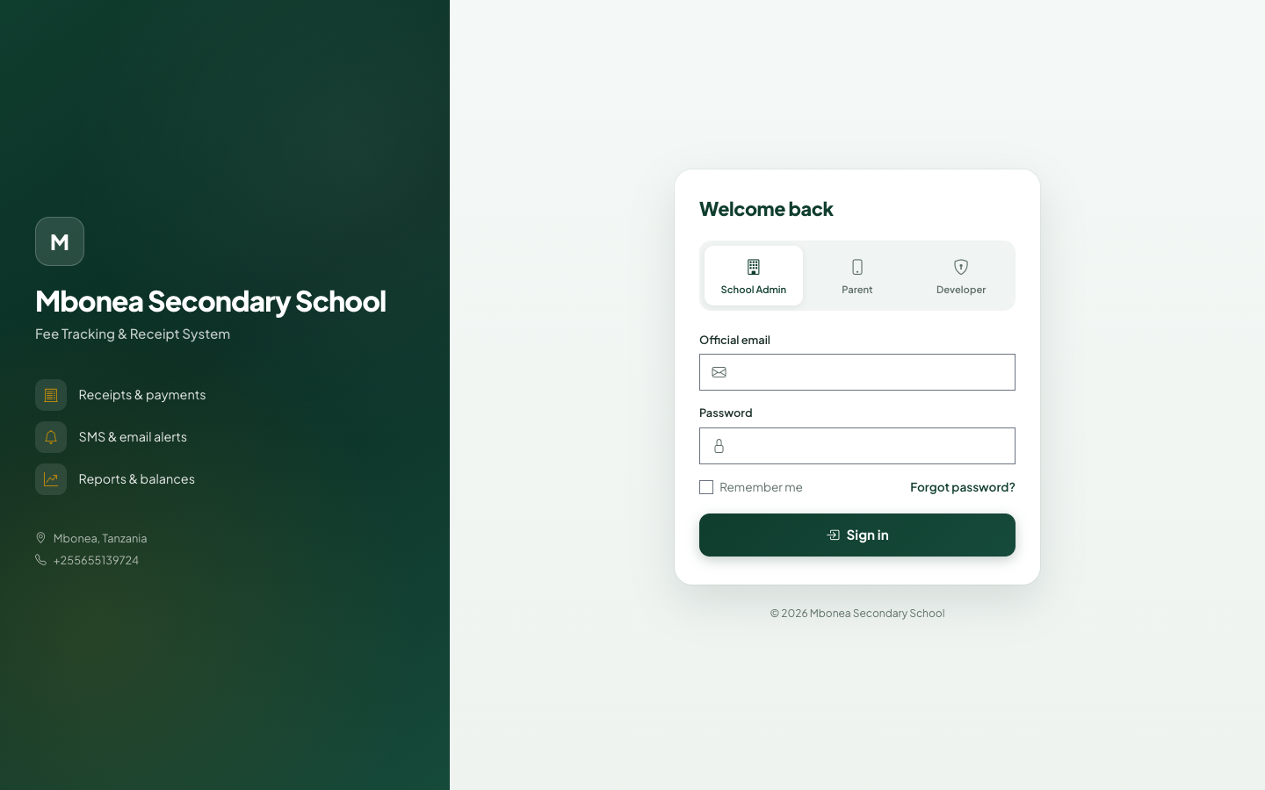
UNIVERSITY OF DAR ES SALAAM
05
Stakeholders and user roles
Role-based access keeps daily operations, configuration and parent records separated
1
School administrator
Registers students, records payments, prints receipts, sends reminders and prepares reports.
2
Super administrator
Configures fee structures, categories, school settings, templates and bank accounts.
3
Parent / guardian
Views linked children, balances, history and notifications; uploads bank evidence.
Three login paths → one controlled system
Final Year Project Report & implemented system · July 2026
5

Slide 6
UNIVERSITY OF DAR ES SALAAM
06
Methodology and project plan
Agile, iterative delivery supported by interviews, observation and document review
Requirements gathering
Six development iterations
Interview
1
Foundation & roles
2
Students & fee records
User roles, reports and communication needs
Observation
Payments & receipts
Communication
3
4
Payment and receipt handling steps
Document review
5
Reports & parent access
6
Final testing & documentation
Data fields, reports and receipt formats
Group discussion
Priorities and team task allocation
12 weeks
TZS 80,000
3 members
23 Mar – 15 Jun 2026
Academic project budget
Front-end, back-end & shared analysis
Final Year Project Report & implemented system · July 2026
6

Slide 7
UNIVERSITY OF DAR ES SALAAM
07
Requirements translated into completed modules
Authentication
Student & parent
Fee setup
Payments
Role-based login and access checks
Register, import and official guardian links
Structures, categories and installment schedule
Category allocation, balance and numbered receipt
Communication
Reports
Parent portal
Settings
SMS/email templates, reminders and logs
Fee position, unpaid, receipt, bank and clearance
Linked children, history, notifications and bank upload
School identity, message and bank configuration
NON-FUNCTIONAL REQUIREMENTS
Usability · Performance · Security · Reliability · Browser compatibility · Responsive design
Final Year Project Report & implemented system · July 2026
7

Slide 8
UNIVERSITY OF DAR ES SALAAM
08
System architecture and technology stack
Laravel MVC with service classes for communication, reporting and bank verification
1
Web browser
Specialised integrations
Responsive Blade + Bootstrap interface
↓
SMS gateway
Email server
2
Routes & middleware
Payment confirmations & reminders
Welcome messages & fee notices
Authentication, CSRF and role checks
↓
DomPDF
Laravel Excel
3
Controllers & services
Receipts, reports & clearance
Student import & report export
Validation, fee rules, reports, messages, bank parsing
↓
4
Models & MySQL
Implemented technologies
Related operational records with foreign keys
Laravel 12
PHP 8.2
MySQL
Bootstrap 5
Blade
Git/GitHub
XAMPP
Final Year Project Report & implemented system · July 2026
8

Slide 9
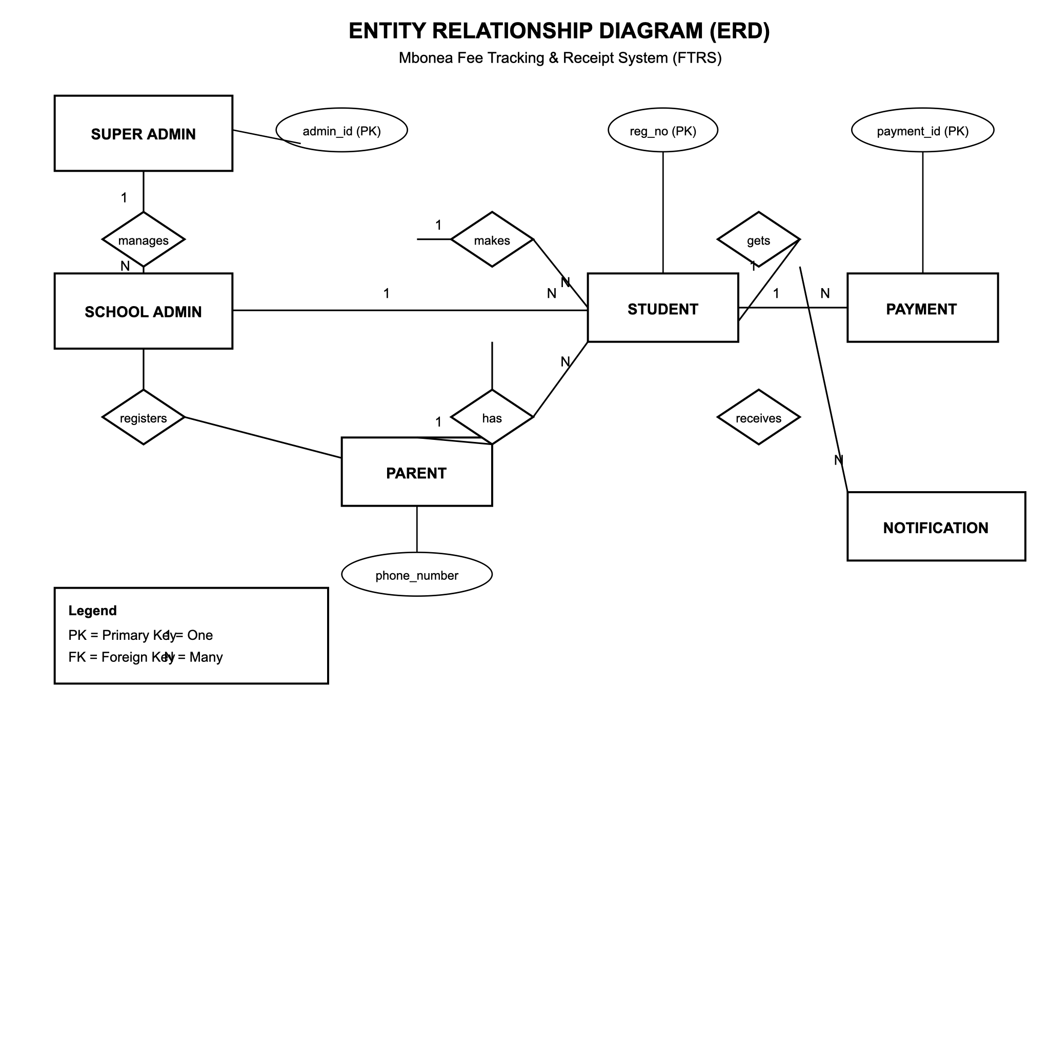
UNIVERSITY OF DAR ES SALAAM
09
Database and security design
Security controls
• Hashed passwords and rate-limited login
• Role middleware for admin, super admin and parent
• Parent record scope through official student links
• Validated requests and CSRF protection
• Controlled PDF uploads for bank evidence
• Foreign keys and unique values for consistency
Design principle
Every payment, message and parent link remains traceable to the correct student.
Final Year Project Report & implemented system · July 2026
9

Slide 10
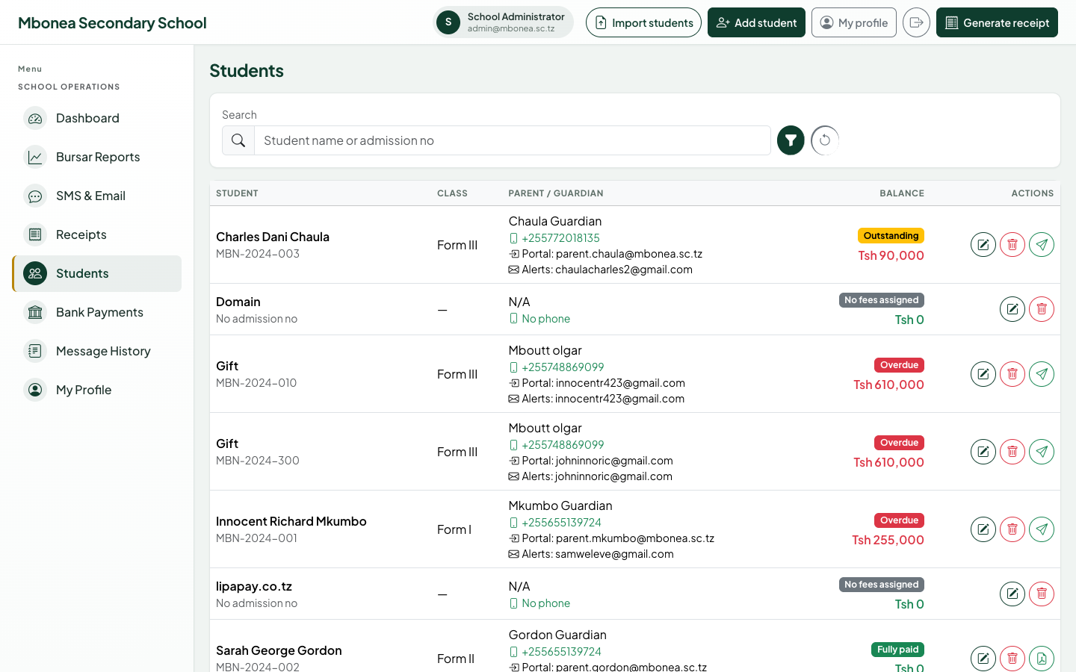
UNIVERSITY OF DAR ES SALAAM
10
Student and parent management flow
Implemented workflow
• Register a new student or import from CSV/XLSX.
• Select an existing parent account or create a new parent during admission.
• Create an official parent–student link with relationship and contact details.
• Send a welcome email containing phone login details and a temporary password.
• Assign fee structures and apply the school-wide installment schedule.
One parent can be linked to multiple children
Final Year Project Report & implemented system · July 2026
10

Slide 11
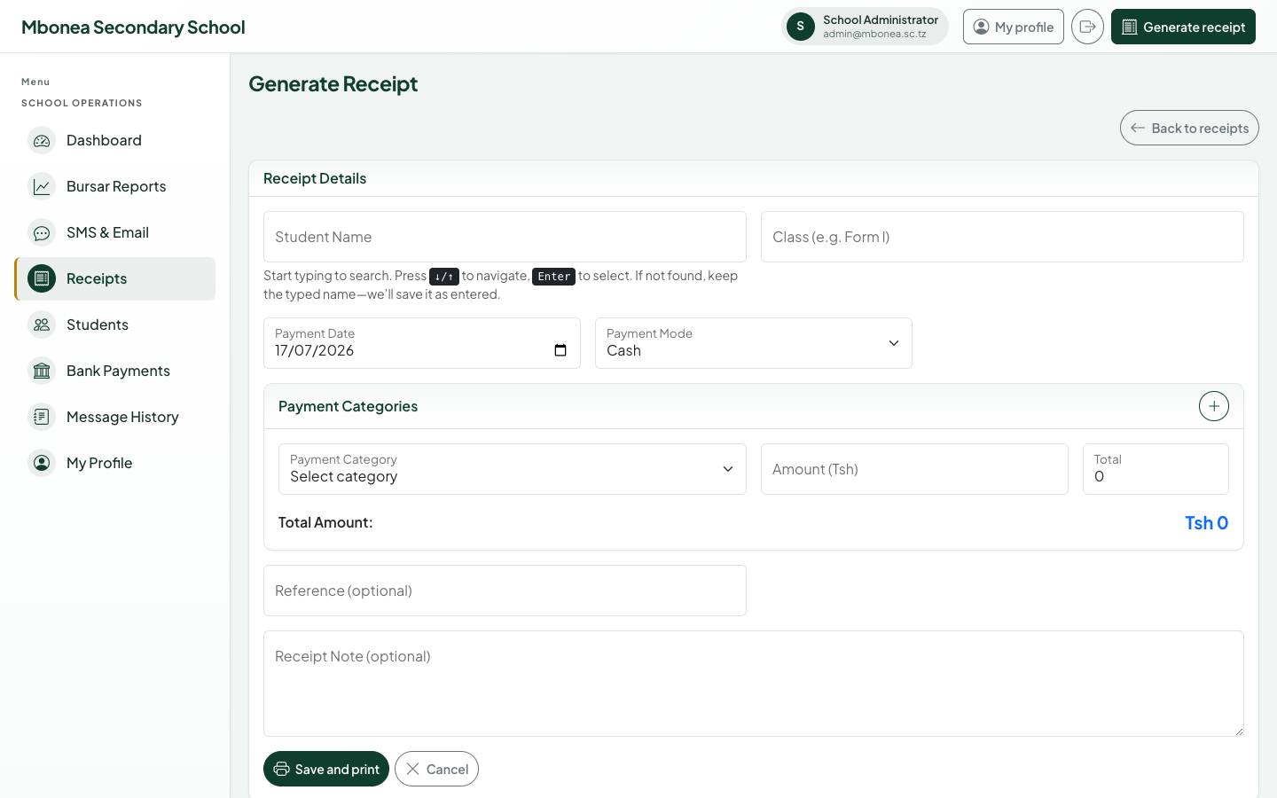
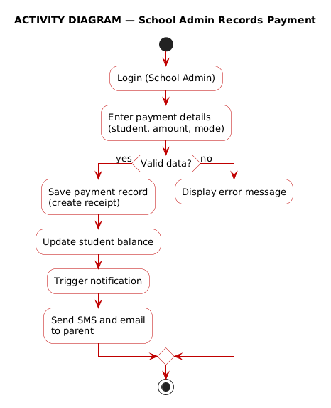
UNIVERSITY OF DAR ES SALAAM
11
Payment recording and receipt workflow
• Validate student, date, mode and category allocations.
• Generate a unique term-based receipt number.
• Update paid amount and outstanding balance immediately.
• Log and send payment confirmation to the parent.
Final Year Project Report & implemented system · July 2026
11

Slide 12
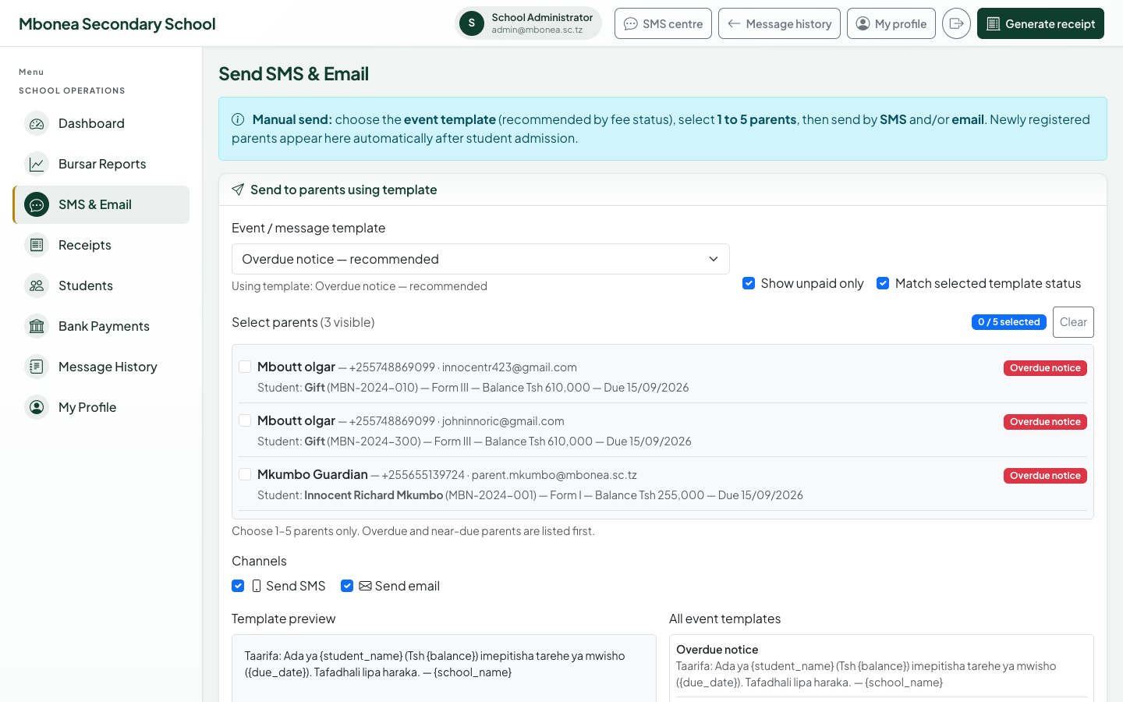
UNIVERSITY OF DAR ES SALAAM
12
SMS, email and reminder workflow
System-driven communication
• New parents appear automatically in the selectable list.
• Manual batches are restricted to 1–5 parents.
• Templates are ordered by fee status: overdue, due today, 3/7/14 days, general.
• Auto mode chooses the correct template for each selected parent.
• Scheduled reminders run daily and message history stores the result.
Channels
SMS + Email + Portal logs
Final Year Project Report & implemented system · July 2026
12

Slide 13
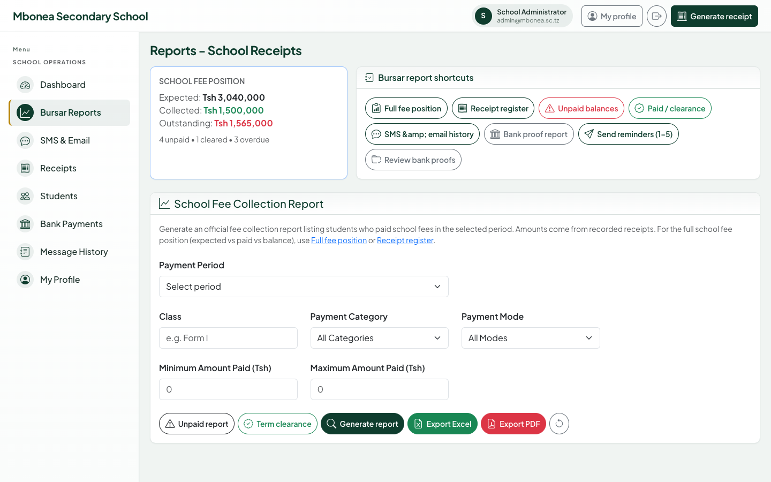
UNIVERSITY OF DAR ES SALAAM
13
Reports and management information
Live reports from recorded transactions
• School fee position
• Collection by period
• Receipt register
• Unpaid balances
• Paid / clearance
• Message history
• Bank proof review
Browser view
PDF
Excel
Supports bursar follow-up and management oversight
Final Year Project Report & implemented system · July 2026
13

Slide 14
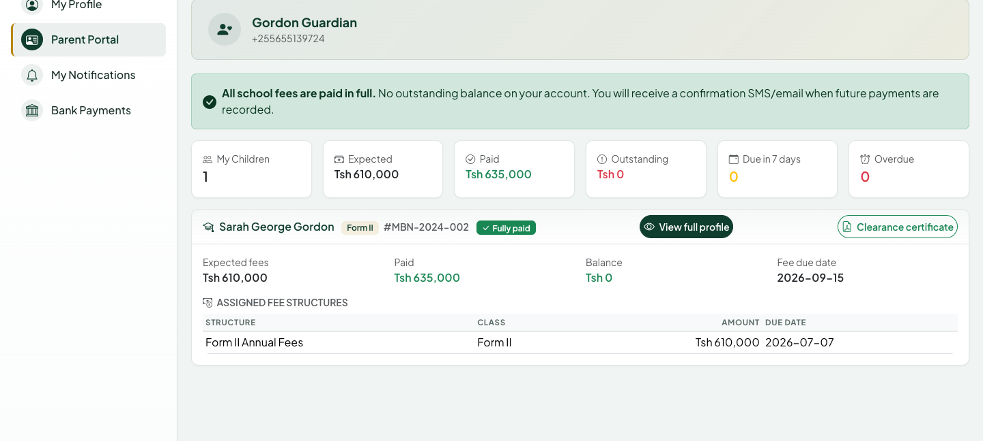
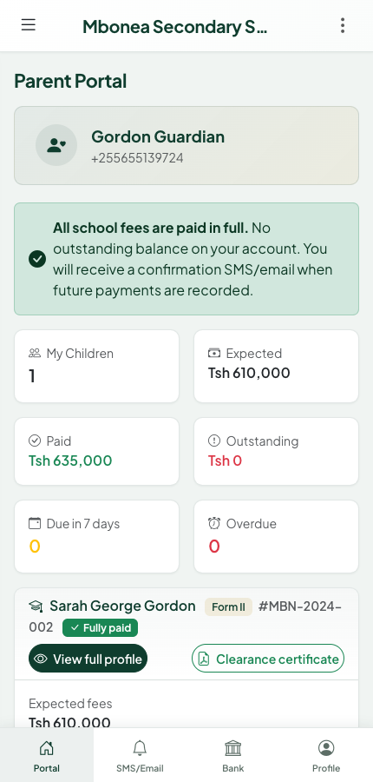
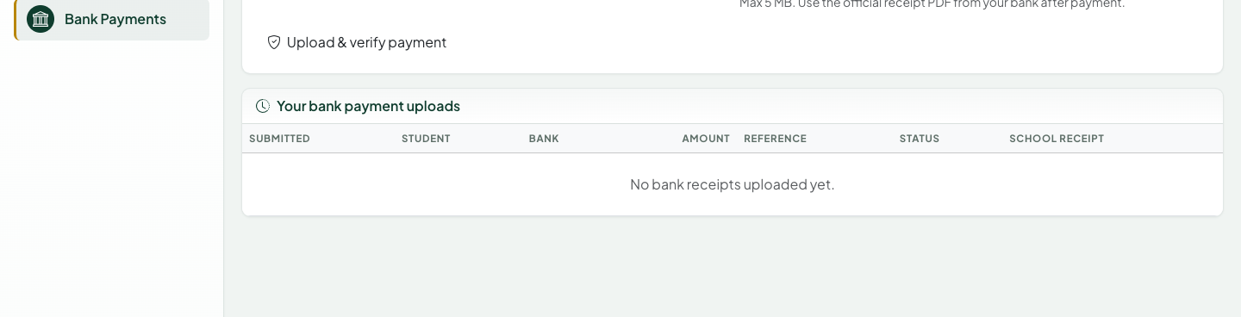
UNIVERSITY OF DAR ES SALAAM
14
Parent portal and bank payment workflow
Parent capabilities
• View only officially linked children
• See expected, paid and outstanding amounts
• Review receipts and notification history
• Upload NMB/CRDB receipt PDFs
• Download clearance when fully paid
• Use desktop or mobile interface
Phone + password login
Final Year Project Report & implemented system · July 2026
14

Slide 15
UNIVERSITY OF DAR ES SALAAM
15
Testing, conclusion and next steps
104
329
12
3 roles
1–5
Automated tests passed
Assertions passed
Report test areas passed
Access boundaries verified
Parent batch rule verified
Conclusion
Limitations and recommendations
• The completed system centralises fee records, balances, receipts, reports and parent communication.
• Role controls and official parent links protect financial and student information.
• All stated project objectives and report test areas were achieved for local demonstration.
• Deploy to a secure production server with automated backups.
• Configure live SMS/email credentials and monitor delivery.
• Improve bank integrations as structured bank data becomes available.
• Provide staff training and periodic security review.
THANK YOU · QUESTIONS & DEMONSTRATION
Sources: Final Year Project Report, implemented system screenshots & automated test suite · July 2026
15

