Slide 1
SHWOZ
Railway Train System Simulation
Design Review

Slide 2
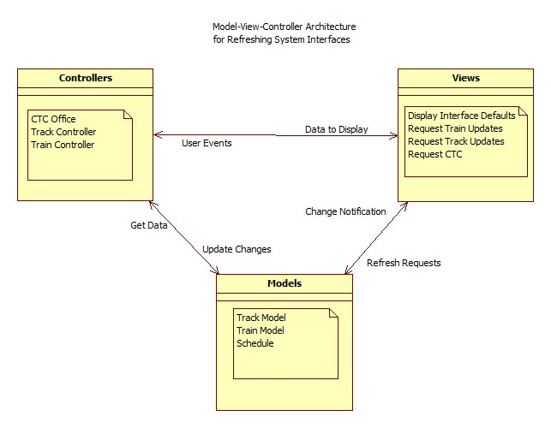
System Architecture

Slide 3
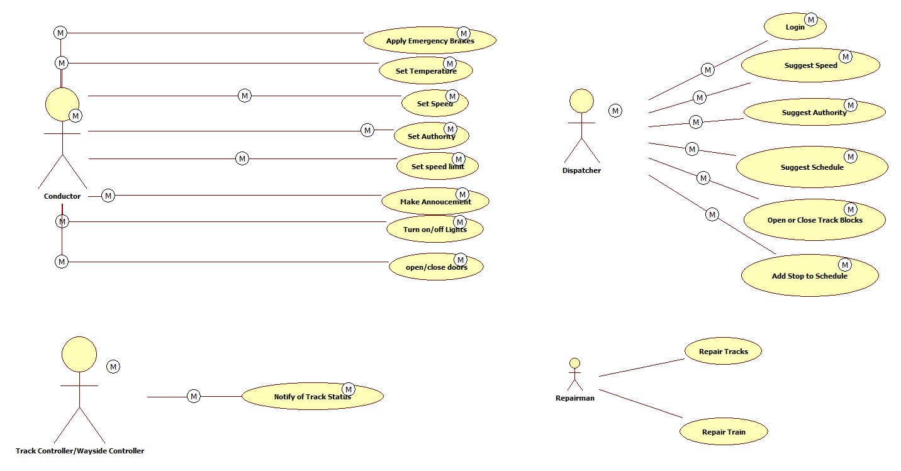
System Use Case Diagram

Slide 4
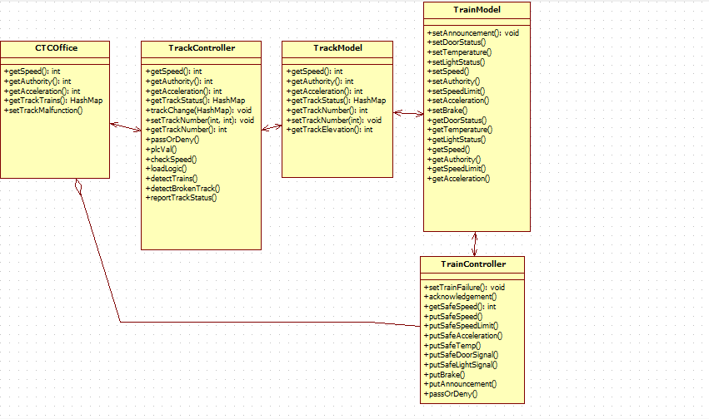
System Class Diagram

Slide 5
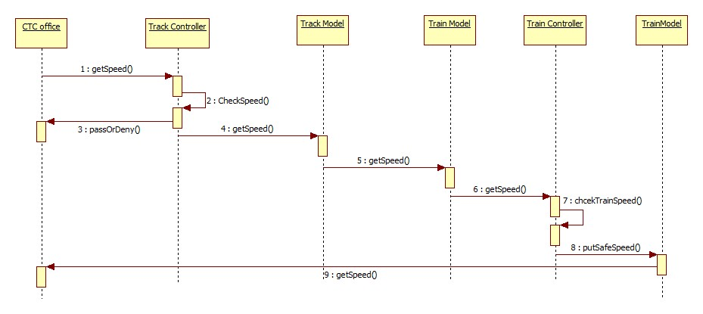
System Sequence Diagram: Set speed

Slide 6
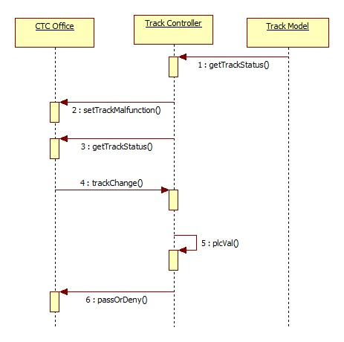
System Sequence Diagram: Malfunction

Slide 7
Train Controller

Slide 8
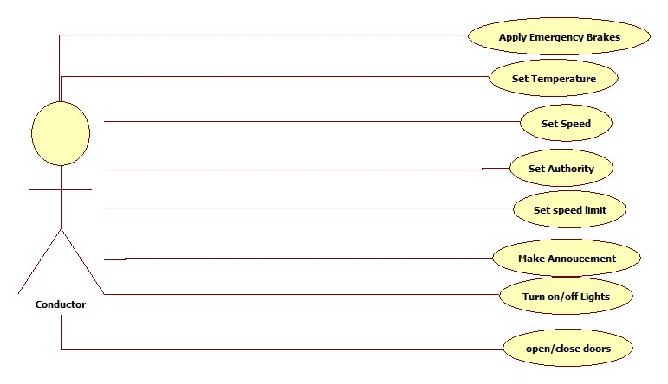
Train Controller Use Case Diagram

Slide 9
Use Case Description: Set Speed
System | Railway train Control system
Use Case | Set Speed
Actors | Train Controller
Description | The Train Controller UI sends a suggested speed that was inserted by the conductor, the speed will be checked with safety standards and the suggested speed may be denied by the train controller The data sent is: the suggested speed by the conductor (miles/hour)
Response | If the suggested speed is valid, it will be applied to the train model and change its speed, and the speed will be shown in the train controller UI as well

Slide 10
Use case Description: open/close doors
System | Railway train Control system
Use Case | Open/close doors
Actors | Train Controller
Description | The Train Controller UI sends a signal which contains the information for opening/closing the doors of the train. The signal will be checked for validity under safety standards( ex. The doors can’t be opened while the train is moving). The signal may be denied by the train controller.
Response | If the signal is valid, it will be applied to the train model and change the state of the light, and the state of the light will be shown in the train controller UI as well

Slide 11
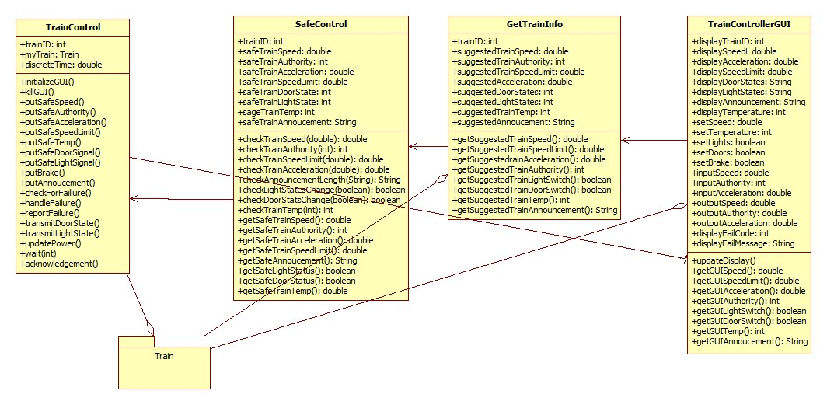
Train Controller Class Diagram

Slide 12
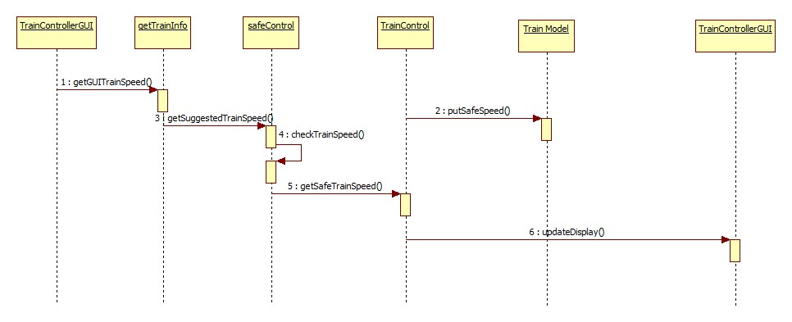
Train Controller Sequence Diagram: Set Speed

Slide 13
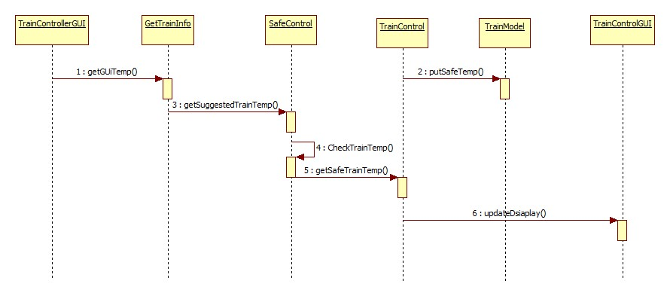
Train Controller Sequence Diagram: Set Temperature

Slide 14
Track Controller

Slide 15
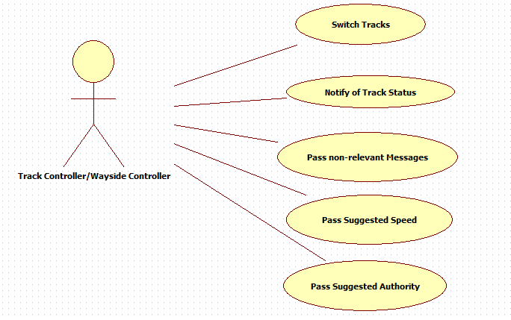
Track Controller Use Case Diagram

Slide 16
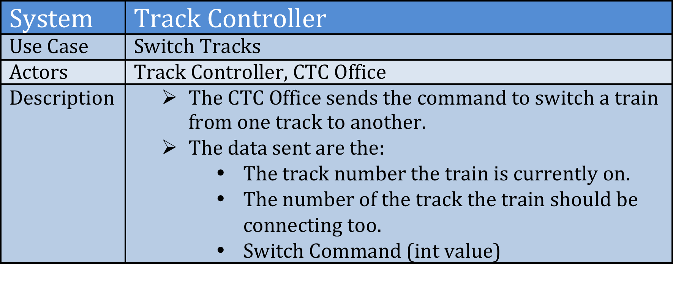
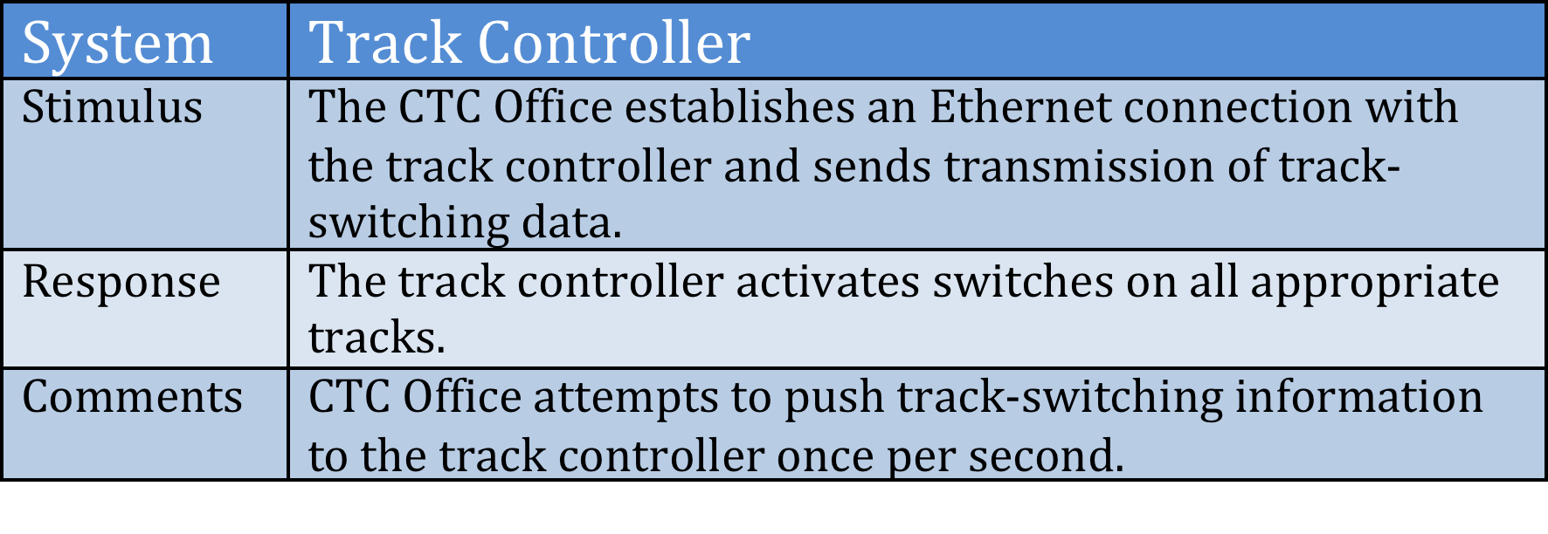
Use Case Description: Switch tracks

Slide 17
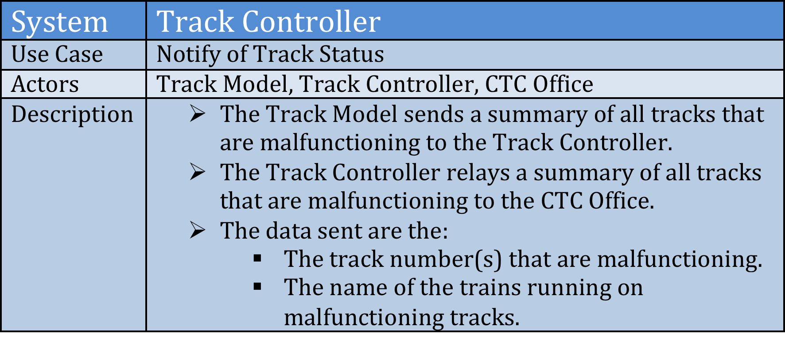
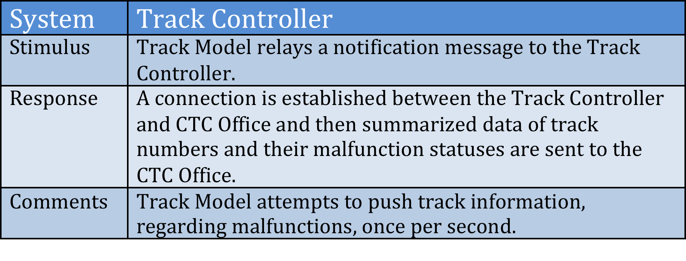
Use Case Description: Notify of Track Status

Slide 18
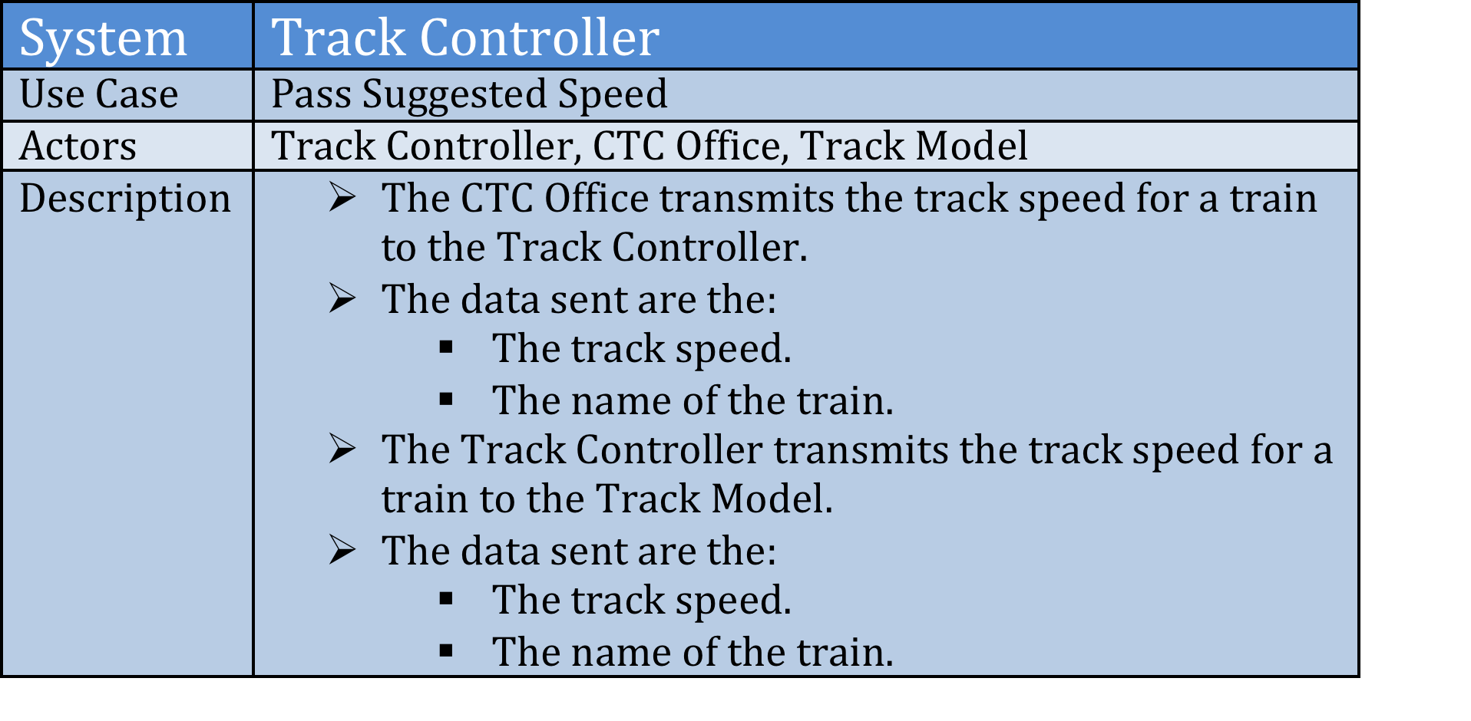
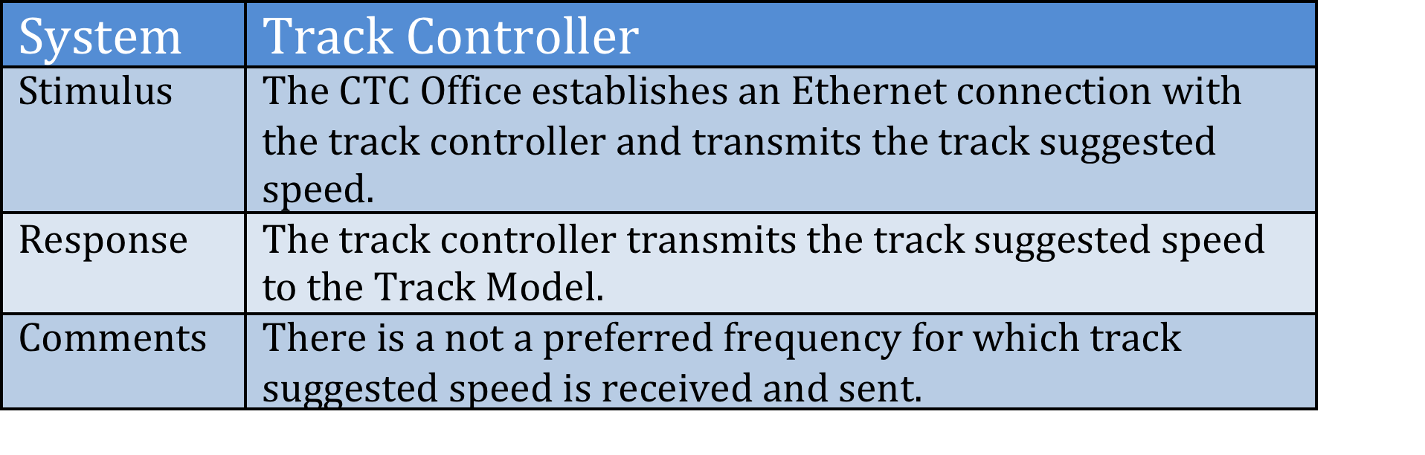
Use Case Description: Pass Suggested Speed

Slide 19
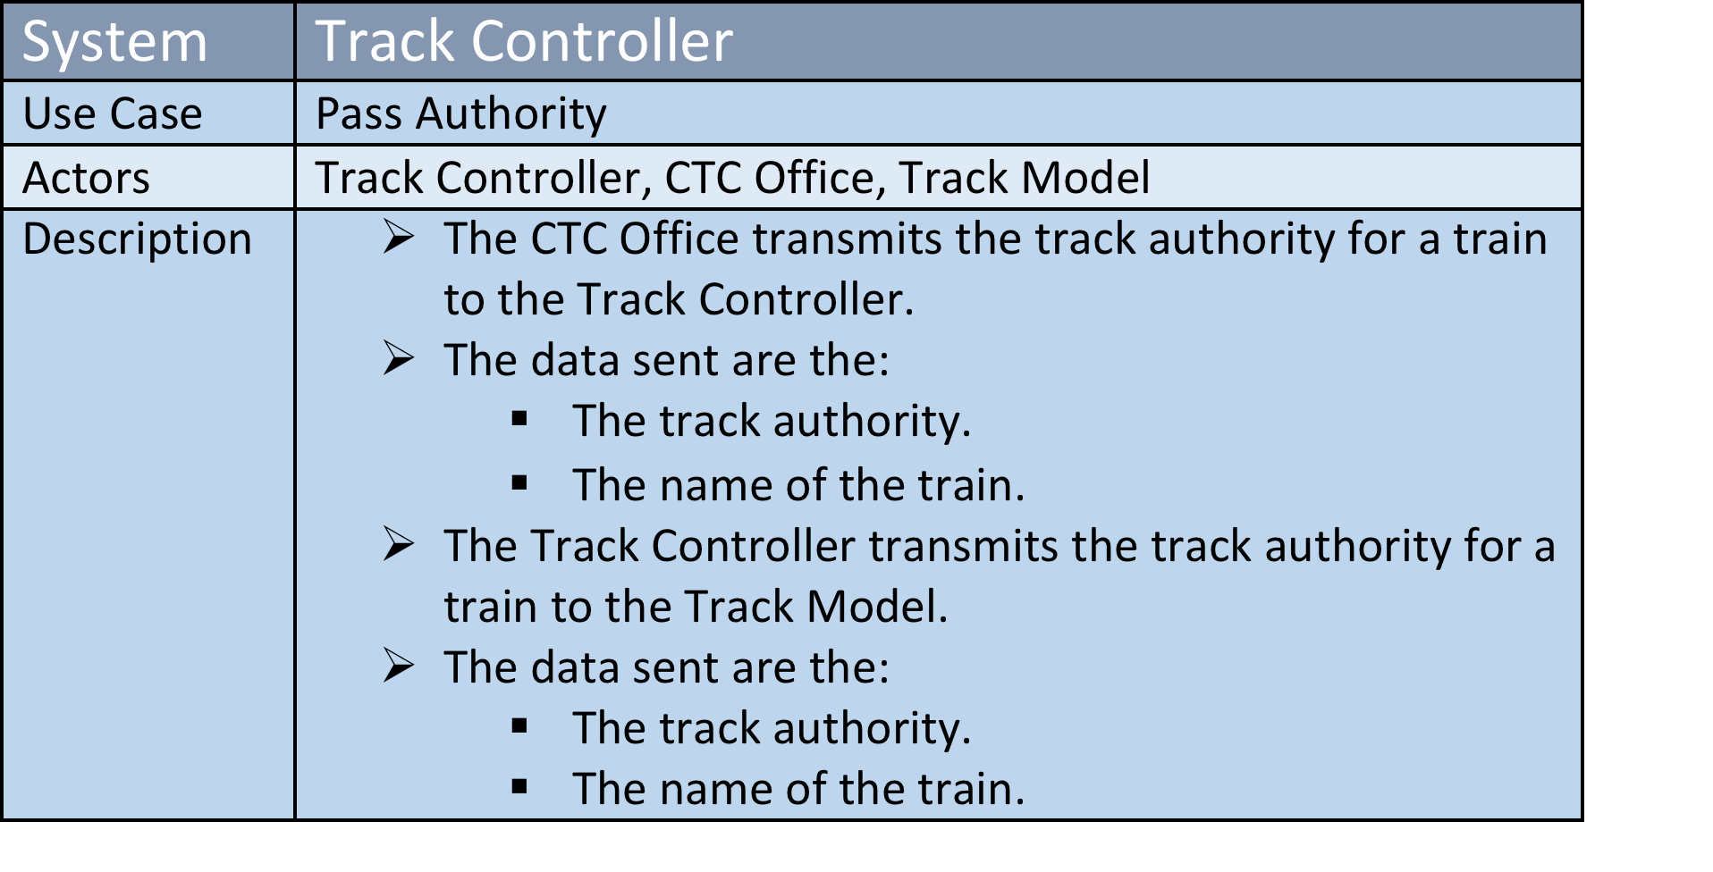
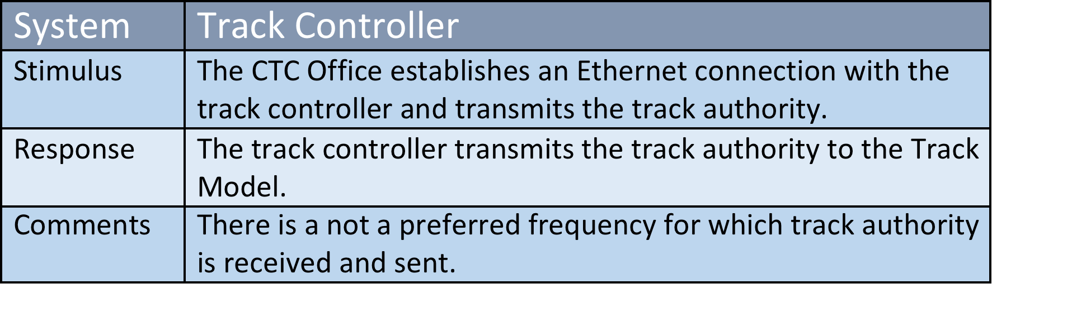
Use Case Description: Pass Suggested Authority

Slide 20
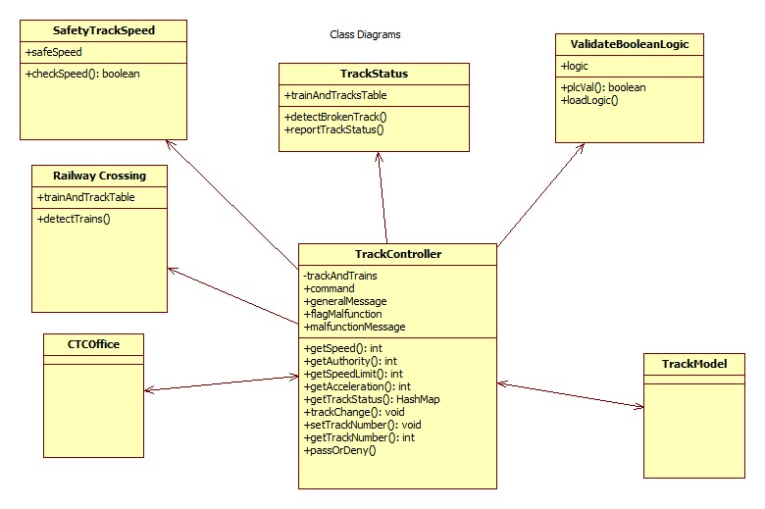
Track Controller Class Diagram

Slide 21
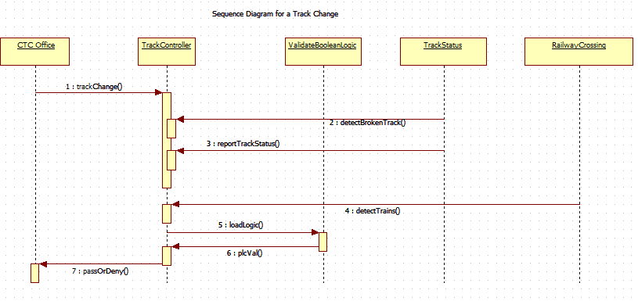
Track Controller Sequence Diagram: Track Change

Slide 22
Track model

Slide 23
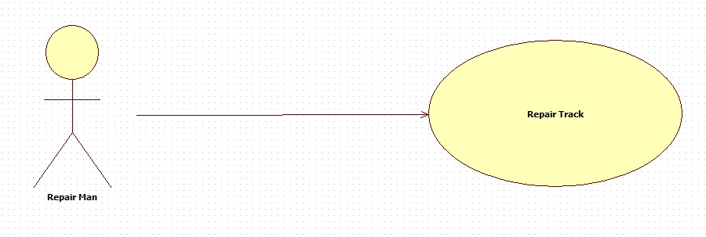
Track Model Use Case Diagram

Slide 24
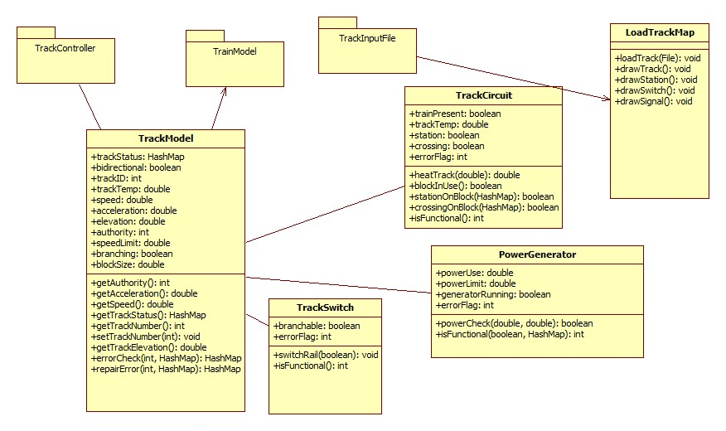
Track Model Class Diagram

Slide 25
CTC OFFICe

Slide 26
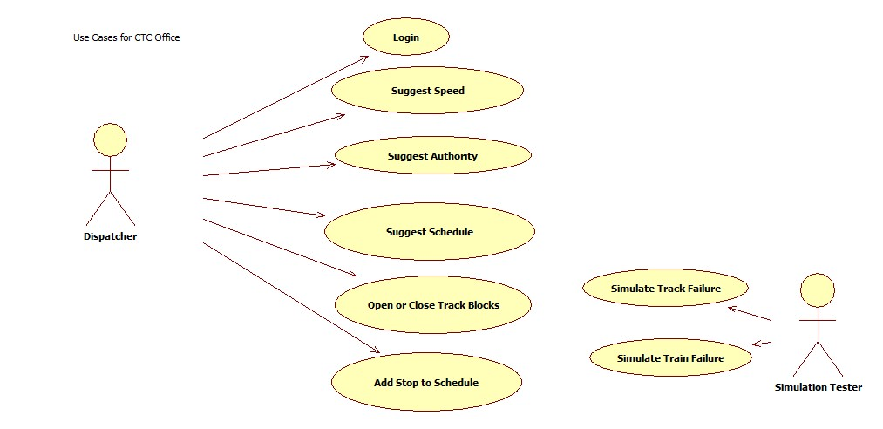
CTC office Use Case Diagram

Slide 27
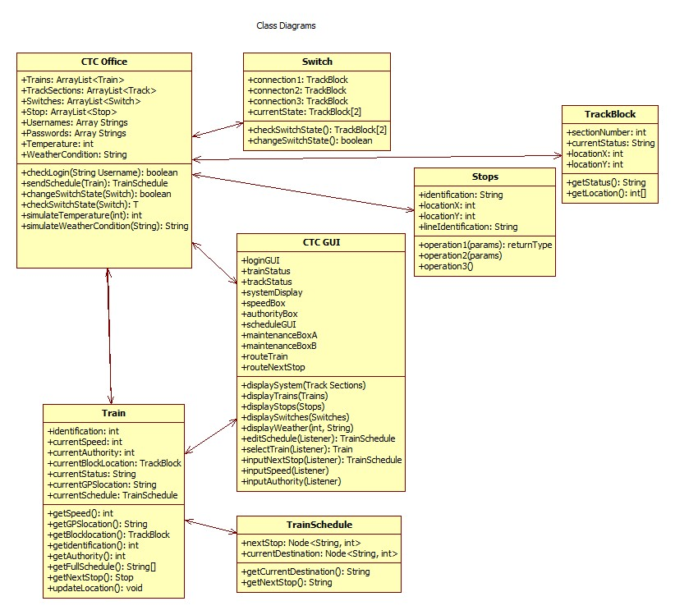
CTC OFFICE Class Diagram

Slide 28
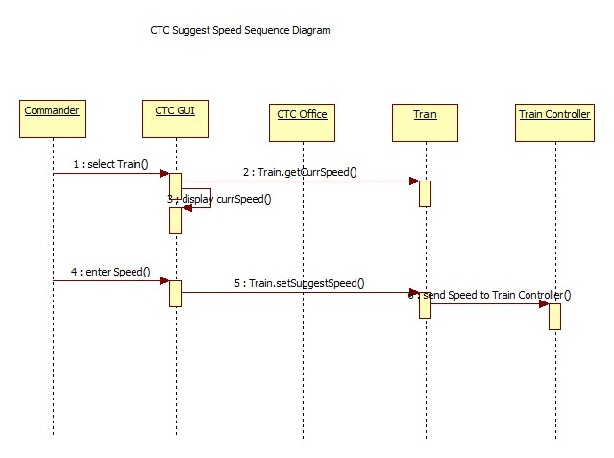
CTC office Sequence Diagram: suggest speed

Slide 29
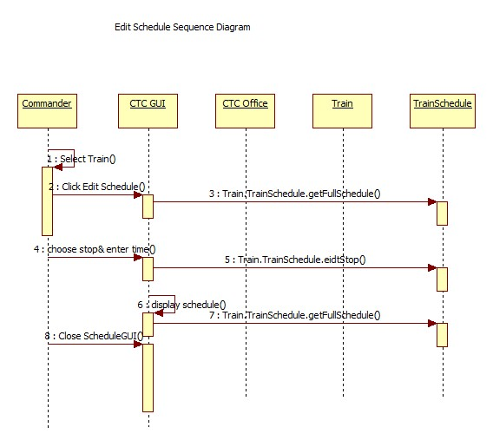
CTC office sequence diagram: edit schedule

Slide 30
Train Model

Slide 31
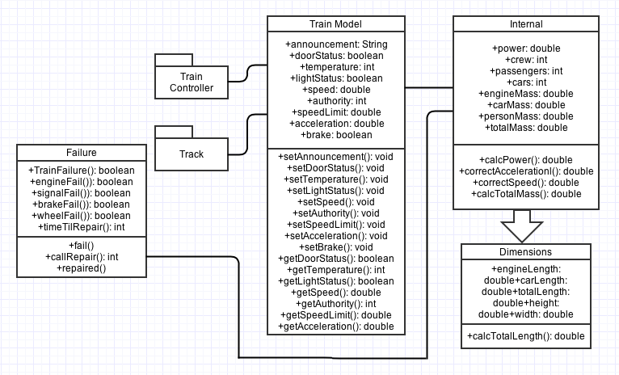
Train Model Class Diagram

Slide 32
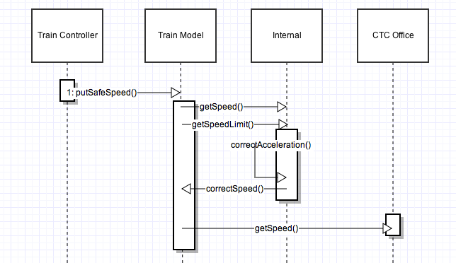
Train Model Sequence diagram: Set Speed (detail)

Slide 33
Thank you
ANY QUESTIONS?

