Slide 1
Estimation of Obesity Levels Based On Eating Habits and Physical Condition

Slide 2
Objectives: Scope:
1. To analyze the influence of lifestyle habits and demographic data on obesity 2. To support early identification of individuals at risk of obesity 3. To identify lifestyle patterns that help prevent obesity, allowing for practical health recommendations
Insights are derived strictly from the available dataset, which includes lifestyle habits and demographic data. Factors beyond the dataset’s coverage—such as genetics and detailed medical history—are not considered. As a result, the findings may have limitations in their depth and generalizability.

Slide 3
Dataset description
Dataset Features:
Age
Height
Weight
Gender
family_history_with_overweight
FAVC – Frequent consumption of high-calorie food (Yes/No)
FCVC – Frequency of vegetable consumption (1-3 scale)
NCP – Number of main meals consumed daily
CAEC – Frequency of food consumption between meals (Never/Sometimes/Frequently/Always)
SMOKE – Smoking status (Yes/No)
CH2O – Daily water intake (1-3 scale)
SCC – Monitors caloric intake (Yes/No)
FAF – Physical activity frequency per week (0-3 scale)
TUE – Daily screen time (0-2 scale)
CALC – Alcohol consumption frequency (Never/Sometimes/Frequently/Always)
MTRANS – Mode of transportation (Walking/Public Transport/Bike/Motorbike/Car)
The target variable includes six obesity categories:
Insufficient_Weight
Normal_Weight
Overweight
Obesity_Type_I
Obesity_Type_II
Obesity_Type_III
The dataset consists of 2,111 samples and 16 input features related to lifestyle habits and demographic information, along with one target variable, NObesity. Data was collected from individuals in Mexico, Peru, and Colombia.
The dataset is slightly imbalanced, with class distribution ranging from approximately 12.87% to 27.48%. This variation is not expected to significantly affect model performance.
No data cleaning was required, as there are no missing values. Outliers were not removed because health data often exhibits natural skewness, and extreme values are still relevant to the analysis; as are part of the studied phenomenon.

Slide 4
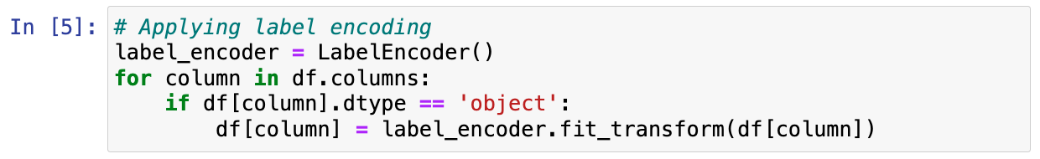
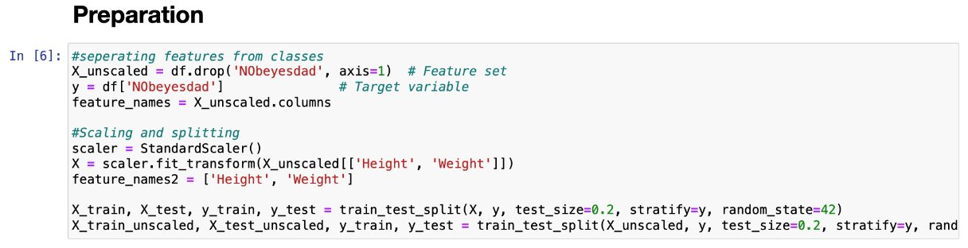
Dataset Processing
We encoded categorical data using the label encoder:
We scaled numerical columns:

Slide 5
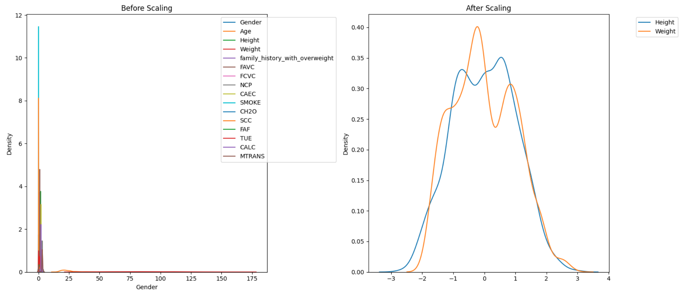
Dataset Processing
We scaled numerical columns:

Slide 6
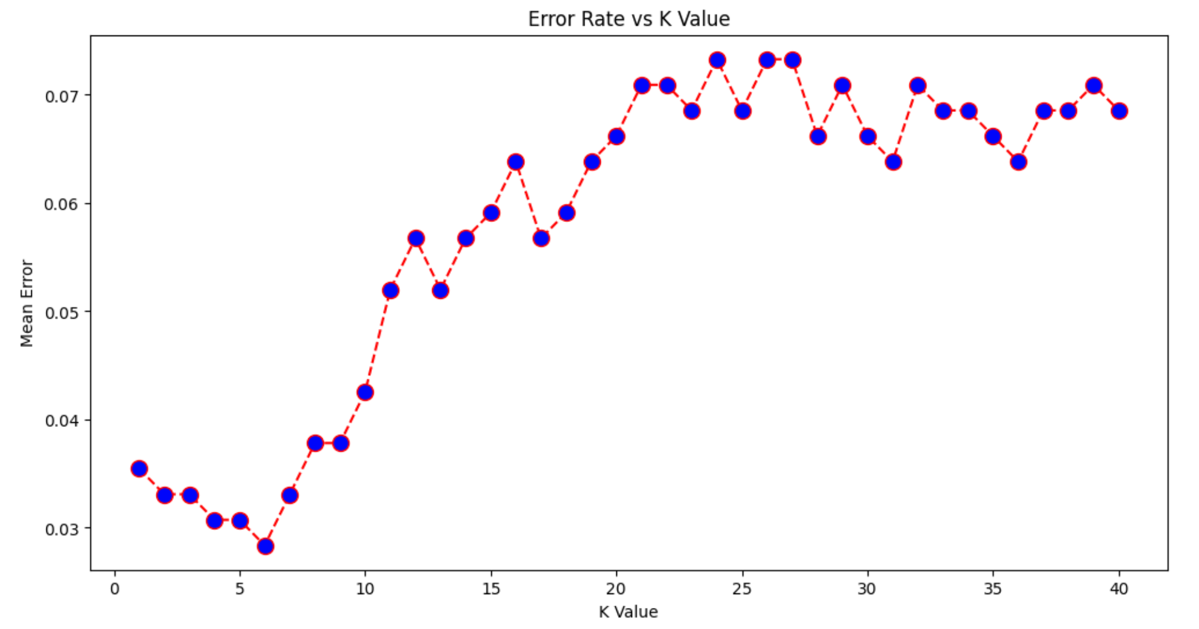
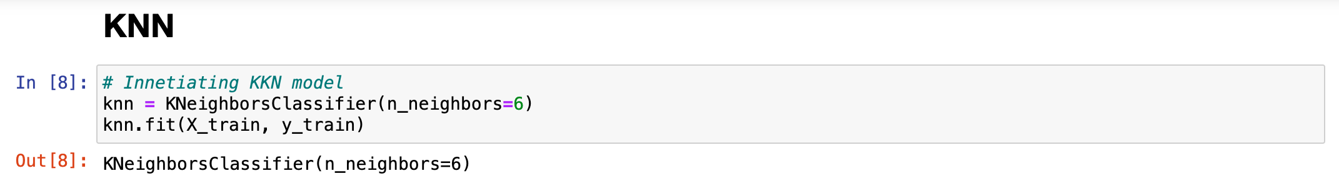
KNN
We found that #neighbors = 6 is the best fit.

Slide 7
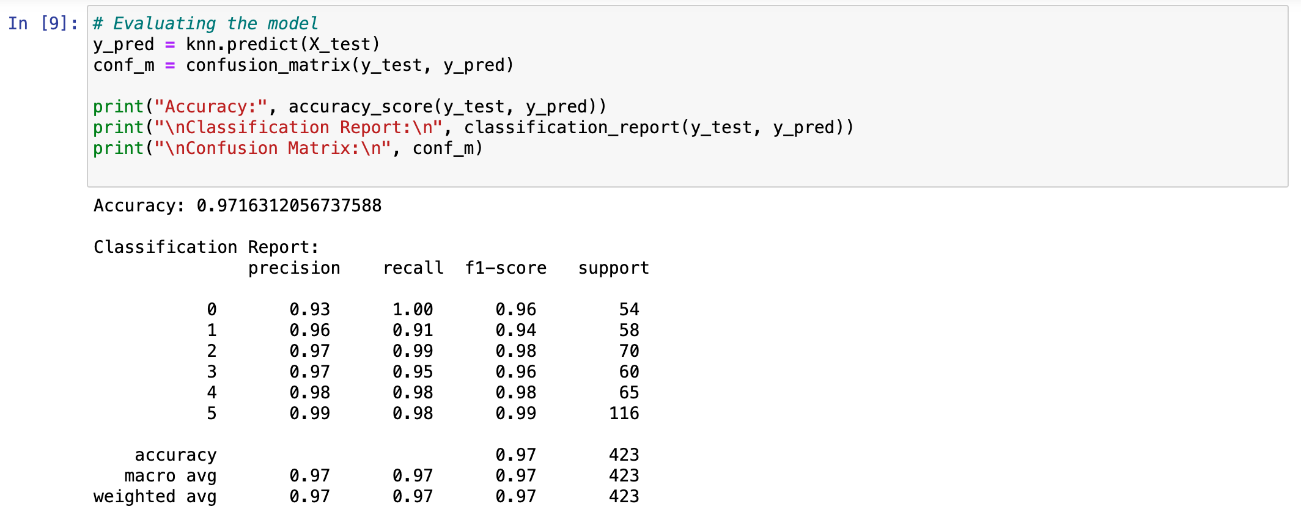
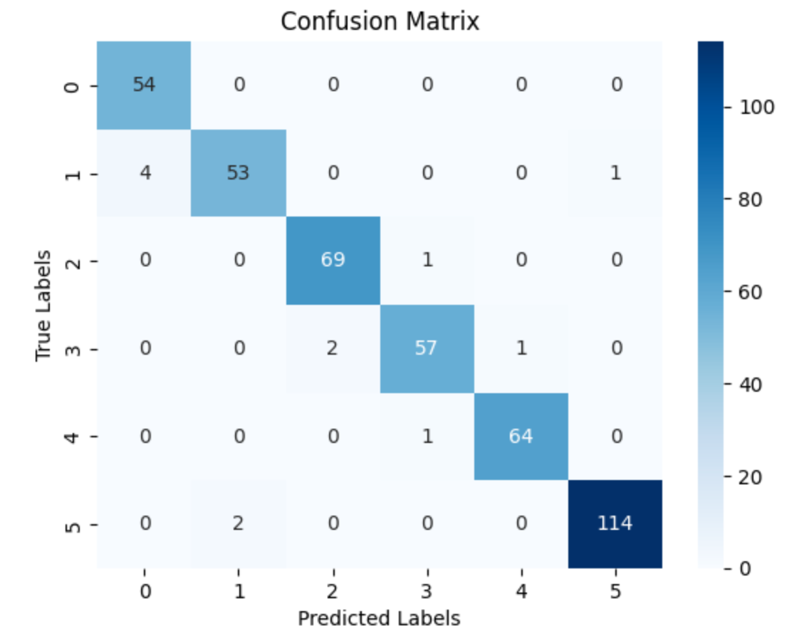
KNN
We obtained very high accuracy with KNN ≈ 97%

Slide 8
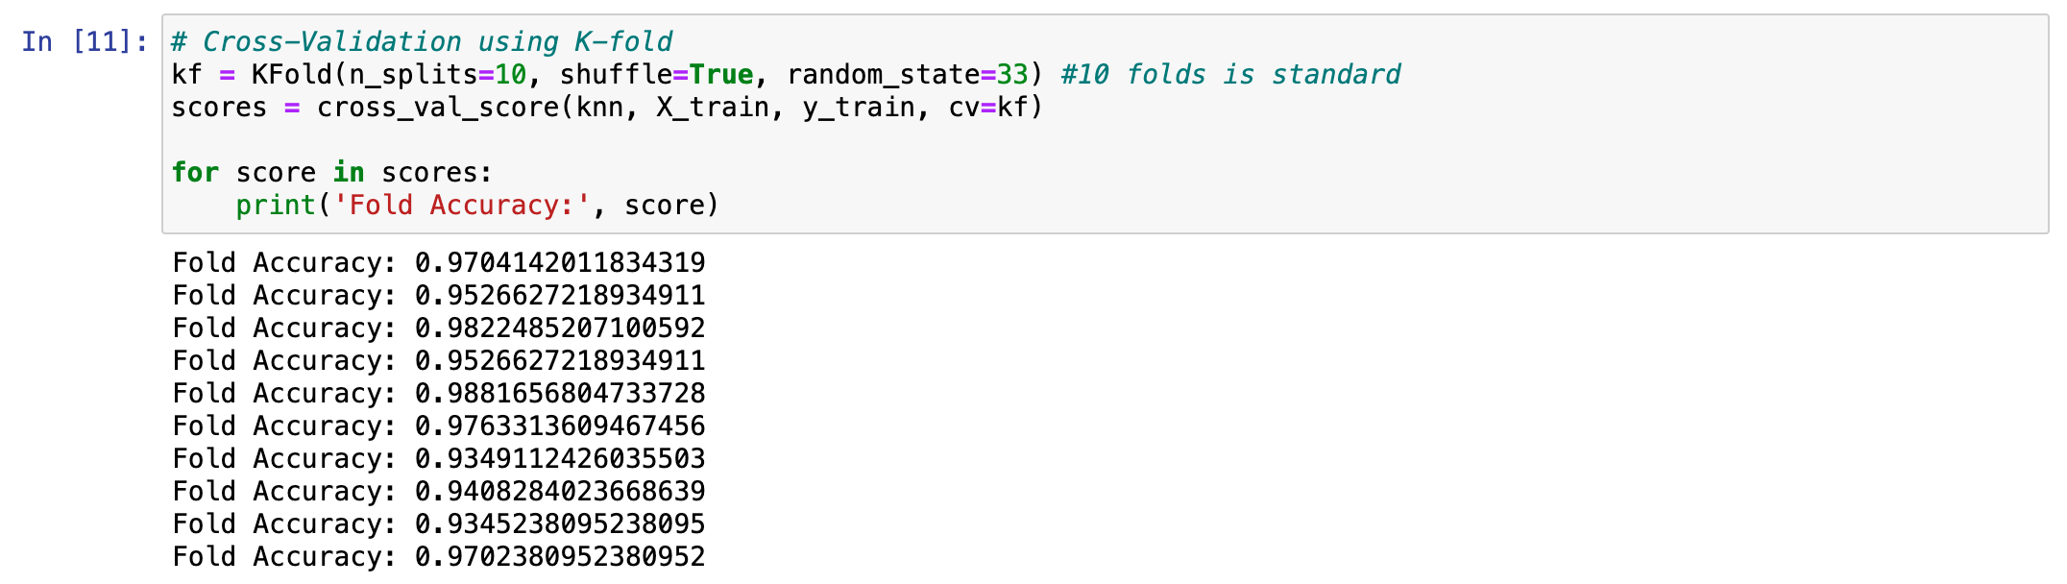
KNN
We also performed K-fold cross validation and obtained similar accuracies for different folds:

Slide 9
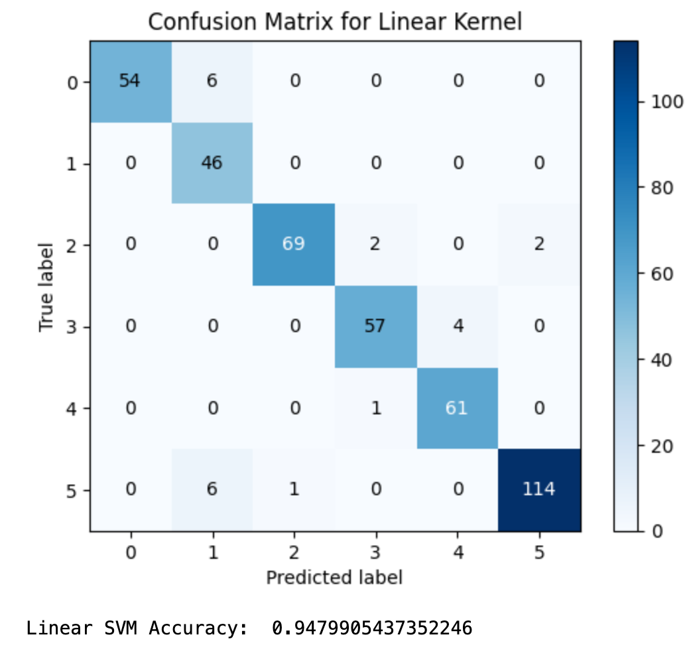

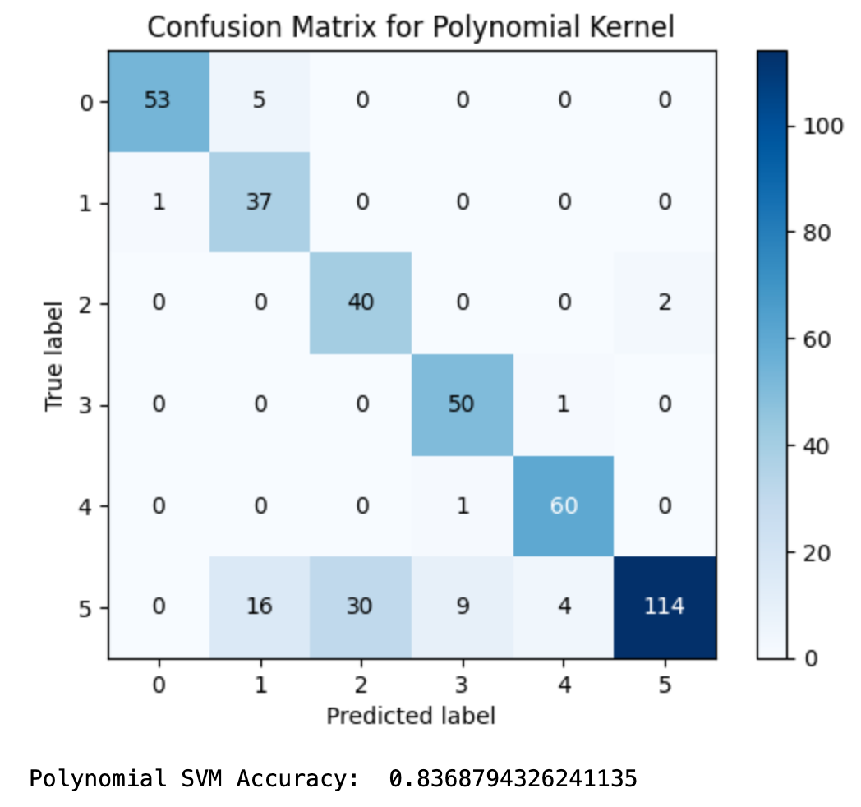
SVM
We tested the accuracy of three kernel types:
We observed that the linear kernel reaped the best results.

Slide 10
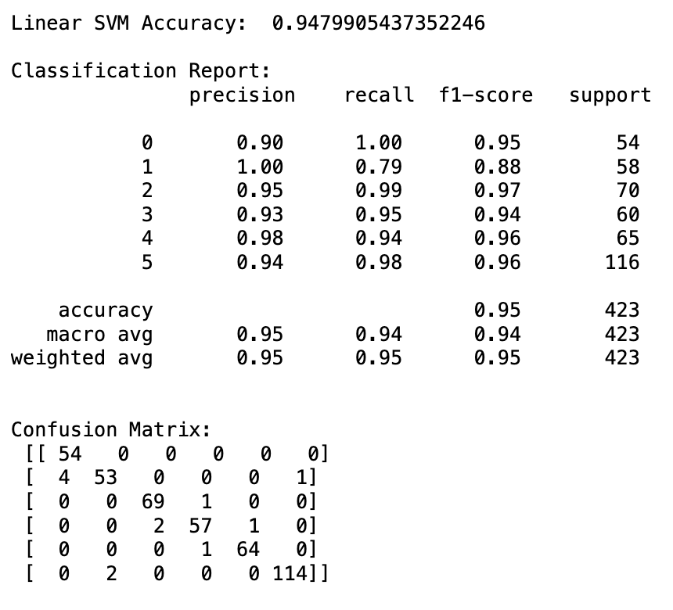
SVM
Results of Linear SVM:

Slide 11
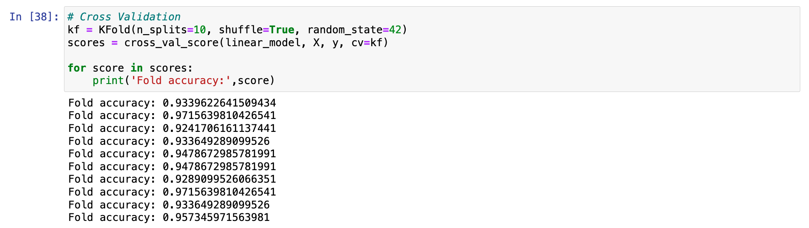
SVM
We also perfromed K-fold cross validation:
And we observed consistently high accuracy levels.

Slide 12
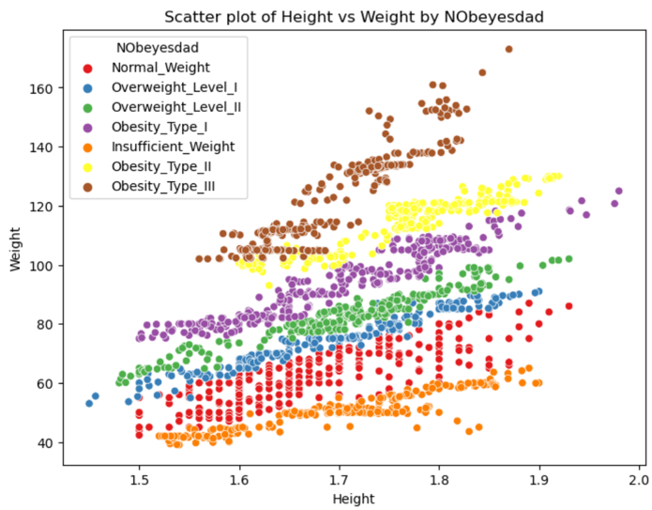
SVM
Data plot:

Slide 13
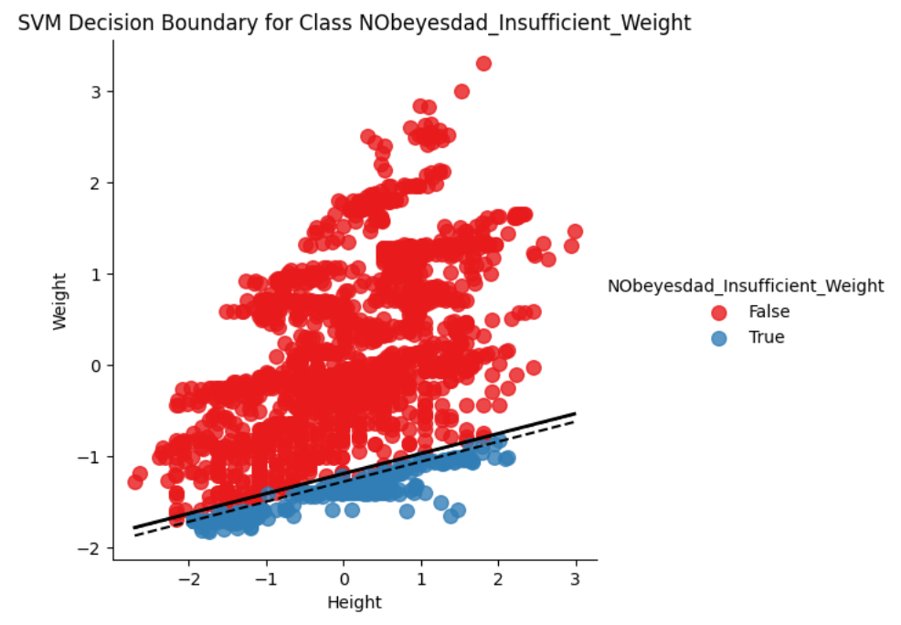
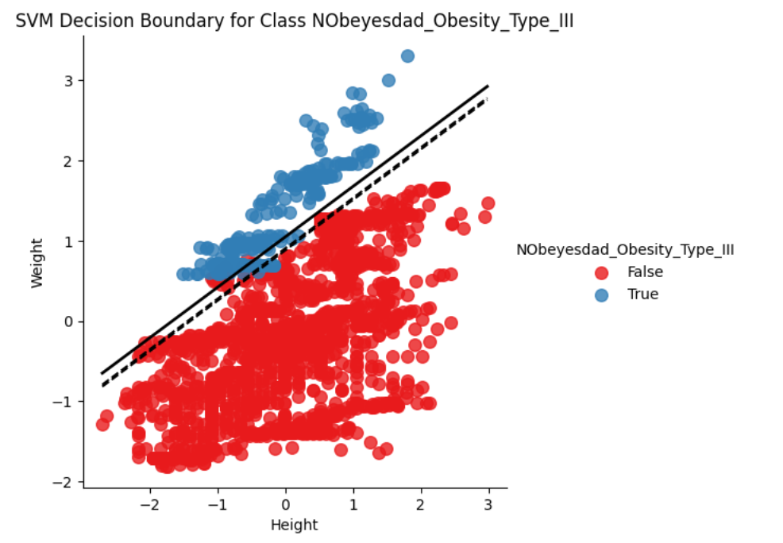
SVM
Plots of the decision boundaries of the classes Insufficient_Weight and Obesity_Type_III:

Slide 14
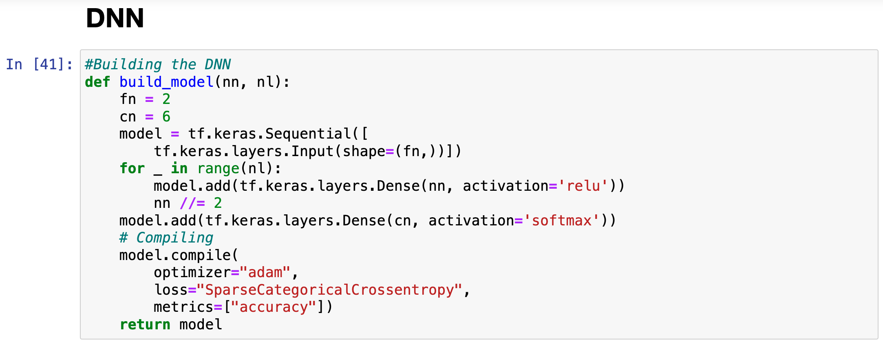
DNN
Model architictiure
fn = # numerical features (height and weight)
cn = number of classes
nl = variable number of hidden layers
nn = # neurons in each layer, which is halved as we go deeper in the network

Slide 15
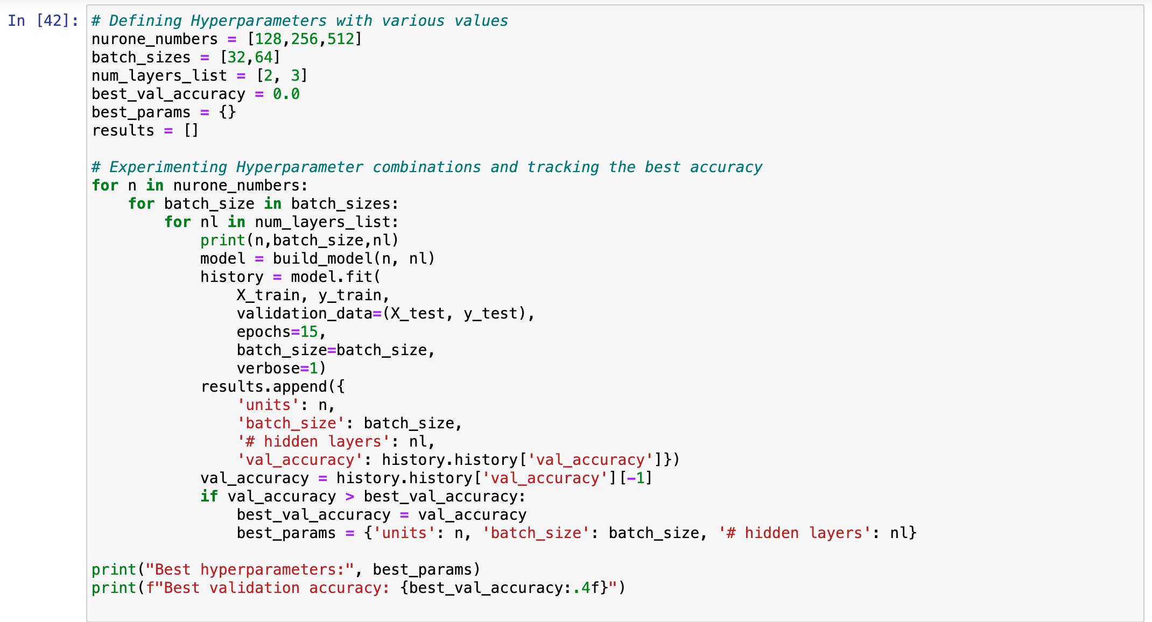
DNN
We experimented with different hyperparameter combinations to obtain higher accuracy levels:
And we found that these were best:

Slide 16
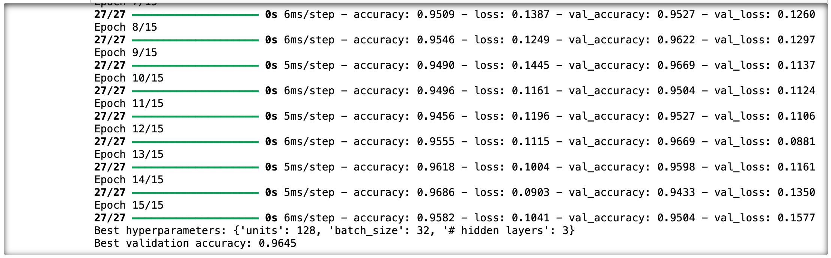
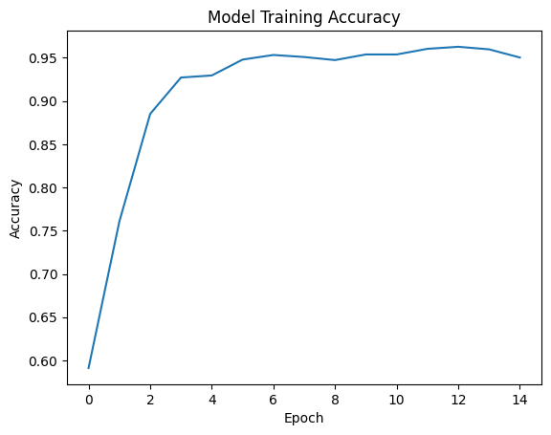
DNN
We used 15 epochs for model validation.
Evaluating performance at the end of each epoch of each hyperparameter combination allowed us to track the model's progress efficiently and ensure it generalizes well over time with optimized performance.

Slide 17
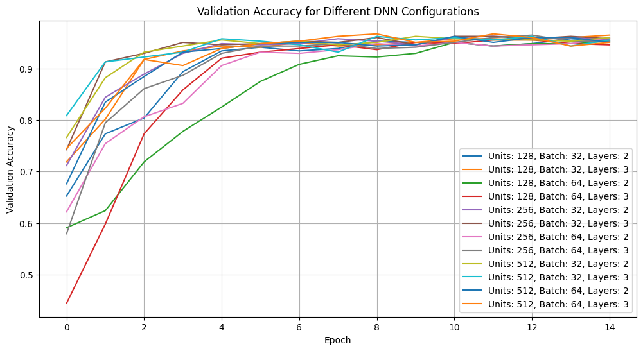
DNN

Slide 18
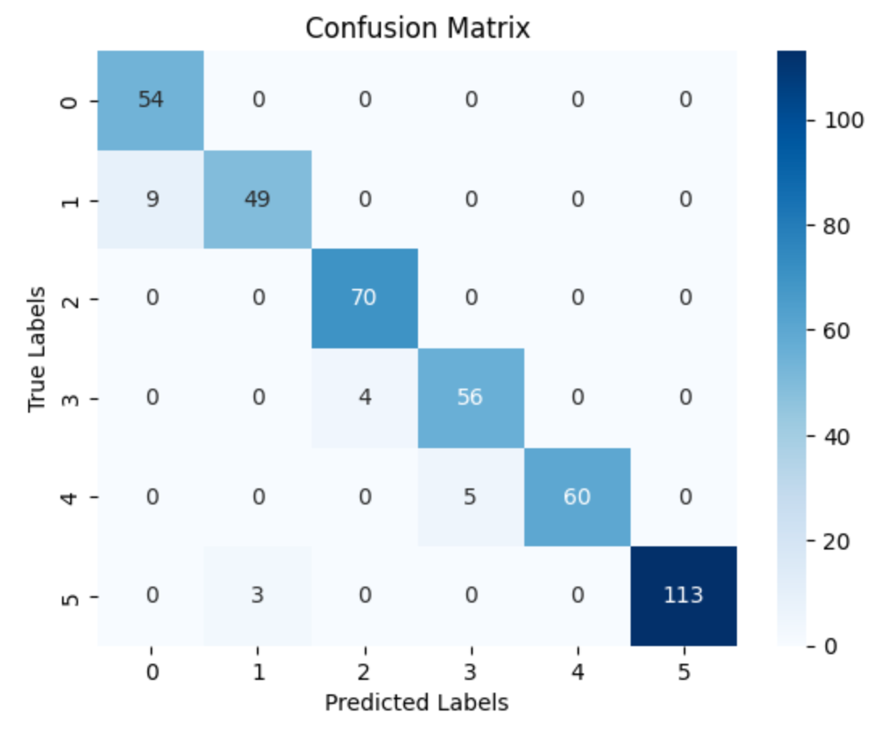
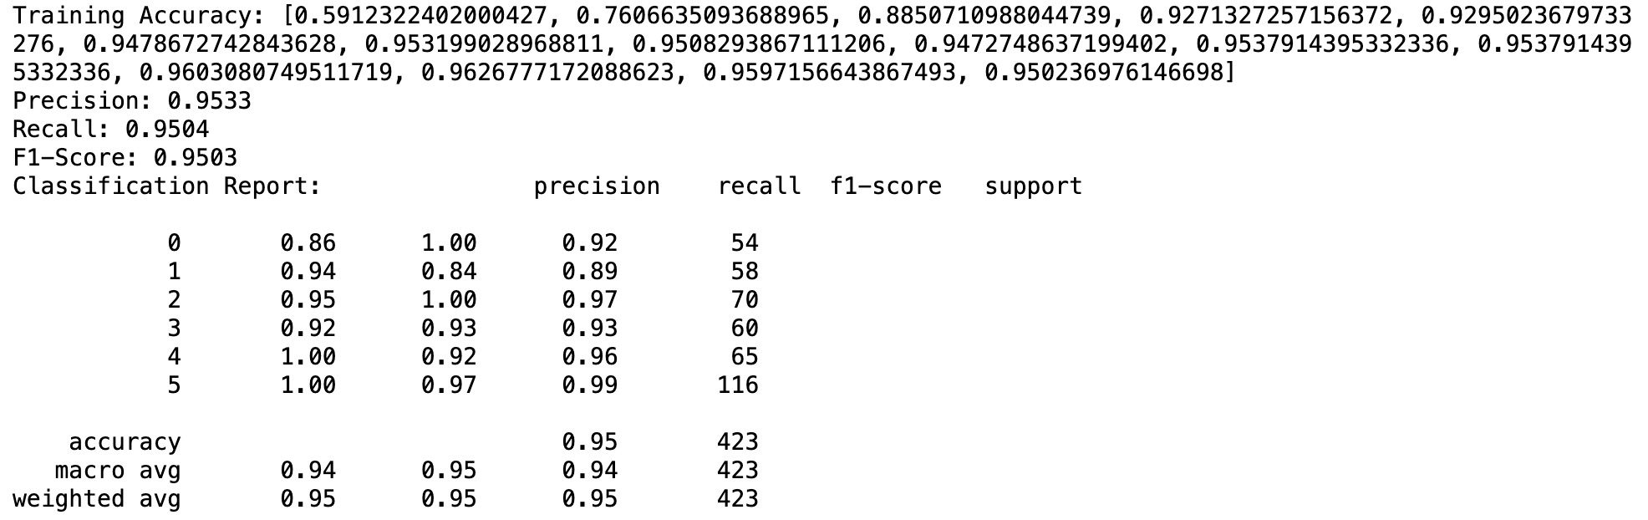
DNN
Results:

Slide 19
Model performance comparison
Comparing confusion matrices and accuracies:
Accuracy ≈ 97%
Accuracy ≈ 95%
Accuracy ≈ 95%
KNN resulted in the highest accuracy

Slide 20
Model performance comparison
Class | KNN Recall | DNN Recall | SVM Recall | Best Recall Model
0 | 1.00 | 1.00 | 1.00 | All
1 | 0.91 | 0.84 | 0.79 | KNN
2 | 0.99 | 1.00 | 0.99 | DNN
3 | 0.95 | 0.93 | 0.95 | KNN+SVM
4 | 0.98 | 0.92 | 0.94 | KNN
5 | 0.98 | 0.97 | 0.98 | KNN+SVM
KNN also consistently had the best recall values
Comparing recall values:

Slide 21
Group 4:
Estimation of Obesity Levels Based On Eating Habits and Physical Condition
Reema Ibrahim Alqahtani
Lena Ehab Ashqar
Sarah Imad Hamdan
Fatma Ossama Gad

