Slide 1
OKINAWA Land of the immortals

Slide 2
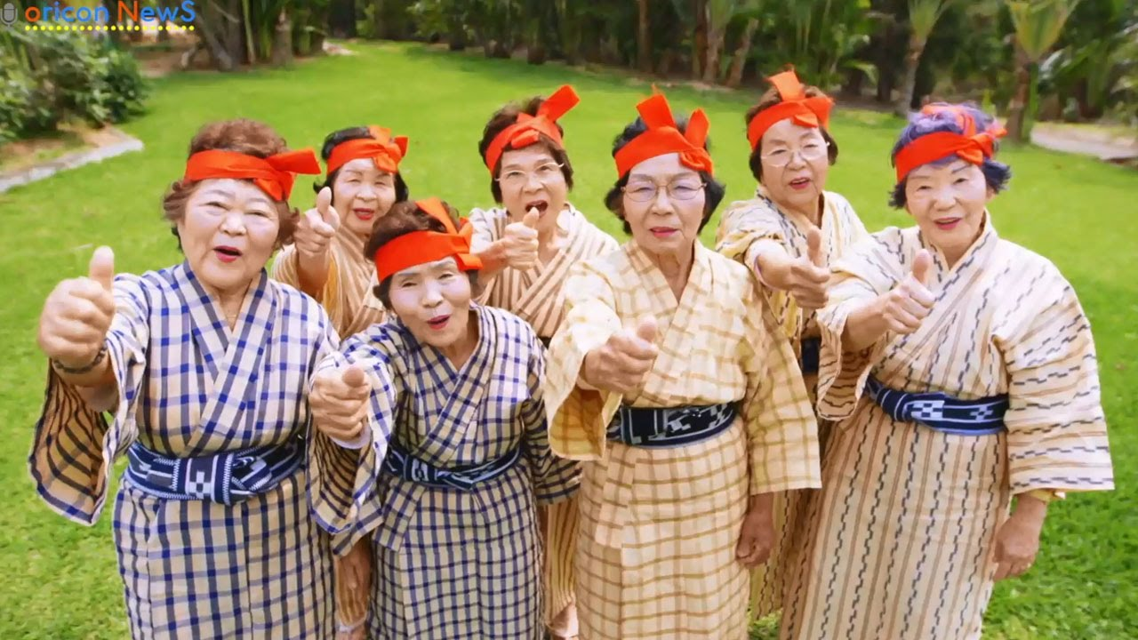

Slide 3
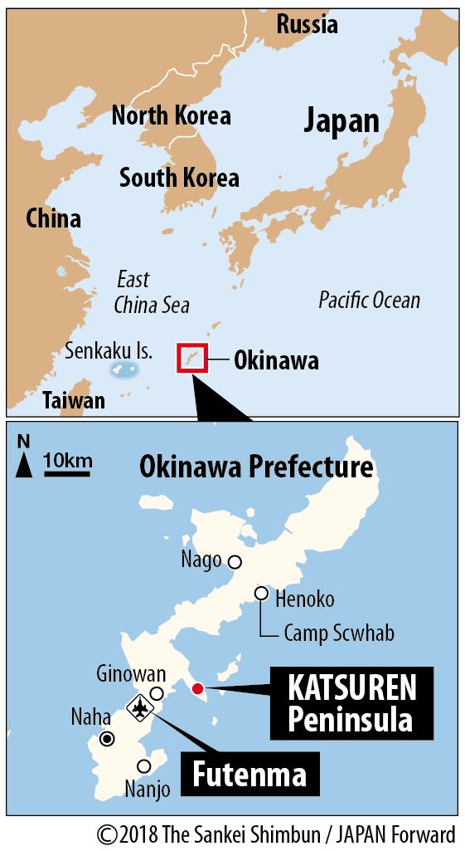
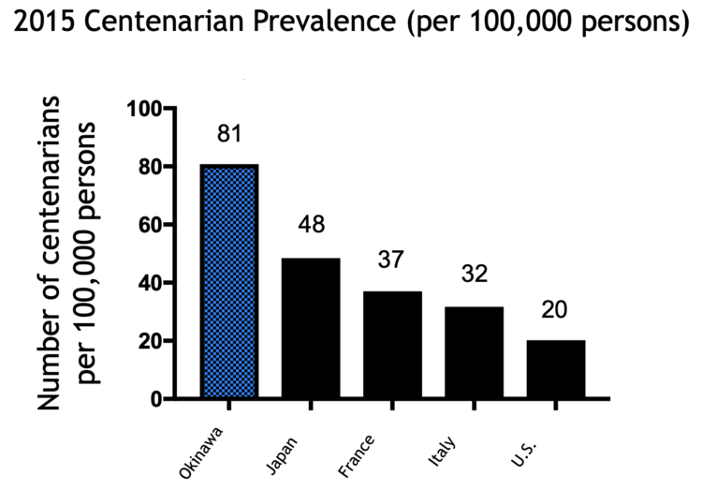
Origin
« Island of longevity »
Life expectancy: men:84, women: 90
3 main ingredients: Hara hachi bu, Moai, Ikigai

Slide 4
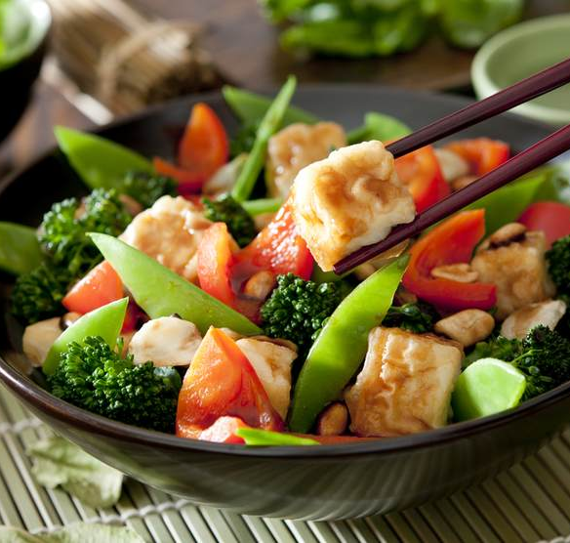
Hara hachi bu
80% rule:
Eat healthy and simple, with local and fresh products, 80% of the time
Stop eating when you are 80% full

Slide 5
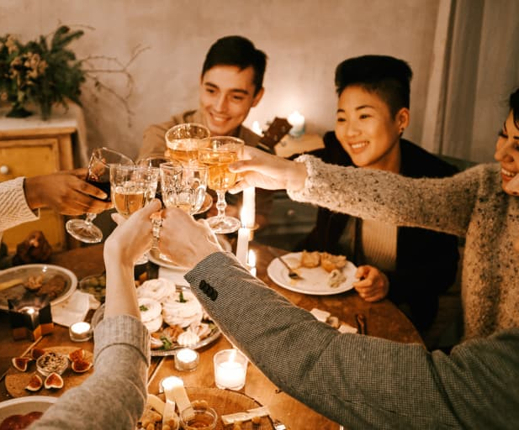
Moai
“Social support group” or “A group of lifelong friends”
Originally meant to pool resources and money from entire villages for projects or social work
Traditionally , groups of 5 children paired together and who did a lifetime commitment to each other
Today more largely a social support groups, called Moai, where people share advice, life experiences, or financial assistance

Slide 6
Ikigai
Meaning: “Reason to live” or literally “Reason to get out of bed in the morning”

Slide 7
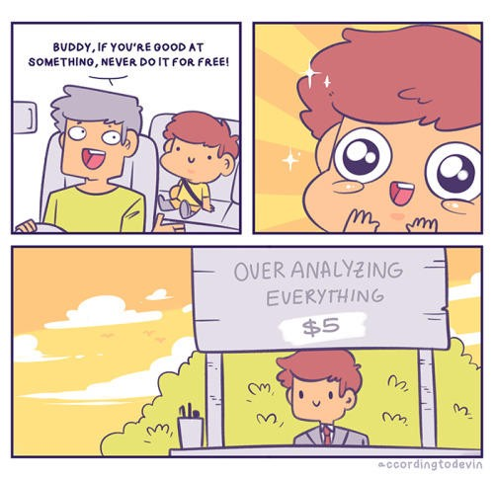
What can you be paid for?
All your skills count !
Being a mom = skills
Practicing sports = skills
Past expériences = skills
Think of your soft skills as well as « action verbs »

Slide 8
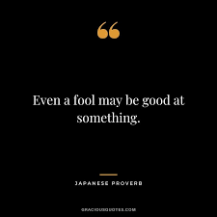
2. What are you good at?
Everyone is good at something
What compliments do you get from your friends & family?
E.g: Initiative, empathy, numbers, music, arts, positivity, analysis etc.

Slide 9

3. What do you like?
It can, but doesn’t have to be, a passion
What are you interested in ?

Slide 10

4. What does the world need?
Mustn’t be world peace or end of world hunger
Find a cause that has meaning for you

Slide 11
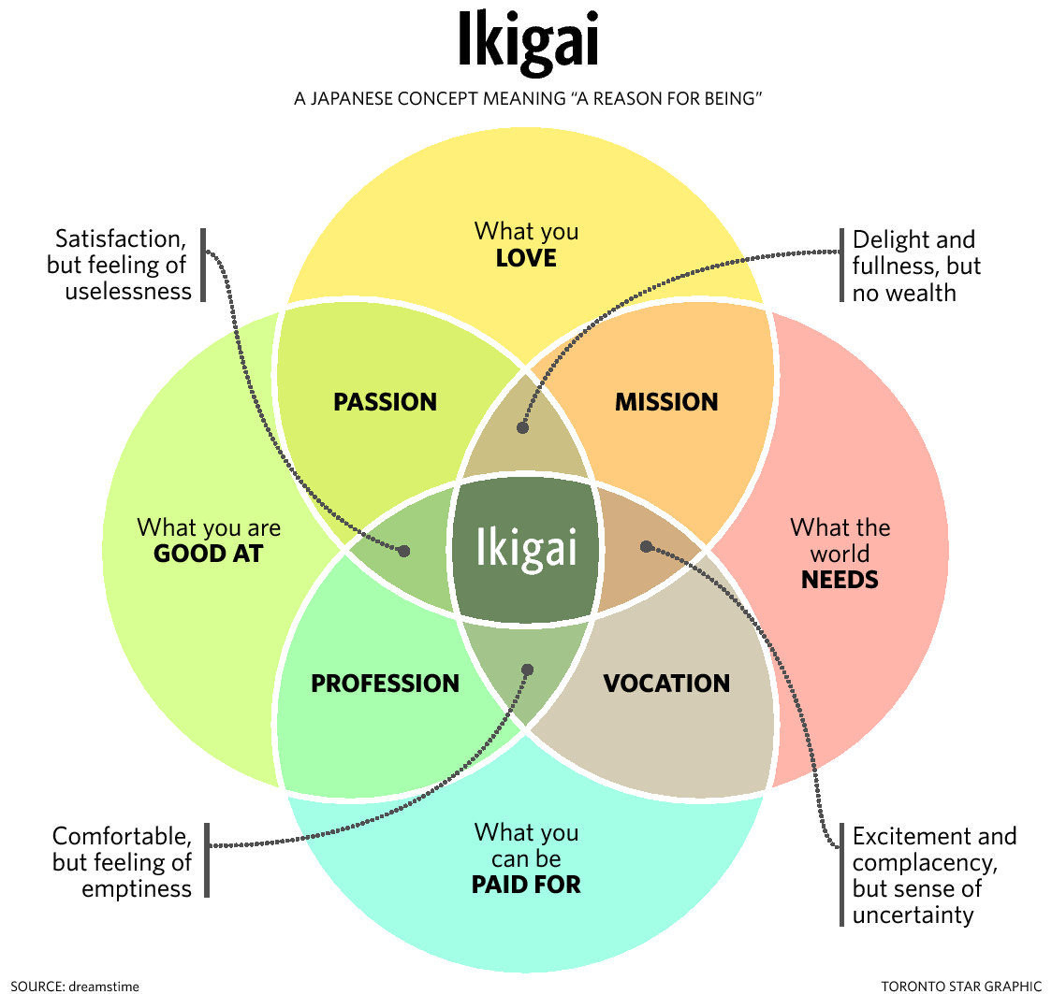

Slide 12

What next ?
Put yourself into action !
If you feel imbalance : explore changes
Else: if all stars are aligned, you have found your ‘True North’ , your orienting point

Slide 13
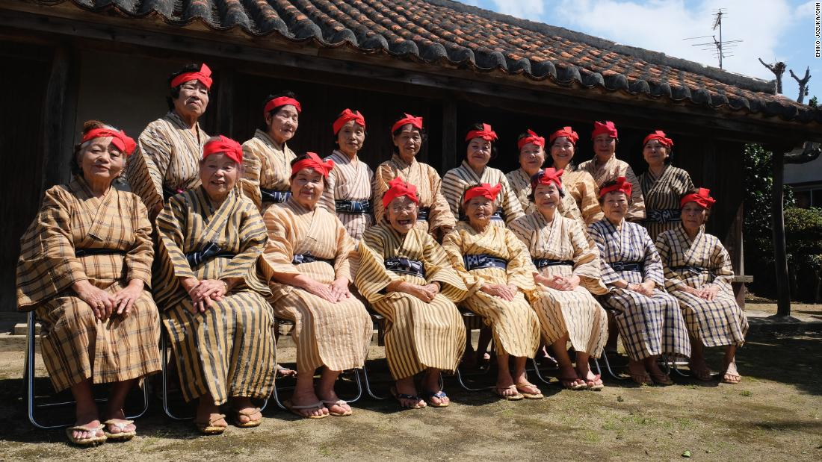
Thank you

