Slide 1
Laundry Notification App
Sarah Noles

Slide 2
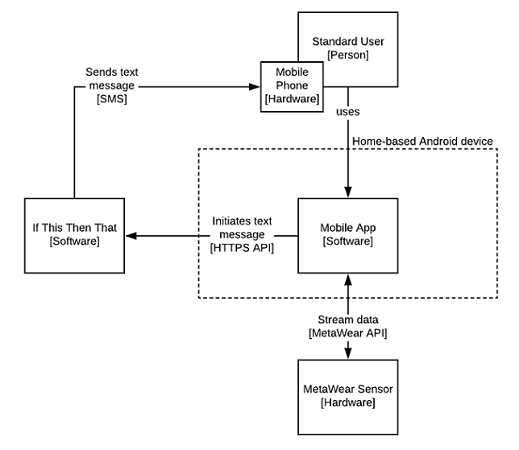
Project Overview
Goal: create app to monitor the status of my washing machine and remind me not to forget to unload it.
Major Features:
IoT sensor used to monitor the status of the machine
Notifications that alert me when the machine is finished running
Continued notifications when I ignore the previous notifications to remind me that I still need to unload the machine

Slide 3
User Story Realization
As a person who does laundry, I want to see the machine status so I can see if the machine is running, stopped, or already unloaded. – implemented
As a person who does laundry, I want to receive status notifications so I can know when to unload the laundry. – implemented
As a person who does laundry, I want to receive status notifications so I can be reminded if I forgot to unload the laundry. – implemented

Slide 4
Current State
Connects to MetaWear sensor and streams data (logged to Logcat)
App displays current machine status with the capability to programmatically change machine status display
Upon status change, app connects to IFTTT API to send a notification to the user that the status has changed
Sample data collected

Slide 5
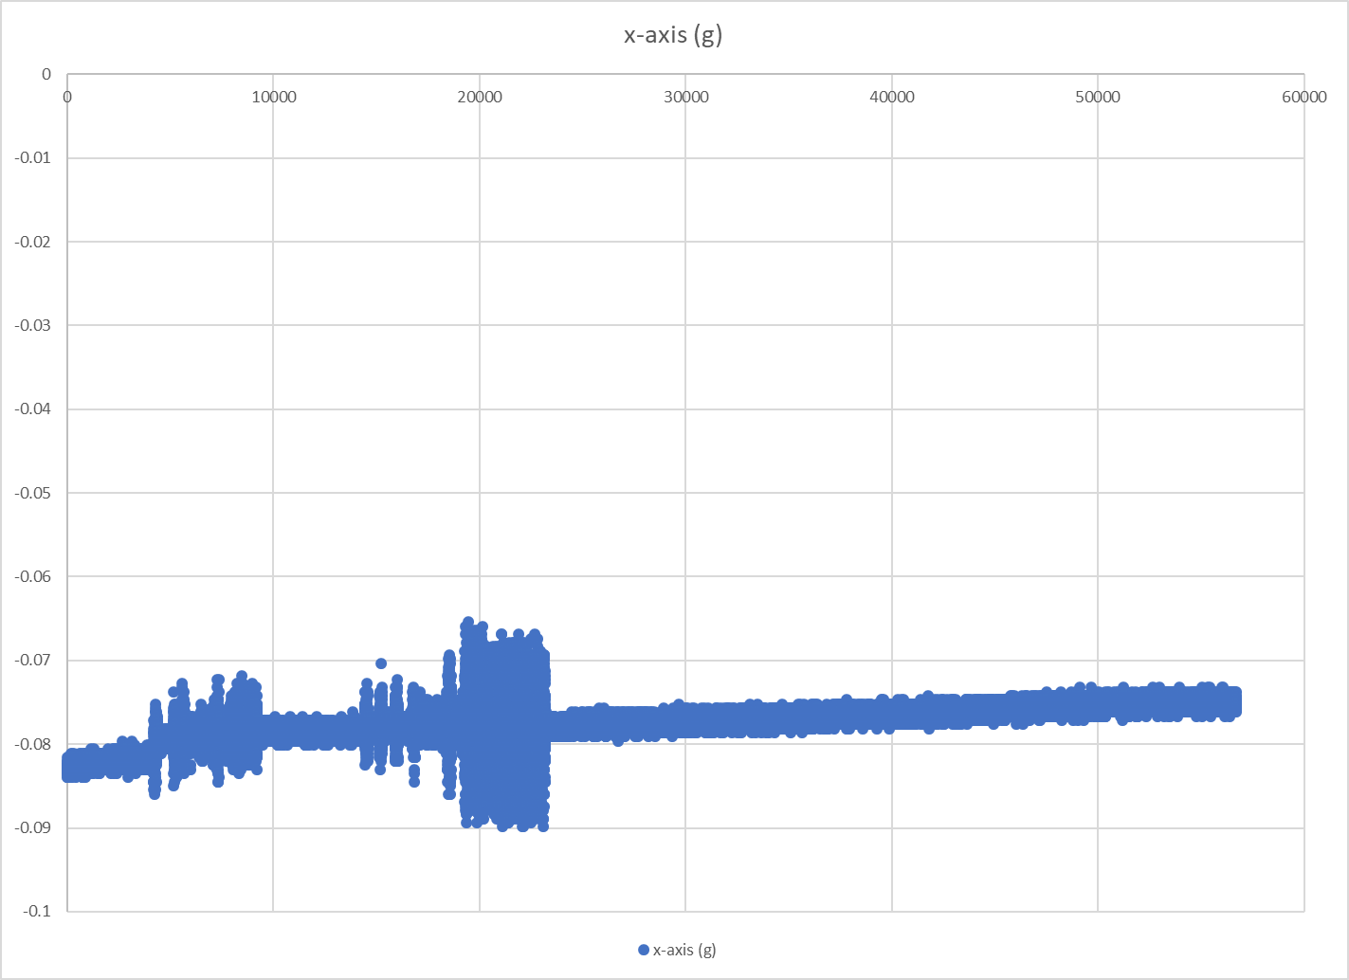
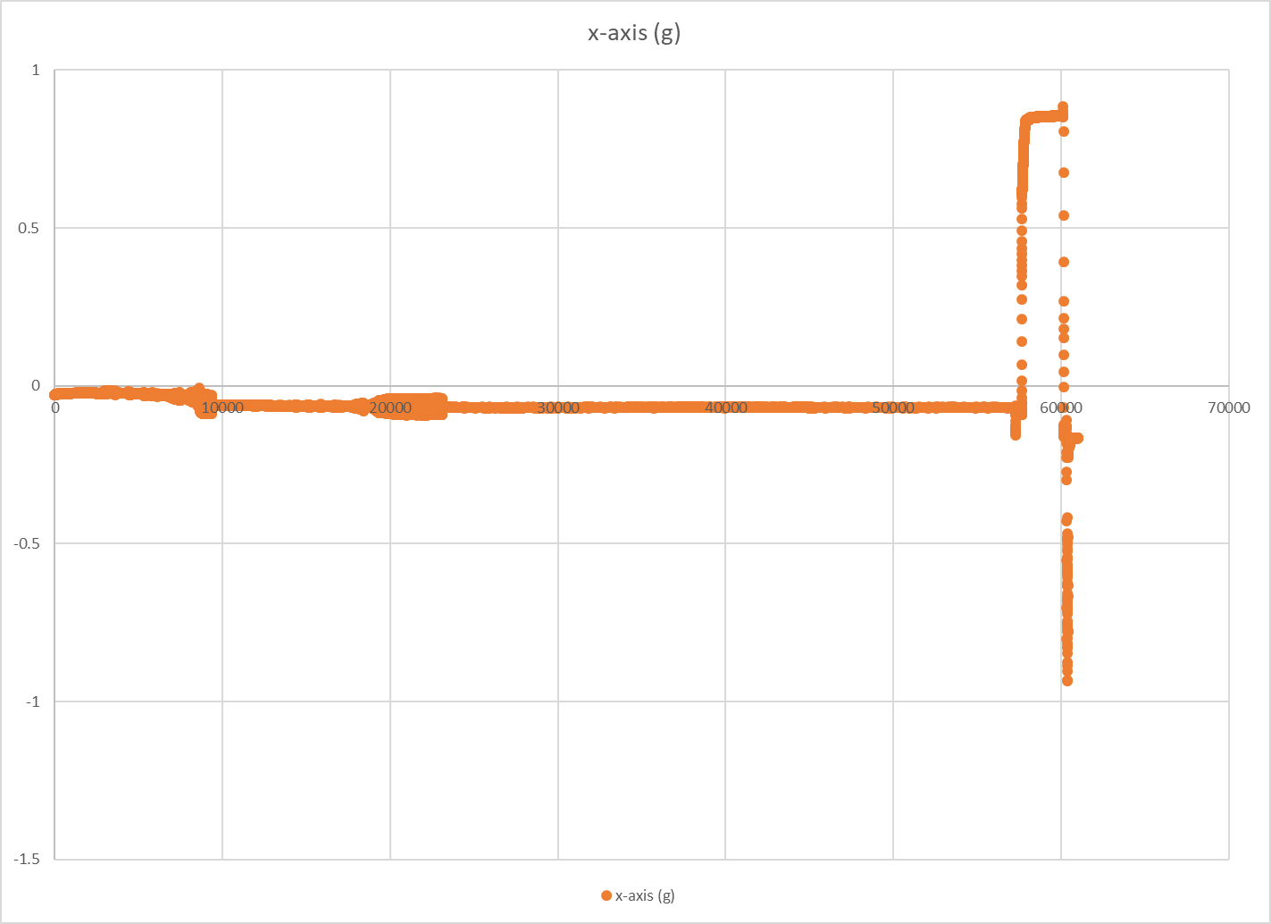
Data Visual

Slide 6
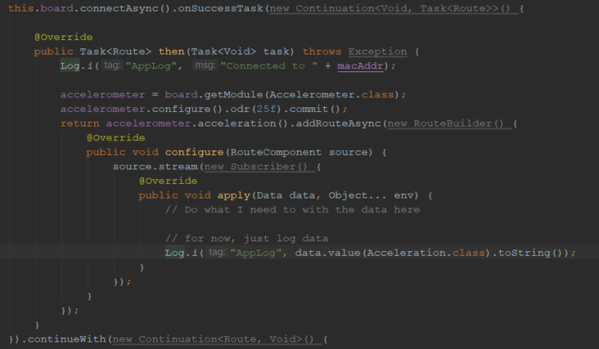
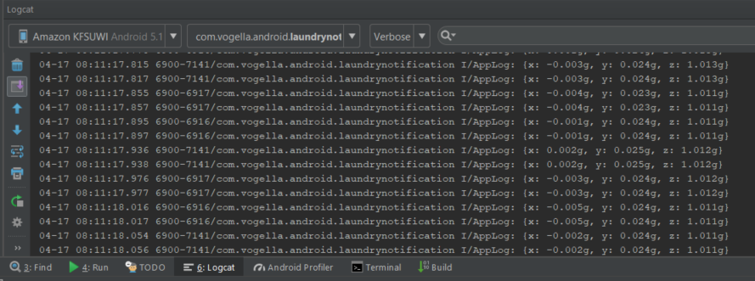
Demo!

Slide 7
Next Steps
Analyze data to determine when machine status changes instead of simulating it
Add additional notification capabilities to send follow-up notifications for unloaded machine
Allow user to configure IFTTT API keys instead of hard-coding
Securely store IFTTT API key for each notification user
Improve user interface??

Slide 8
Demo!

Slide 9
Future Work
Implement API key storage more securely (in progress)
Additional user feedback on MetaWear status
Allow more customization (notification intervals, etc.)

