Slide 1
Hacking Tasklist
Sarah Noles
4/12/2018

Slide 2
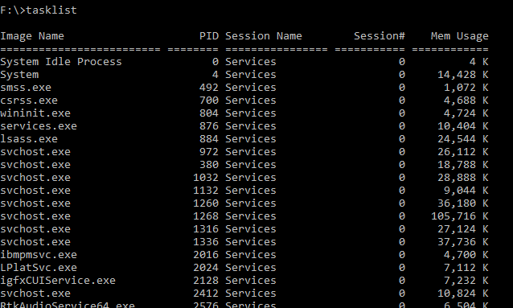
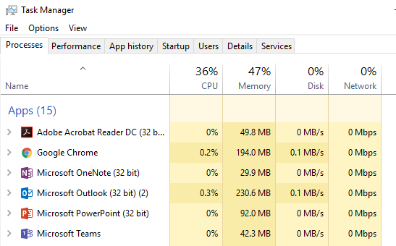
Project Goals
Hack tasklist, taskkill, and Task Manager
…which turned into hacking tasklist
Hacking goals
Hide the presence of specific processes
Change the behavior when trying to kill a process

Slide 3
The beginning
Examined functions for those that indicated printing
There were a lot of functions and I missed “_vsnwprintf” so I proceeded the manual way
Manual way: put a break point on a function, jump over the function, see if it prints to console. If so, drill into the function and repeat.
Inefficient and time consuming, but eventually got to the right place

Slide 4
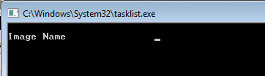
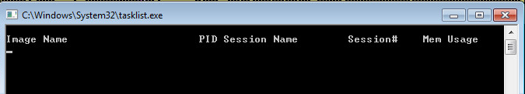

Printing headers
The header prints (woo!) one string at a time…not too exciting

Slide 5
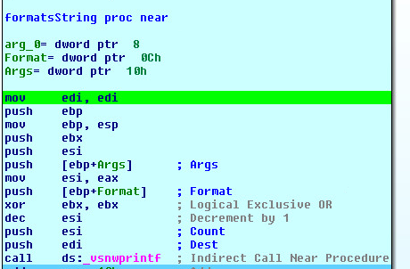

Printing processes
Assembly snippet:
Args = pointer to process
in memory
Format = format string
_vsnwprintf “prints” the new
formatted string to
memory location
Args:
Format:

Slide 6


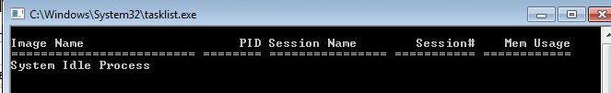
Printing processes
Prints Args to memory location at Dest
Fast forward a little bit…
Result:
This seems like where I should focus

Slide 7
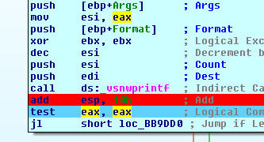
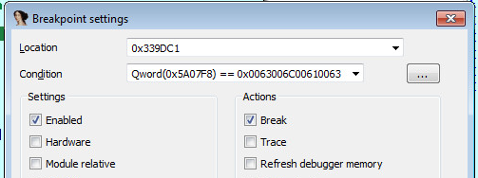
Pseudo-hack
First, attempted to use conditional breakpoints to determine when to change the value that is printed
Started calc.exe
Set conditional breakpoint immediately after _vsnwprintf to stop only if value written to destination equals= “calc”

Slide 8

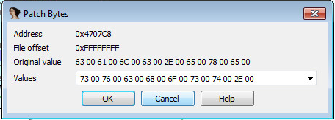
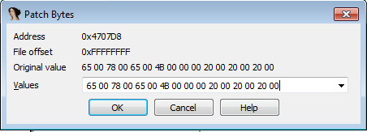
Pseudo-hack
When the breakpoint hit, I used “Patch Byte” to change the value from calc.exe to svchost.exe
Memory value before breakpoint:
Patching Bytes
Memory value after breakpoint

Slide 9
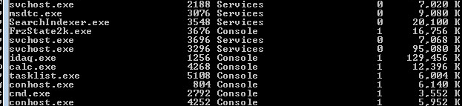
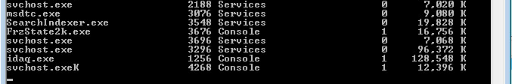
Pseudo-hack results
Real Tasklist Output
Debugged Tasklist Output

Slide 10
So far so good, right…?

Slide 11
The real hack
Ideally, I wouldn’t have to manually interact with the program to do this
Next steps: alter the program to always hide calc.exe

Slide 12
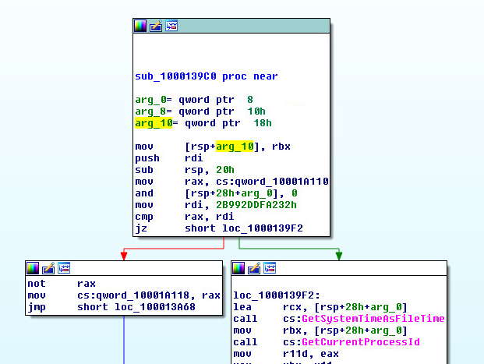
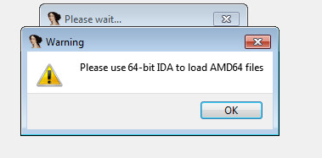
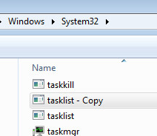
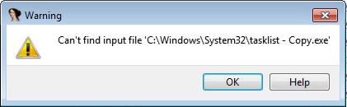
The (attempted) real hack
Windows executables are weird (and sometimes magical)
Made a copy of tasklist.exe and all of a sudden it’s a 32-bit exe
Made copy of tasklist.exe in
C:\Windows\System32, and
the file doesn’t exist?

Slide 13
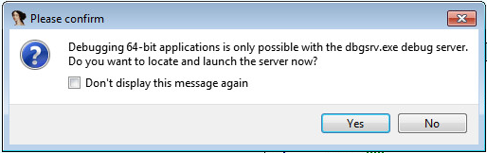
The (attempted) real hack
Tried to do the same with another exe in C:\Windows\System32…Same behavior ☹
Switching gears…let’s just embrace the 64-bit world!
For like 5 minutes until I realized 64-bit Ida requires using a remote debugger (seriously?!?!)
Read somewhere online that I could debug locally using Windbg debugger. Nope…
Switching gears again, tried to see if anyone has attempted this before on the internet
Didn’t find much, but did find a blog post about manually patching netapi32.dll for MS08-067 because the writer didn’t want to reboot the server (what?!)

Slide 14
Future Work
Find a new project that doesn’t involve C:\Windows\System32 and magic Windows executables

