Slide 1
Predicting IGN Scores with Statistical Learning Methods
Sarah McDougald
Statistics - Class of 2020

Slide 2
Data Sources
3 sources of data:
IGN dataset
public access at https://www.reddit.com/r/datasets/comments/2awdgx/i_made_this_dataset_of_all_of_igns_game_reviews/
approx. 17,000 games with variables for game title, platform, IGN score, and genre
Wikipedia scraped data – Engine and Engine Version
public access at www.Wikipedia.com
149 games with various variables, including Engine and EngineVersion (e.g. Unreal Engine 4)
Kaggle dataset – Sales
public access
approx. 16,000 games with additional variables for sales, broken down by region (e.g. North American sales)

Slide 3
Prepared Datasets
`ign`
n > 17,000
base dataset with IGN ratings
`ign_wiki`
n = 149
join between ign dataset and scraped Wikipedia data with Engine variables
`ign_sc`
n > 9,000
join between ign dataset and Kaggle game sales data
All data cleaned, NA values removed, uniqueness of rows checked.

Slide 4
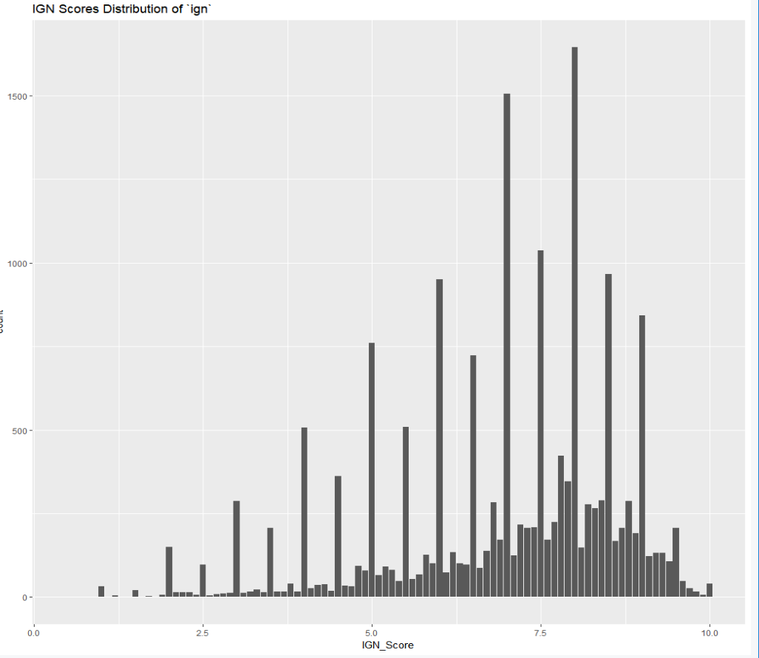
Distribution of IGN Scores – all time, up until 2014
median: ~ 7.25

Slide 5
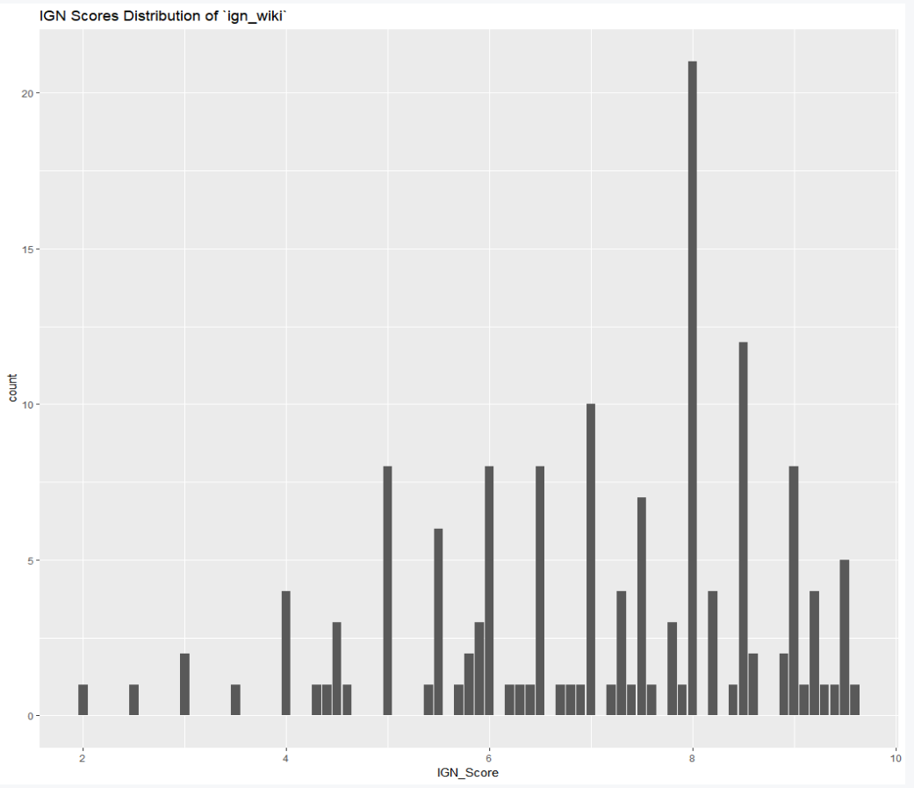
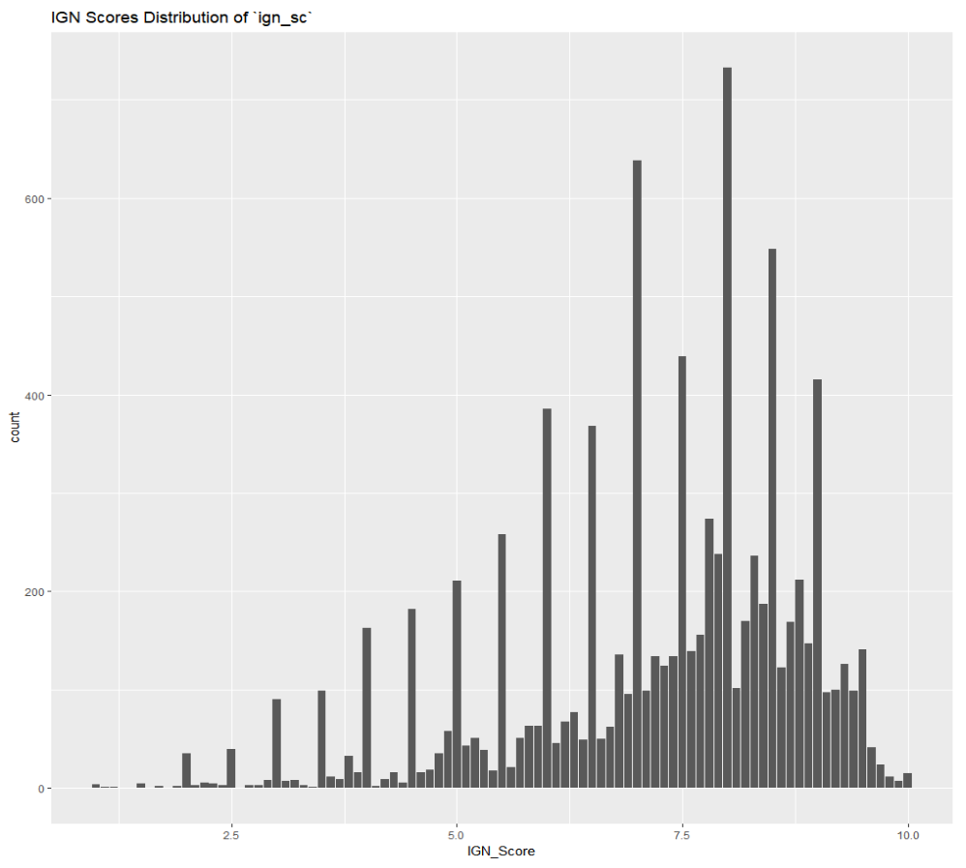
Distribution of IGN Scores – `ign_wiki` and `ign_sc`

Slide 6
Model Training
Regression – Multiple Linear Regression Models
Model strategies:
Models using ign_wiki
Model 1: variables Engine, SimplifiedGenre (simplified due to data size)
Model 2: variables Engine, SimplifiedGenre, EngineVersion
Model 3: only variable SimplifiedGenre
Models using ign_sc
Model 4: variables Rating, Platform, Genre, and all sales variables (by region and global)
Model 5: variables NA_Sales, Rating, Platform, Genre

Slide 7
Winning Model:
model name: `MLM_model_5`
type of statistical learning method: Multiple Linear Regression
formula: `IGN_Score ~ NA_Sales + Rating + Platform + Genre`
Estimated Test Error using k-fold cross-validation (k = 10):
Error (using MSE) = 2.277 points
Estimated Test Error using Validation Set Approach (randomly split `ign_sc` dataset into equal-size training and testing sets):
MSE = 2.298 points
average error: Model is off by approx. 1.51 IGN score points.

Slide 8
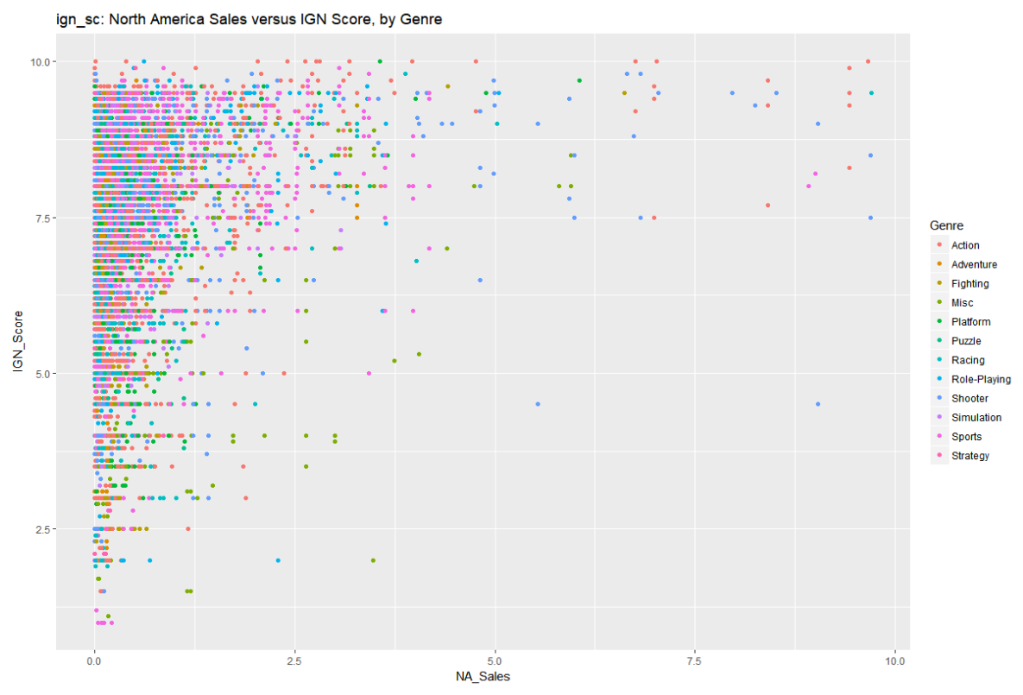
Variable Exploration: North America Sales of a game
Observations:
10.0 games are Action
NA_Sales > 5 million means IGN score is near-guaranteed > 7.5

Slide 9
Making predictions with guess_IGN_score()
Two functions created:
guess_IGN_score() – guesses the IGN score for the given specs of a game
find_data() – searches the model’s database for the inputs to guess_IGN_score()
Example:
Find Wolfenstein’s data: find_data("Wolfenstein")
Guess Wolfenstein’s IGN score: guess_IGN_score(NA_Sales = 0.47, Rating = "M", "PS4", Genre = "Shooter")

Slide 10
Planned project expansions...
More statistical learning theory models
Example: Polynomial regression, log transformation of variables
More data!
May scrape additional variables from Wikipedia, try to enlarge `ign_wiki` dataset
Prediction of other variables
Data included for Metacritic scores
Potential question: “Are Metacritic scores less predictable than IGN scores, or more?”

Slide 11
Thanks for stopping by!
Questions?

