Slide 1

Car Accidents in Calderdale: Education Outreach
Work done by:
Edward Crouser, Eric Blanchard, Jess Nguyen, and Sarah McLain

Slide 2
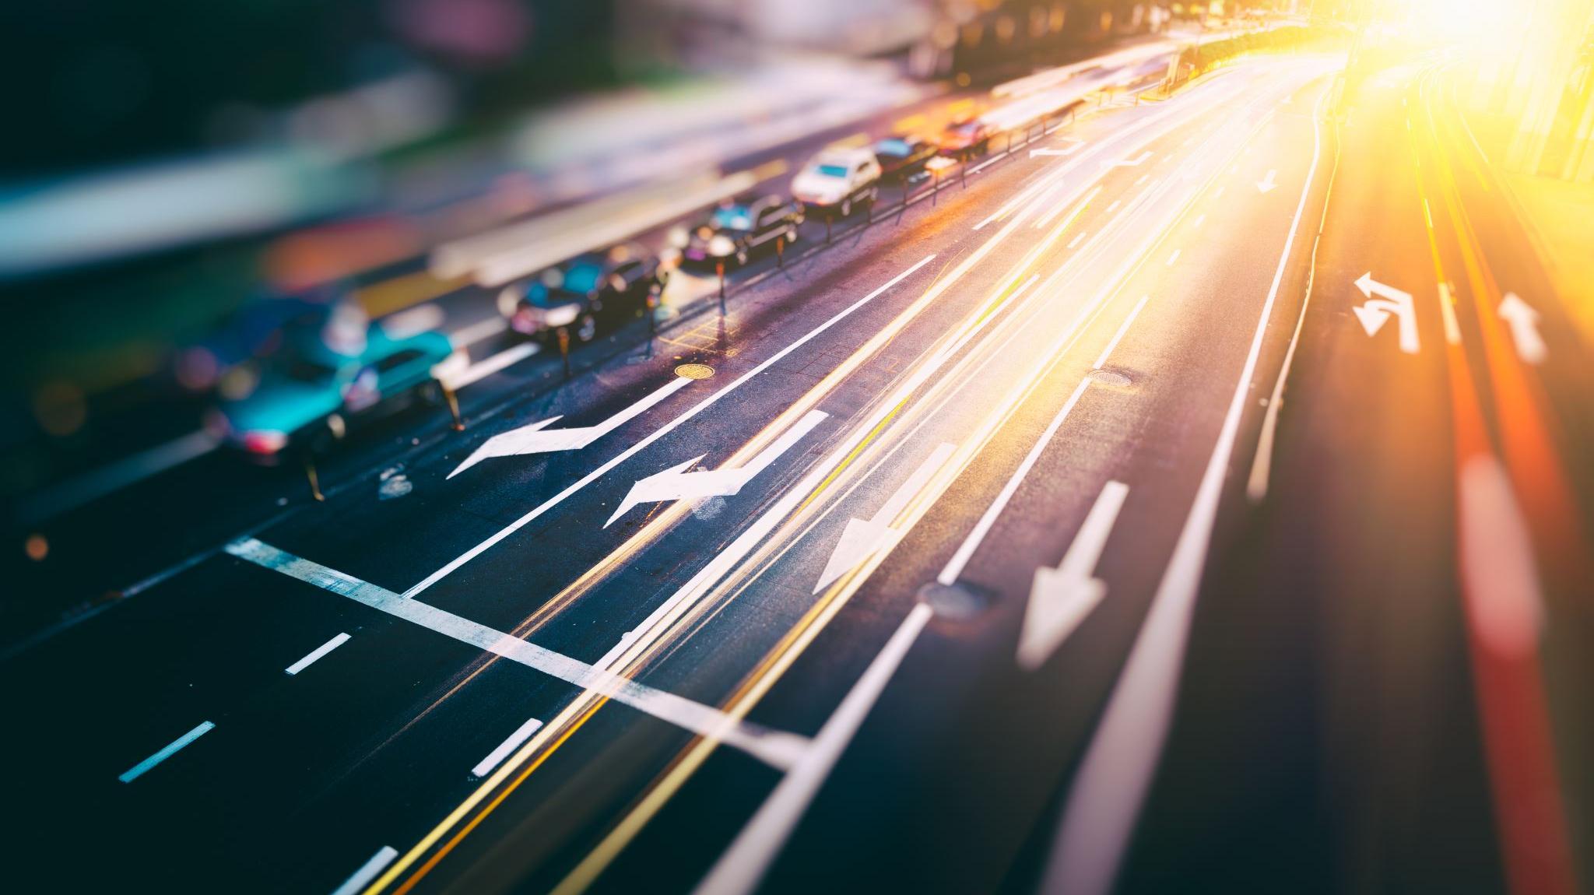
Overview:
The district of Calderdale would like to add a page to their website as part of their Safe Driving Initiative.
They would like the users to be able to interact with and access accident data from previous years.
Users should be able to see when, where, and under what conditions previous accidents have taken place.

Slide 3
Data Sources:
DataWorks:
https://dataworks.calderdale.gov.uk/dataset/24qdx/road-traffic-accidents
GEOJSON Files:
https://dataworks.calderdale.gov.uk/download/24qdx/zjf/Calderdale%20Collisions%202020%20SS.geojson
https://dataworks.calderdale.gov.uk/download/24qdx/qtk/Accidents%202019.geojson
https://dataworks.calderdale.gov.uk/download/24qdx/enf/accident%202018.geojson
https://dataworks.calderdale.gov.uk/download/24qdx/29j/Accident%202017.geojson
Starter Code:
Sourced from UofO Edx Bootcamp Module 10, 14, 15

Slide 4
Objectives:
Create:
A user interactive dashboard displaying accident information:
- Drop down menu to change data year
- Bar and Pie charts displaying different accident conditions
JavaScript leaflet map where accident data is displayed in removable layers by the year.
Flask powered API, HTML, CSS, JS, and a Database for the data.
Python Jupyter notebook with cleaned data and statistical information on accident data.

Slide 5
Website link:

