Slide 1

Predicting Job Salaries

Slide 2

Executive Summary
Purpose: Our goal is to better understand how job descriptions can predict salary ranges, helping both employers and job seekers.
Approach: We analyzed a large dataset of job descriptions to find patterns and insights that influence pay.
Key Findings: We discovered that certain job titles, roles, skills, and benefits have a strong impact on salary.
Result: By simplifying and organizing the data, we’ve made it easier to predict salary ranges based on job descriptions.

Slide 3
Continued:
For Job Seekers: It provides clear expectations for salary, making negotiation easier.
For Employers: This helps set fair and competitive salaries.
Overall Impact: A more data-driven approach to salary setting can lead to better outcomes for everyone.

Slide 4
Business Problem
How can organizations accurately predict and set competitive salary ranges based on job descriptions to improve talent acquisition, retention, and overall compensation strategies?
Inefficient Compensation Strategies: Companies may overpay or underpay.
Talent Acquisition and Retention Challenges: Not offering competitive salaries can make it difficult for the companies to retain top talent.
Lack of Transparency: Employees may feel that they are treated unfairly.
Inconsistent Salary Structures: Companies may struggle with internal equity where employees with similar qualification are paid differently.

Slide 5

Business Impact
Implementing a data-driven approach to salary prediction offers several key benefits:
Talent Acquisition & Retention: Competitive and fair salaries attract top talent and reduce turnover, enhancing employer branding.
Financial Efficiency: Accurate salary ranges optimize compensation costs and improve budget planning, ensuring financial resources are used effectively.
Employee Satisfaction: Fair compensation practices boost morale, productivity, and trust, leading to a more motivated workforce.
Strategic Decision-Making: Data-driven insights enable informed decisions on salary structures and resource allocation, supporting long-term business goals.
Risk Mitigation: Ensures compliance and internal equity, reducing legal risks and fostering a positive work environment.

Slide 6

Dataset Overview
Dataset Details: We looked at over 1.6 million job descriptions, covering various roles, job titles, qualification, skills, and industries from different cities and countries of the world.
Challenges: The data was initially complex, with many different job titles and salary ranges that needed to be simplified.

Slide 7

Simplifying the Data
Job Titles: We grouped similar job titles together to reduce complexity.
Role: In a similar way, grouped the Role column together to reduce the complexity.
Skills: We organized hundreds of different skills into broader categories like
‘Programming’ and ‘Management’.
Benefits: We categorized employee benefits into common types like ‘Health’ and ‘Financial’.

Slide 8
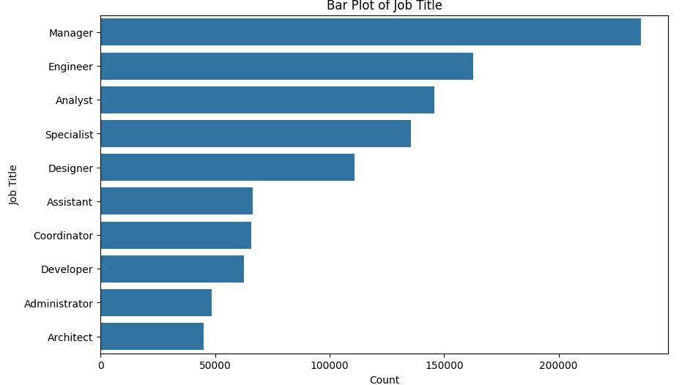

Slide 9
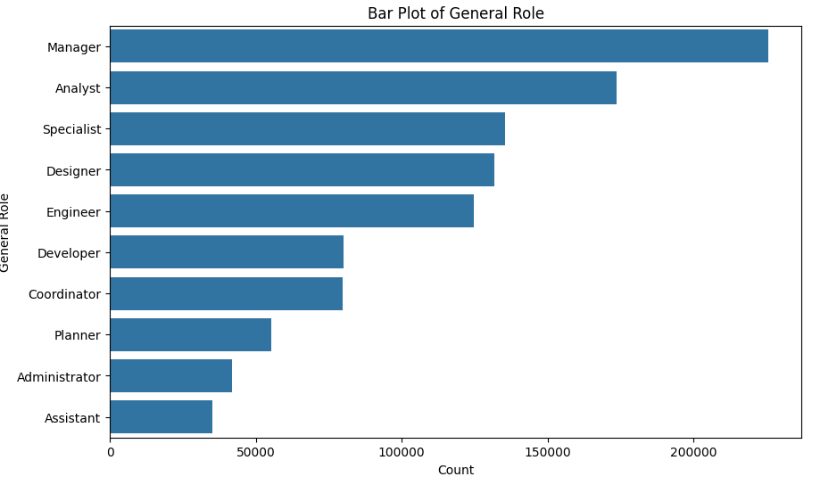

Slide 10
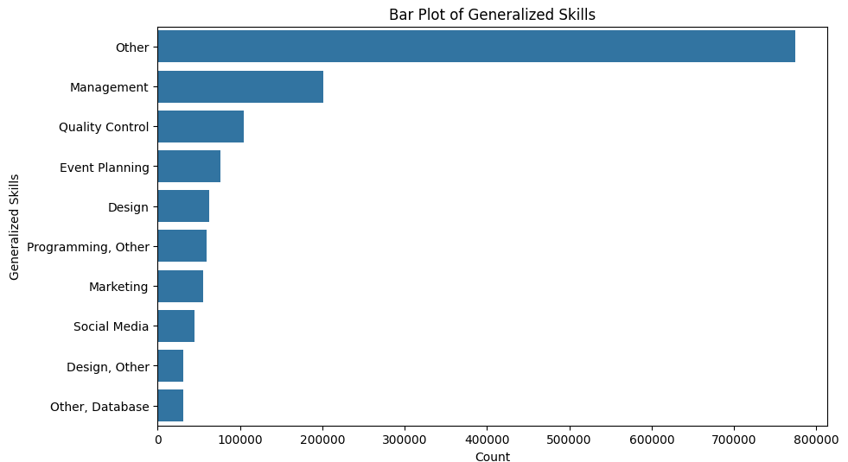

Slide 11
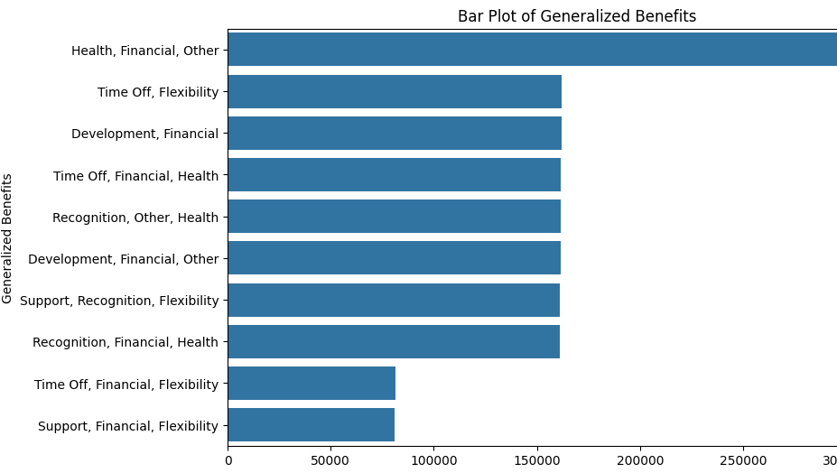

Slide 12
Model Performance and Overfitting Detection
Initial Model Runs:
After cleaning and preprocessing the data, we initially ran several machine learning models, including Decision Tree Classification and Random Forest.
These models achieved a 100% accuracy rate, which, while seemingly ideal, was a significant red flag.
Dropped Features: We decided to drop several features that, although potentially relevant, were less important in the predictive power of the model. These included: Location, Country, Company, Industry, Job title.
Outcome:
After dropping these features, the model's performance was re-evaluated. The results showed a more realistic accuracy, indicating that the model was now focusing on the underlying patterns in the data rather than memorizing specifics.
This step helped in creating a more robust model that is better suited for real-world predictions
Models | AUC | F1 Score | ROC
Decision Tree Classifier | 1 | 1 | 1
Random Forest | 1 | 1 | 1

Slide 13
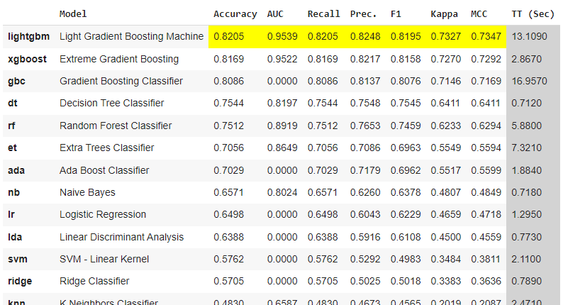

Slide 14
Key findings
Top Predictors:
Experience: The most significant factor in determining salary ranges, with a strong
positive correlation to higher salary brackets.
Qualifications: Higher educational qualifications contribute significantly to predicting salary, often leading to higher compensation.
Skills: Specific skill sets, particularly those in high demand, are critical in salary determination.
Business Implications:
Align compensation strategies with experience, qualifications, and skills.
Use these insights to enhance recruitment, focusing on candidates with strong qualifications and relevant skills.

