Slide 1
System Analysis Beginning Analysis and Investigating Requirements

Slide 2
Topics covered
Describe the activities of the systems analysis life cycle phase
Describe the difference between functional and nonfunctional system requirements
Identify and understand the different types of users who will be involved in investigating system requirements

Slide 3
Topics covered
Describe the kind of information that is required to develop system requirements
Determine system requirements through review of documentation, interviews, observation, prototypes, questionnaires, vendor research, and joint application design sessions
Discuss the need for validation of system requirements to ensure accuracy and completeness and the use of a structured walkthrough

Slide 4
Requirement Engineering
Requirements engineering refers to the process of defining, documenting and maintaining requirements to the sub-fields of software engineering concerned with this process.
In the waterfall model, requirements engineering is presented as the system analysis phase of the development process.
Later software development methods, including the Rational Unified Process (RUP), assume that requirements engineering continues through the lifetime of a system.

Slide 5
Requirements engineering
The process of establishing the services that a customer requires from a system and the constraints under which it operates and is developed.

Slide 6
Requirement Engineering
The activities involved in requirements engineering vary widely, depending on the type of system being developed and the specific practices of the organization(s) involved. These may include:
Gathering information for requirements inception or requirements elicitation
Requirements analysis and negotiation - checking requirements and resolving stakeholder conflicts

Slide 7
Requirement Engineering
Requirements specification (e.g., software requirements specification; SRS) - documenting the requirements in a requirements document
Systems modeling - deriving models of the system, often using a notation such as the Unified Modeling Language (UML) or the Lifecycle Modeling Language (LML)
Requirements validation - checking that the documented requirements and models are consistent and meet stakeholder needs
Requirements management - managing changes to the requirements as the system is developed and put into use

Slide 8
Requirement Engineering
These are sometimes presented as chronological stages although, in practice, there is considerable interleaving of these activities.

Slide 9
System stakeholders
Any person or organization who is affected by the system in some way and so who has a legitimate interest
Stakeholder types
End users
System managers
System owners
External stakeholders

Slide 10
Stakeholders in the Mentcare system
Patients whose information is recorded in the system.
Doctors who are responsible for assessing and treating patients.
Nurses who coordinate the consultations with doctors and administer some treatments.
Medical receptionists who manage patients’ appointments.
IT staff who are responsible for installing and maintaining the system.

Slide 11
Stakeholders in the Mentcare system
A medical ethics manager who must ensure that the system meets current ethical guidelines for patient care.
Health care managers who obtain management information from the system.
Medical records staff who are responsible for ensuring that system information can be maintained and preserved, and that record keeping procedures have been properly implemented.

Slide 12
System Analyst
Systems analyst* – uses analysis and design techniques to solve business problems using information technology
Has computer technology knowledge and programming expertise
Understands business problems
Uses logical methods for solving problems
Is more of a business problem solver than a technical programmer
* Requirement Engineer, Requirements Analyst, Functional Architect, Business Systems Analyst, Business Analyst (generic term), etc.

Slide 13
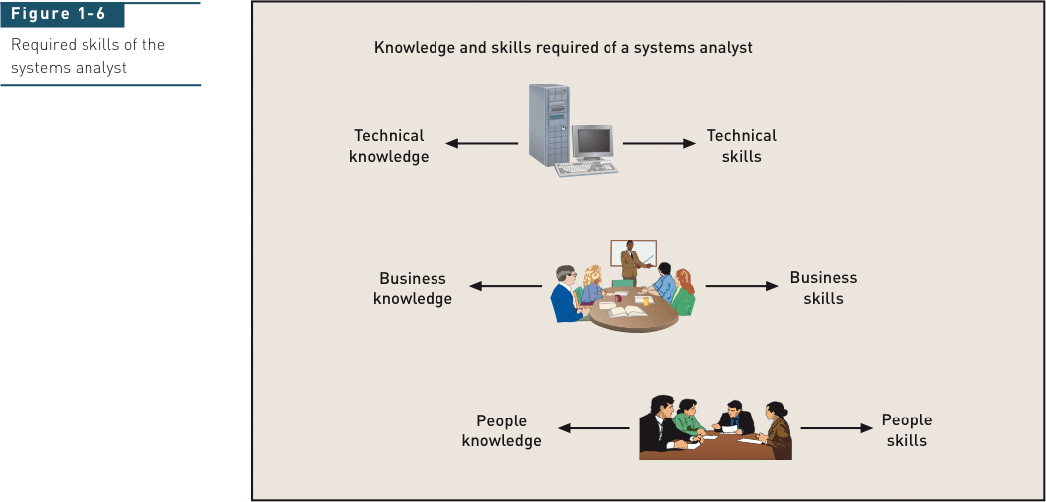
Analyst’s Approach to Problem Solving

Slide 14
Technical Knowledge and Skills
An analyst should have fundamental technology knowledge of
Computers / peripheral devices (hardware)
Communication networks and connectivity
Database and database management systems (DBMS)
Programming languages (for example, VB.NET or Java)
Operating systems and utilities

Slide 15
Technical Knowledge and Skills
Analyst uses tools
Software productivity packages
Integrated development environments (IDEs) for programming languages
CASE tools, testing, documentation support, reverse engineering, configuration management
Analyst understands SDLC techniques
Project planning, systems analysis
Systems design, database design, network design
Construction, implementation, systems support

Slide 16
Business Knowledge and Skills
Analyst must understand
Business functions performed by organization
Strategies, plans, traditions, and values of the organization
Organizational structure
Organization management techniques
Functional work processes
Systems analysts typically study business administration/management in college with a major in CIS or MIS

Slide 17
People Knowledge and Skills
Interpersonal and communication skills are crucial to
Obtaining information
Motivating people
Getting cooperation
Understanding the complexity and workings of an organization in order to provide necessary support

Slide 18
What is a requirement?
The system requirements are the descriptions of the system services and constraints that are generated during the requirements engineering process.
It may range from a high-level abstract statement of a service or of a system constraint to a detailed mathematical functional specification.

Slide 19
Types of requirement
User requirements
Statements in natural language plus diagrams of the services the system provides and its operational constraints. Written for customers.
System requirements
A structured document setting out detailed descriptions of the system’s functions, services and operational constraints. Defines what should be implemented so may be part of a contract between client and contractor.

Slide 20
User and system requirements

Slide 21
Readers of different types of requirements specification

Slide 22
Functional and non-functional requirements
Functional requirements
Statements of services the system should provide, how the system should react to particular inputs and how the system should behave in particular situations.
May state what the system should not do.
Non-functional requirements
Constraints on the services or functions offered by the system such as timing constraints, constraints on the development process, standards, etc.
Often apply to the system as a whole rather than individual features or services.

Slide 23
Functional requirements
Describe functionality or system services.
Depend on the type of software, expected users and the type of system where the software is used.
Functional user requirements may be high-level statements of what the system should do.
Functional system requirements should describe the system services in detail.

Slide 24
Mentcare system: functional requirements
A user shall be able to search the appointments lists for all clinics.
The system shall generate each day, for each clinic, a list of patients who are expected to attend appointments that day.
Each staff member using the system shall be uniquely identified by his or her 8-digit employee number.

Slide 25
Requirements imprecision
Problems arise when functional requirements are not precisely stated.
Ambiguous requirements may be interpreted in different ways by developers and users.
Consider the term ‘search’ in requirement 1
User intention – search for a patient name across all appointments in all clinics;
Developer interpretation – search for a patient name in an individual clinic. User chooses clinic then search.

Slide 26
Requirements completeness and consistency
In principle, requirements should be both complete and consistent.
Complete
They should include descriptions of all facilities required.
Consistent
There should be no conflicts or contradictions in the descriptions of the system facilities.
In practice, because of system and environmental complexity, it is impossible to produce a complete and consistent requirements document.

Slide 27
Non-functional requirements
These define system properties and constraints e.g. reliability, response time and storage requirements. Constraints are I/O device capability, system representations, etc.
Process requirements may also be specified mandating a particular IDE, programming language or development method.
Non-functional requirements may be more critical than functional requirements. If these are not met, the system may be useless.

Slide 28
Types of nonfunctional requirement

Slide 29
Non-functional requirements implementation
Non-functional requirements may affect the overall architecture of a system rather than the individual components.
For example, to ensure that performance requirements are met, you may have to organize the system to minimize communications between components.
A single non-functional requirement, such as a security requirement, may generate a number of related functional requirements that define system services that are required.
It may also generate requirements that restrict existing requirements.

Slide 30
Non-functional classifications
Product requirements
Requirements which specify that the delivered product must behave in a particular way e.g. execution speed, reliability, etc.
Organisational requirements
Requirements which are a consequence of organisational policies and procedures e.g. process standards used, implementation requirements, etc.
External requirements
Requirements which arise from factors which are external to the system and its development process e.g. interoperability requirements, legislative requirements, etc.

Slide 31
Examples of nonfunctional requirements in the Mentcare system
Product requirement The Mentcare system shall be available to all clinics during normal working hours (Mon–Fri, 0830–17.30). Downtime within normal working hours shall not exceed five seconds in any one day. Organizational requirement Users of the Mentcare system shall authenticate themselves using their health authority identity card. External requirement The system shall implement patient privacy provisions as set out in HStan-03-2006-priv.

Slide 32
Metrics for specifying nonfunctional requirements
Property | Measure
Speed | Processed transactions/second User/event response time Screen refresh time
Size | Mbytes Number of ROM chips
Ease of use | Training time Number of help frames
Reliability | Mean time to failure Probability of unavailability Rate of failure occurrence Availability
Robustness | Time to restart after failure Percentage of events causing failure Probability of data corruption on failure
Portability | Percentage of target dependent statements Number of target systems

Slide 33
Problems of requirements analysis
Stakeholders don’t know what they really want.
Stakeholders express requirements in their own terms.
Different stakeholders may have conflicting requirements.
Organisational and political factors may influence the system requirements.
The requirements change during the analysis process. New stakeholders may emerge and the business environment may change

Slide 34
Key points
Requirements for a software system set out what the system should do and define constraints on its operation and implementation.
Functional requirements are statements of the services that the system must provide or are descriptions of how some computations must be carried out.
Non-functional requirements often constrain the system being developed and the development process being used.
They often relate to the emergent properties of the system and therefore apply to the system as a whole.

Slide 35
GATHERING INFORMATION FOR REQUIREMENTS DISCOVERY

Slide 36
Techniques for Information Gathering
The process of gathering information about the required and existing systems and distilling the user and system requirements from this information.
Systems normally have a range of stakeholders.
Involves technical staff working with customers to find out about the application domain, the services that the system should provide and the system’s operational constraints.
May involve end-users, managers, engineers involved in maintenance, domain experts, trade unions, etc. These are called stakeholders.

Slide 37
Techniques for Information Gathering
Software engineers work with a range of system stakeholders to find out about the application domain, the services that the system should provide, the required system performance, hardware constraints, other systems, etc.

Slide 38
Techniques for Information Gathering Stakeholders in the MHC-PMS
Patients whose information is recorded in the system.
Doctors who are responsible for assessing and treating patients.
Nurses who coordinate the consultations with doctors and administer some treatments.
Medical receptionists who manage patients’ appointments.
IT staff who are responsible for installing and maintaining the system.

Slide 39
Techniques for Information Gathering Stakeholders in the MHC-PMS
A medical ethics manager who must ensure that the system meets current ethical guidelines for patient care.
Health care managers who obtain management information from the system.
Medical records staff who are responsible for ensuring that system information can be maintained and preserved, and that record keeping procedures have been properly implemented.

Slide 40
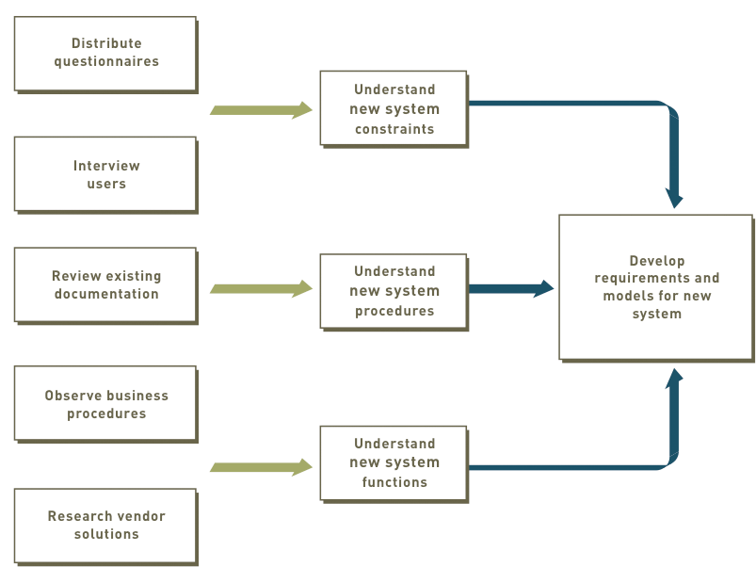
Techniques for Information Gathering - Relationship Between Information Gathering and Model Building

Slide 41
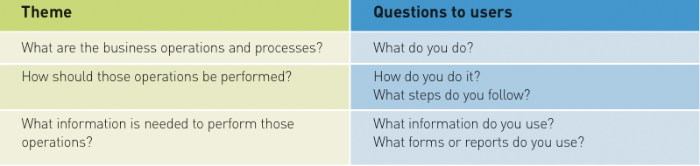
Techniques for Information Gathering - Themes for Information-Gathering Questions

Slide 42
Techniques for Information Gathering – Fact-Finding Methods
Review existing reports, forms, and procedure descriptions
Interview and discuss processes with users
Observe and document business processes
Build prototypes
Distribute and collect questionnaires
Conduct joint application design (JAD) sessions
Research vendor solutions

Slide 43
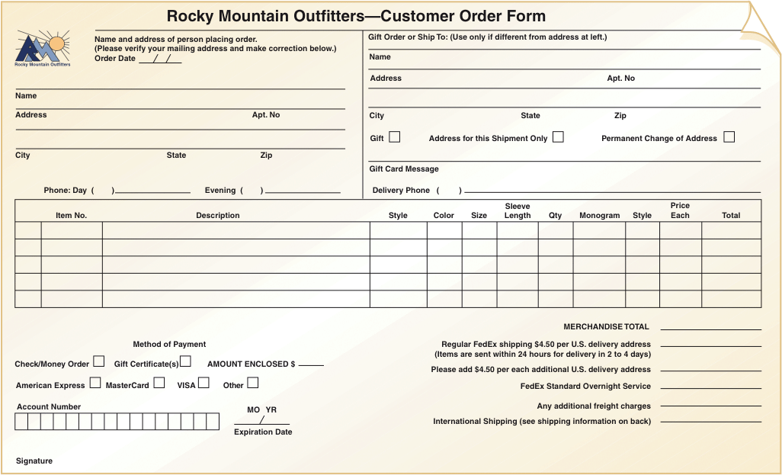
Techniques for Information Gathering – Fact-Finding Methods - Review Existing Reports, Forms, and Procedure Descriptions

Slide 44
Techniques for Information Gathering – Fact-Finding Methods - Conduct Interviews and Discussions with Users
Effective way to understand business functions and rules
Time consuming and resource expensive
May require multiple sessions to
Meet all users
Understand all processing requirements
Can meet with individuals or groups of users
List of detailed questions prepared

Slide 45
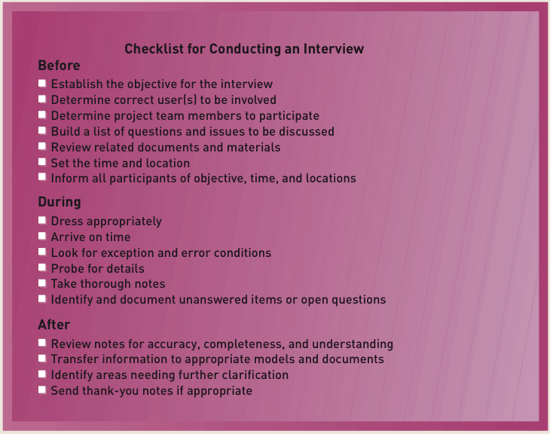
Techniques for Information Gathering – Fact-Finding Methods - Conduct Interviews and Discussions with Users

Slide 46
Techniques for Information Gathering – Fact-Finding Methods - Observe and Document Business Processes
Varies from office walkthroughs to performing actual tasks
Not necessary to observe all processes at same level of detail
May make users nervous, so use common sense
Can document workflows with UML activity diagrams

Slide 47
Techniques for Information Gathering – Fact-Finding Methods - Build Prototypes
Preliminary working model of a larger, more complex system component
Discovery, design, evolving prototypes
Prototype should be
Operative
Working model to provide “look and feel”
Focused to accomplish single objective
Quick
Built and modified rapidly with CASE tools

Slide 48
Techniques for Information Gathering – Fact-Finding Methods - Distribute and Collect Questionnaires
Limited and specific information from a large number of stakeholders
Preliminary insight into business
Not well suited for gathering detailed information
Closed-ended questions direct person answering question
Open-ended questions encourage discussion and elaboration

Slide 49
Techniques for Information Gathering – Fact-Finding Methods - Conduct Joint Application Design Sessions
Fast and efficient investigation of system requirements
Seeks to compress fact-finding, modeling, policy formation, and verification activities into shorter time frame
Critical factor is to have all important stakeholders present

Slide 50
Techniques for Information Gathering – Fact-Finding Methods - Joint Application Design Participants
Session leader trained in group dynamics and JAD group facilitation
Knowledgeable business and system users and policy makers
Technical staff representatives to handle
Computer and network configurations
Operating environments
Security issues
Project team members

Slide 51
Techniques for Information Gathering – Fact-Finding Methods - Joint Application Design Facility
Conducted in special room
Limit interruptions
May be off-site
Resources
Overhead projector, white board, flip charts, work material
Electronic support (laptops)
CASE tools
Group support systems (GSS)

Slide 52
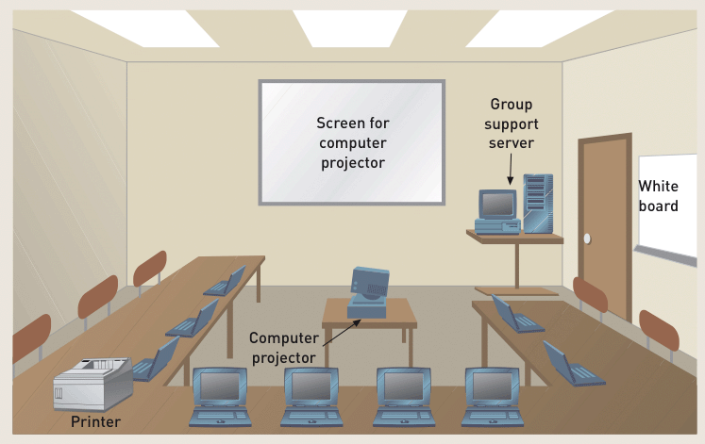
Techniques for Information Gathering – Fact-Finding Methods - A Joint Application Design Facility

Slide 53
Techniques for Information Gathering – Fact-Finding Methods - Research Vendor Solutions
Many problems have been solved by other companies
Positive contributions of vendor solutions
Frequently provide new ideas
May be state of the art
Cheaper and less risky
Danger
May purchase solution before understanding problem

Slide 54
Techniques for Information Gathering – Fact-Finding Methods - Useful Techniques in Vendor Research
Technical specifications from vendor
Demo or trial system
References of existing clients
On-site visits
Printout of screens and reports

Slide 55
Requirements specification

Slide 56
Requirements specification
The process of writing down the user and system requirements in a requirements document.
User requirements have to be understandable by end-users and customers who do not have a technical background.
System requirements are more detailed requirements and may include more technical information.
The requirements may be part of a contract for the system development
It is therefore important that these are as complete as possible.

Slide 57
Ways of writing a system requirements specification
Notation | Description
Natural language | The requirements are written using numbered sentences in natural language. Each sentence should express one requirement.
Structured natural language | The requirements are written in natural language on a standard form or template. Each field provides information about an aspect of the requirement.
Design description languages | This approach uses a language like a programming language, but with more abstract features to specify the requirements by defining an operational model of the system. This approach is now rarely used although it can be useful for interface specifications.
Graphical notations | Graphical models, supplemented by text annotations, are used to define the functional requirements for the system; UML use case and sequence diagrams are commonly used.
Mathematical specifications | These notations are based on mathematical concepts such as finite-state machines or sets. Although these unambiguous specifications can reduce the ambiguity in a requirements document, most customers don’t understand a formal specification. They cannot check that it represents what they want and are reluctant to accept it as a system contract

Slide 58
Requirements and design
In principle, requirements should state what the system should do and the design should describe how it does this.
In practice, requirements and design are inseparable
A system architecture may be designed to structure the requirements;
The system may inter-operate with other systems that generate design requirements;
The use of a specific architecture to satisfy non-functional requirements may be a domain requirement.
This may be the consequence of a regulatory requirement.

Slide 59
Natural language specification
Requirements are written as natural language sentences supplemented by diagrams and tables.
Used for writing requirements because it is expressive, intuitive and universal. This means that the requirements can be understood by users and customers.

Slide 60
Guidelines for writing requirements
Invent a standard format and use it for all requirements.
Use language in a consistent way. Use shall for mandatory requirements, should for desirable requirements.
Use text highlighting to identify key parts of the requirement.
Avoid the use of computer jargon.
Include an explanation (rationale) of why a requirement is necessary.

Slide 61
Problems with natural language
Lack of clarity
Precision is difficult without making the document difficult to read.
Requirements confusion
Functional and non-functional requirements tend to be mixed-up.
Requirements amalgamation
Several different requirements may be expressed together.

Slide 62
Example requirements for the insulin pump software system
3.2 The system shall measure the blood sugar and deliver insulin, if required, every 10 minutes. (Changes in blood sugar are relatively slow so more frequent measurement is unnecessary; less frequent measurement could lead to unnecessarily high sugar levels.) 3.6 The system shall run a self-test routine every minute with the conditions to be tested and the associated actions defined in Table 1. (A self-test routine can discover hardware and software problems and alert the user to the fact the normal operation may be impossible.)

Slide 63
Structured specifications
An approach to writing requirements where the freedom of the requirements writer is limited and requirements are written in a standard way.
This works well for some types of requirements e.g. requirements for embedded control system but is sometimes too rigid for writing business system requirements.

Slide 64
Form-based specifications
Definition of the function or entity.
Description of inputs and where they come from.
Description of outputs and where they go to.
Information about the information needed for the computation and other entities used.
Description of the action to be taken.
Pre and post conditions (if appropriate).
The side effects (if any) of the function.

Slide 65
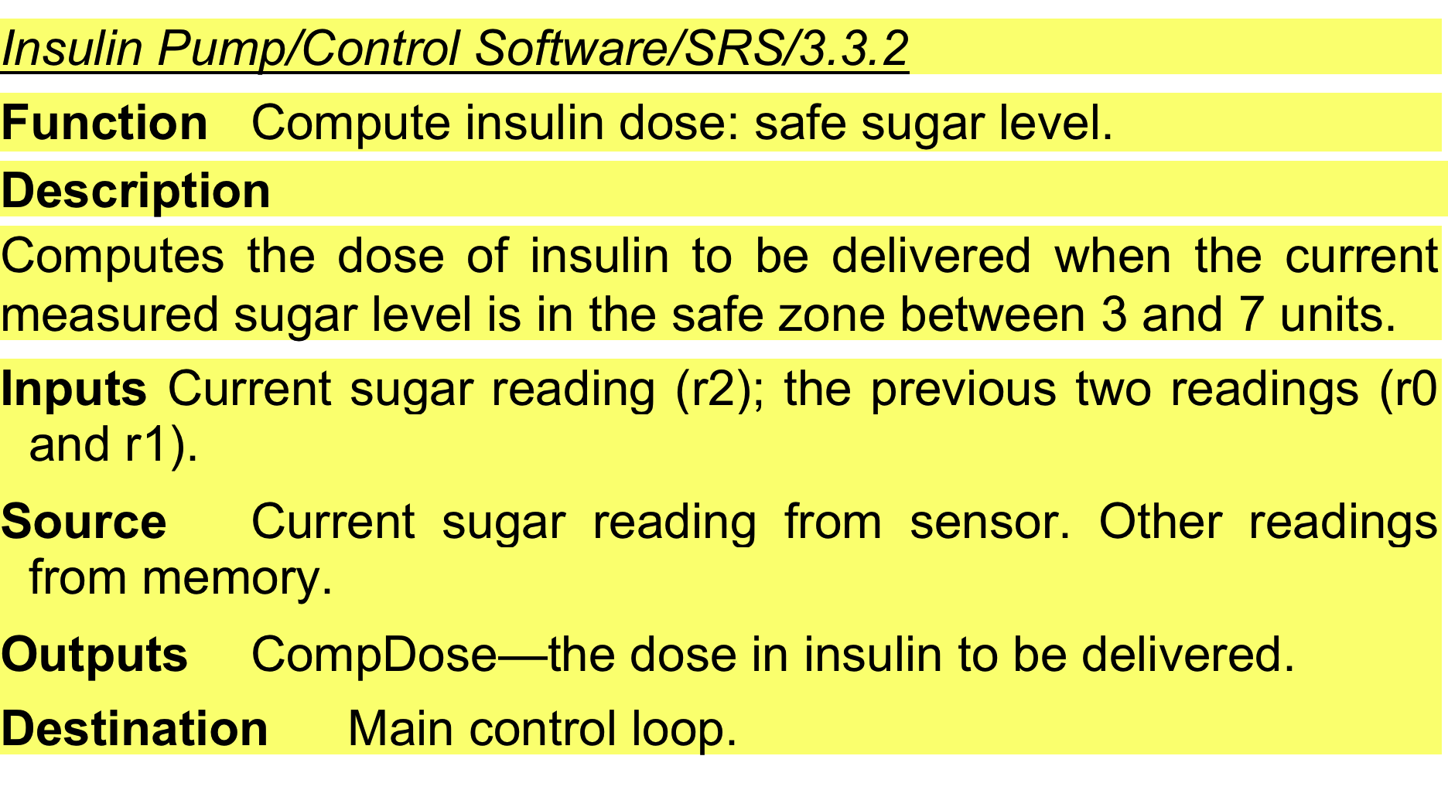
A structured specification of a requirement for an insulin pump

Slide 66
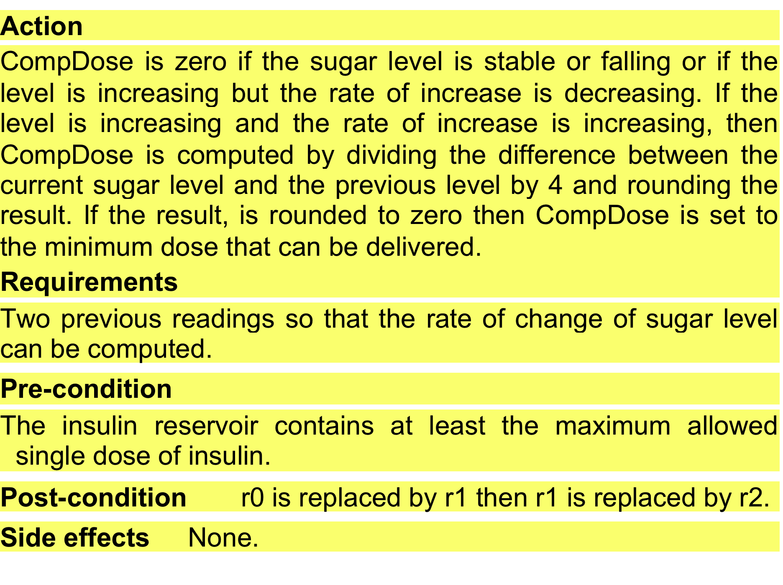
A structured specification of a requirement for an insulin pump

Slide 67
Tabular specification
Used to supplement natural language.
Particularly useful when you have to define a number of possible alternative courses of action.
For example, the insulin pump systems bases its computations on the rate of change of blood sugar level and the tabular specification explains how to calculate the insulin requirement for different scenarios.

Slide 68
Tabular specification of computation for an insulin pump
Condition | Action
Sugar level falling (r2 < r1) | CompDose = 0
Sugar level stable (r2 = r1) | CompDose = 0
Sugar level increasing and rate of increase decreasing ((r2 – r1) < (r1 – r0)) | CompDose = 0
Sugar level increasing and rate of increase stable or increasing ((r2 – r1) ≥ (r1 – r0)) | CompDose = round ((r2 – r1)/4) If rounded result = 0 then CompDose = MinimumDose

Slide 69
Use cases
Use-cases are a kind of scenario that are included in the UML.
Use cases identify the actors in an interaction and which describe the interaction itself.
A set of use cases should describe all possible interactions with the system.
High-level graphical model supplemented by more detailed tabular description (see Chapter 5).
UML sequence diagrams may be used to add detail to use-cases by showing the sequence of event processing in the system.

Slide 70
Use cases for the Mentcare system

Slide 71
The software requirements document
The software requirements document is the official statement of what is required of the system developers.
Should include both a definition of user requirements and a specification of the system requirements.
It is NOT a design document. As far as possible, it should set of WHAT the system should do rather than HOW it should do it.

Slide 72
Users of a requirements document

Slide 73
Requirements document variability
Information in requirements document depends on type of system and the approach to development used.
Systems developed incrementally will, typically, have less detail in the requirements document.
Requirements documents standards have been designed e.g. IEEE standard. These are mostly applicable to the requirements for large systems engineering projects.

Slide 74
The structure of a requirements document
Chapter | Description
Preface | This should define the expected readership of the document and describe its version history, including a rationale for the creation of a new version and a summary of the changes made in each version.
Introduction | This should describe the need for the system. It should briefly describe the system’s functions and explain how it will work with other systems. It should also describe how the system fits into the overall business or strategic objectives of the organization commissioning the software.
Glossary | This should define the technical terms used in the document. You should not make assumptions about the experience or expertise of the reader.
User requirements definition | Here, you describe the services provided for the user. The nonfunctional system requirements should also be described in this section. This description may use natural language, diagrams, or other notations that are understandable to customers. Product and process standards that must be followed should be specified.
System architecture | This chapter should present a high-level overview of the anticipated system architecture, showing the distribution of functions across system modules. Architectural components that are reused should be highlighted.

Slide 75
The structure of a requirements document
Chapter | Description
System requirements specification | This should describe the functional and nonfunctional requirements in more detail. If necessary, further detail may also be added to the nonfunctional requirements. Interfaces to other systems may be defined.
System models | This might include graphical system models showing the relationships between the system components and the system and its environment. Examples of possible models are object models, data-flow models, or semantic data models.
System evolution | This should describe the fundamental assumptions on which the system is based, and any anticipated changes due to hardware evolution, changing user needs, and so on. This section is useful for system designers as it may help them avoid design decisions that would constrain likely future changes to the system.
Appendices | These should provide detailed, specific information that is related to the application being developed; for example, hardware and database descriptions. Hardware requirements define the minimal and optimal configurations for the system. Database requirements define the logical organization of the data used by the system and the relationships between data.
Index | Several indexes to the document may be included. As well as a normal alphabetic index, there may be an index of diagrams, an index of functions, and so on.

Slide 76
Requirements validation

Slide 77
Requirements validation
Concerned with demonstrating that the requirements define the system that the customer really wants.
Requirements error costs are high so validation is very important
Fixing a requirements error after delivery may cost up to 100 times the cost of fixing an implementation error.

Slide 78
Requirements checking
Validity. Does the system provide the functions which best support the customer’s needs?
Consistency. Are there any requirements conflicts?
Completeness. Are all functions required by the customer included?
Realism. Can the requirements be implemented given available budget and technology
Verifiability. Can the requirements be checked?

Slide 79
Requirements validation techniques
Requirements reviews
Systematic manual analysis of the requirements.
Prototyping
Using an executable model of the system to check requirements. Covered in Chapter 2.
Test-case generation
Developing tests for requirements to check testability.

Slide 80
Requirements reviews
Regular reviews should be held while the requirements definition is being formulated.
Both client and contractor staff should be involved in reviews.
Reviews may be formal (with completed documents) or informal. Good communications between developers, customers and users can resolve problems at an early stage.

Slide 81
Review checks
Verifiability
Is the requirement realistically testable?
Comprehensibility
Is the requirement properly understood?
Traceability
Is the origin of the requirement clearly stated?
Adaptability
Can the requirement be changed without a large impact on other requirements?

Slide 82
Requirements change

Slide 83
Changing requirements
The business and technical environment of the system always changes after installation.
New hardware may be introduced, it may be necessary to interface the system with other systems, business priorities may change (with consequent changes in the system support required), and new legislation and regulations may be introduced that the system must necessarily abide by.
The people who pay for a system and the users of that system are rarely the same people.
System customers impose requirements because of organizational and budgetary constraints. These may conflict with end-user requirements and, after delivery, new features may have to be added for user support if the system is to meet its goals.

Slide 84
Changing requirements
Large systems usually have a diverse user community, with many users having different requirements and priorities that may be conflicting or contradictory.
The final system requirements are inevitably a compromise between them and, with experience, it is often discovered that the balance of support given to different users has to be changed.

Slide 85
Requirements evolution

Slide 86
Requirements management
Requirements management is the process of managing changing requirements during the requirements engineering process and system development.
New requirements emerge as a system is being developed and after it has gone into use.
You need to keep track of individual requirements and maintain links between dependent requirements so that you can assess the impact of requirements changes. You need to establish a formal process for making change proposals and linking these to system requirements.

Slide 87
Requirements management planning
Establishes the level of requirements management detail that is required.
Requirements management decisions:
Requirements identification Each requirement must be uniquely identified so that it can be cross-referenced with other requirements.
A change management process This is the set of activities that assess the impact and cost of changes. I discuss this process in more detail in the following section.
Traceability policies These policies define the relationships between each requirement and between the requirements and the system design that should be recorded.
Tool support Tools that may be used range from specialist requirements management systems to spreadsheets and simple database systems.

Slide 88
Requirements change management
Deciding if a requirements change should be accepted
Problem analysis and change specification
During this stage, the problem or the change proposal is analyzed to check that it is valid. This analysis is fed back to the change requestor who may respond with a more specific requirements change proposal, or decide to withdraw the request.
Change analysis and costing
The effect of the proposed change is assessed using traceability information and general knowledge of the system requirements. Once this analysis is completed, a decision is made whether or not to proceed with the requirements change.
Change implementation
The requirements document and, where necessary, the system design and implementation, are modified. Ideally, the document should be organized so that changes can be easily implemented.

Slide 89
Requirements change management

Slide 90
Key points
Requirements for a software system set out what the system should do and define constraints on its operation and implementation.
Functional requirements are statements of the services that the system must provide or are descriptions of how some computations must be carried out.
Non-functional requirements often constrain the system being developed and the development process being used.
They often relate to the emergent properties of the system and therefore apply to the system as a whole.

Slide 91
Key points
The requirements engineering process is an iterative process that includes requirements elicitation, specification and validation.
Requirements elicitation is an iterative process that can be represented as a spiral of activities – requirements discovery, requirements classification and organization, requirements negotiation and requirements documentation.
You can use a range of techniques for requirements elicitation including interviews and ethnography. User stories and scenarios may be used to facilitate discussions.

Slide 92
Key points
Requirements specification is the process of formally documenting the user and system requirements and creating a software requirements document.
The software requirements document is an agreed statement of the system requirements. It should be organized so that both system customers and software developers can use it.

Slide 93
Key points
Requirements validation is the process of checking the requirements for validity, consistency, completeness, realism and verifiability.
Business, organizational and technical changes inevitably lead to changes to the requirements for a software system. Requirements management is the process of managing and controlling these changes.

Slide 94
Chapter 4 of Software Engineering 9th Edition, Sommerville
Chapter 4 of System Analysis and Design in A Changing World, 4th Edition
Chapter 4 of Software Engineering 10th Edition, Sommerville

