Slide 1

GREEN GUARDIANS DISEASE DETECTION IN PLANTS USING MACHINE LEARNING
David , Sarah

Slide 2
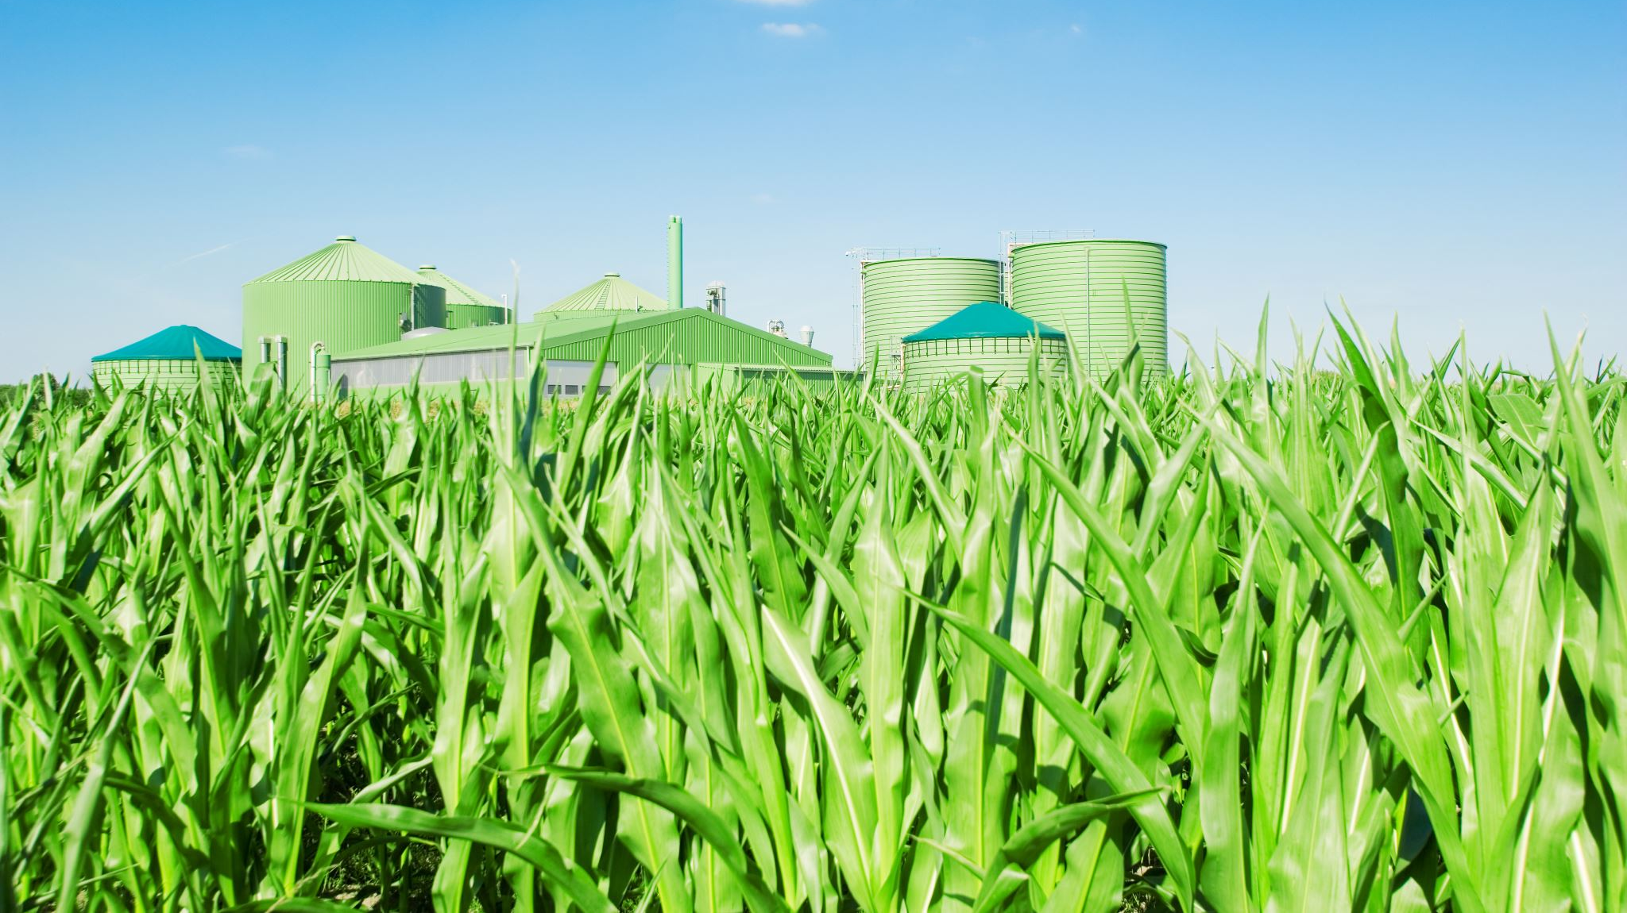
INTRODUCTION
Plant health is crucial for agriculture and food security, but traditional methods of detecting plant diseases are slow, prone to human error, and inefficient for large-scale farming.
This project aims to develop an automated solution using Machine Learning, specifically Support Vector Machines (SVM), to detect plant diseases by analyzing leaf images. By leveraging key visual features such as color, texture, and shape, the system aims to improve accuracy and efficiency in identifying plant diseases compared to manual inspection methods.

Slide 3
Objectives
The primary objective of this project is to develop an ML-based solution using Support Vector Machines (SVM) to classify plant diseases based on image features extracted from leaf samples. Specific objectives include:
Feature Extraction: Develop an efficient method to extract relevant features (color, texture, and shape) from plant leaf images.
Model Development: Train and fine-tune the SVM model to accurately classify plants as healthy or diseased.
Evaluation: Assess the performance of the SVM model using metrics such as accuracy, precision, and recall to ensure its reliability.
Scalability: Create a system that can be scaled to different types of crops and diseases, providing a general solution for various agricultural needs.

Slide 4
Problem Description
Agriculture faces major challenges in combating plant diseases that can cause extensive damage to crops. Early detection of these diseases is critical for mitigating losses and implementing effective interventions. However, manual detection methods suffer from several limitations: These limitations include:
Time-Intensive: Large-scale farming makes it difficult to inspect every plant thoroughly.
Subjectivity: Disease detection depends on human expertise, which can vary widely between inspectors.
Delayed Detection: Many diseases exhibit subtle early symptoms that can be easily missed.
These challenges underscore the need for a more reliable, scalable, and automated approach to plant disease detection.

Slide 5
SUPPORT VECTOR MACHINES - SVM
What is SVM?
SVM is a supervised ML algorithm used for classification tasks.
It works by finding the optimal hyperplane that separates data points from different classes.
Key Idea: Maximize the margin between the data points and the hyperplane, ensuring the best separation between healthy and diseased plants.
SVM Kernels:
Linear Kernel
Polynomial Kernel
Radial Basis Function (RBF) Kernel (often used for non-linear separations)

Slide 6
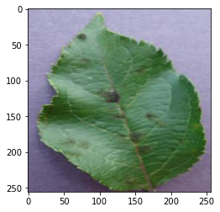
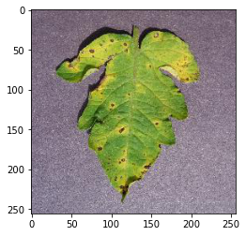
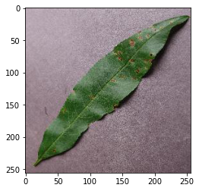
About the Dataset
The dataset to be explored will be obtained from Kaggle.
This dataset consists of about 87K rgb images of healthy and diseased crop leaves which is categorized into different classes.
Some of the classes
- Pepper__bell___healthy
- Tomato_Early_blight
- Tomato_Septoria_leaf_spot

Slide 7

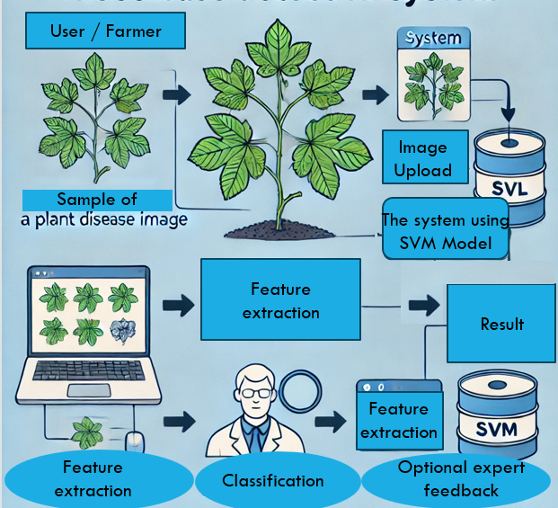
Use case diagram
Image Upload: The Farmer/User uploads an image of a diseased plant.
Feature Extraction: The system extracts features from the leaf image using the machine learning model.
Classification Using SVM: The SVM model (Support Vector Machine) processes the features to classify the plant as healthy or diseased.
Optional Expert Feedback: The system provides an option for an expert to verify the results if needed.

Slide 8

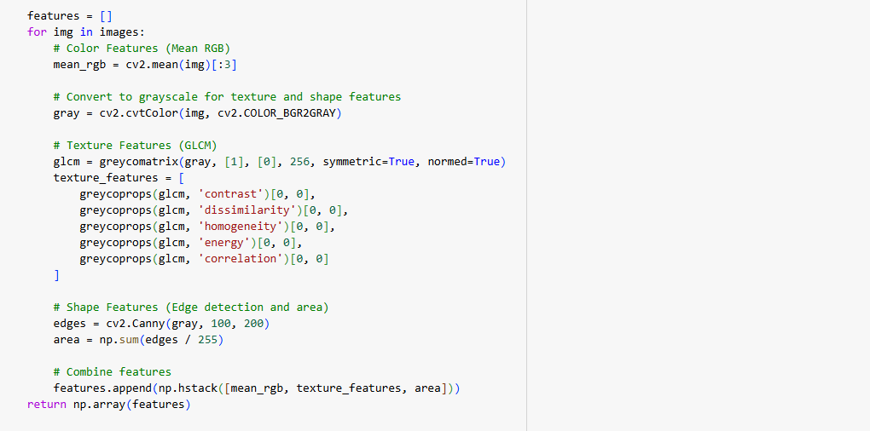
Data Preprocessing
Data Collection:
Images of healthy and diseased plant leaves from Kaggle.
Covers crops like apple, tomato, rice, and potato.
Feature Extraction:
Color: Mean RGB values.
Texture: Gray Level Co-occurrence Matrix (GLCM).
Shape: Geometric properties (area, perimeter, edge detection).

Slide 9
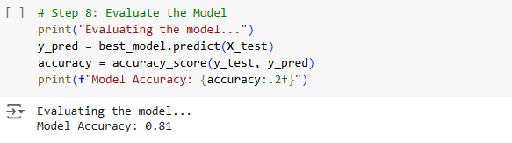
Model Training
SVM Model Training:
Data split: 80% training, 20% testing.
Kernels: Linear and Radial Basis Function (RBF).
The kernel that will be utilized eventually will depend on the complexity encountered with the dataset. This is because a Linear Kernel is used when the data is simple and can be separated with a straight line while the Radial Basis Function (RBF) Kernel is used for more complex data that requires a curved boundary for separation.
Hyperparameter Tuning: Optimizing C and gamma.
C will control how strict the model is about making mistakes, and gamma will help us determine how far the influence of a single data point reaches. Adjusting these helps the model perform better.
Model Evaluation:
Metrics: Accuracy, Precision, Recall.
Confusion Matrix for classification performance.

Slide 10
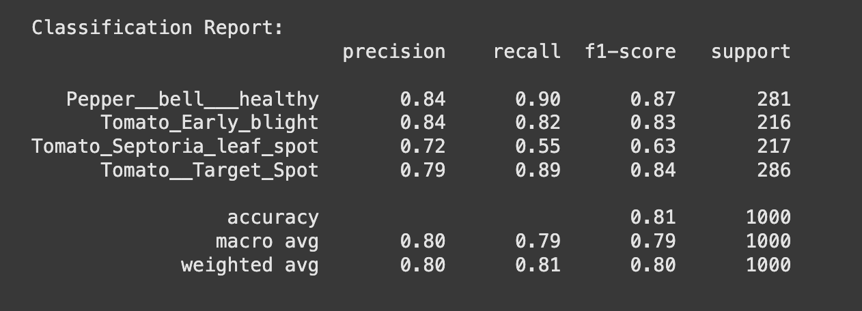
Training Results
Our plant disease classifier achieved an overall accuracy of 81% on the test dataset. Key performance metrics include:
Precision: High for classes like "Pepper__bell___healthy" (84%) and "Tomato_Early_blight" (84%).
Recall: Best performance observed in "Tomato__Target_Spot" (89%).
F1-Score: Ranges from 0.63 (Tomato_Septoria_leaf_spot) to 0.87 (Pepper__bell___healthy), indicating strong performance in most categories.

Slide 11
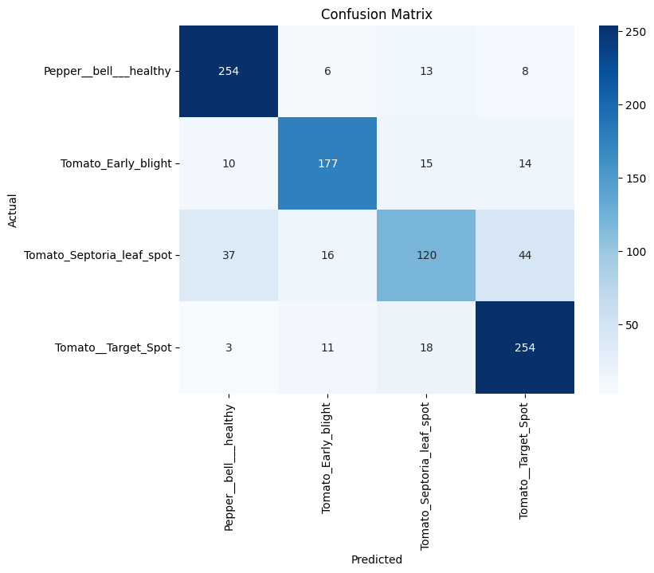
Confusion Metrix

Slide 12
Confusion Metrix ANALYSIS
The confusion matrix visualizes how well the model classifies plant diseases by showing the relationship between actual and predicted classes:
Diagonal values (e.g., 254 for "Pepper__bell___healthy") indicate correct predictions. Higher numbers here are better.
Off-diagonal values (e.g., 37 for actual "Tomato_Septoria_leaf_spot” predicted as "Pepper__bell___healthy") represent misclassifications.
For example:
- The model correctly predicted 254 "Pepper__bell___healthy" but misclassified 27 as other classes.
- Similarly, 177 "Tomato_Early_blight" cases were correct, but 39 were misclassified.
- Overall, the matrix highlights where the model performs well (high numbers on the diagonal) and where it struggles (higher off-diagonal numbers).

Slide 13

CHALLENGES AND LIMITATIONS
Feature Engineering: The performance of SVM heavily depends on the quality of features extracted.
High-Dimensional Data: SVM struggles with large, complex datasets (e.g., high-resolution images).
Kernel Selection: Choosing the right kernel is crucial for achieving good results.

Slide 14
contributions
Sarah
Data Collection & Preprocessing: Gather the plant disease dataset from Kaggle, ensuring it contains images of healthy and diseased plant leaves. She will also preprocess the data, including image resizing, normalization, and splitting into training and testing sets.
Feature Extraction: Extract key features from the images, such as color, texture, and shape, using image processing techniques.
Model Evaluation: Focus on evaluating the performance of the SVM model, generating accuracy metrics and confusion matrices.
David
Model Training: Implementing the SVM model. He will experiment with different SVM kernels (linear, RBF) and optimize hyperparameters (C, gamma) to achieve the best results.
Use-Case Diagram and System Workflow: Create the use-case diagram and ensure that the system's overall workflow is well-structured and documented in the presentation.
Reference Code & Implementation: Provide links to reference code and implementations for similar projects, ensuring the team has access to reusable and adaptable code resources.

Slide 15
RELATED Past WorkS
We will be reviewing these past works that have explored the use of machine learning techniques for plant disease detection, showcasing different approaches, datasets, and algorithms to improve the accuracy of early identification:
Mohanty et al. (2016): This research pioneered the use of deep learning models for plant disease identification, particularly Convolutional Neural Networks (CNNs). The authors demonstrated how large image datasets could be leveraged to train neural networks to accurately classify plant diseases. The study's approach was a significant shift from traditional image processing techniques to data-driven machine learning models.
Anjna et al. (2020): In this study, researchers explored various machine learning algorithms such as Random Forest and K-Nearest Neighbors for plant disease detection. Their work compared different models in terms of performance metrics like accuracy and recall. They also investigated how different feature extraction methods, such as color and texture analysis, impacted the performance of these models.
Genaev et al. (2021): This study focused on using Support Vector Machines (SVM) for plant disease classification, particularly for detecting diseases in crops like tomatoes and rice. The researchers experimented with different kernels in the SVM algorithm to optimize the classification of diseased and healthy plant samples. Their work highlighted the challenges of feature engineering and the importance of tuning model hyperparameters for better accuracy.

Slide 16

Thank you!

