Slide 1


Proposed BI Architecture CST2210: Intro to BI Architecture
Prepared by:
Ahmed Aldery
Fatma Bezine
Ifeoluwa Ibidun
Oluwatomiloba Omoloba
Feb. 21, 2023

Slide 2
Contents
Executive Summary
Information Architecture
Application Architecture
Technology Architecture
Future State Architecture

Slide 3
Executive Summary
A change in approach from a large enterprise-wide BI project to a phased approach in implementation, to the College.
Kimball model
Aws for cloud service provision to combat the lack of servers and storage.
Integrating the AC Way journey from the Business plan into the development of the project
Future state diagram
IBM Cognos

Slide 4
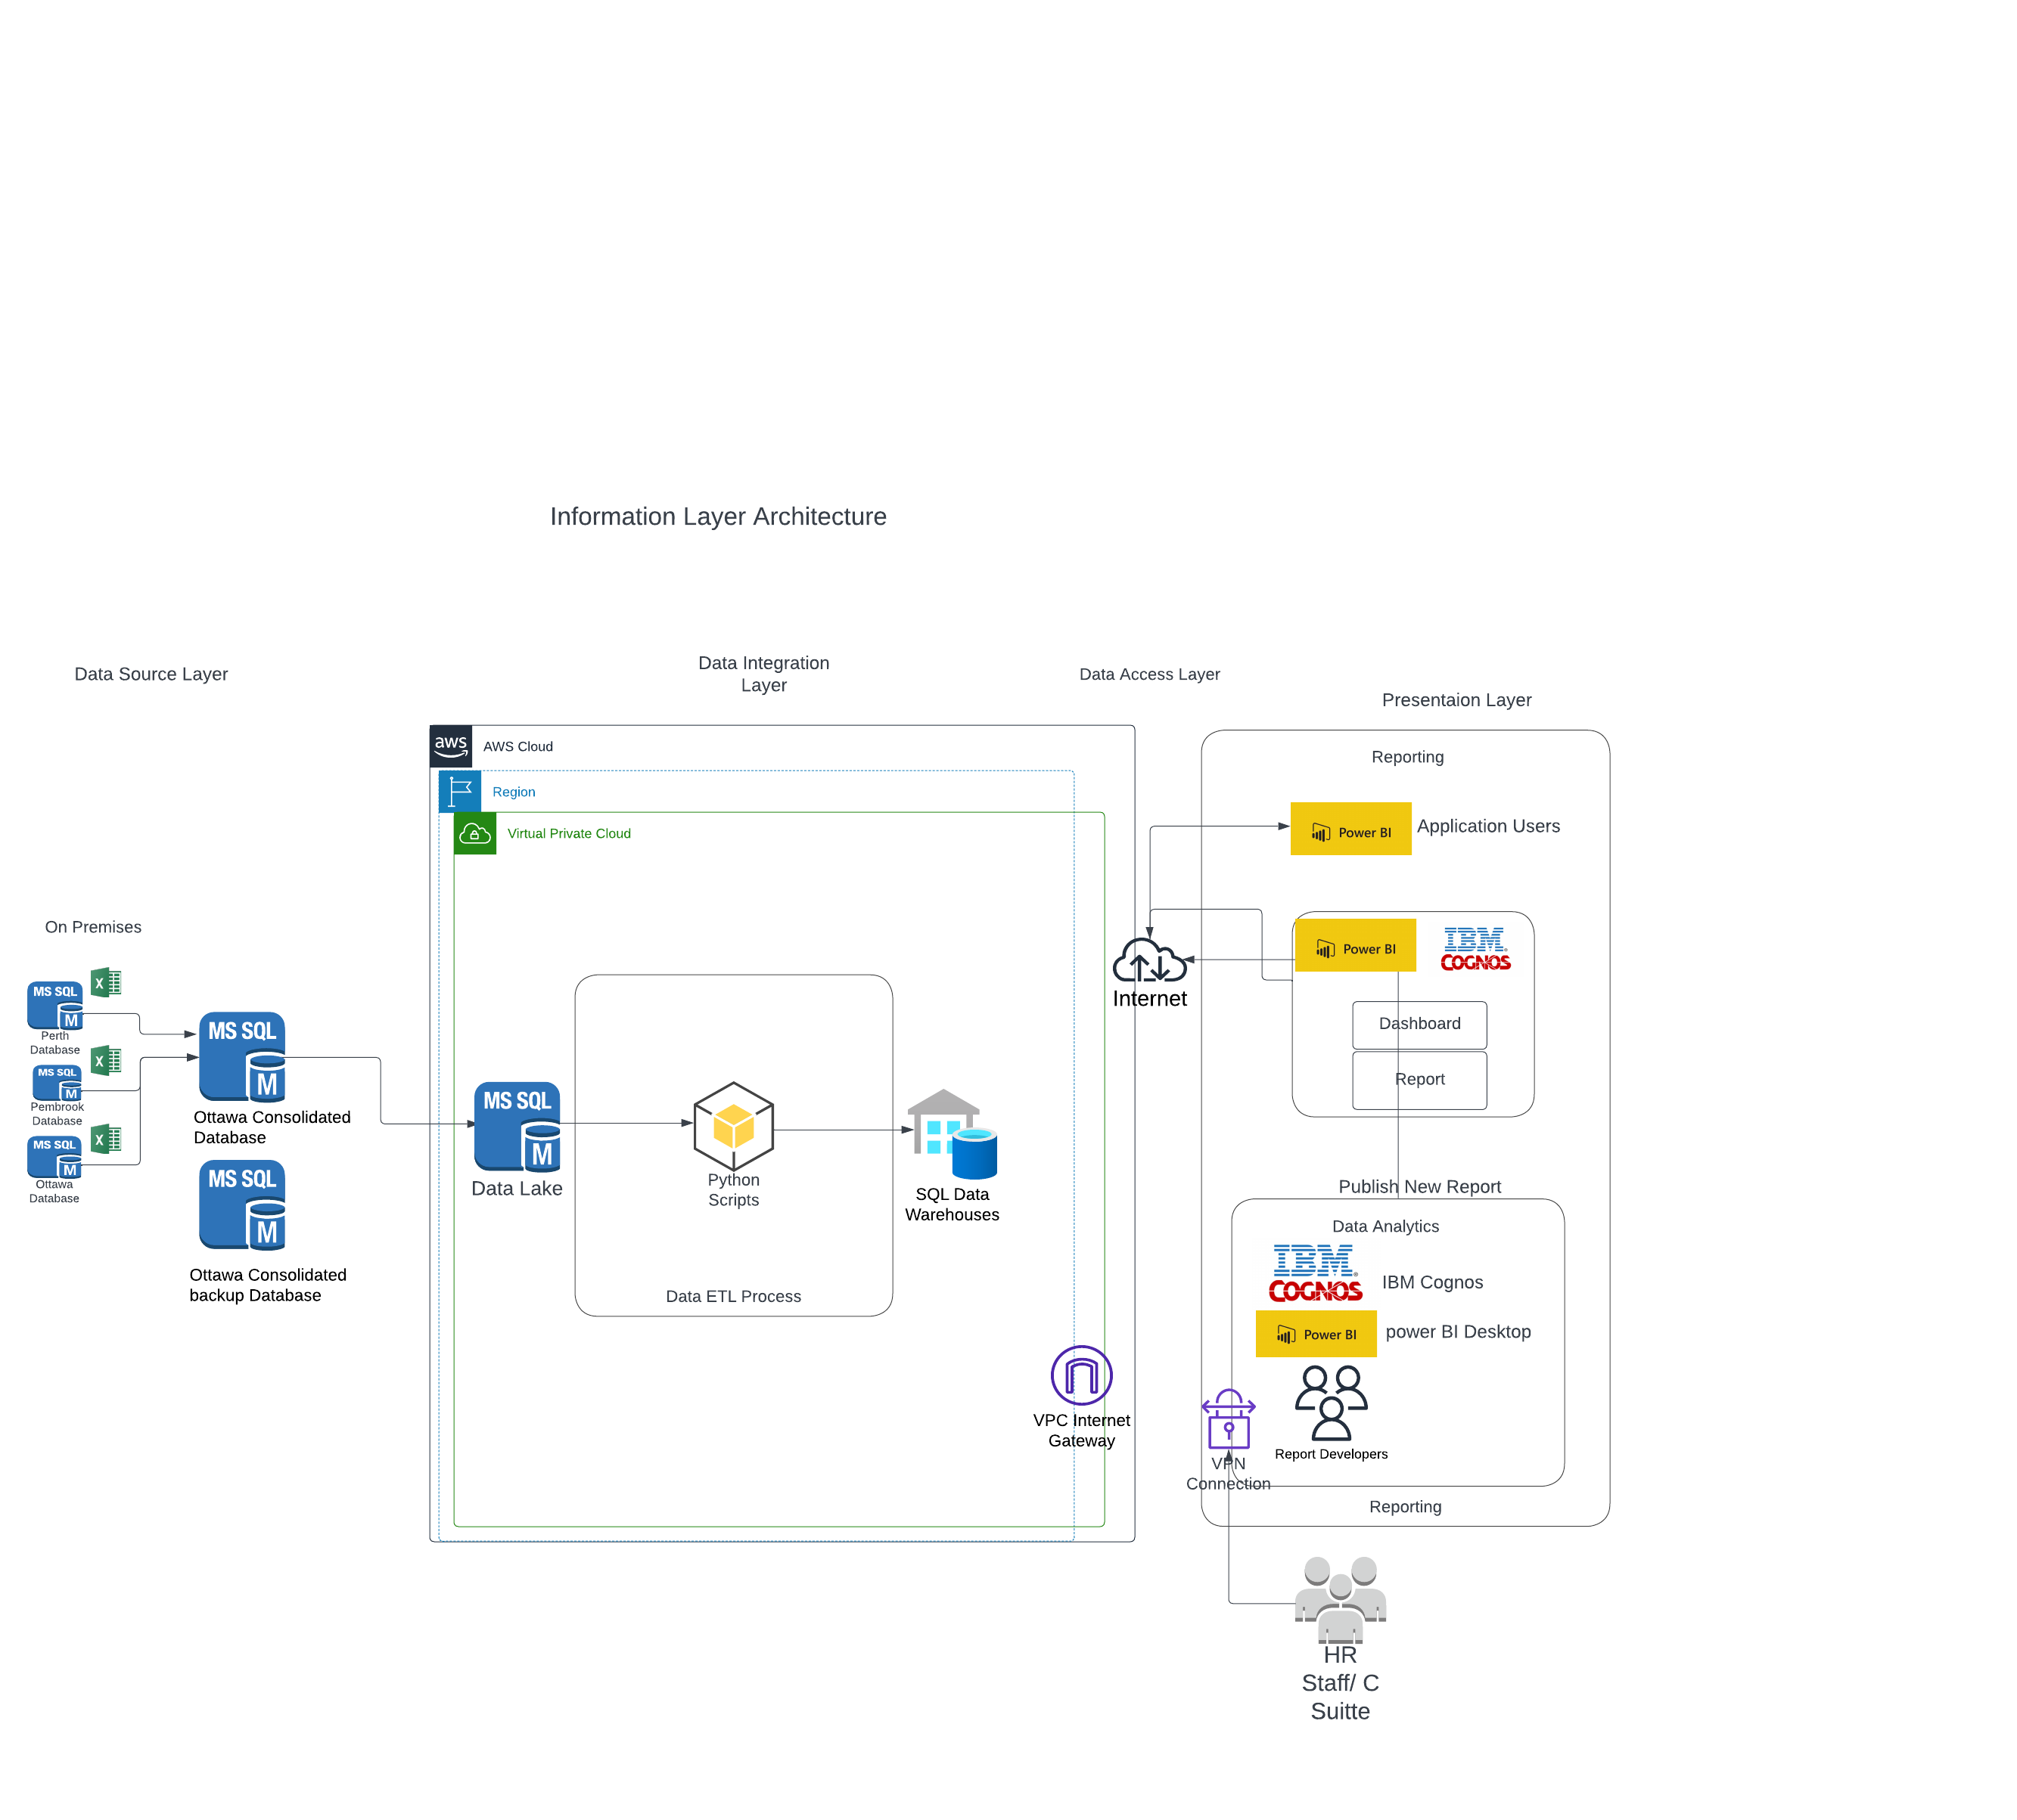
Information Architecture

Slide 5
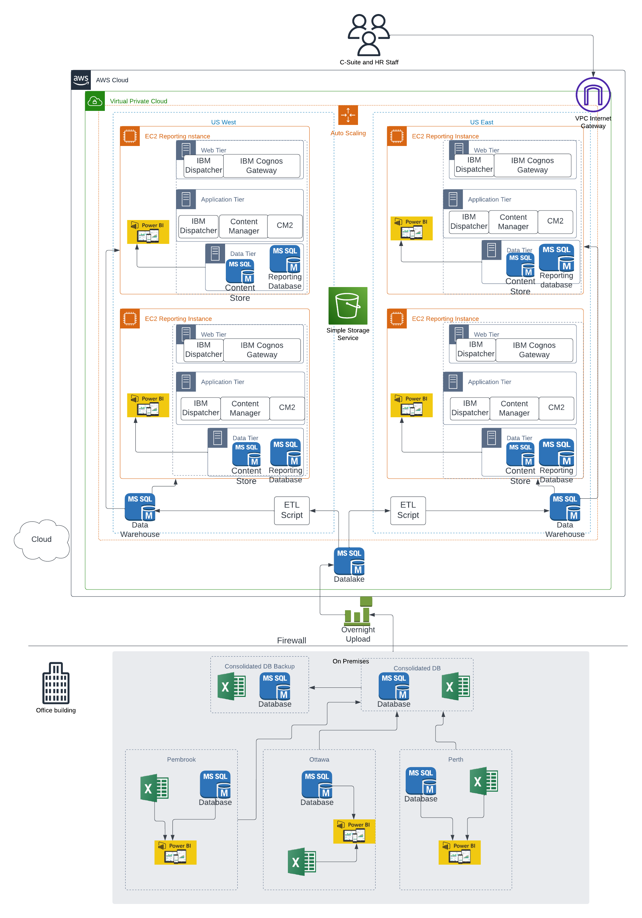
Application Architecture

Slide 6
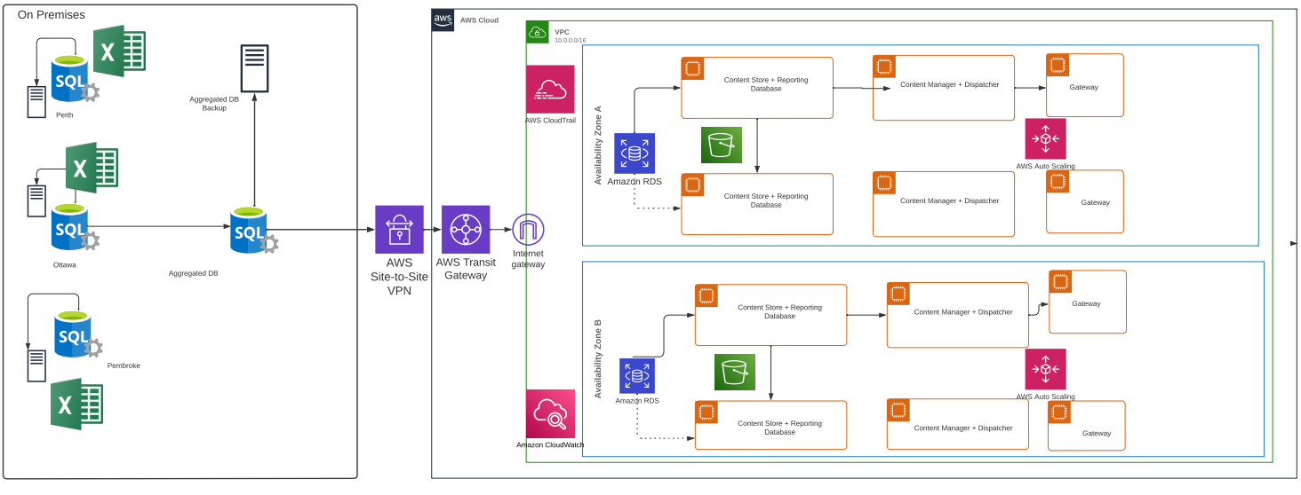
Technology Architecture

Slide 7
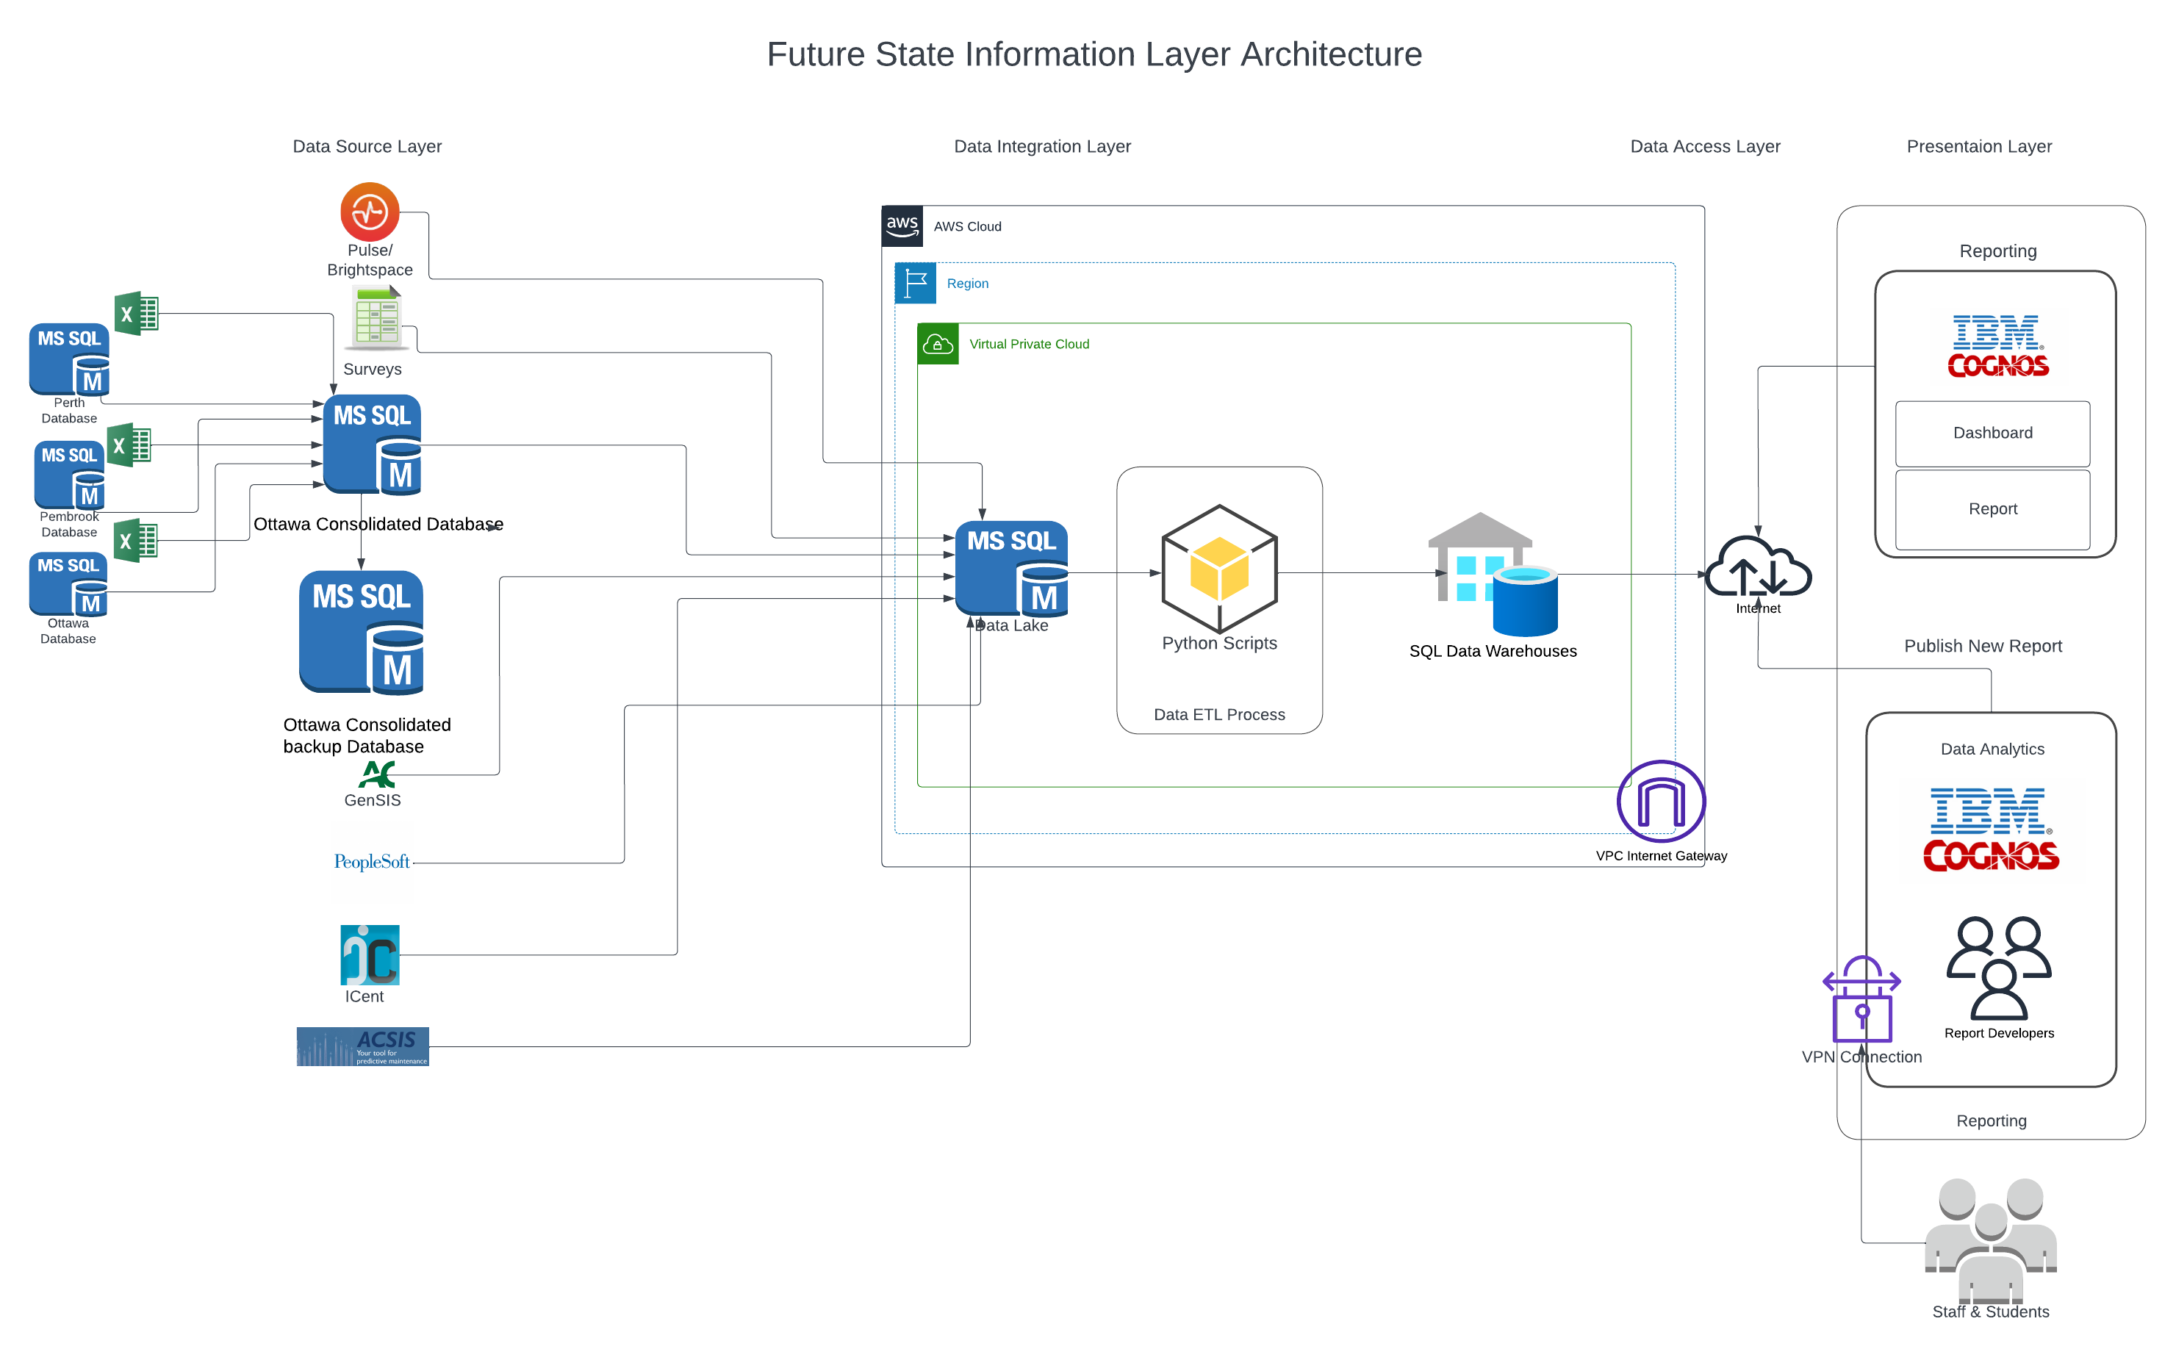
Future State Architecture

Slide 8

Questions

