Slide 1
Tutorial: Effective Visual Aids
Department of Humanities
New York City College of Technology

Slide 2
Photographs
Person
Place
Object
Effective Labels

Slide 3
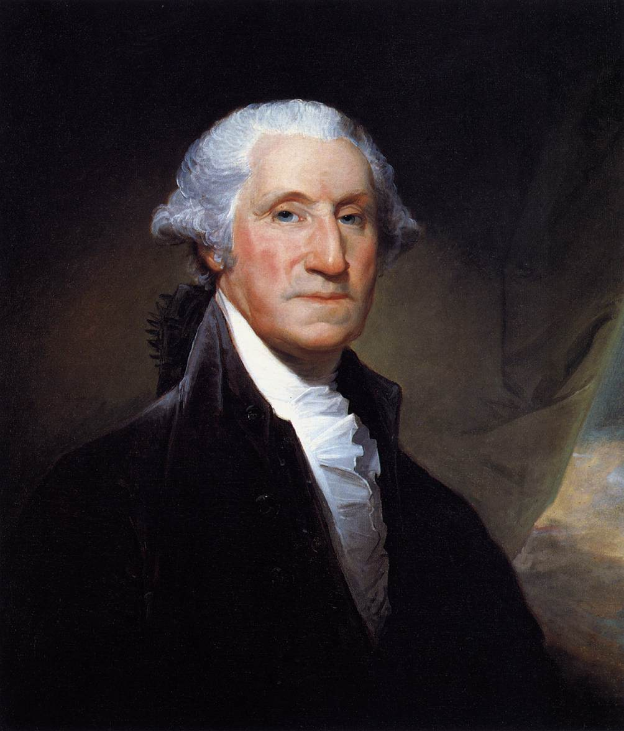
George Washington
Source: Portrait by Gilbert Stuart, 1795

Slide 4
Charts
Spreadsheet
Simple List
Comparison List
Similarly Worded Bullet Points
Acronym

Slide 5
NYC Taxis
Non Hybrid
Hybrid
Miles Per Gallon
Horsepower
Cost
18
225
$27,570
60
110
$20,975

Slide 6
Signs of Global Warming
Extreme temperatures (hot and cold)
Stronger Storms
Melting Arctic Icecaps
Rising Sea Level

Slide 7
Diabetes Characters
Type 1 Diabetes
Body Makes no Insulin
Insulin Injection Required
Occurs in Young People
Type 2 Diabetes
Insulin made, but not used properly
Pills can help manage
Occurs in Older and Overweight People

