Slide 1
Blood Bank
Under the supervision
of
Eng.\ Mohamed Ibrahim
TEAM MEMBERS :
a) Romany Nasrt shawky. (Team leader)
b) Ru'a Ayman Mohamed Abdou.
c) Reham Ibrahim Abdeldayem.
d) Sara Reda Abdallah.
e) Sameh Mohamed Galal.
f) Reham Mostafa Ali.

Slide 2
Abstract:
The purpose of our project is to build an organized system to control in more effective way the process of donating blood and optaining it.

Slide 3
Program Interface :
Donor
Log in
Resipient
Completeing a form
Staff
Sign in
Sign
Cheking data

Slide 4
Chart showing a table in data base of the amount of blood available by blood tybe:

Slide 5
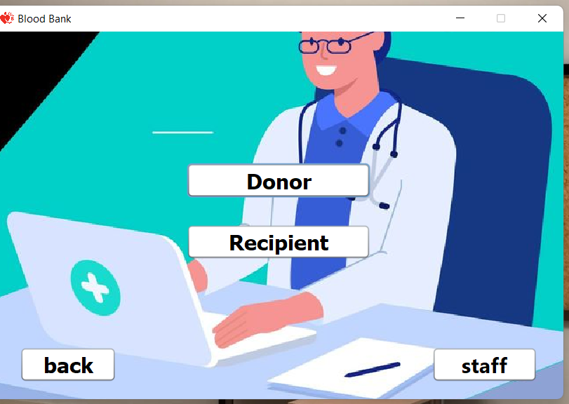
This frame showing our program interface

Slide 6
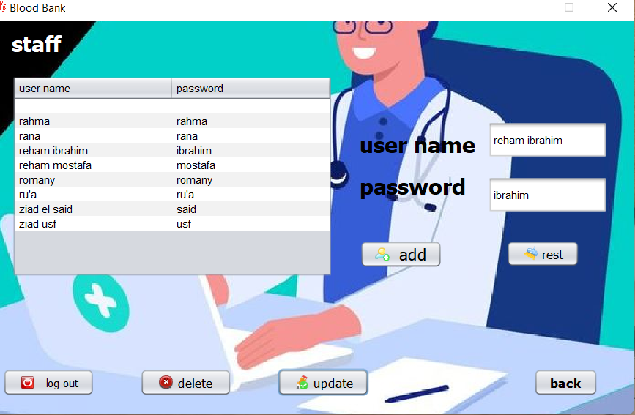
This frame showing staff adding donors

Slide 7
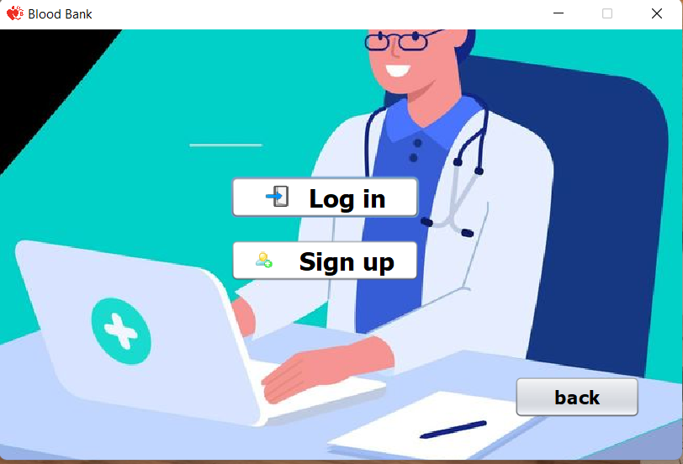
This frame showing options for donor or recieptient to log in or sign up

Slide 8
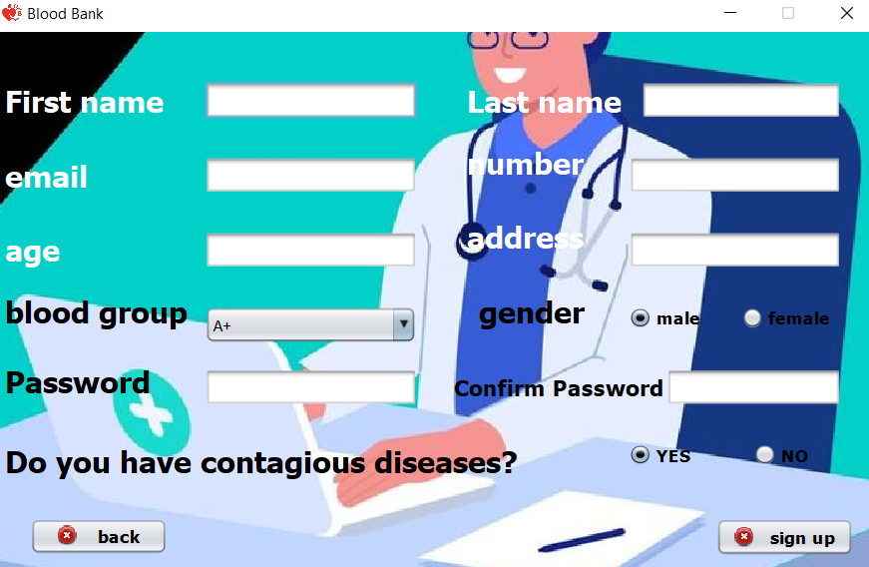
This frame showing a form completed by donor

Slide 9
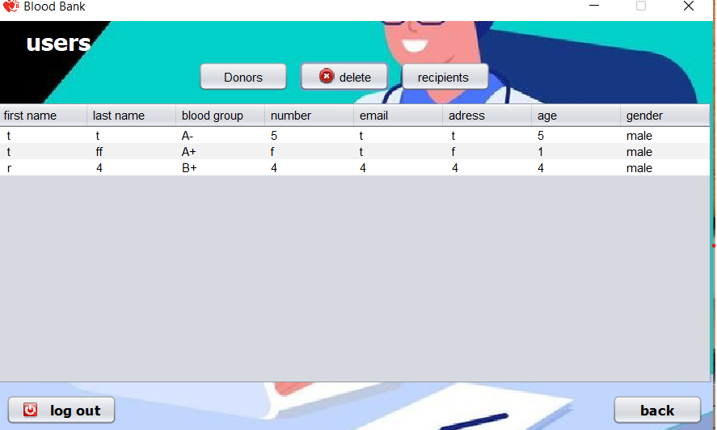
This frame showing update on system giving by our team leader that helps user and staff taking look on general statue about our system and cheking latest data in system.

Slide 10
This frame enabling amember of staff managing data in table by various buttons each one carrying out an action showed by system.

Slide 11
THANK
YOU

