Slide 1
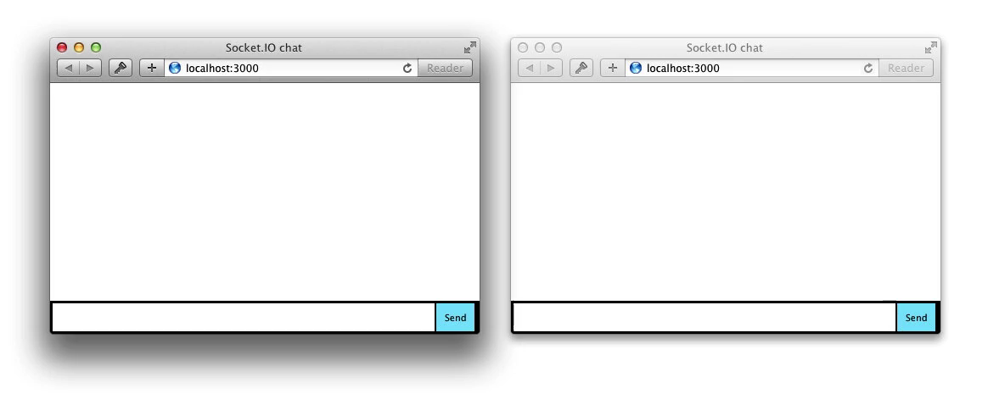


Building Your First Node.js App and Publishing to Azure
Sarah Sexton
Notes:
Hello everybody! Thank you so much for joining me for my session today. My name is Sarah Sexton, and I am a Technical Evangelist working for Microsoft. My job is to engage with user groups and developers and help them find success with building on Microsoft and Windows platforms.

Slide 2

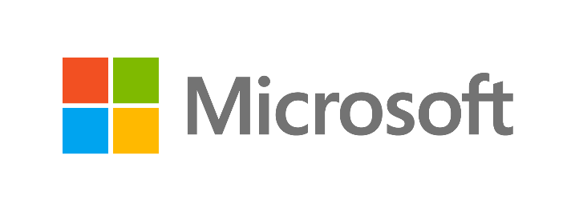
SPEAKER | TOPIC | WHEN | WHERE
David Giard | Microsoft Azure without Microsoft | 8/10, 2:30PM | Wisteria
David Washington | Building touch experiences that don’t suck | 8/10, 2:30PM | Guava
Paul DeCarlo | Hands on: Creating an Internet of Things Weather Station with Particle Wi-Fi development kit and the Microsoft Azure Cloud | 8/10, 7PM | Mess Hall
Dan Gartner | What's New with Visual Studio 2015: Supercharged Edition! | 8/11, 10:30AM | Tamarind
Wade Wegner | Azure API Apps for Web, Mobile, and Logic Apps | 8/11, 4PM | B
Chris Risner | ASP.NET on Linux and Mac: Camping at the Four Seasons | 8/11, 4PM | F
Nik Molnar | Tracking Real World Web Performance | 8/12, 10:30AM | F
Sarah Sexton | Building your first Node.js app and Publishing to Azure | 8/12, 12:15PM | C
Brian Lewis | A beginners guide to using PowerShell to manage Windows and Azure | 8/12, 1PM | Portia
Notes:
Here are some other Microsoft Evangelists and esteemed colleagues with awesome presentations at this conference. After my talk, if you want to learn about Powershell, you might consider checking out Brian Lewis’ guide to using Powershell to manage Azure.

Slide 3
Open Source
Cross Platform
Azure Linux VMs, open Suse, Ubuntu, centos
Azure hosted Node.js, Django, Python, Java
Azure support for Chef, Docker, Puppet Labs
Major contributor to Hadoop project, Cordova
W3C standards contributor with Microsoft Edge
Open sourced C#, Roslyn .NET Compiler, ASP.NET
Azure Hadoop as a service HDInsight
Azure Git and GitHub integration
Apps in every app store, Office, Outlook, Wunderlist
Visual Studio Cross Platform tools, Cordova, Manifold
Visual Studio Code runs on Linux and Mac
Windows 10 Bridges for Objective-C and Android
Native HTML support for Windows 10 Universal apps
Microsoft Edge browser: stop coding for IE
WebGL, Unity and tools for Game dev
Notes:
In the spirit of our theme, “Microsoft is open,” I am going to be talking about publishing open source code on Azure, that was compiled in an open source language, written using a free Microsoft-made text editor program, and stored publicly in an open source repository.

Slide 4
Building Your First Node.js App, Publishing to Azure
Agenda
What is Node.js?
Building Your First App
Demonstration
Publishing to Azure
Notes:
Here is the agenda for today. In my presentation, you are going to learn how to build your very first Node.js app and publish it online directly from Azure through GitHub. You will follow me on my personal journey from when I first heard about Node.js, to learning what it was, downloading the appropriate tools, building something with it, and finally publishing it to Azure. You’ll leave with some basic knowledge about Node.js, how to get started building your first Node app, and how to share it with the rest of the world.

Slide 5
What is Node.js?
Web Dev using JavaScript
A Runtime environment & library
Creates real-time web servers easily
Notes:
First of all, let us tackle the question of: What is Node.js?
To put it simply, Node.js is a tool for making web applications using JavaScript.
JavaScript is extremely popular, and anyone who knows it client-side in the browser can learn to use it in Node quite easily. Node includes a built-in HTTP toolkit for easily creating web servers; you can create a single-page website in less than a dozen lines of code.
It also scales exceptionally well. A single Node process can handle tens of thousands of simultaneous requests before experiencing any performance lag.

Slide 6
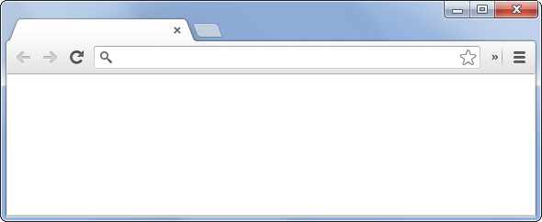
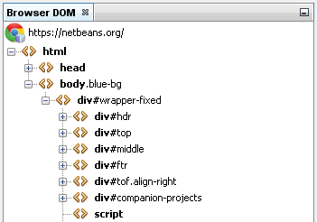
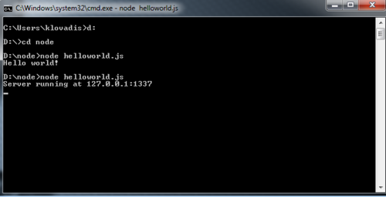
What is Node.js?
Node =
HTML
DOM
Browser
.js file
Notes:
Node.js was born when Google took its Javascript engine, V8, written for use in Chrome, and removed all the browser stuff. V8 is a just-in-time compiler (that is, very fast) which converts the javascript code into low-level CPU instructions before running it (just like one would for C/C++ code).
Node is a runtime environment and library for running JavaScript applications outside the browser. The javascript code executes directly from a .js file. Node essentially lets you use javascript just like you would use ruby, python or perl. It provides a set of built-in libraries for performing common IO tasks.
Node’s Package Manager system, NPM, lets developers publish to and install from a single source of open source code. NPM is the final piece of the Node.js puzzle, because it makes it extremely easy to find and use publicly available libraries to accomplish common tasks. Let’s talk about NPM in more detail.

Slide 7
What is NPM?
Node Package Manager
Bundled & installed automatically
Publish to & install from:
GitHub, Bitbucket, CodePlex, SourceForge, Visual Studio Online, etc.
Notes:
NPM is the official package manager for Node. It’s the NuGet to ASP.NET; it’s the Gem to Ruby.
It is a central repository for all the extensions & 3rd party libraries.
It comes bundled & installed automatically with the environment.
No reinventing the wheel, Just search for a library that does what you want.
Real-time applications are becoming a big deal now; WebSockets have reached a degree of support to where sites can start to take advantage of them, and Node does WebSockets & long poll http connections really well.

Slide 8
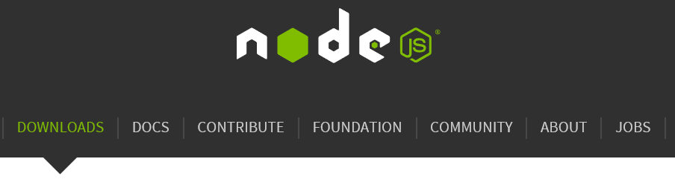
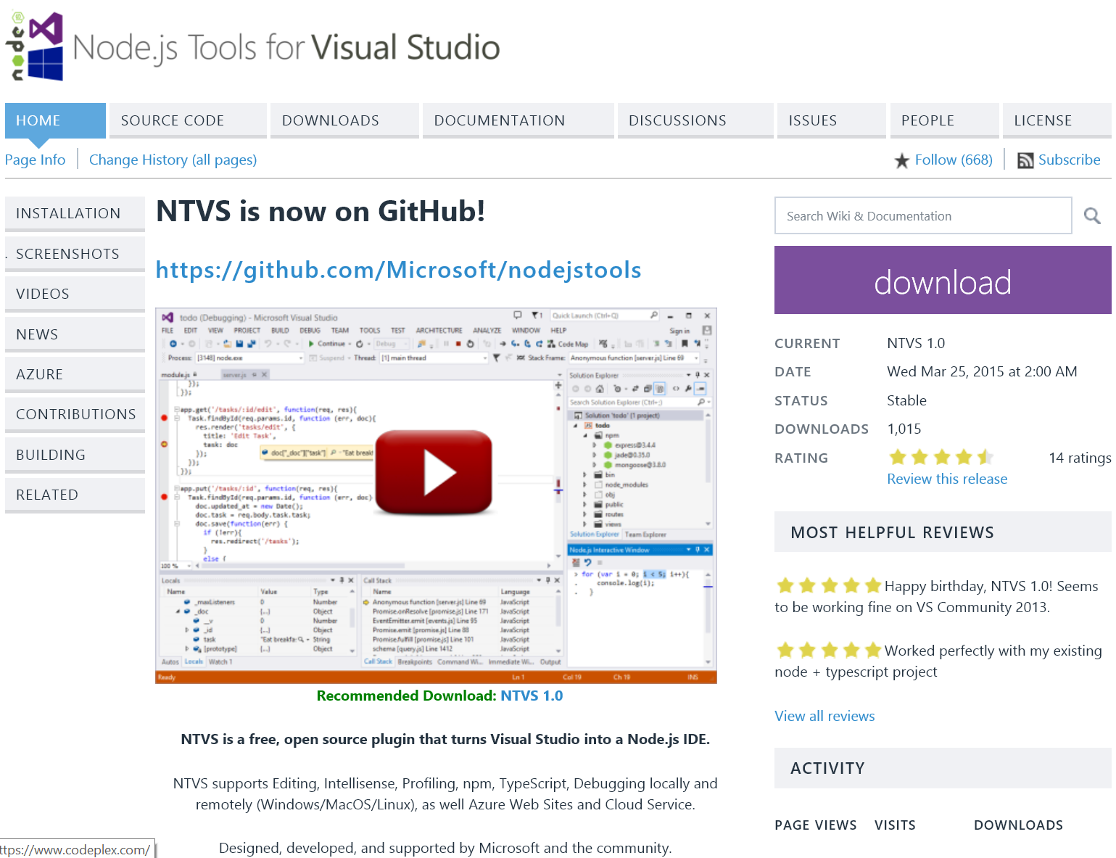
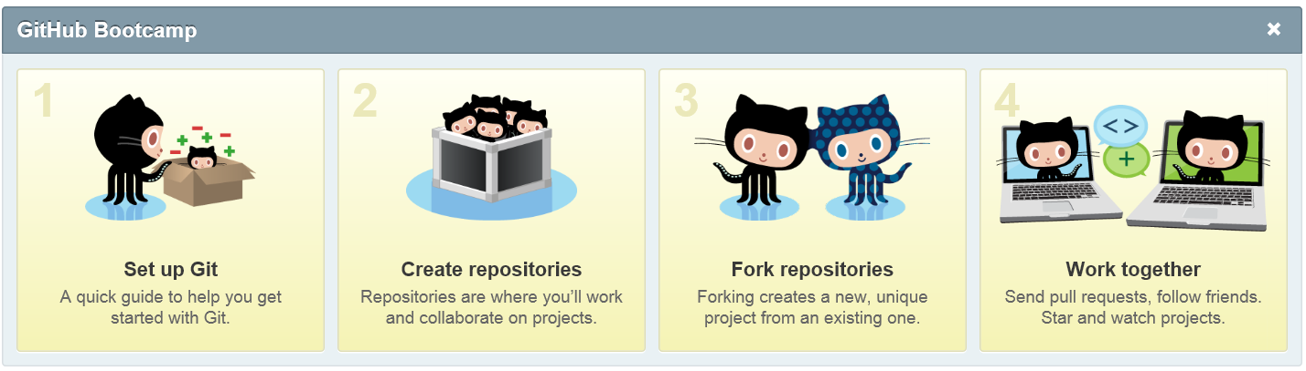
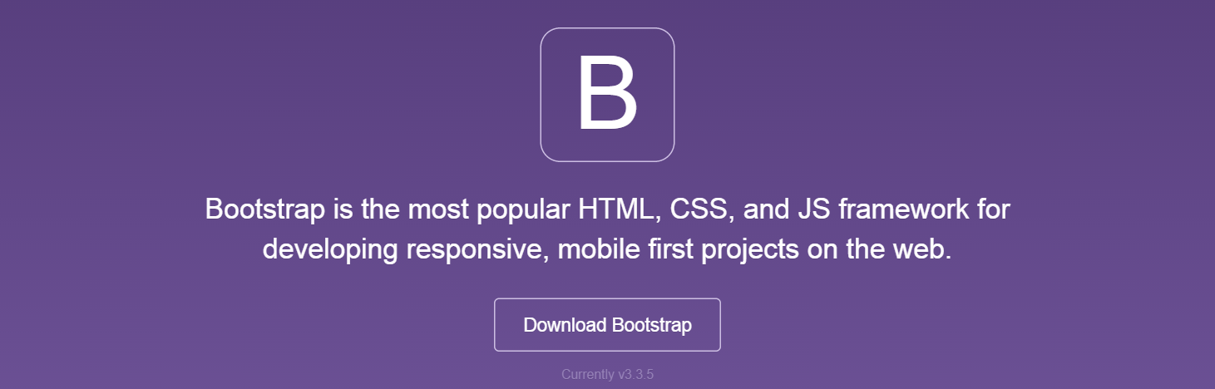
Tools
Node.js
NPM
text editor
GitHub
Microsoft Azure
Express
Socket.io
Bootstrap
VS 2013
NTVS
Notes:
To get started with building your first app, you’ll need the Node.js command prompt on your computer. Then you use the npm commands to install each module your app will need. You’ll also need a Text Editor, if you don't have one already, for editing code. “Visual Studio Code” is the new “Notepad++”
Of course, you want to set up your preferred method of source control, be it Github, Visual Studio Online, Bitbucket, or Git.
If you’re not comfortable with typing commands into a black box, Node.js Tools for Visual Studio, or NTVS, is a free, open source plugin that turns Visual Studio into a Node.js IDE.

Slide 9
Dependencies
Express:
A web framework that handles multiple different HTTP requests at one URL.
Implement Express to use templating engines to generate HTML.
Socket.IO:
Simple JS library & Node.js module
Allows real-time bidirectional event-based communication apps
Implement Socket.IO to connect, send, and receive messages.
Notes:
Let me tell you what dependencies I’ll be showing you today.
Express is a web framework that lets you structure your web app to handle multiple different HTTP requests at a specific URL. You also implement Express to use multiple templating engines to generate HTML.
Socket.IO is a simple JavaScript library and node.js module that allows you to create real-time bidirectional event-based communication apps simply and quickly. It simplifies the process of using Web Sockets significantly. I used Socket.IO to make my chatroom app. Implement Socket.IO to connect, send, and receive messages.

Slide 10
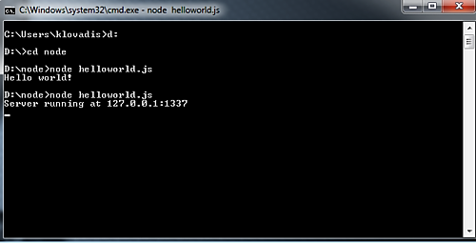
Running Apps Locally from the Console
Notes:
For the rest of my presentation, I will demonstrate how to run an app locally from the console.

Slide 11
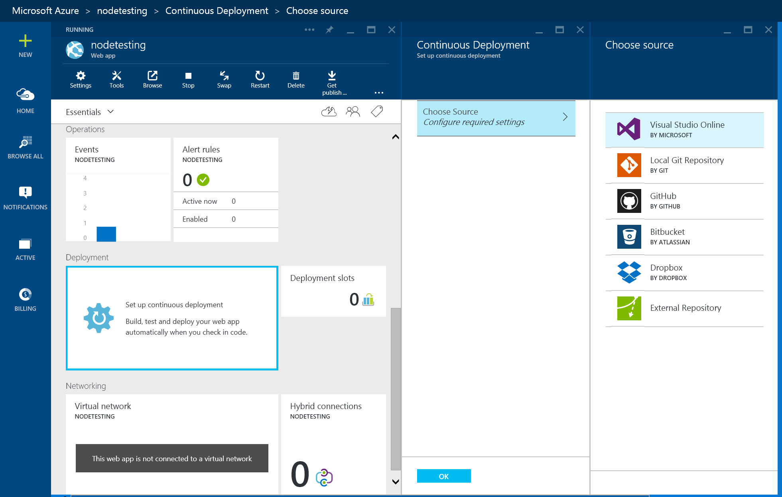
Continuous Integration
Notes:
Then I will illustrate the wonders of Continuous Integration.
Deploying your web app from Visual Studio Online, GitHub, Bitbucket, Dropbox, or an External Repository results in a continuous deployment process where Azure will pull in the most recent updates from your project.
Continuous deployment is useful when you have multiple people working on a project and want to ensure that the latest version is always published regardless of who made the most recent update. Continuous deployment is also useful if you are using an online tool as the central repository for your application.

Slide 12
Resources
Resource | Source
Download Node.js | NodeJS.org
A chatroom for all! Part 1 - Introduction to Node.js | Rami Sayar
Create a Node.js chat application with Socket.IO in Azure App Service | Mike Wasson
How to add environment variables to your Path in Windows 8 or Windows 8.1 | Chris Hawkes
Open source workshops that teach web software skills. | NodeSchool.io
“Git-it” – Learn Git and GitHub basics. | Jessica Lord
Deploying from local git repository to Azure websites (with video) | Iris Classon
Project Repository for Building Apps with Node.js Microsoft Virtual Academy | Rami Sayar
MVA: Building Apps with Node.js Jump Start | Stacey Mulcahy & Rami Sayar
Install and Configure the Azure Command-Line Interface (CLI) | Ralph Squillace
Explain Like I’m Five: What the heck is node.js? | Reddit Web Dev
Get Started: Chat Application | Socket.io
Notes:
In conclusion, we learned how to build a very first Node.js app on open source software and publish it online directly from Azure through GitHub. We followed my personal journey from when I first heard about Node.js, to learning what it was, downloading the appropriate tools, building something, and finally publishing it to Azure. Hopefully you’ve gained some basic knowledge about Node.js, how to get started building your first Node app, and how to share it with the rest of the world. Thank you very much.

Slide 13
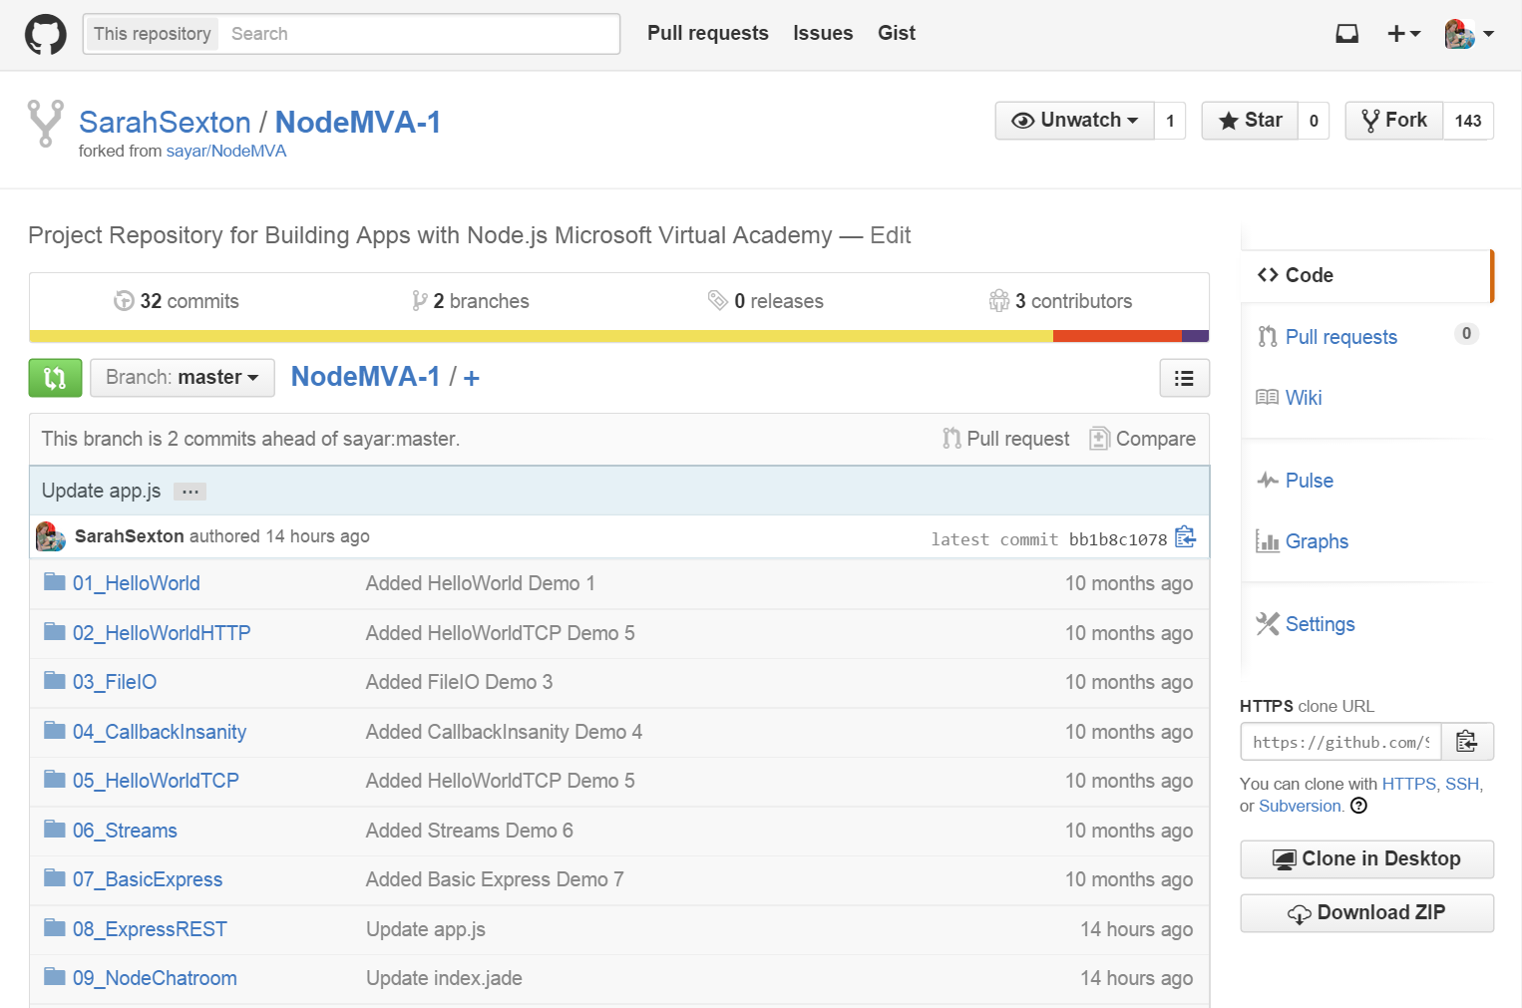
Environment
Node.js command prompt
cd .. (go up a folder)
dir (list directory contents)
mkdir (make new folder)
Git init (Initialize Git)
cls (clear screen)
npm install
npm install express
npm install jade
npm install --save socket.io
mongoD
node app.js (Start running app)
Ctrl+C (end process)
Notes:
So when you open up the Node.js command prompt, it starts you in a default folder, so you’ll have to use the “cd ..” and “dir” commands to navigate your way through the directory of folders until you get where you want to be.
Then you use “npm install” to install each module your app needs to function. Express and Socket.io were a few of the things that the Node Chatroom application needed to function properly.

Slide 14
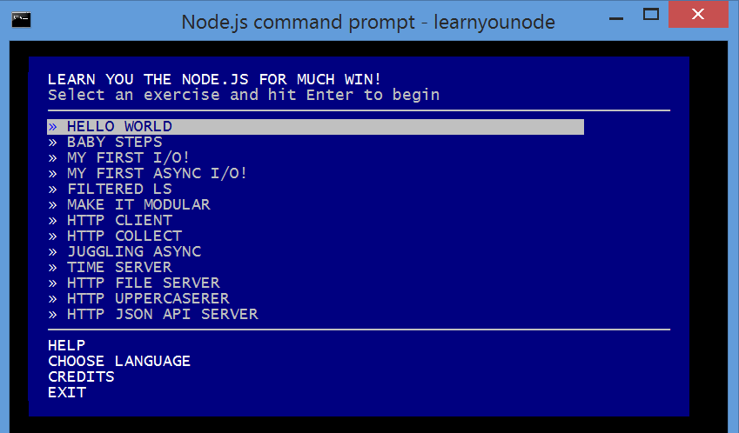
Create Your First Node App
npm install -g LearnYouNode
LearnYouNode
Notes:
To do more research into creating a First Node App, I went to Node.js’s website in search of official documentation and tutorials. There, I found something called NodeSchool, which they describe as being “a fantastic resource for learning about Node.js and the related ecosystem around Node. There are a series of curricula which are designed with a choose-your-own-adventure style.”
So I visited NodeSchool.io, clicked Tutorials, and was introduced to a workshop called LearnYouNode.
-g stands for Global
When you do a global install, it installs the package globally so you can run them regardless of where you are in the command prompt, not specifically to one folder.

Slide 15
What is Node.js?
Bottom layer: C library called libuv
Framework for performing asynchronous IO operations without blocking.
Second layer: V8
Just-In-Time (very fast) compiler
Converts JavaScript → Low-level CPU instructions before running
Optimizes common JS tasks
Third layer: CommonJS
Organizes modules of JS code into separate files
Specifies how to include those files for execution
Ex: JS code calls require(filepath) → Loads & executes JS file → Returns exports.
Top Layer: Node Package Manager (NPM)
Publish to & install from a single source of open source code!
Notes:
Let’s get back to Node. Node.js is a combination of several technologies.
The very bottom layer is a C library called libuv, which is a framework for performing asynchronous IO operations without introducing blocking.
The second layer is V8, which is Google's Javascript engine written for use in Chrome. V8 is a just-in-time (aka very fast) compiler which converts the JS code into low-level CPU instructions before running it (just like one would for C/C++ code). This lets the code run much faster than in older javascript engines. V8 also includes many optimizations for handling very common tasks in javascript, such as concatenating strings or iterating certain types of arrays.
The third layer is CommonJS, a specification for how to organize distinct modules of JS code into separate files, and for including those files for execution. JS code can call require(filepath) to load and execute a JS file in an isolated context, and anything exported by that file gets returned by the require call.
And last but not least, CommonJS’s implementation was later extended by the creation of Node Package Manager. This system lets developers publish to and install from a single source of open source code. NPM is the final piece of the Node.js puzzle, because it makes it extremely easy to find and use publicly available libraries to accomplish common tasks. Let’s talk about NPM in more detail.

Slide 16
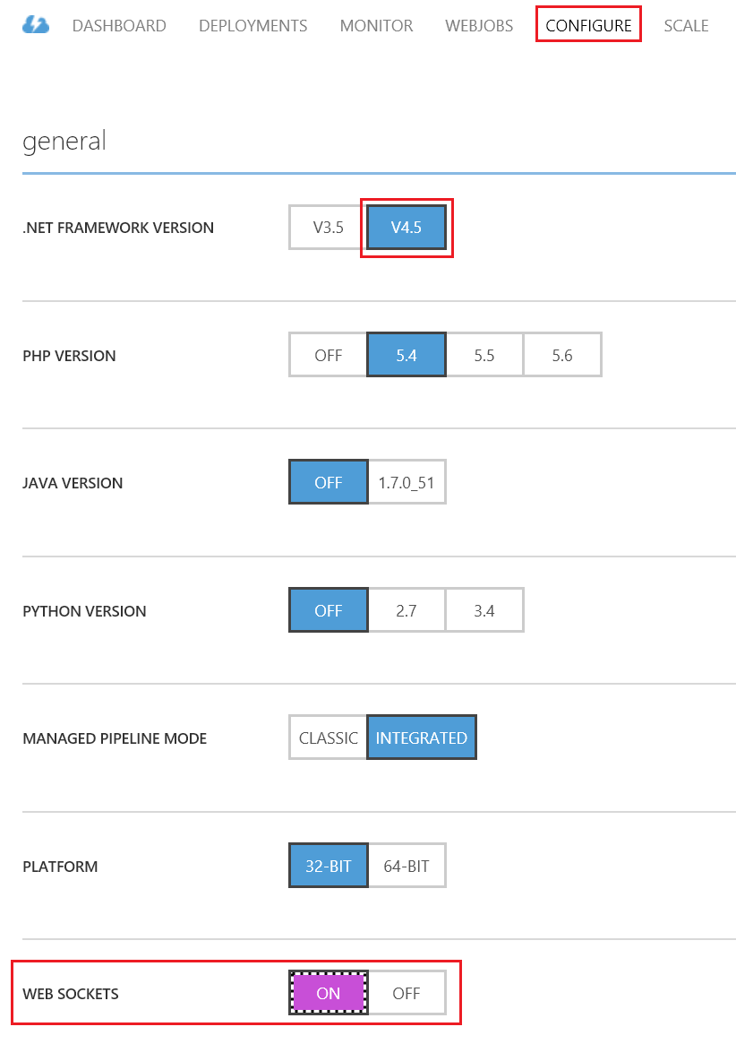
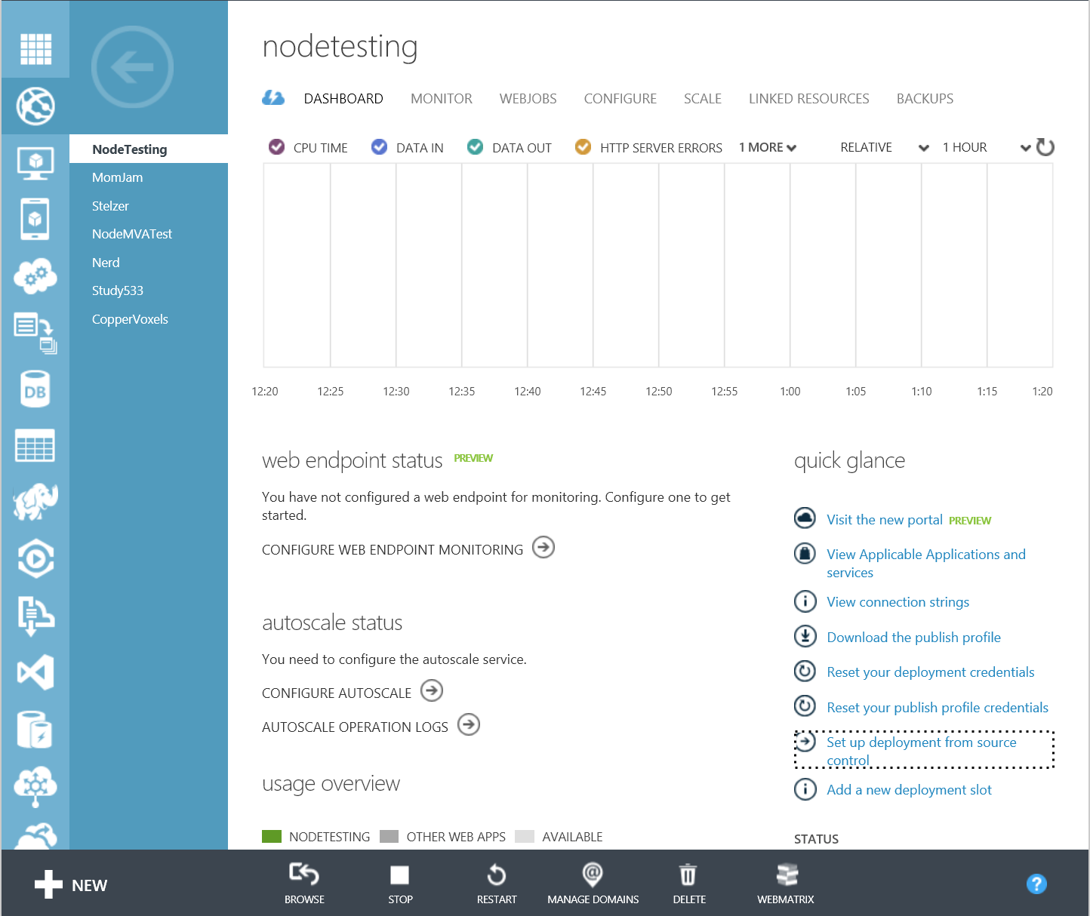
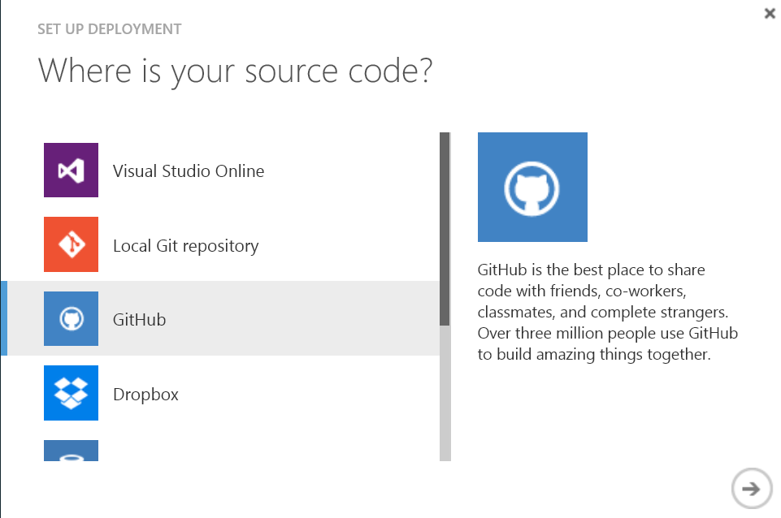
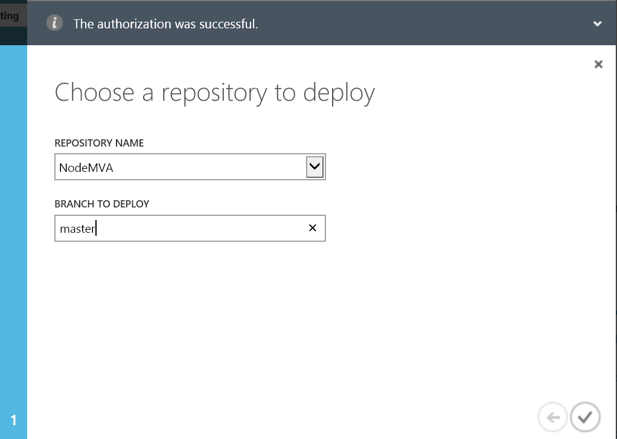
Continuously Integrate from GitHub to Azure
Notes:
https://manage.windowsazure.com

Slide 17
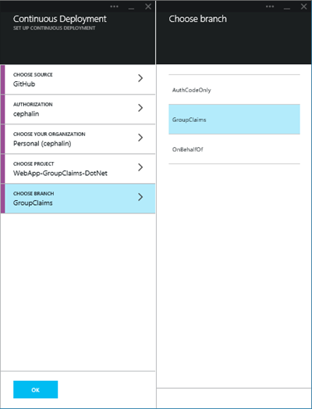
Continuously Integrate from GitHub to Azure
Notes:
https://portal.azure.com

Slide 18
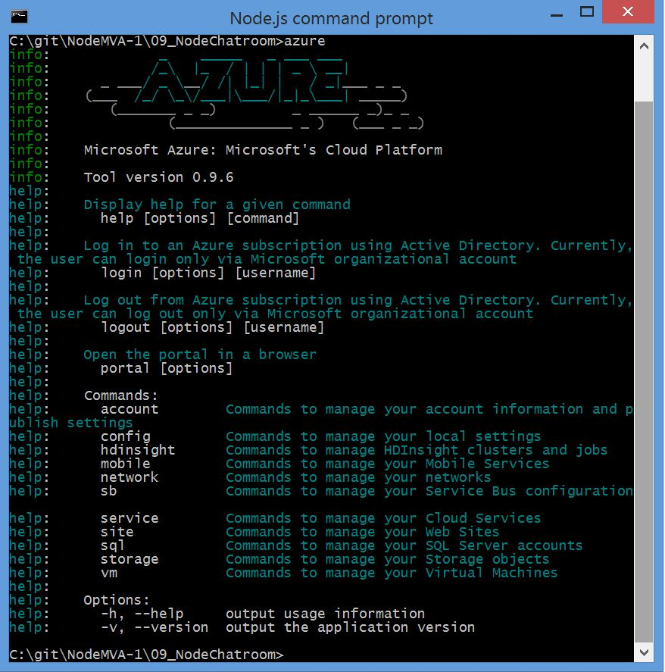
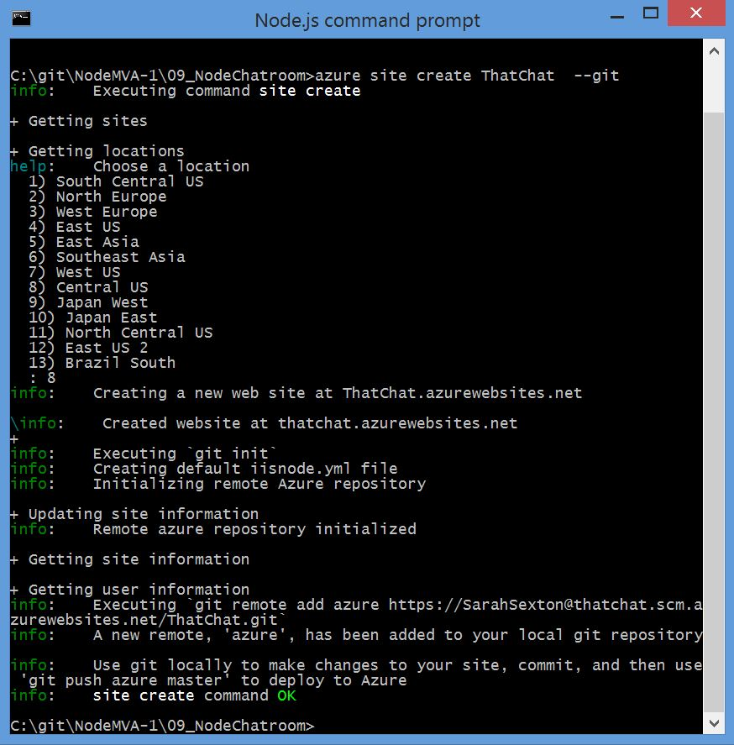
Continuously Integrate from GitHub to Azure
Notes:
Azure Command Line Interface
These screenshots connect locally to Git, NOT remotely to GitHub.

Slide 19
What is Blocking?
A blocking operation blocks code execution.
Code makes a call to a file system → Execution halts until system returns a response.
One solution was to create multiple threads.
Processes can fork into separate copies → Multiple threads can execute simultaneously.
However, multi-threading is costly.
Memory consumption
Processing overhead of launching new processes
Notes:
For those of you that don’t know, let me explain what Blocking is. In most languages when the code makes a call to a file system or remote system, code execution completely halts until that system returns with a response. This is called a blocking operation, because it blocks the current code execution. If the database is running on a separate computer, then that means the web server is just sitting there idle, doing nothing. It can't handle any other web requests until that query comes back, so it's effectively a dead process for how ever many milliseconds it takes for the query to come back.
The solution devised many years ago to handle the blocking problem was to create multiple threads of execution. A process could launch another copy of itself, called a fork, which would run separately from the main process.
This kind of process juggling is costly, both in memory consumption and the processing overhead of launching new processes to handle increased demand.

Slide 20
Strengths & Weaknesses
When to Use Node:
High levels of concurrency
Little dedicated CPU time
Writing JavaScript code everywhere
When Not to Use Node:
Very long-running calculations in the backend
The server would not be able to handle any other requests coming in.
Notes:
On the one hand, Node is great for streaming or event-based real-time applications like Chat applications, Real-time applications and collaborative environments, Game servers, Advertisement servers, or Streaming servers. Node is great for when you need high levels of concurrency but little dedicated CPU time.
On the other hand, Node is structured to be single-threaded; there is an event loop that runs. If you are building an application that requires you to do some very long-running calculations in the backend, Node might not be the best tool. It blocks all the other events that will be coming in. The server would not be able to handle any other requests coming in.
Explain when it blocks and when it doesn’t block

