Slide 1
Hyderabad Institute of Technology and Management
Carbo_Lens: AI-Based Generalized Risk Monitoring Framework for Carbon Sequestration Projects
Student details:
Sarah Snigdha Chikelay (23E51A66A3)
Pranathi Swamy (23E51A6690)
Tulugu Mavya (23E51A66B4)
Vishnu Vardhan (23E51A66C8)
Date: 26/ 09 / 2026
Mentor: Dr. Rajeshwar

Slide 2
Table of Contents
1. Introduction
2. Base paper – method, findings, limitations
3. Existing work & technology used
4. Proposed work – research gap
5. Technologies in proposed work
6. Block diagram / system flow
7. Implementation progress – results so far
8. Advantages & future scope
9. Documentation status
10. Publication plan
11. Base paper link

Slide 3
Introduction
Carbon sequestration projects (forests, mangroves, restoration sites) store CO₂ and earn carbon credits.
Permanence is the risk that stored carbon is released again – by fire, drought, clearing or cyclones.
Field verification is slow and costly, so most small projects are rarely checked after registration.
Permanence is a named integrity requirement of India’s Carbon Credit Trading Scheme (CCTS) offset mechanism, where afforestation and mangrove restoration are approved methodologies (BEE, 2025).
Problem: monitoring approaches today are built per project type and per dataset, so results cannot be compared across projects.
Our goal: one configurable, explainable framework that detects early environmental threats to carbon permanence across different ecosystem types, using only free satellite and climate data.

Slide 4
Base Paper-Understanding of base paper, methodology, findings and limitations
Nguyen, A. & Saha, S. (2024). Machine Learning and Multi-source Remote Sensing in Forest Carbon Stock Estimation: A Review. arXiv:2411.17624
Methodology
  Systematic review of recent studies combining ML with multi-source remote sensing (optical, SAR, LiDAR) for forest carbon estimation.
  Compares model families (Random Forest, SVM, neural networks) and data-fusion combinations across forest types.
Findings
  Accuracy depends mainly on multi-source data fusion and model optimisation, not on any single sensor.
  Tree-based ensembles such as Random Forest remain strong for tabular, multi-source environmental features.
  Ecological characteristics of the forest affect which combination works best.
Limitations → our opportunity
  Estimates carbon stock at a point in time; does not monitor threats to that carbon over time.
  Focused on forests; other sequestration ecosystems are not covered.
  Reports quantities, not explainable risk levels or early warnings.

Slide 5
Existing Work & Technology Used (Process of existing work)
Existing systems (process: satellite data → AI biomass/change model → MRV or risk report)
  ESA CarbonTrust – EO + AI biomass + wildfire history + IPCC climate scenarios for forward-looking carbon permanence.
  ESA Regen Atlas – forward-looking risk analytics for carbon projects (wildfire, cyclone, pests).
  Kanop (ESA TSI2IFCCBM) – AI SaaS for forest carbon and biodiversity MRV from multispectral, SAR and LiDAR.
  ESA CarbonEagle – SAR + optical biomass MRV for forest carbon credits (REDD+).
  NASA Carbon Monitoring System – research programme producing biomass and carbon datasets.
Technology used by them: Sentinel-1/2, Landsat, GEDI LiDAR, ML biomass models, GIS dashboards.
Common limitation: all are forest-focused, commercial/closed, and built for carbon markets and auditors – not for small community-scale projects, and not configurable across ecosystems.

Slide 6
Proposed Work( finding the reserach gap)
Research gap
  Existing work estimates how much carbon is stored. Little work provides a generalized, configurable framework that assesses threats to carbon permanence across different ecosystem types with explainable outputs.
Proposed work
  One framework, per-ecosystem configuration: indicator list, weights and masking rules live in a config file (forest.yaml, mangrove.yaml) – a new ecosystem is a new file, not new code.
  Indicator normalization: every indicator compared to that site’s own normal for that month, so a mangrove in AP and a forest in Odisha are comparable on one scale.
  Anomaly detection + supervised risk model + SHAP explanation → Low / Medium / High with reasons.
  Tested for generalization: trained on globally sampled patches, evaluated on unseen regions and on an unseen ecosystem type.
Scientific safeguard: the system reports potential permanence risk requiring field verification – it never claims carbon has been lost.

Slide 7
Technologies in Proposed Work
Data (all free, accessed via Google Earth Engine – non-commercial tier, registered)
  Sentinel-2 (10 m, ~5-day): NDVI, NDWI | Dynamic World: land cover | Hansen/GFW: forest loss
  NASA FIRMS: active fire | ERA5-Land: temperature, soil moisture, wind | CHIRPS: rainfall
Machine learning
  Isolation Forest (unsupervised anomaly detection, per site) · Random Forest (supervised disturbance likelihood) · SHAP (explainability) – scikit-learn
Application stack
  Backend: Python, FastAPI · Database: PostgreSQL + PostGIS · Processing: Pandas, NumPy, GeoPandas
  Frontend: React.js + Leaflet (GIS map, trends, alerts)
Engineering practice
  Git/GitHub with protected dev branch and pull-request review; config-driven design; reproducible scripts.

Slide 8
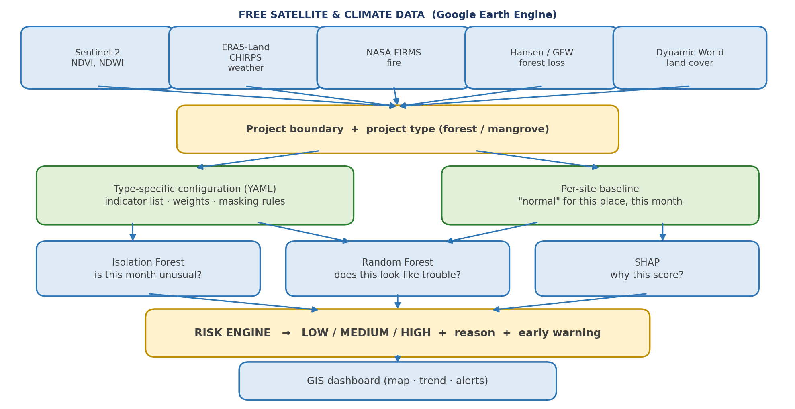
Block Diagram / Flow Chart

Slide 9
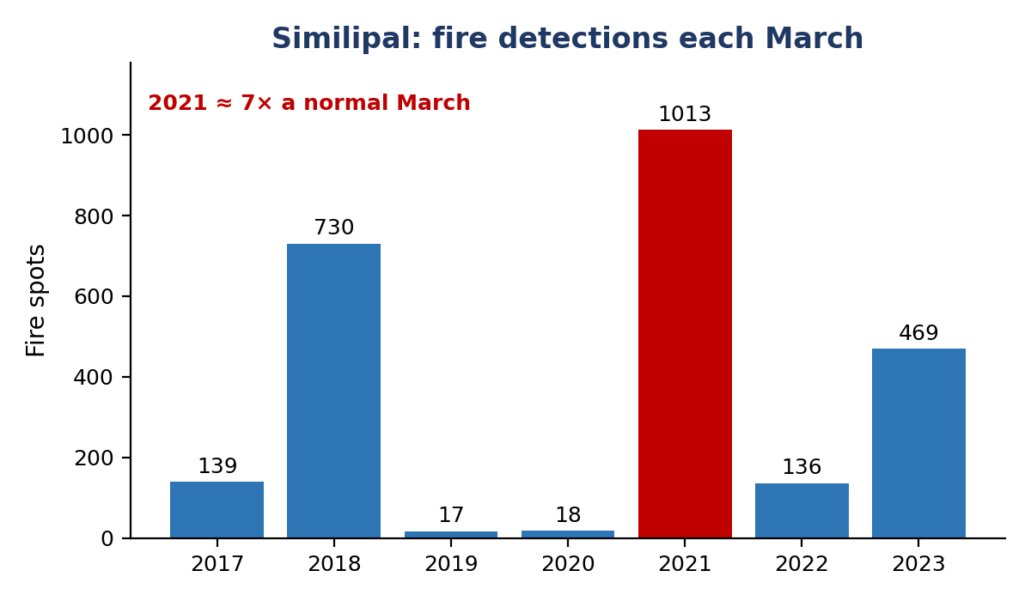
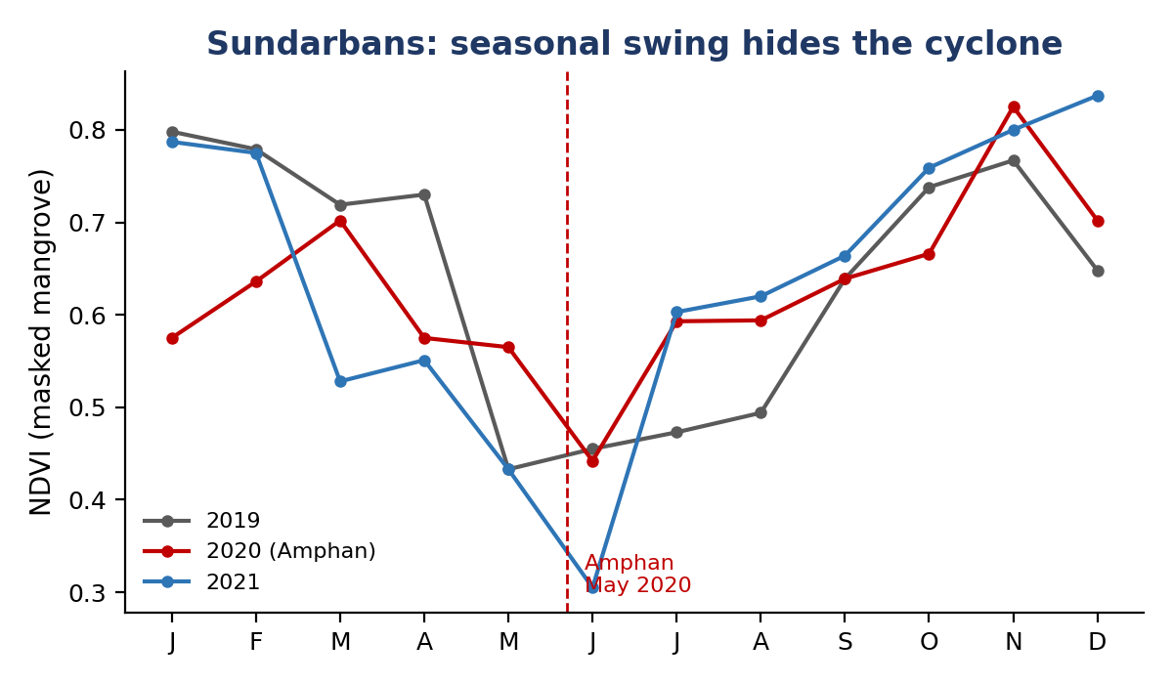
Proposed Work Status / Implementation Progress (evidence of progress)
Done: Earth Engine registered & team access configured; GitHub repo with dev/feature branches; working data pipeline pulling real satellite and fire data.
Forest test site fixed – Similipal, Odisha: our script counted FIRMS detections. March 2021 = 1,013 spots vs ~100–150 in a normal March (≈7×). March 2018 (730) gives a second event to test on.
Mangrove sites measured – Sundarbans (35,171 ha) and Coringa (9,971 ha) after masking to dense evergreen pixels.
  Key finding: an unmasked mangrove box gave NDVI 0.08–0.30 (half the box is water); masking raised it to 0.6–0.8. Mangrove greenness swings 0.78 → 0.44 seasonally – larger than any damage signal.
  → Evidence that raw indicators cannot be compared across ecosystems, and that per-type configuration and per-month baselines are necessary. Similipal needed neither.

Slide 10
Advantages & future Scope(Proposed Work)
Advantages
  Works across ecosystem types through configuration, not new code – extensible to wetlands, peatland, agroforestry.
  Uses only free, open data – viable for small and community-scale projects with no MRV budget.
  Explainable: every risk level carries the indicators that caused it (SHAP), not just a colour.
  Early-warning oriented: monitors continuously instead of reporting historical carbon stock.
  Scientifically cautious: flags potential risk for verification rather than asserting carbon loss.
Future scope
  Add Sentinel-1 radar to see through monsoon cloud cover.
  Align risk categories with Verra’s AFOLU Non-Permanence Risk Tool to inform buffer-pool sizing.
  Support India’s CCTS offset mechanism (mangrove and afforestation methodologies) and carbon-insurance use cases.

Slide 11
Documentation (Project Work status)
Repository: github.com/SarahSnigdha/Carbo_Lens – protected dev branch, feature branches per member, pull-request review.
Documents maintained
  Knowledge-transfer document (problem, architecture, indicators, plan)
  Team setup guide (environment, Earth Engine access, Git workflow)
  Research guide with per-member tasks for forest and mangrove indicator thresholds
  A development plan with weekly milestones
Code committed so far: fire-history analysis, mangrove NDVI extraction, mangrove masking check, environment test script.
Next documentation: indicator configuration files (forest.yaml, mangrove.yaml) with literature-backed thresholds and weights.

Slide 12
Publication Details
Status: paper in preparation – not yet submitted.
Working title
  “Ecosystem-specific indicator configuration for satellite-based permanence risk monitoring of carbon sequestration projects”
Planned contribution
  Comparison of forest vs mangrove indicator behaviour using free Sentinel-2 and FIRMS data.
  Spatial cross-validation on unseen regions, plus a leave-one-ecosystem-out experiment showing why per-type configuration is required.
Target venue: peer-reviewed Scopus/WoS-indexed conference or journal (IEEE / Springer / MDPI Remote Sensing). No predatory venues.
Timeline: draft methods & data (Month 3) → final experiments and figures (Month 4, weeks 1–2) → submission (Month 4, week 4).

Slide 13
Base Paper link
Base paper
  Nguyen, A. & Saha, S. (2024). Machine Learning and Multi-source Remote Sensing in Forest Carbon Stock Estimation: A Review.
  arXiv:2411.17624 · DOI: 10.48550/arXiv.2411.17624
  https://arxiv.org/abs/2411.17624 (open access)
Supporting references
  Hansen, M. C. et al. (2013). High-resolution global maps of 21st-century forest cover change. Science, 342(6160), 850–853.
  Brown, C. F. et al. (2022). Dynamic World: near real-time global 10 m land use land cover mapping. Scientific Data, 9, 251.
  Verra (2023). VCS AFOLU Non-Permanence Risk Tool, v4.2.
  Bureau of Energy Efficiency (2025). Detailed Procedure for the Offset Mechanism of the CCTS, v1.0.

Slide 14

THANK YOU

