Slide 1
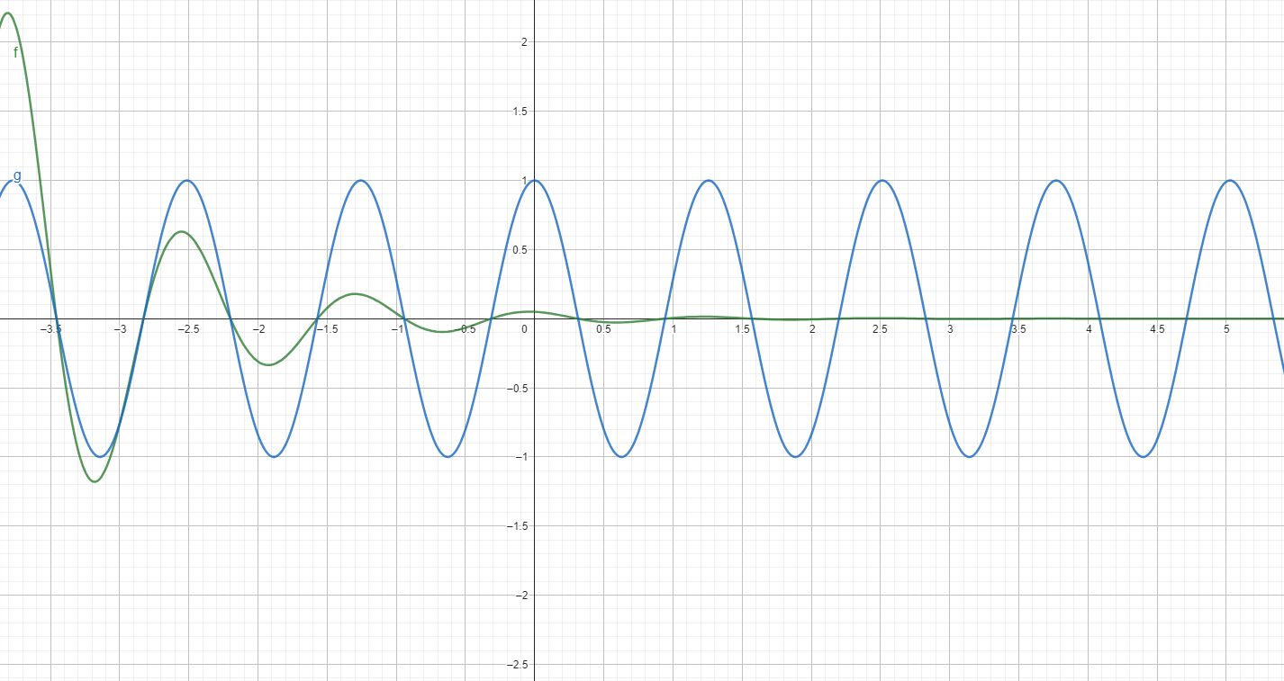

Slide 2
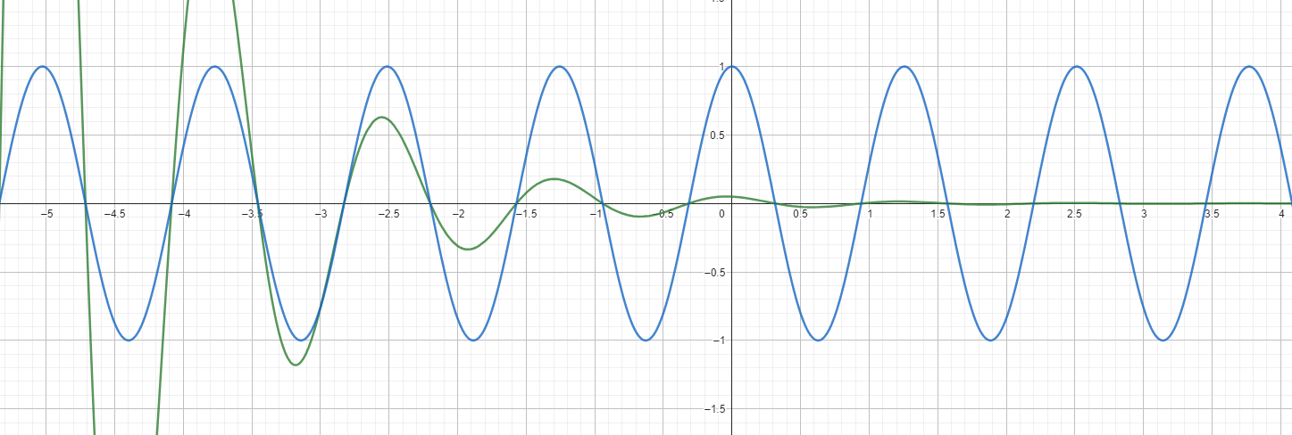

Slide 9
CO₂
photosynthesis
birds fish
whales
etc.
phytoplankton
zooplankton
aggregation
faeces
sinking

