Slide 1
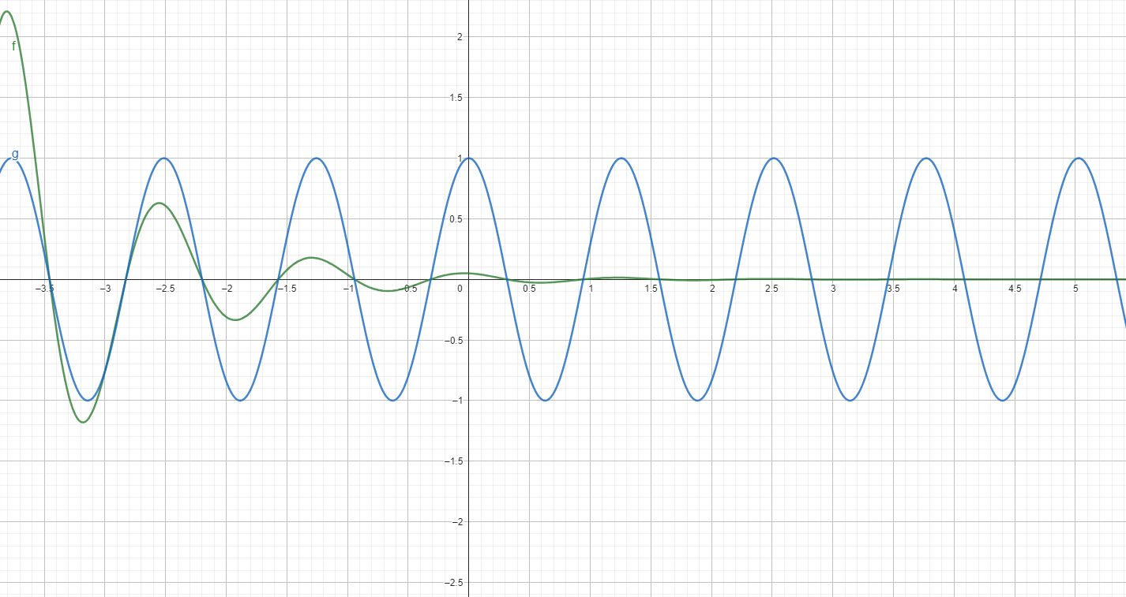

Slide 2
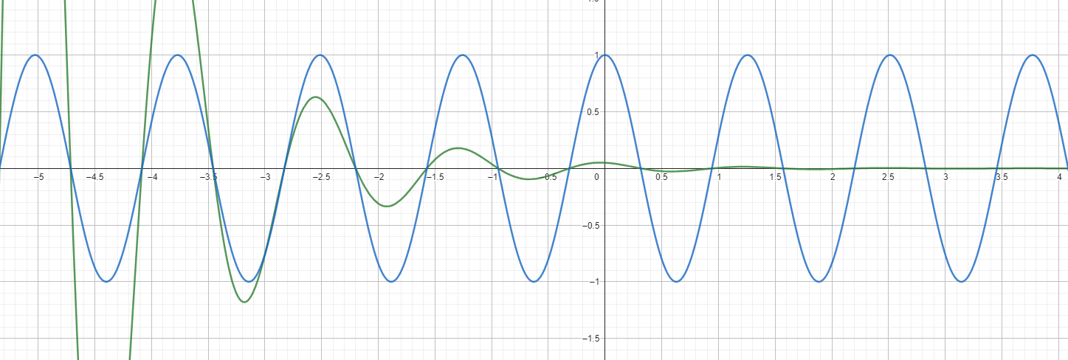

Slide 9
light (including UV)
CO₂
open ocean
marginal ice zone
consolidated/pack ice
photosynthesis
birds fish
whales
etc.
phytoplankton
zooplankton
aggregation
faeces
thermocline
sinking
sequestration

Slide 10
light (including UV)
open ocean
CO₂
marginal ice zone
consolidated/pack ice
photosynthesis
birds fish
whales
etc.
phytoplankton
zooplankton
aggregation
faeces
thermocline
sinking
sequestration

Slide 11
light (including UV)
open ocean
CO₂
marginal ice zone
consolidated/pack ice
photosynthesis
birds fish
whales
etc.
phytoplankton
zooplankton
aggregation
faeces
thermocline
sinking
sequestration

