Slide 1
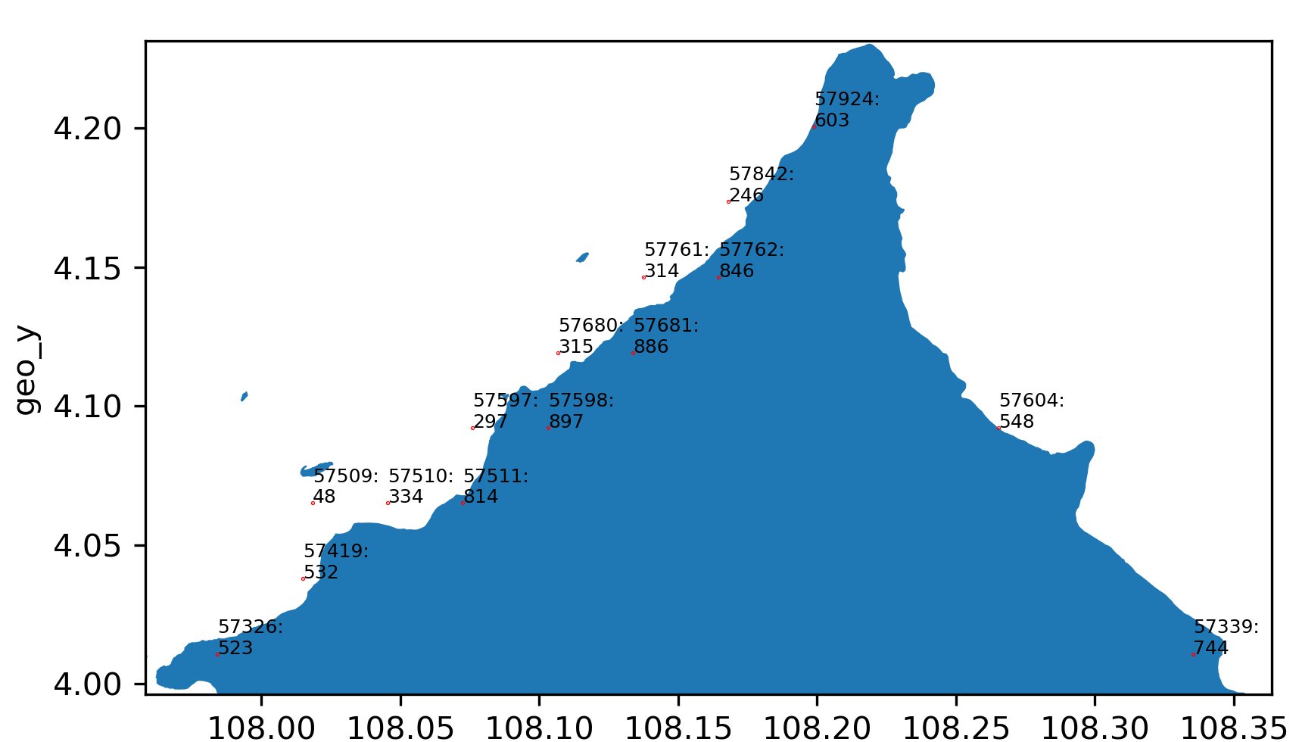

Slide 2
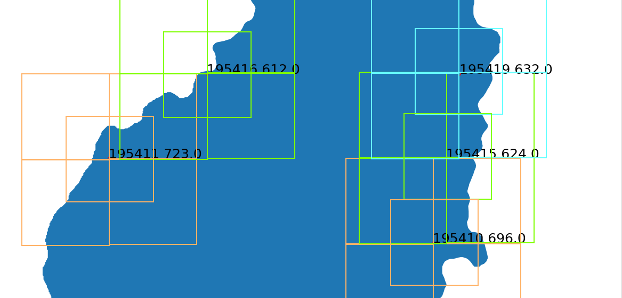

Slide 3
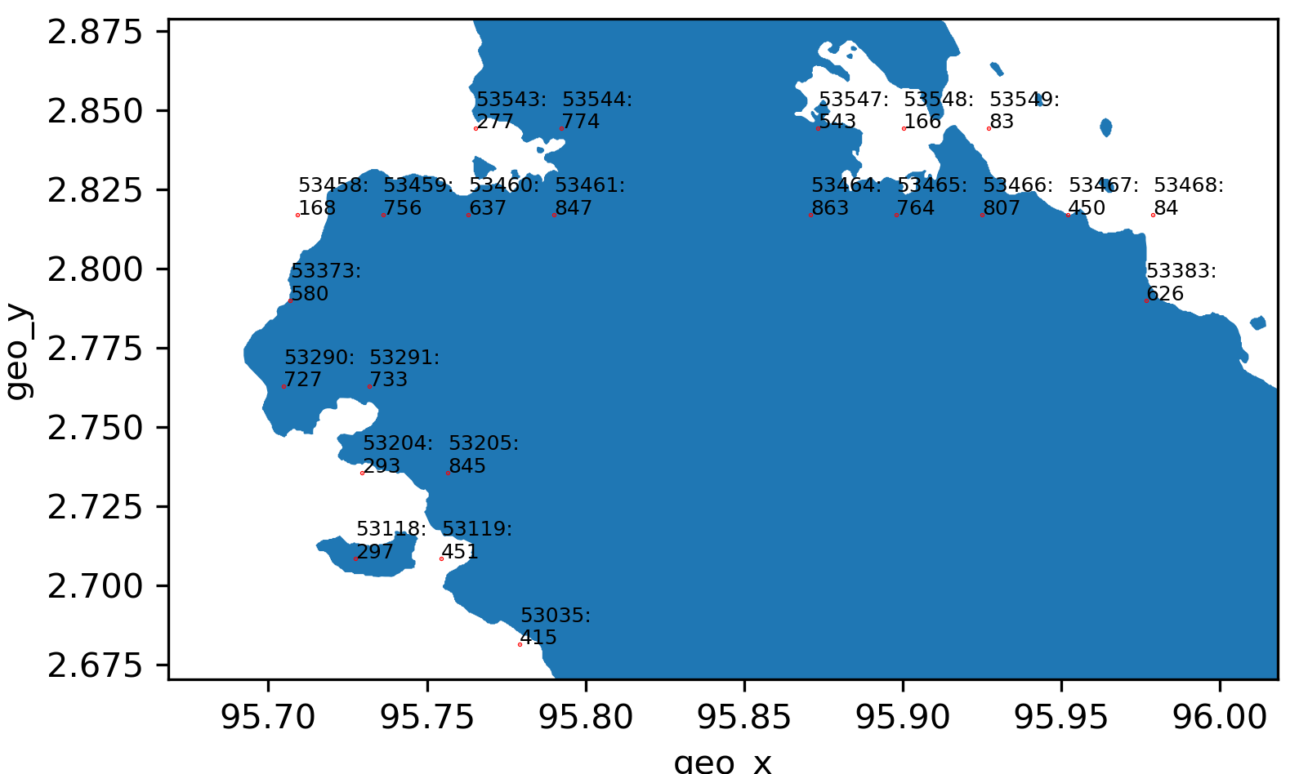

Slide 4
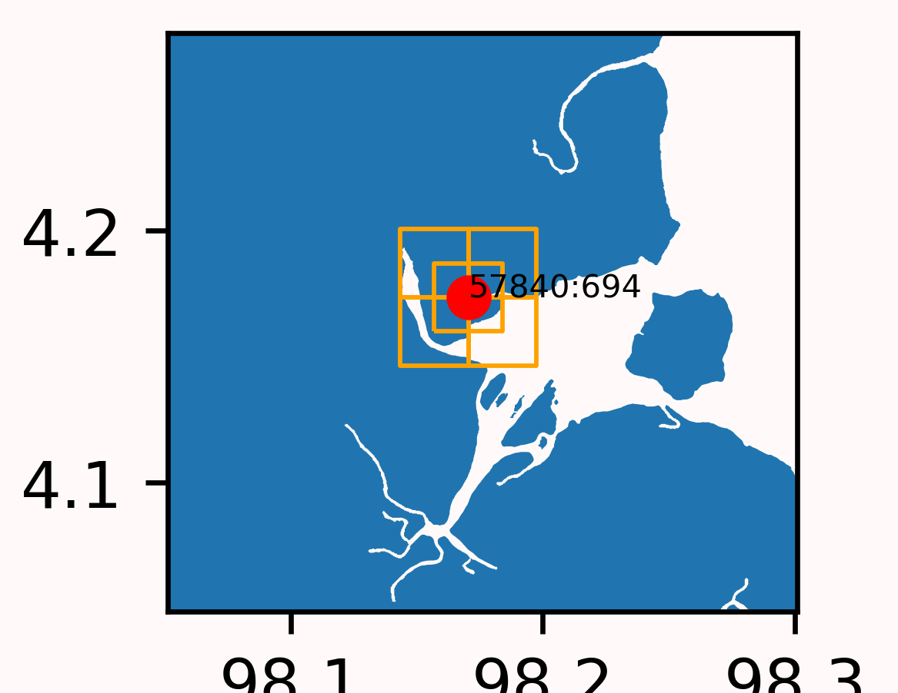
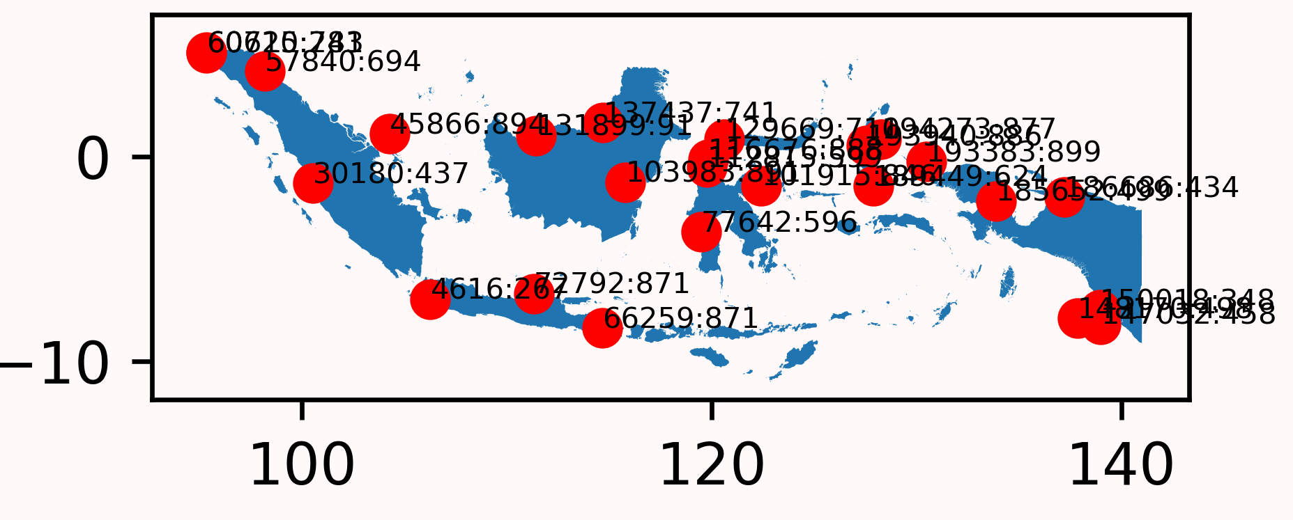
Example result for plotting_cell_reference_coord_determination.py left: full map, right: zoom in on a single point

Slide 5
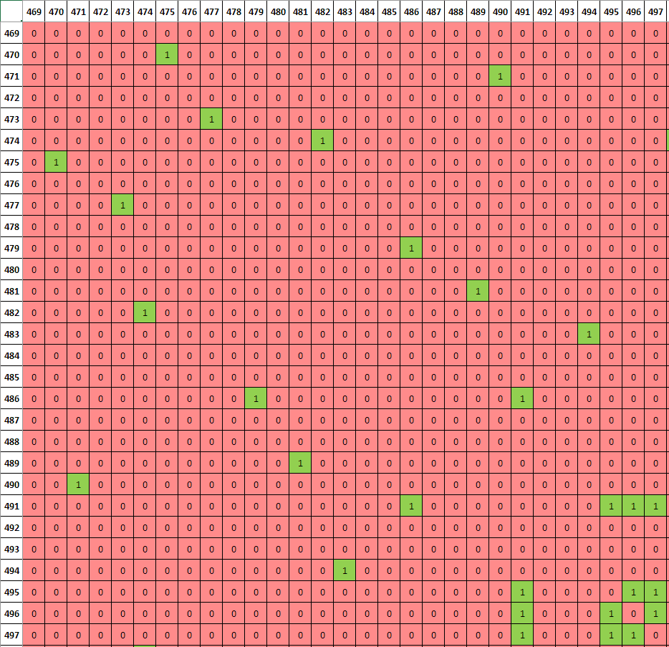
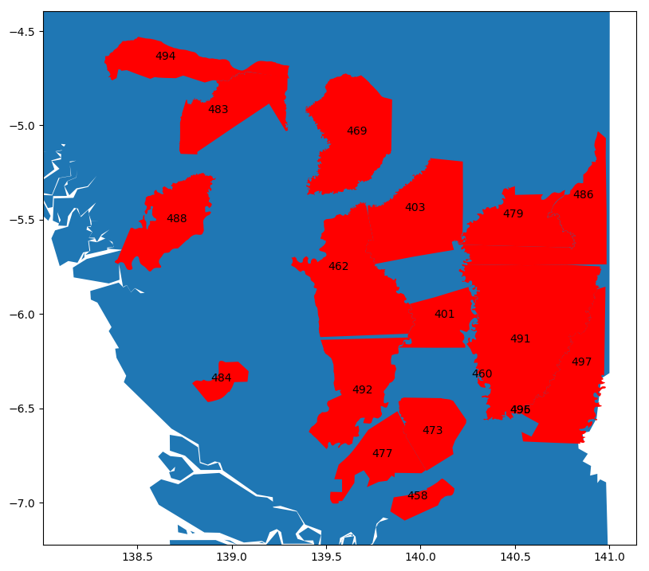
Notes:
Illustrated relation btwn concession distribution <-> corresponding adjacency matrix

Slide 6
Analysis of the logging concessions that are <25% covered by grid cells
Cell | Location on map
118 | Border
232 | Border
233 | Border
293 | Small Island
294 | Small Island
295 | Small Island
297 | Small Island
303 | border
307 | Small island
363 | border
431 | Border
434 | border
438 | border
Cell | Location on map
444 | Border
445 | border
446 | Border
447 | border
448 | border
453 | Border
454 | border
455 | border
456 | border
487 | Small island
532 | border
552 | border

Slide 7
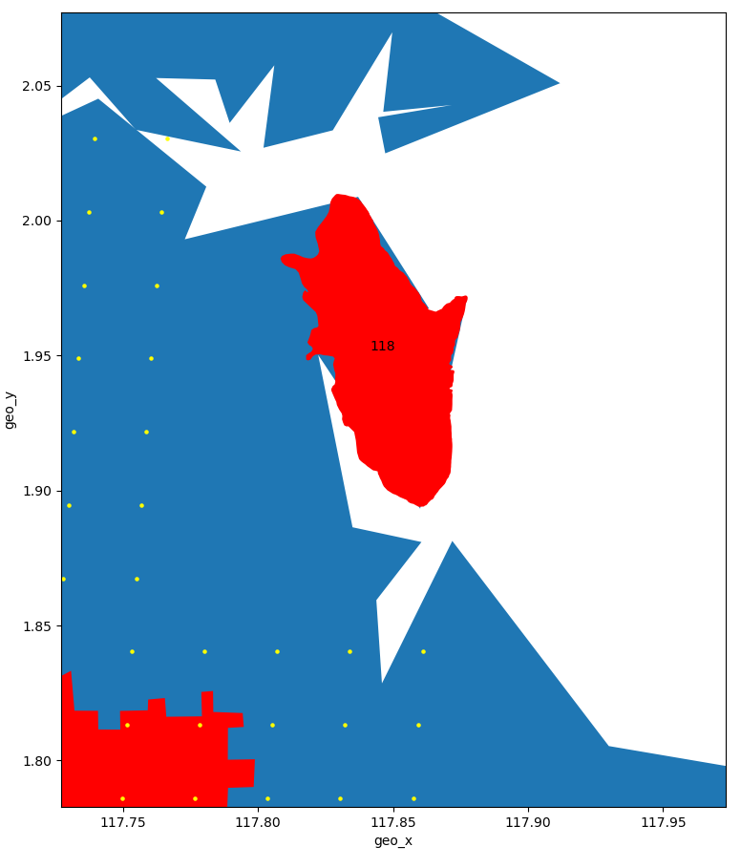
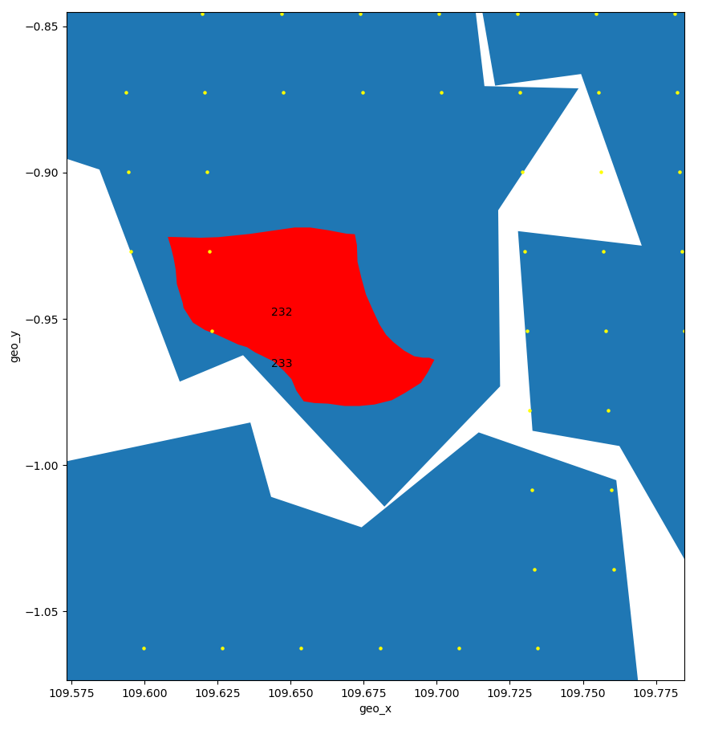

Slide 8
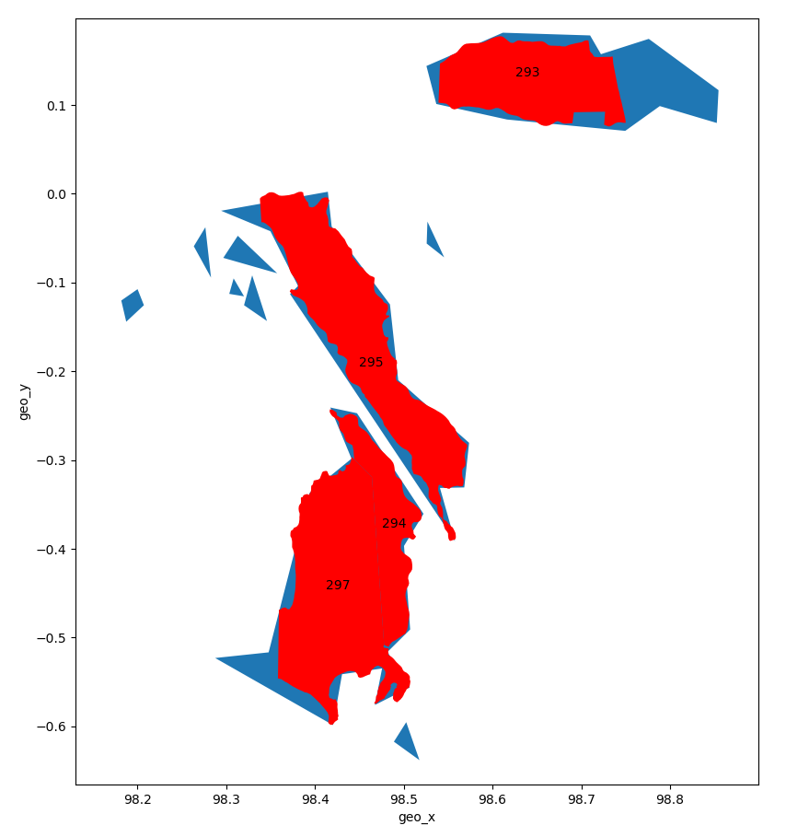
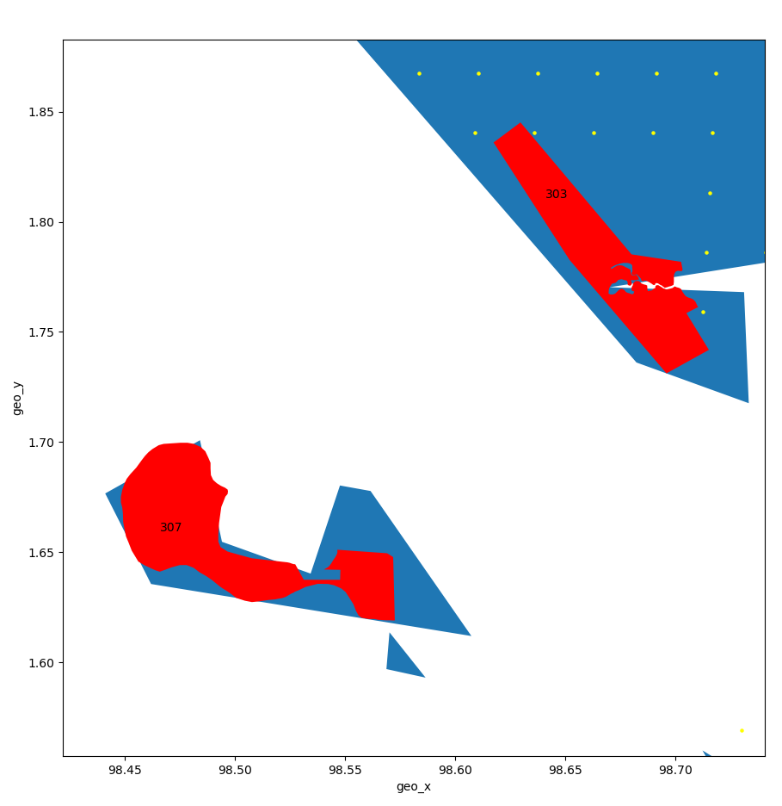

Slide 9
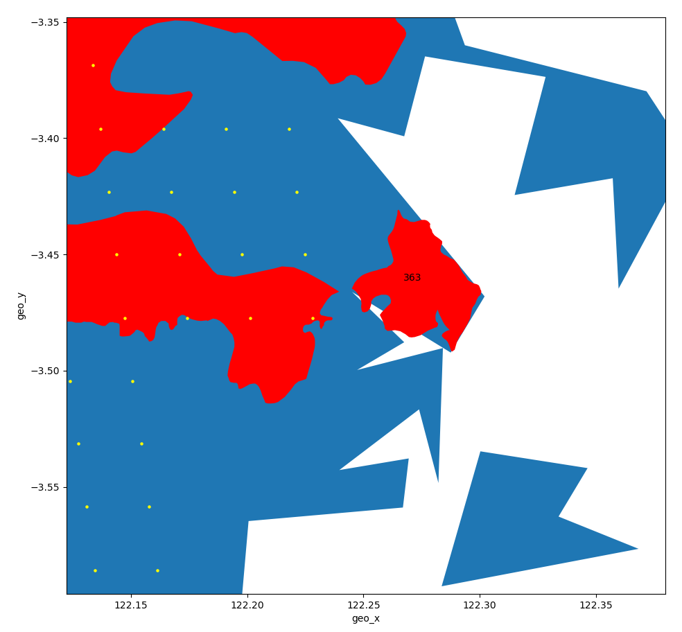
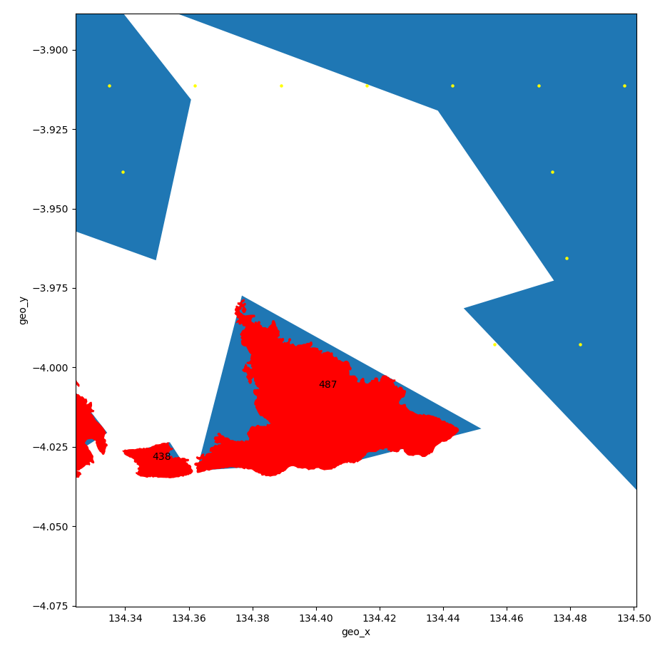

Slide 10
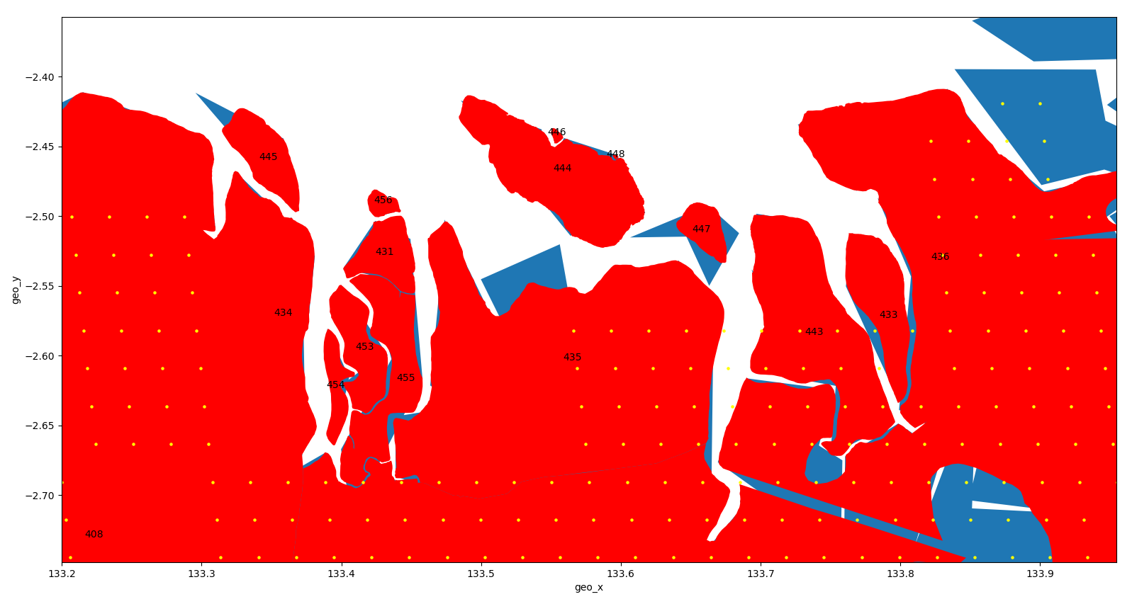

Slide 11
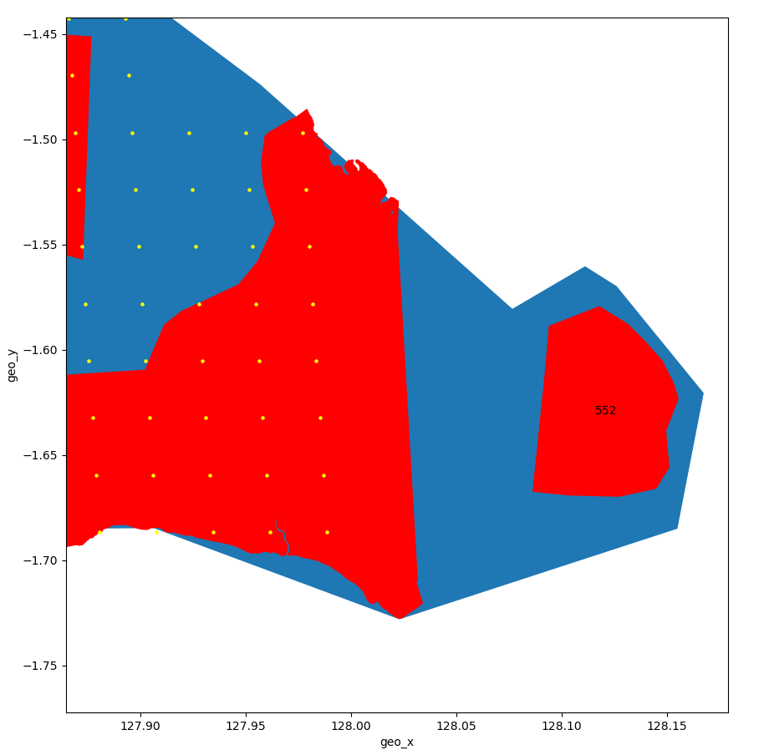
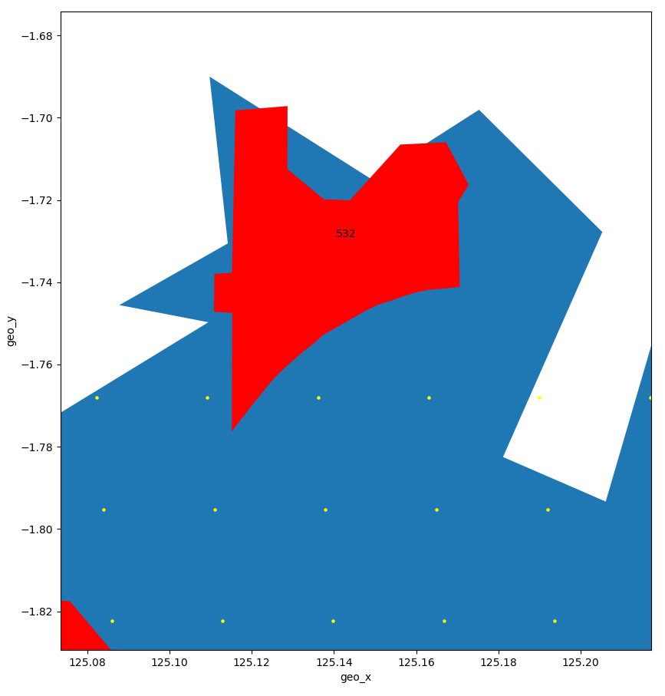

Slide 12
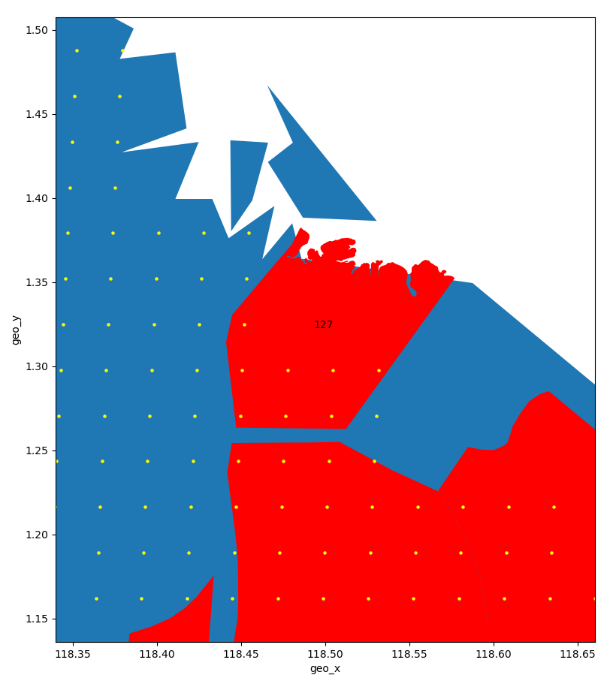
Analysis of logging concessions that are 25-50% of cell covered
Cell | Location on map
127 | Border
312 | island
433 | Border
435 | Border
520 | Border on island
544 | Border
549 | border
551 | Border/island

Slide 13
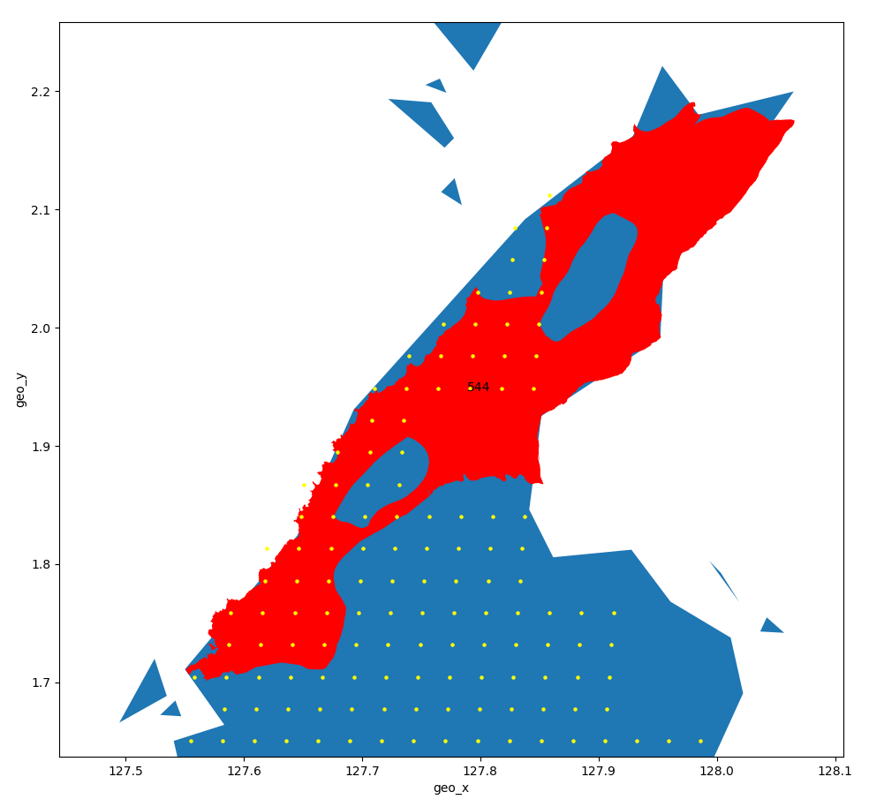
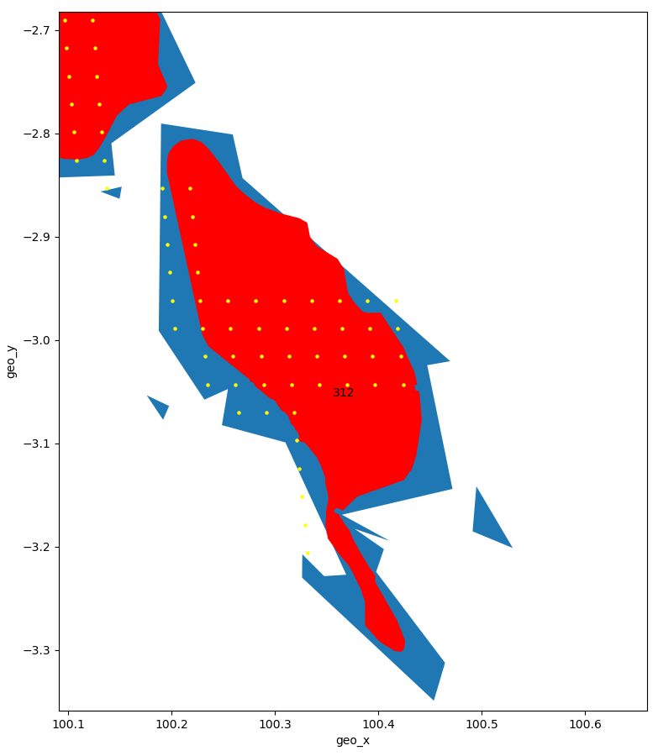

Slide 14
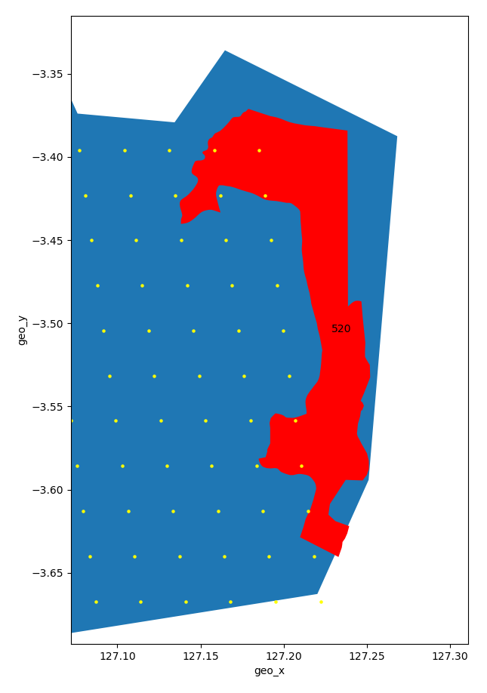
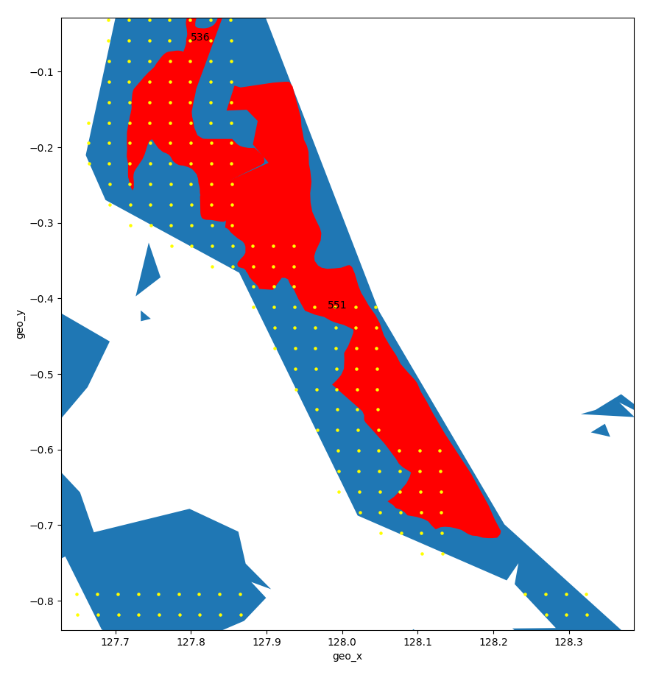

Slide 15
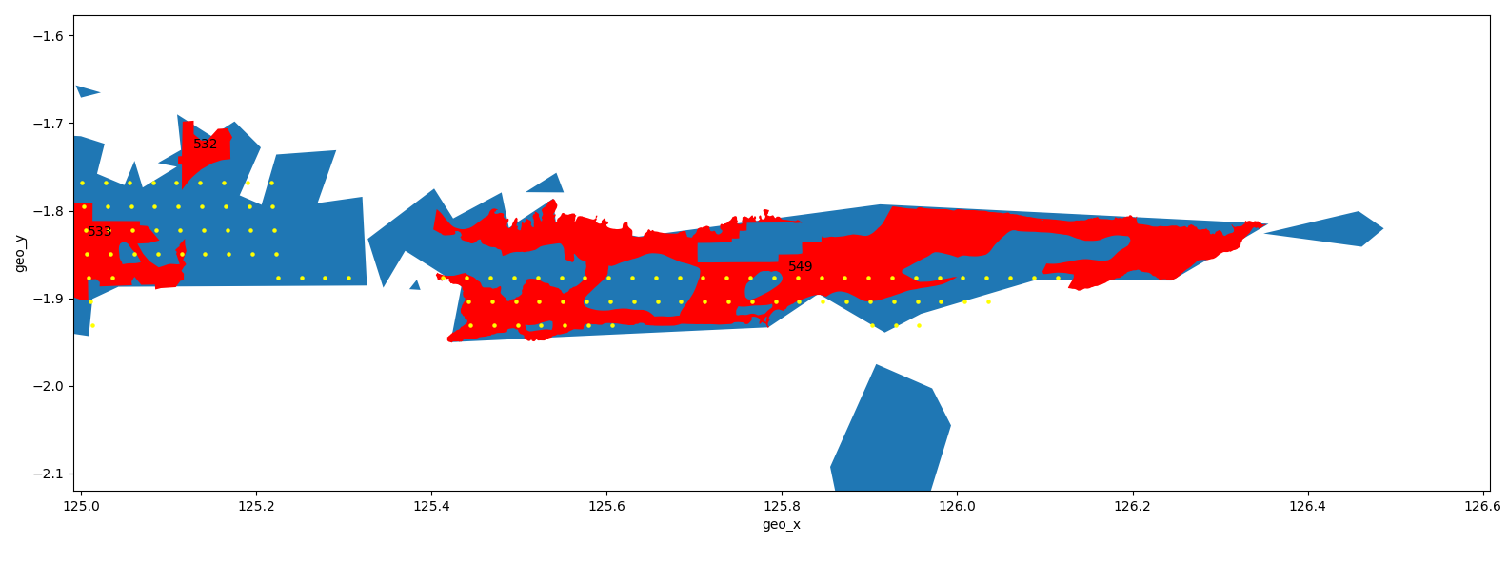

Slide 16
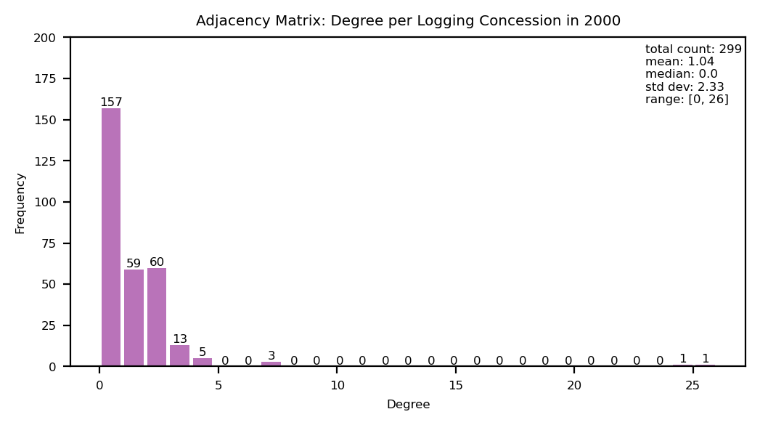
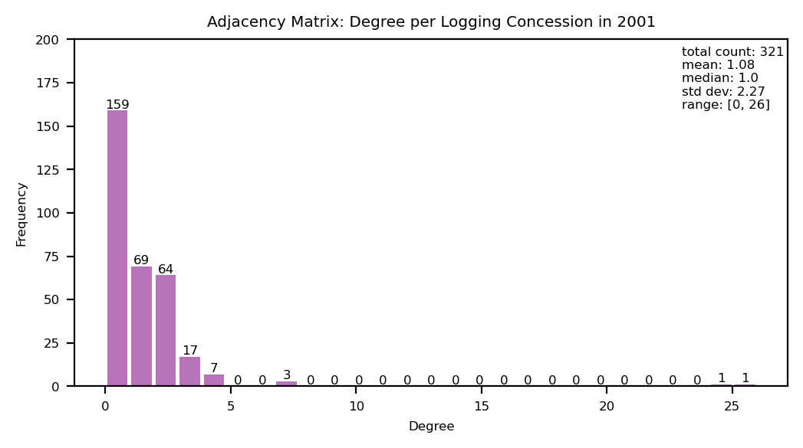
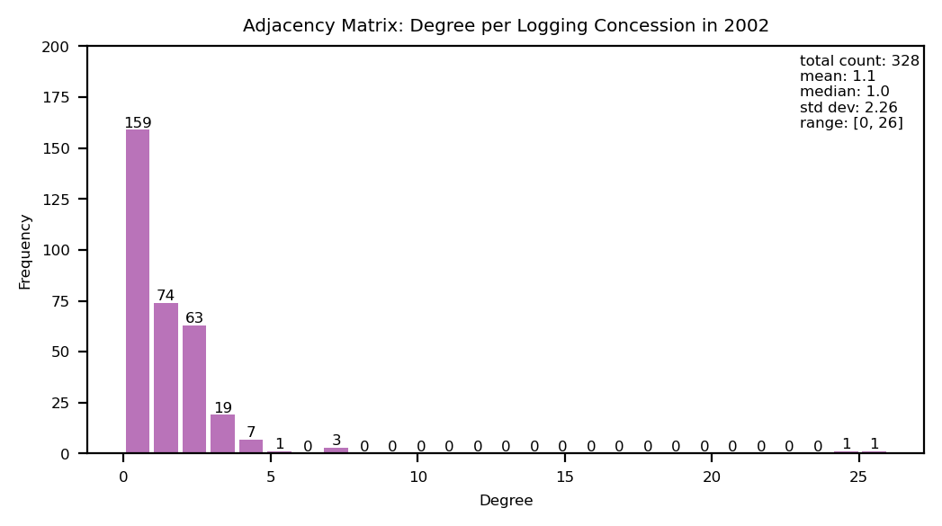

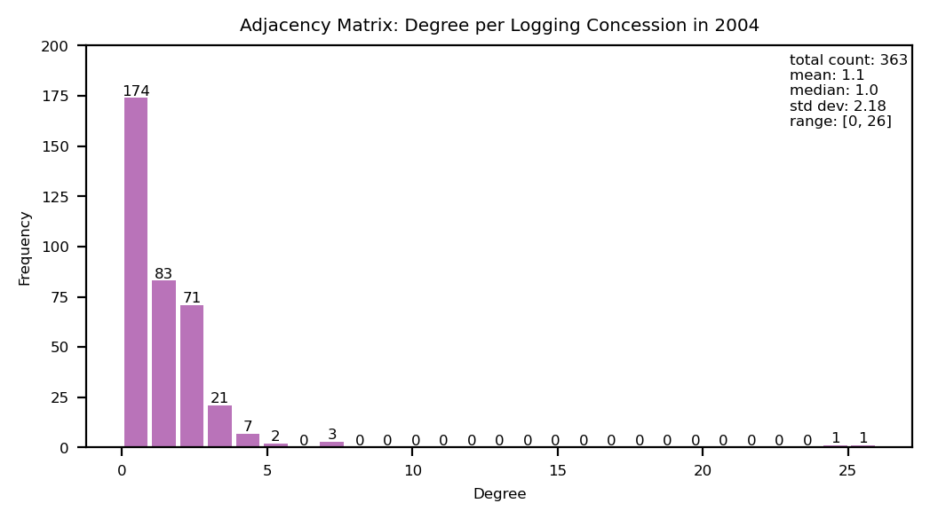
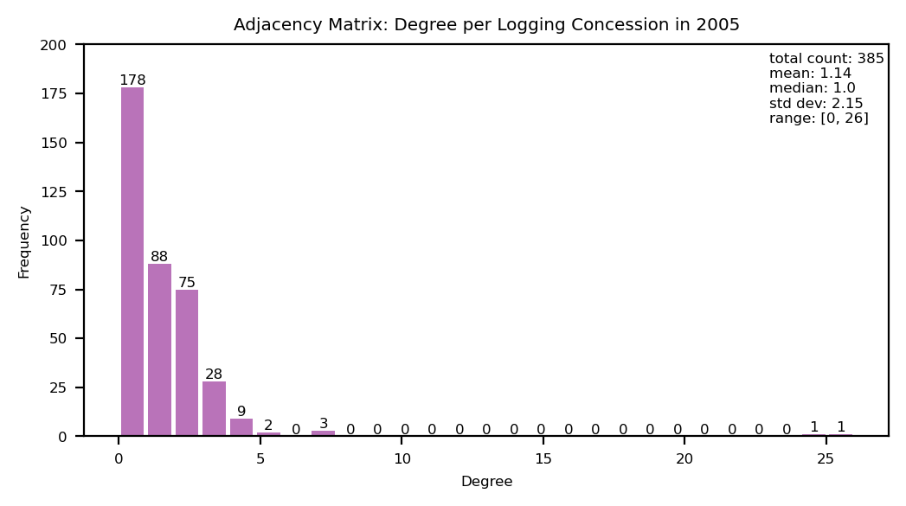
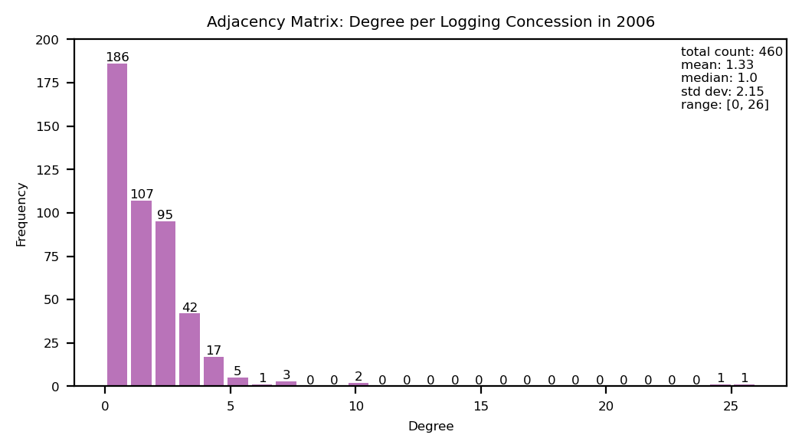
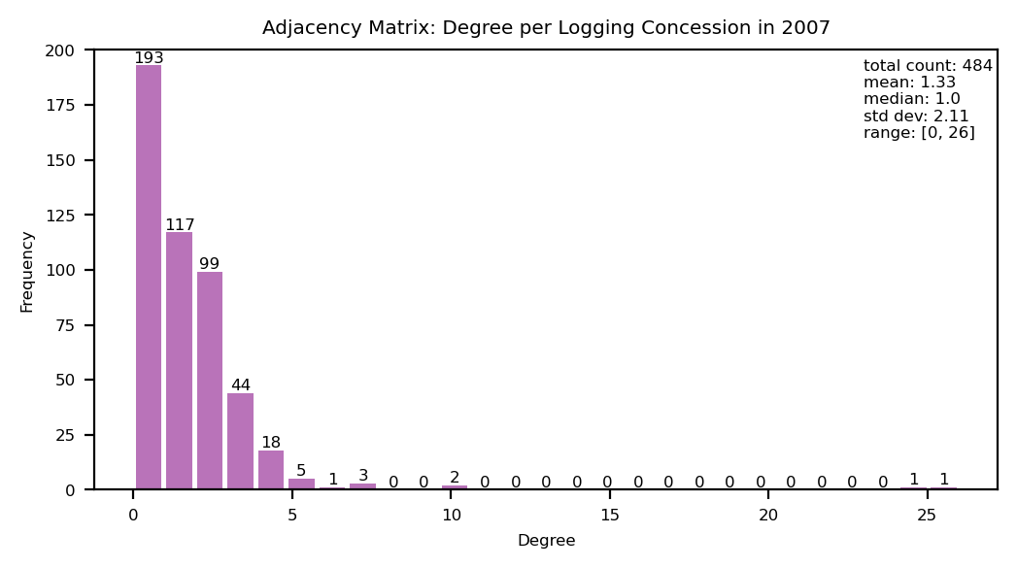

Notes:
Adjacency matrices over time

