Slide 1

Data Science Capstone
SpaceX Launching Info Investigation
Sarah Zhang

Slide 2
CONTENTS
01
02
03
04
Executive Summary
Introduction
Methodology
Result & Conclusion

Slide 3
01
Executive Summary

Slide 4

Executive Summary
In this project, we will use
SpaceX API and some online rescoures to collect the launching data;
EDA to analyse the successful rate of the past experienments;
the visualization tools to analyse which feature is the most significate to the outcome;
classification models to predict the next launch event

Slide 5
02
Introduction

Slide 6
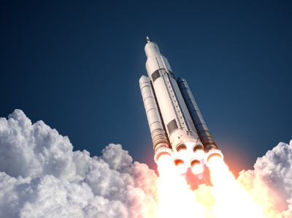


Introduction
SpaceX advertises Falcon 9 rocket launches on its website with a cost of 62 million dollars; other providers cost upwards of 165 million dollars each, much of the savings is because SpaceX can reuse the first stage. Therefore, if we can determine if the first stage will land, we can determine the cost of a launch. We will determine the price of each launch and if Space X will reuse the first stage.

Slide 7
03
Methodology

Slide 8

Data Collection & Data Wragling
Data collection from two ways:
SpaceX API, a public API, is free to gather data about Falcon 9 launches
The dataset is not clean, which has some missing values. I did a checking and made it clean
Wikipedia, which contains a list of Falcon 9 and Falcon Heavy Lauches records
Used web scraping and saved to a csv file
After getting above dataset, I did a data wragling to see the overview of our dataset. To summarize the result, the landing outcome label was created

Slide 9
EDA & Interactive Visual Analytics
Using SQL language to summarize some statistics that we care about, such as
the total payload mass, date of first successful outcome, number of booster version
Using seaborn to visualize the relationship between features.
scatterplot and barplot areused
Using interactive map with Folium
Markers indicate launch site
Circles indicate highlighted area
Lines indicate the distance between two area

Slide 10
Predictive Analysis
Prepare data and standalize them.
Split data into training and testing group
Use logistics regression, support vector machine, decision tree and KNN classification models to train the dataset.
Compare and get a most accuracy result

Slide 11
04
Results &
Conclusion

Slide 12
EDA with SQL Results
SpaceX has four Launch sites in the space mission.
All of the launch site that begin with the string ‘CCA’ are F9 v1.0 booster version.
111268 payload mass carried by boosters launched by NASA (CRS).
Booster version F9 v1.1 carry 2928.4 payload mass averagly.
F9 FT B1032.1, F9 B4 B1040.1 and F9 B4 B1043.1 have success in drone ship and have payload mass greater than 4000 but less than 6000.
There are 100 times success and 1 time failure in flight in mission.
Booster version F9 v1.1 B1012 and F9 v1.1 B1015 with CCAFS LC-40 launch sites are failed in 2015

Slide 13
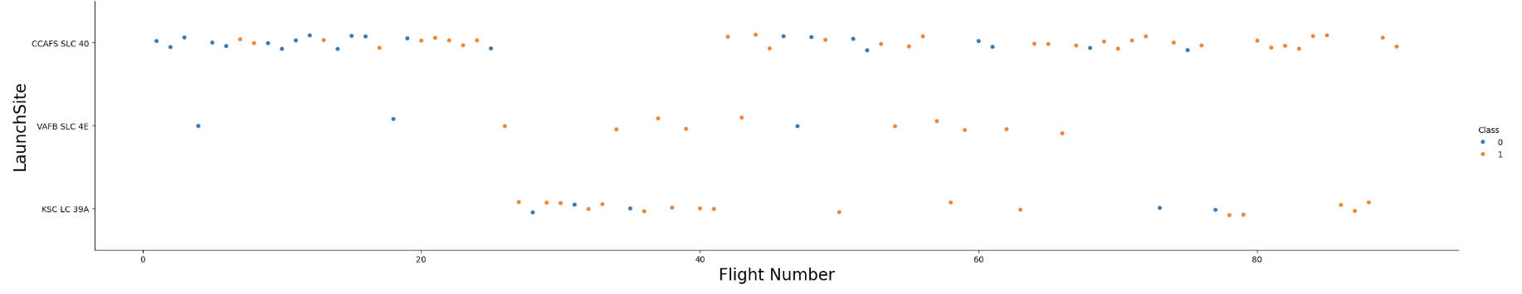
EDA with Visualization Results
CCAFS SSSSLC 40 launch site is the most often used site. It’s also has a wide range of Flight number except flight number between 30 to 40.
While KSC LC 39A is have a large numbrt of flight numbrt between that range.
VAFB SLC 4E doesn’t launch many times, but only failed three times

Slide 14
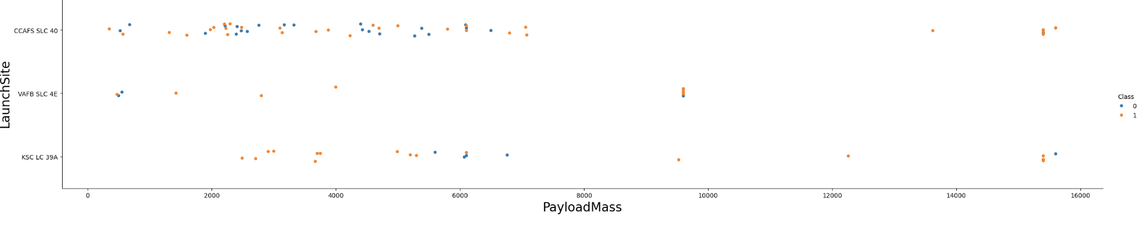
EDA with Visualization Results
Payload over 9000 has a better successful rate

Slide 15
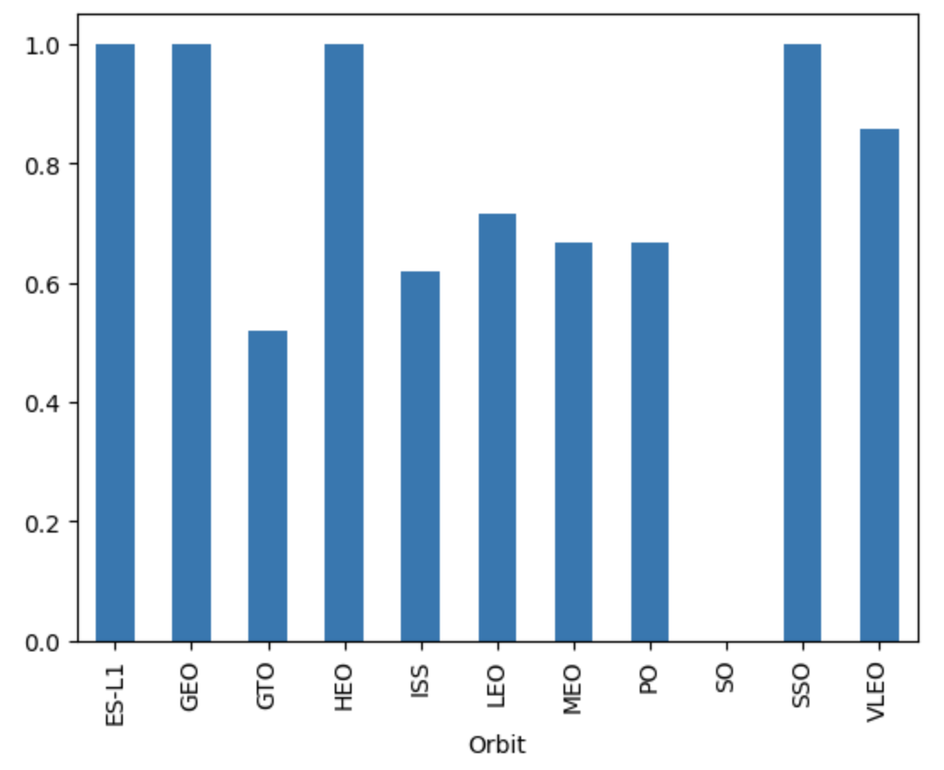
EDA with Visualization Results
ES-L1, GEO, HEO and SSO are 100% success by Orbit
Followed by LEO (around 70%) , MEO and PO (around 65%)
Unfortunately, there is no success with orbit SO

Slide 16
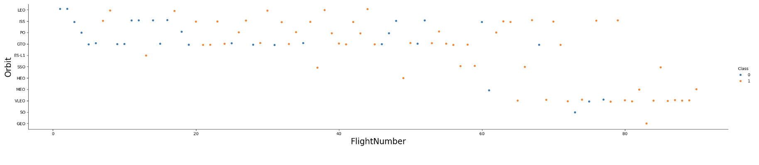
EDA with Visualization Results
At the begining, SpaceX is more often to test with orbit LEO, ISS, PO and OTO. After Flight number 60, they change to focus more on VLEO
It is obverious that the success rate increase a lot as time pass. Especially when they test on VLEO.

Slide 17
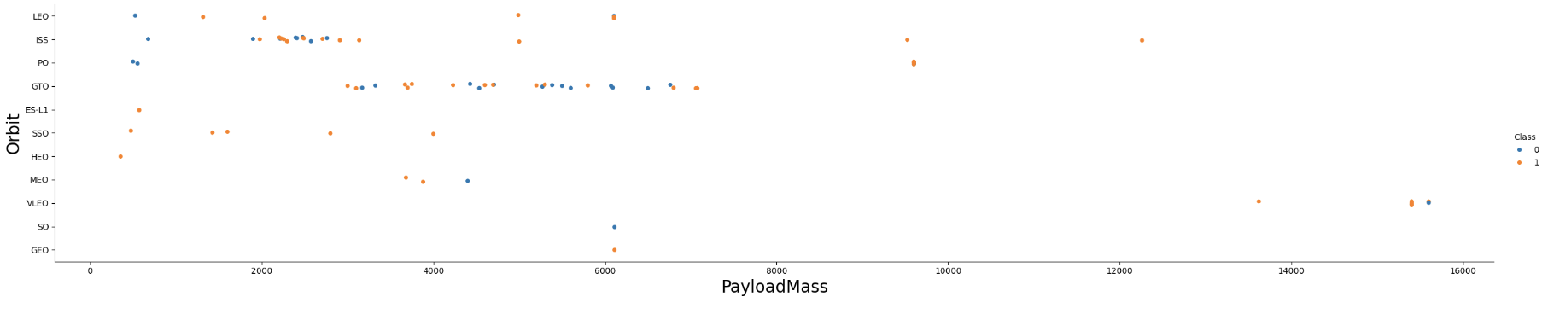
EDA with Visualization Results
ES-L1, SSO and HEO perform good in low payload (less than 2000), while LEO, ISS, PO failed in most cases.
VLEO has a very high payload mass but the highest one with 16000 failed

Slide 18
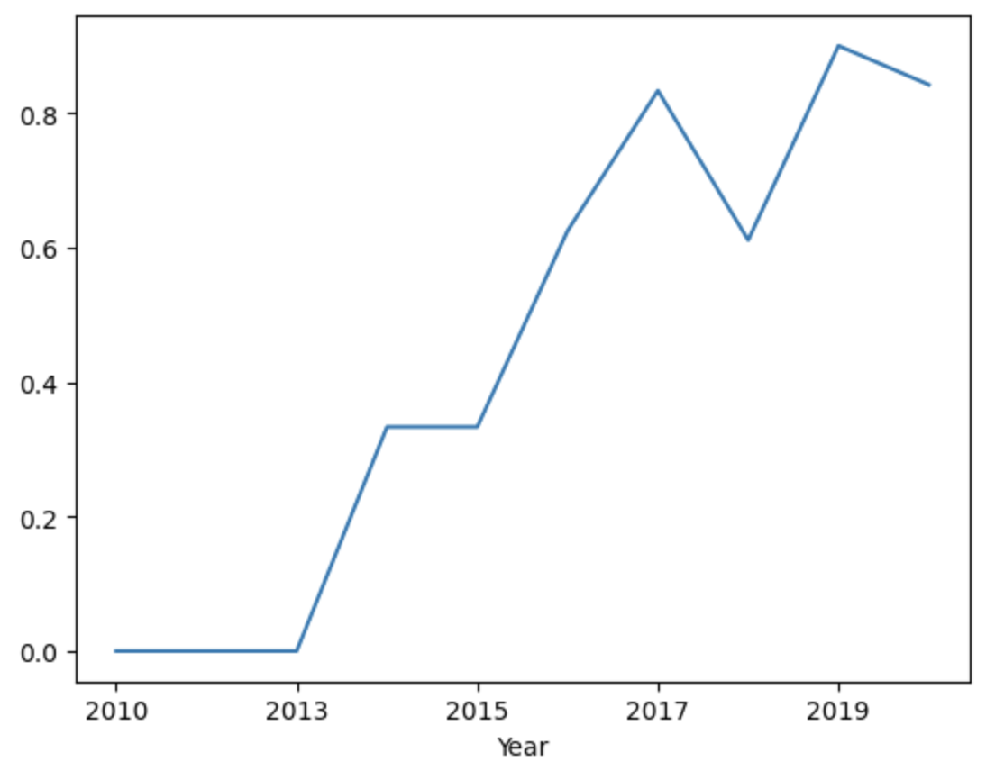
EDA with Visualization Results
The success rate keep increased pass the years

Slide 19
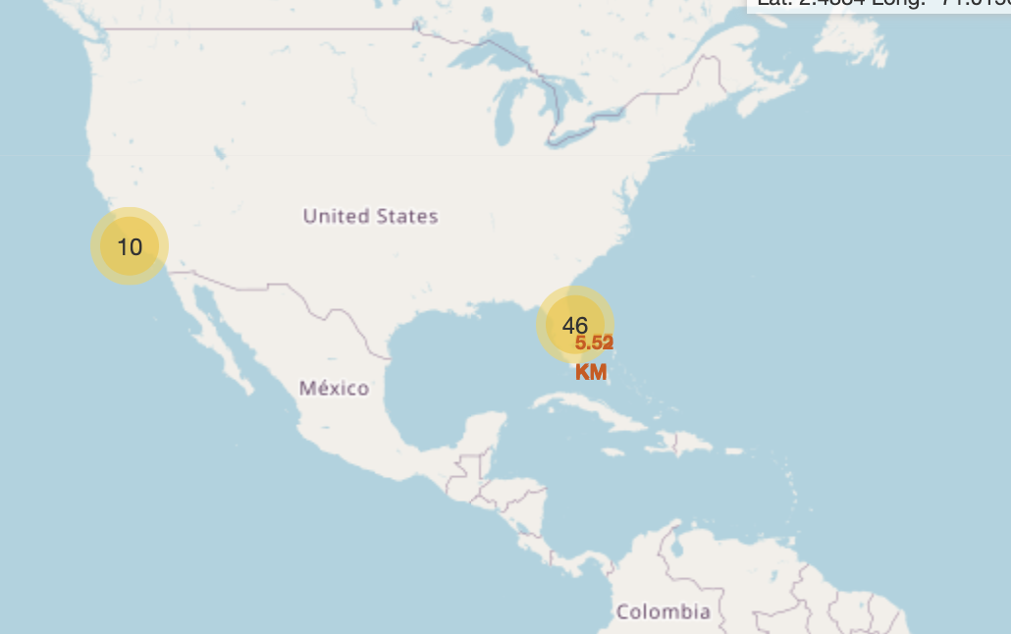
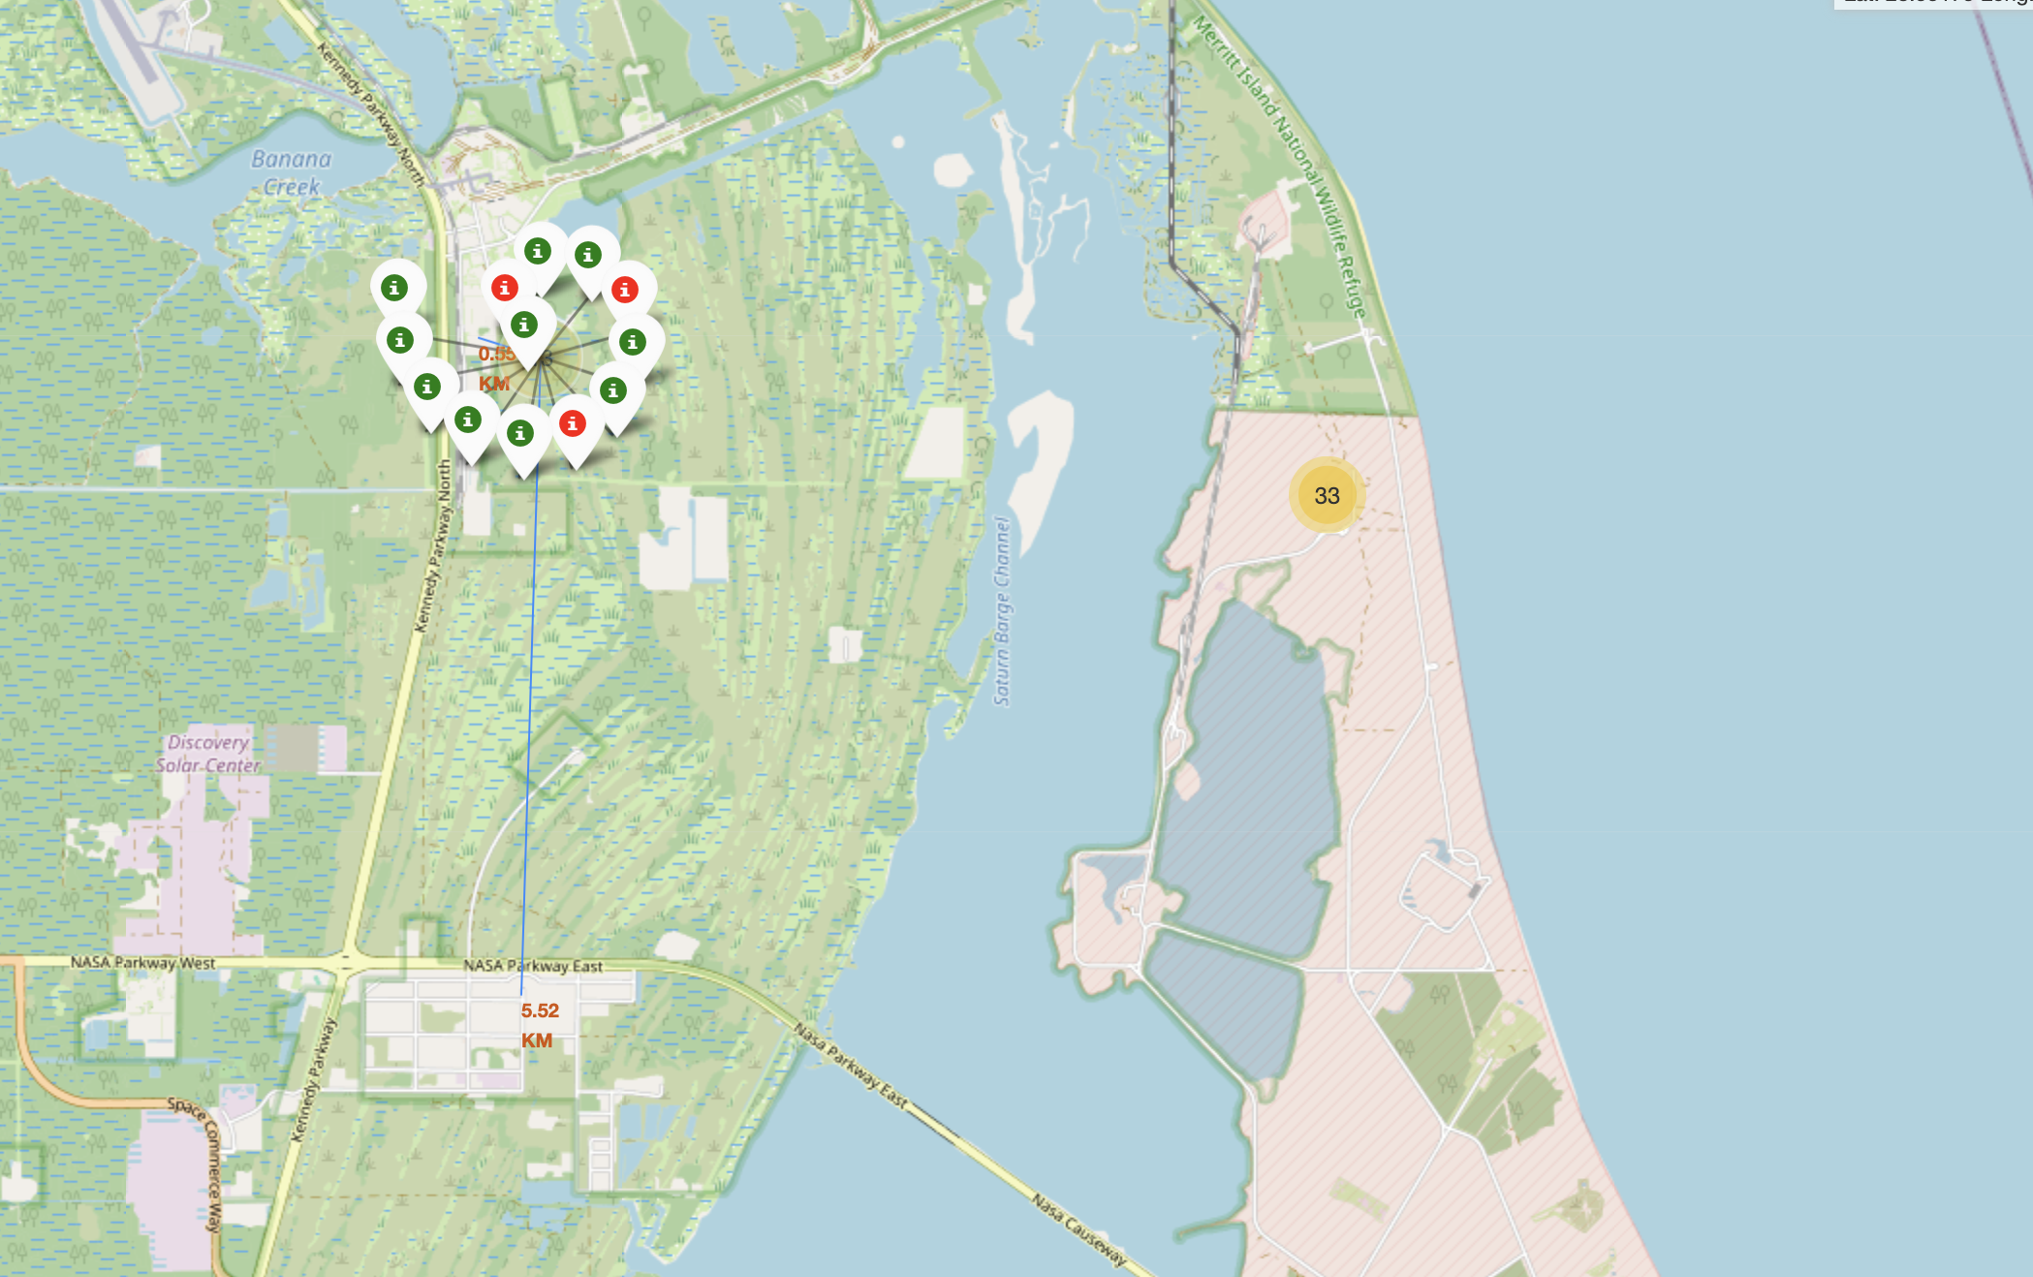
interactive Map with Folium Results
Launch site usually loacte in a safe place near the sea
The one near the Kennedy Parkway has the highest successful rate. It’s also near the city. The nearest one only 0.55 KM.

Slide 20
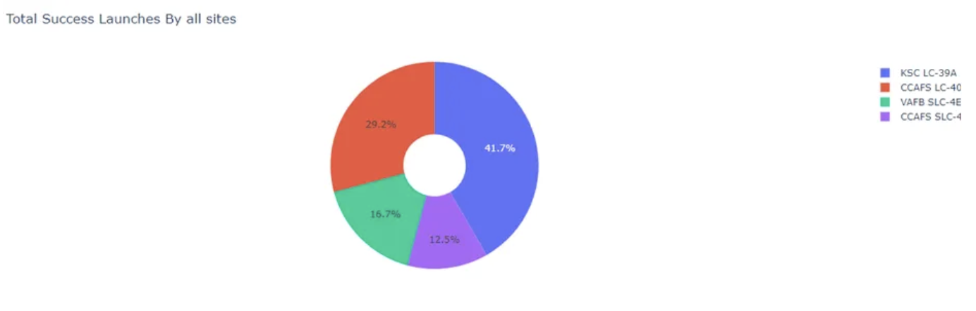
Plotly Dash Dashboard
KSC LC-39A have the largest number of success lauches, which is about 42%, nearly a half.
The second Launch site is CCAFS LC-40, 29%

Slide 21
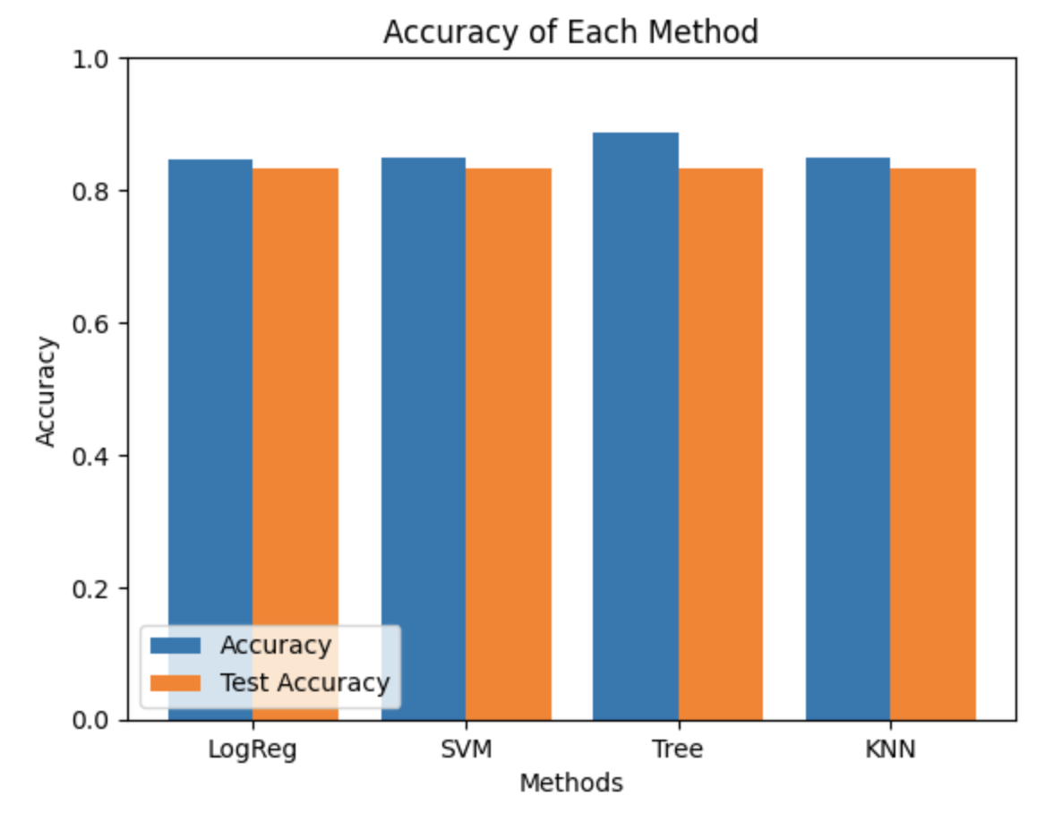
Predictive Analysis Results
Desicion tree model has the best performance, which has 89% accuracy and 83% of test accuracy.

Slide 22

Conclusion
By leveraging existing data and conducting thorough analyses, SpaceX and other rocket companies can strategically identify avenues to slash launch costs. This proactive approach ensures their evolution, preventing their traditional, expensive launches from rendering them obsolete and alienating their clientele.

Slide 23
THANKS

