Slide 1

Handwritten Digit Recognition
Dr. Motasem Elshourbagy

Slide 2
Team Number: 22
Team Members
Rahma Mohamed Makram
Rana Mohamed Hussein Mohamed
Sarah Gamal El-Deen
Solwan Shokry Ahmed

Slide 3
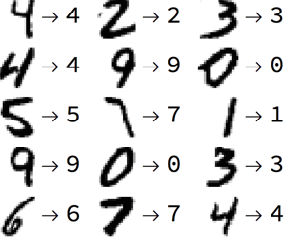
Handwritten Digit Recognition
The handwritten digit recognition is the ability of computers to recognize human handwritten digits. It is a hard task for the machine because handwritten digits are not perfect and can be made with many different flavours.
The handwritten digit recognition is the solution to this problem which uses the image of a digit and recognizes the digit present in the image.

Slide 4
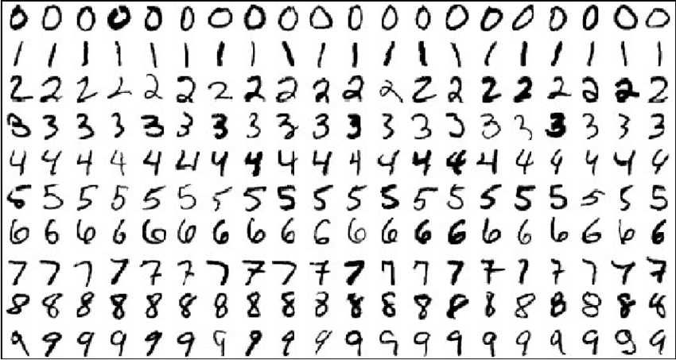
MNIST Data Set
The MNIST database (Modified National Institute of Standards and Technology database) is a large database of handwritten digits that is commonly used for training various image processing systems. The database is also widely used for training and testing in the field of machine and deep learning. It was created by "re-mixing" the samples from NIST's original datasets. Furthermore, the black and white images from NIST were normalized to fit into a 28x28 pixel bounding box and anti-aliased, which introduced grayscale levels.
The MNIST database contains 60,000 training images and 10,000 testing images.
The MNIST handwritten digit classification problem is a standard dataset used in computer vision and deep learning.

Slide 5
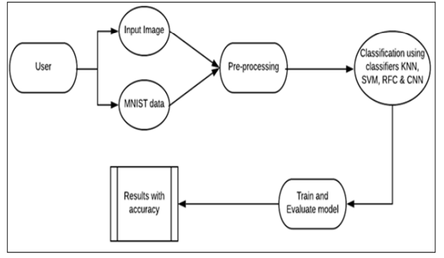
Block Diagram:

Slide 6
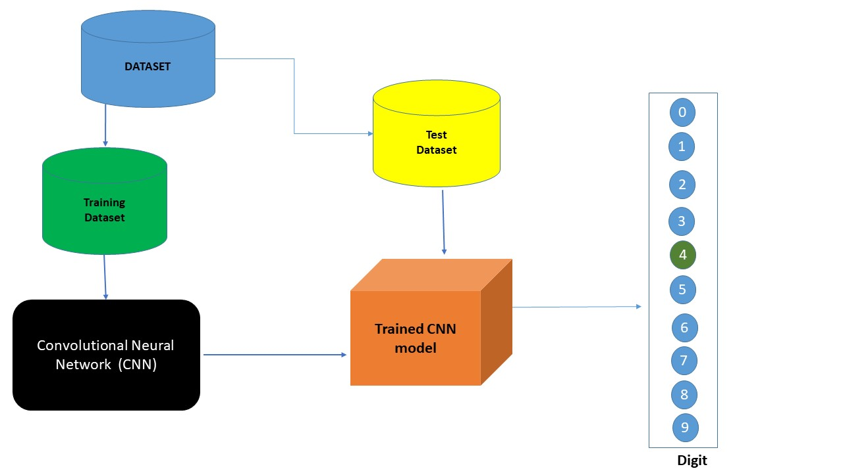
Block Diagram:

Slide 7



Tools Used:
1- Jupyter Notebook.
2- Computer vision library: OpenCV
3- Network used: Convolutional Network
4- Dataset: MNIST Dataset
5- Framework used: TensorFlow
6- API : Keras
7- GUI : Tkinter library.

Slide 8
Algorithm for Handwritten Digit Detection
Import the libraries and load the dataset.
Preprocess the data.
Create the model.
Train the model.
Evaluate the model.
Obtain the image to be predicted from the user
Perform processing on the image and predict digit :
The image is converted to a grey scale image and color inverted, the image is introduced to the trained model to make predictions
In case of the web cam prediction the image processing also include:
Gaussian Blur
Thresholding
Canny Edge detection
Find contours
Find Contour area

Slide 9
Block Diagram:

Slide 10
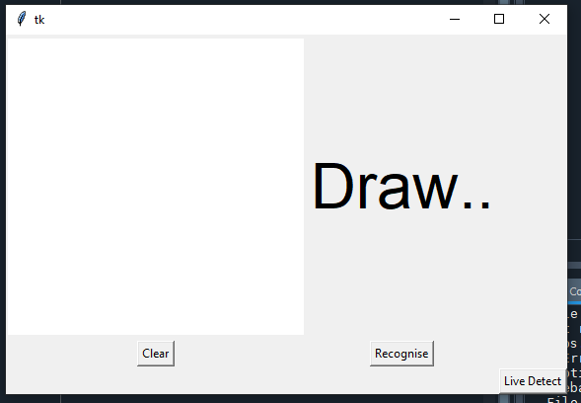
GUI

Slide 11
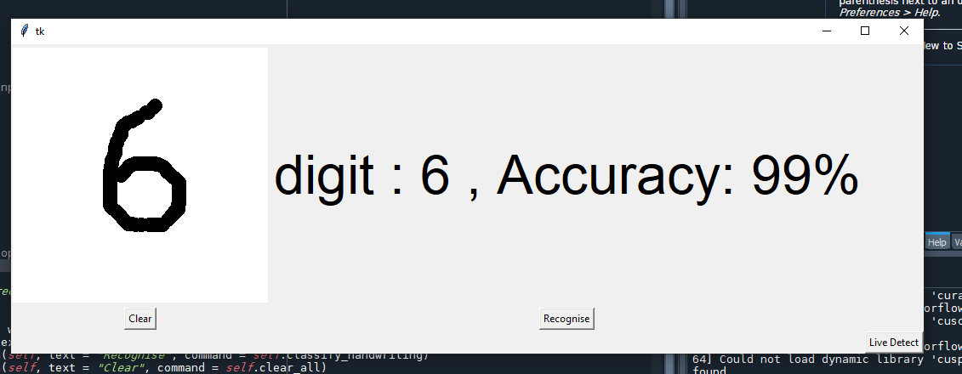
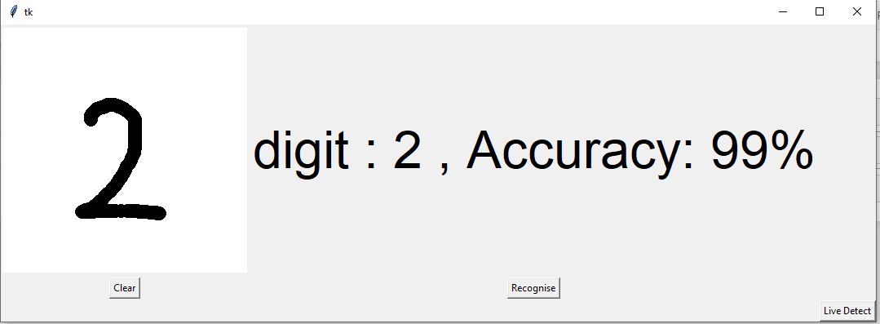
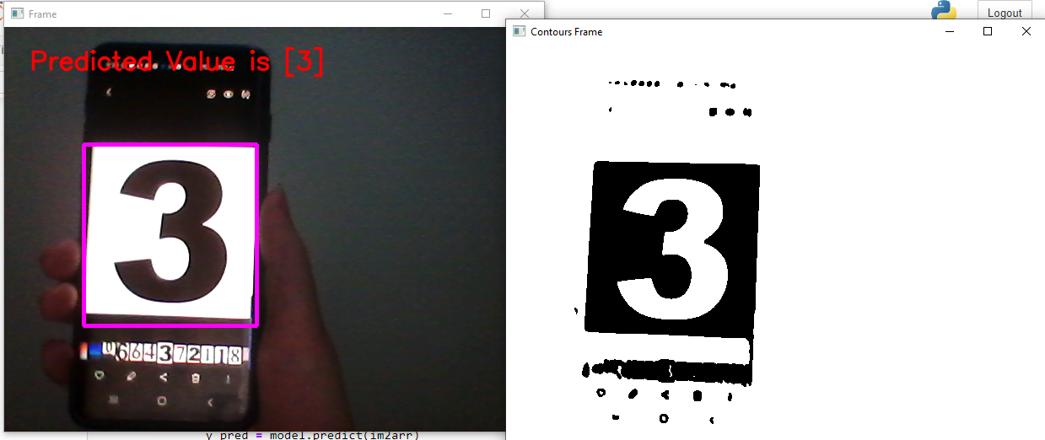

Slide 12
Thank You

