Slide 1
REAL-TIME BIG DATA ANALYTICS PLATFORM
NYC Taxi Real-Time
Analytics Platform
Streaming NYC Yellow Taxi trips from Kafka through Spark into ClickHouse — orchestrated end to end with Airflow and visualized in Superset & queried via AI Agent.
Kafka
Spark
ClickHouse
Airflow
Docker
NYC TLC YELLOW TAXI TRIP RECORDS · 2025

Slide 2





PROJECT OVERVIEW
What we built
A Big Data platform that takes NYC Yellow Taxi trip records, streams them the way live production traffic would arrive, cleans and aggregates them in flight, and stores the result where analysts can query it in milliseconds — fully automated and containerized.
Simulate real-time streaming
Automated orchestration
Publish historical trip records through Kafka as if they were live events.
Airflow verifies infrastructure health and triggers the stream.
Clean & transform at scale
Modern, containerized stack
Spark Structured Streaming validates, casts and filters every trip.
Every service runs isolated and reproducible via Docker Compose.
Analytics-ready storage
ClickHouse holds trip-level records for sub-second queries.
02

Slide 3







TECHNOLOGY STACK
Built on proven, industry-standard tools
Python
Apache Kafka
Apache Spark
ClickHouse
Core language
Event streaming
Stream processing
Analytical DB
Apache Airflow
Docker Compose
FastAPI & LangChain AI Agent API
Orchestration
Containerization
Data wrangling
03

Slide 4

HOW IT WORKS
One trip, five hand-offs
Apache Airflow — orchestrates every stage
Parquet Files
Kafka
Spark
ClickHouse
Raw NYC TLC trip data
taxi-trips topic
Clean · validate · aggregate
Trips table
AI Agent
Dashboards, KPIs & zone insights
Seven stages — walked through one by one, next.
04

Slide 5
STEP 1 OF 6 — SOURCE DATA
NYC TLC Yellow Taxi trip records
Sourced from the official NYC Taxi & Limousine Commission archive (nyc.gov/tlc) — monthly Parquet files covering every yellow-cab trip in 2025, streamed sequentially to simulate a live production feed.
35+ MILLION
20
ClickHouse target schema — taxi_trips
pickup_datetime
DateTime
TRIP RECORDS (FULL 2025)
RAW SOURCE FIELDS
dropoff_datetime
DateTime
passenger_count
Int32
trip_distance
Float32
172
3.1 mi
pickup_location_id
Int32
dropoff_location_id
Int32
DISTINCT PICKUP ZONES
AVERAGE TRIP DISTANCE
fare_amount / tip_amount
Float32
total_amount
Float32
payment_type
UInt8
05

Slide 6
STEP 2 OF 6 — EVENT STREAMING
Kafka — the real-time backbone
TRAFFIC MODES
What it does
The producer can simulate different demand levels
A Python producer reads NYC Taxi trip rows from the Parquet source and publishes each one as a JSON message to a Kafka topic — turning a static historical file into a live, continuous event stream that downstream consumers can subscribe to.
Peak
~0.05s delay ± 40%
Rush-hour message rate
Normal
Topic
taxi-trips
~0.5s delay ± 30%
Message format
JSON, one trip per record
Typical daytime traffic
Bootstrap server
localhost:9092
Off-peak
~2.0s delay ± 25%
Overnight, low-demand hours
06

Slide 7
STEP 3 OF 6 — STREAM PROCESSING
Spark — cleaning and validating in flight
Spark Structured Streaming subscribes to the Kafka topic, parses each JSON message against a defined schema, casts every field to its proper type, and applies a set of data-quality rules before writing clean micro-batches to ClickHouse via JDBC.
TRANSFORMATIONS
Parse
VALIDATION FILTER
1
Only trips passing every rule reach ClickHouse
Read raw Kafka JSON against a fixed 10-field schema.
Cast
fare_amount ≥ 0
2
Convert timestamps, ints and floats to their target types.
passenger_count ≤ 8
De-duplicate
dropoff_datetime > pickup_datetime
3
Drop exact duplicate trip records.
pickup / dropoff zone IDs between 1 and 265
4
Clean nulls
payment_type between 0 and 6
Drop rows missing pickup/dropoff time; fill missing passenger count.
excludes zero-distance trips with fare > $10
07

Slide 8
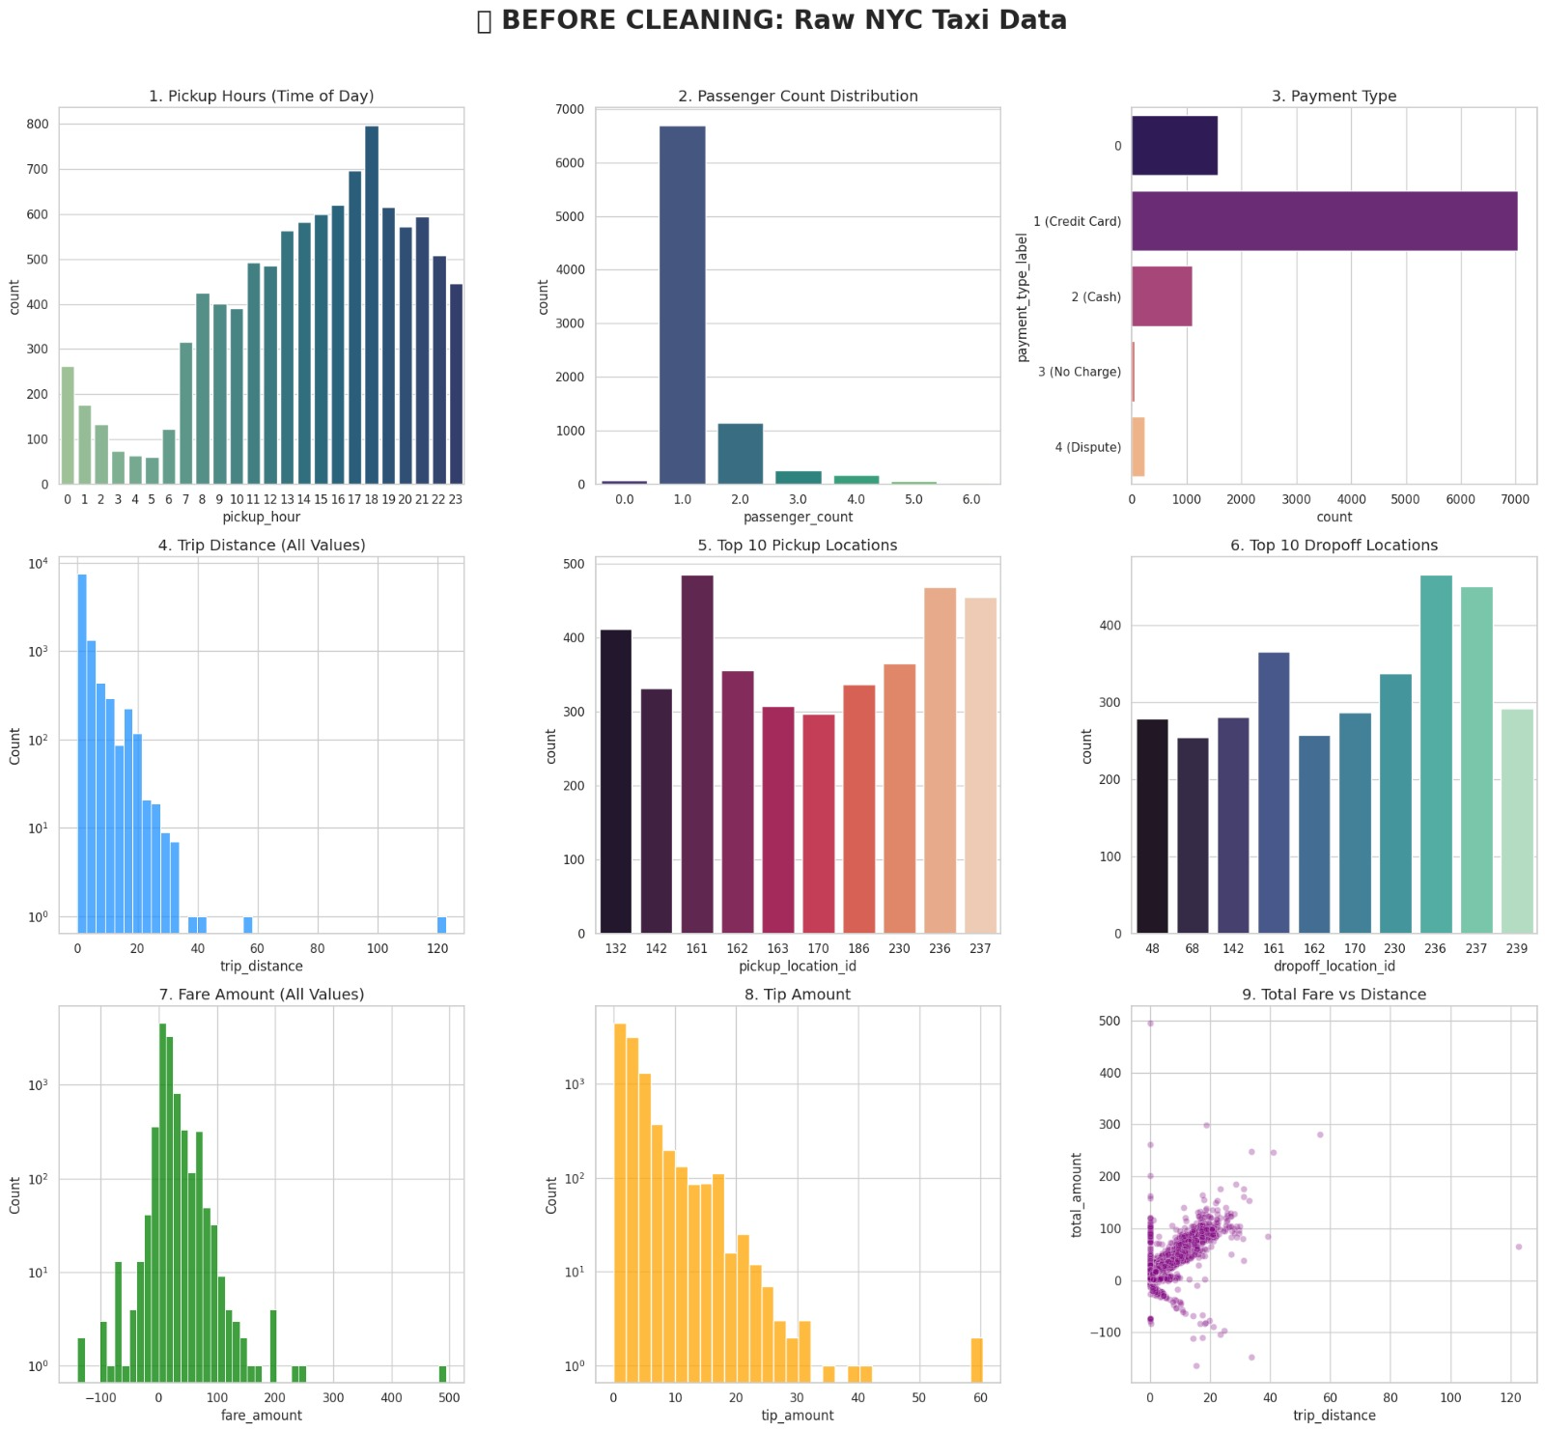
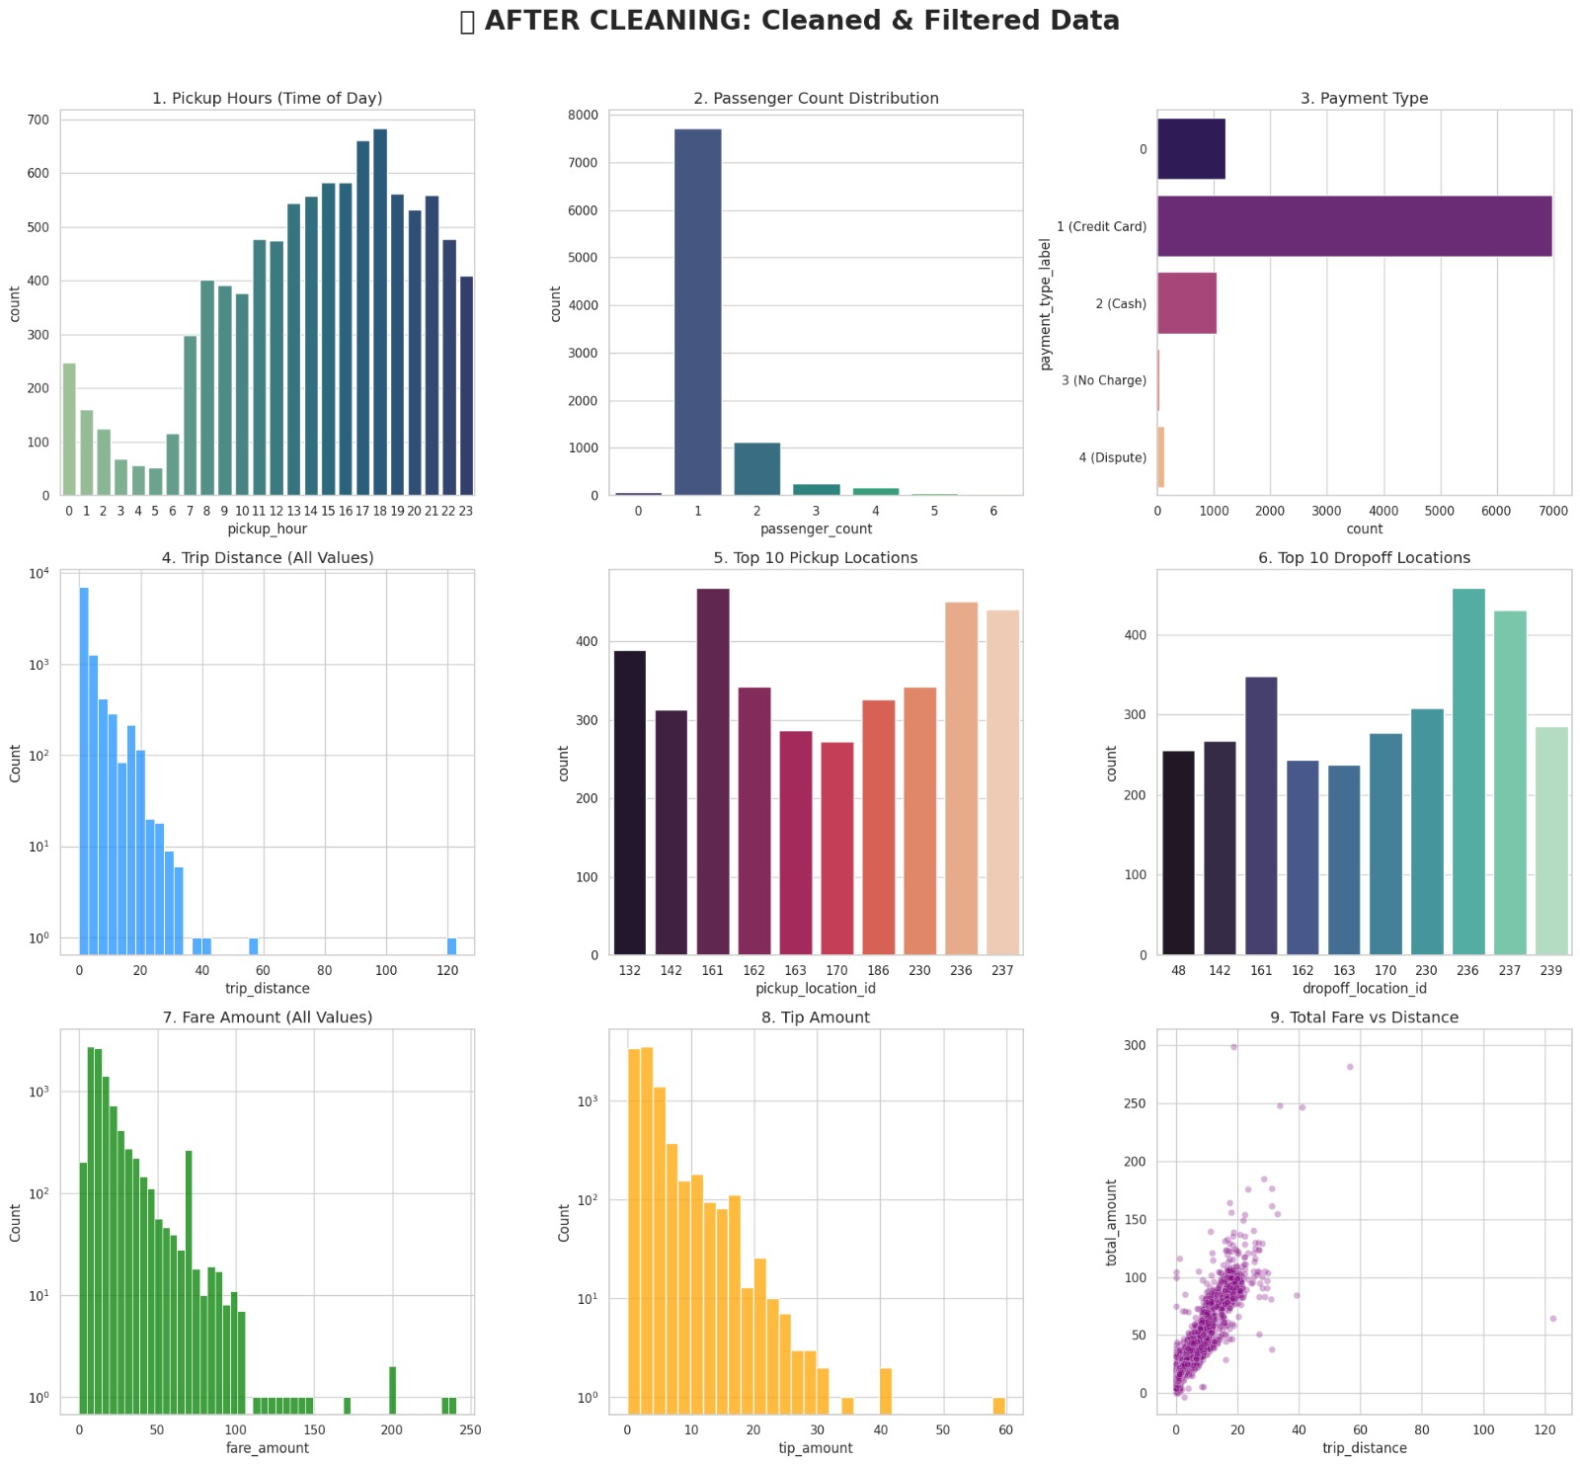
STEP 3 OF 6 — STREAM PROCESSING
Spark — cleaning and validating in flight

Slide 9
STEP 4 OF 6 — ANALYTICAL STORAGE
ClickHouse — built for instant queries
Why ClickHouse
ANALYTICAL QUERIES
What Agents asks ClickHouse
A column-oriented analytical database purpose-built for aggregations over large volumes of event data — exactly the kind of scan-heavy queries a taxi-demand dashboard needs to run in milliseconds.
Total trip volume
COUNT(*) across all trips
SETUP
Average fare & tip
Database
NYC_TAXI
AVG(fare_amount), AVG(tip_amount)
Table
taxi_trips
Engine
MergeTree()
Tip performance by zone
AVG(tip_amount) grouped by pickup_location_id
Ordered by
pickup_datetime
Write path
Spark → JDBC → ClickHouse
Demand over time
COUNT(*) grouped by minute-level pickup time
08

Slide 10



STEP 5 OF 6 — ORCHESTRATION
Airflow — keeping every stage honest
A single DAG — nyc_taxi_pipeline_dag — verifies that Kafka and ClickHouse are reachable before triggering the streaming simulation, with automatic retries on failure.
verify_kafka_connectivity
verify_clickhouse_connectivity
Checks kafka:9092 is reachable
Pings the ClickHouse HTTP endpoint
trigger_stream_simulation
Kicks off the taxi data stream
SCHEDULE
RETRIES
FAILURE ALERTS
Manual trigger
1, with 1-minute delay
Email on failure (configurable)
09

Slide 11
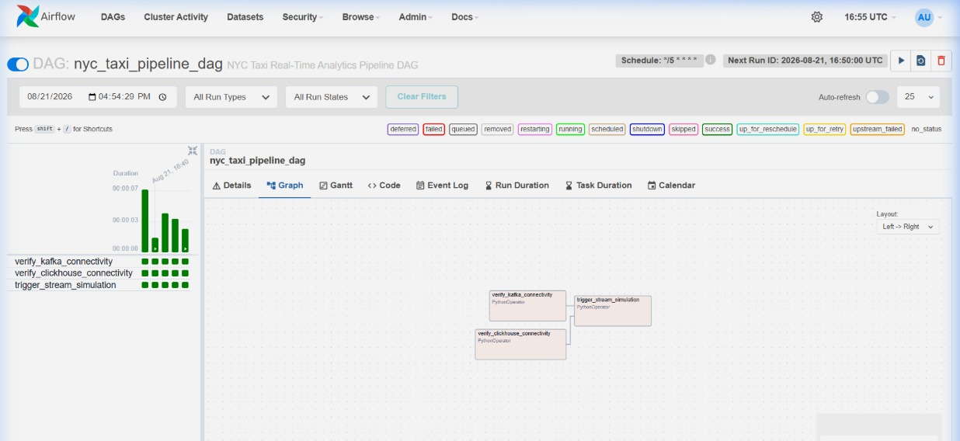
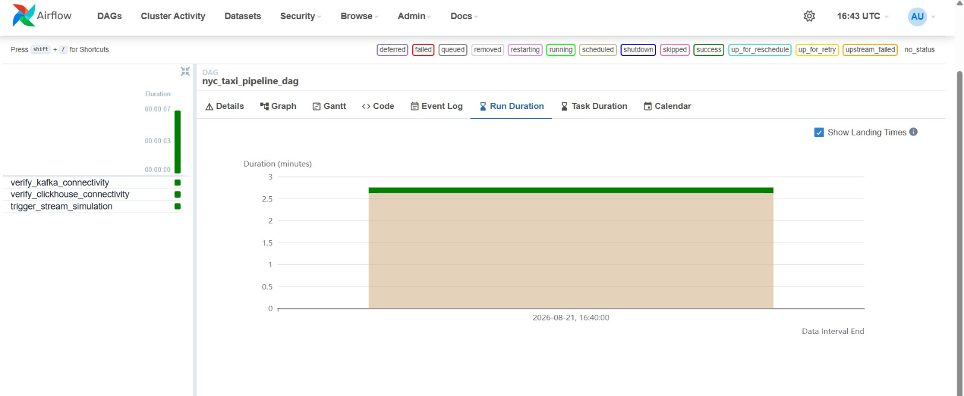
STEP 5 OF 6 — ORCHESTRATION
Airflow — keeping every stage honest

Slide 12
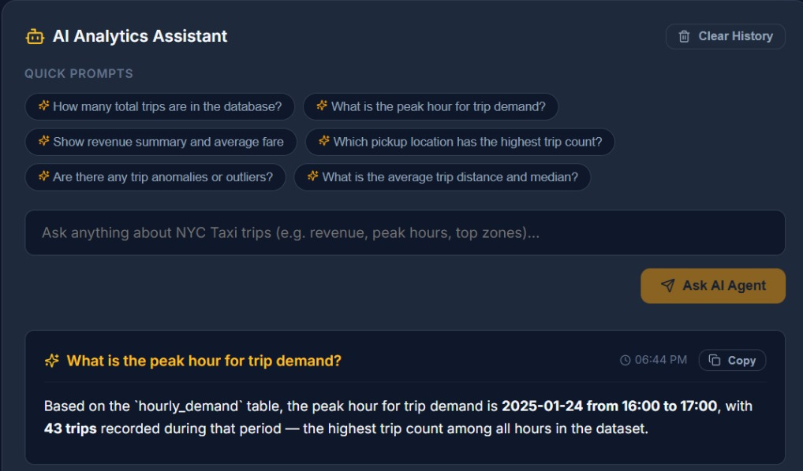
STEP 6 OF 6 — AI Agent
AI Agent — where you ask
10

Slide 13
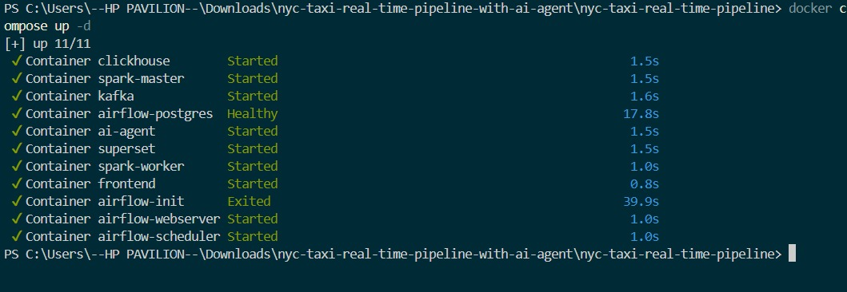
Docker — the real-time backbone
06

Slide 14
RESULTS & VISUALIZATIONS in SPARK
Revenue & payment patterns
Computed directly from the 35+ Million trips — Full Year 2025.
Total revenue by day of week
Payment method mix
Credit card
70%
Unspecified
16%
Cash
11%
Dispute
2%
No charge
1%
12

Slide 15






BUSINESS IMPACT
Questions the platform is built to answer
BUSINESS QUESTIONS
?
What are the busiest pickup & drop-off zones?
EXPECTED OUTCOMES
What transportation analytics teams gain
?
Which hours experience the highest demand?
Monitor taxi demand in real time
?
Which days generate the highest revenue?
Identify high-revenue zones
?
What are the most profitable routes?
Understand passenger behavior
Track operational KPIs at a glance
?
How does trip demand change over time?
Spot demand trends as they emerge
?
How do passenger trends vary across locations?
Support data-driven decisions
13

Slide 16





WHAT'S NEXT
Roadmap for future enhancements
Real-time alerting
Predictive demand forecasting
Cloud deployment
Push notifications the moment demand or revenue moves unusually.
Model historical patterns to anticipate next-week demand.
Migrate the stack to AWS / Azure for elastic scale.
CI/CD integration
Automated reporting
Advanced Multi-Agent System
Automated testing and deployment for every pipeline change.
Scheduled summaries delivered straight to stakeholders.
Implement conversational memory for the AI Agent.
14

Slide 17
Thank You
NYC Taxi Real-Time Analytics Platform
Kafka · Spark · ClickHouse · Airflow · Superset · AI Agent · Docker
github.com/Sarahhh005/nyc-taxi-real-time-pipeline

