Slide 1
APPLIED MACHINE LEARNING
Saud Abdul Rahman Al Homied
1706345D

Slide 2
Introduction

Slide 3
OBJECTIVES
Data source of Over 22,000 meets and 412,000 lifters from competitions worldwide
To predict the amount of weight lifted for a deadlift based on Age, Sex, Bodyweight and Equipment used.
“How much weight is possible for me to lift in a deadlift?”

Slide 4
Data Preparation
Pre-processing our Data

Slide 5
Pre-processing
Identified common Data errors
Blanks mean lift was not attempted
Negative values means lift was failed
Blanks and Negative values changed to NaN
Gender values replaced from “M” and “F” to “Male” and “Female”

Slide 6
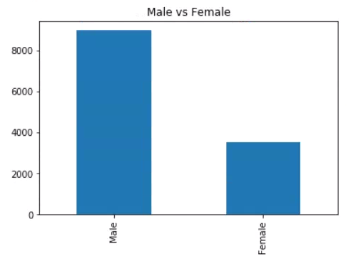
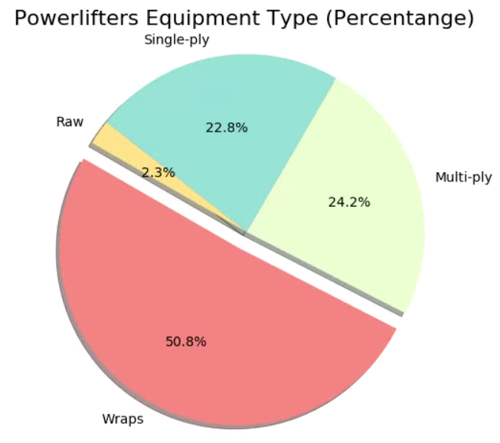
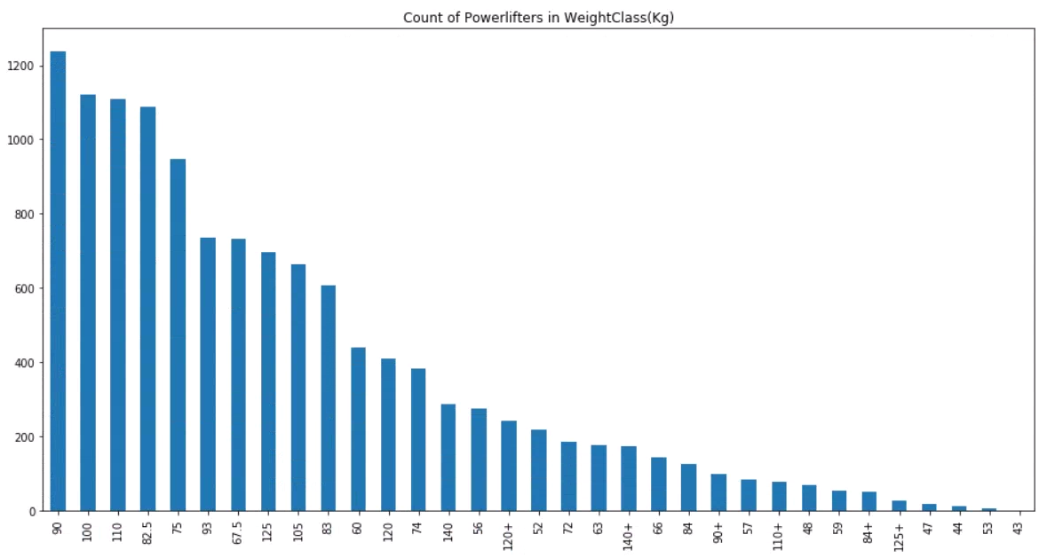
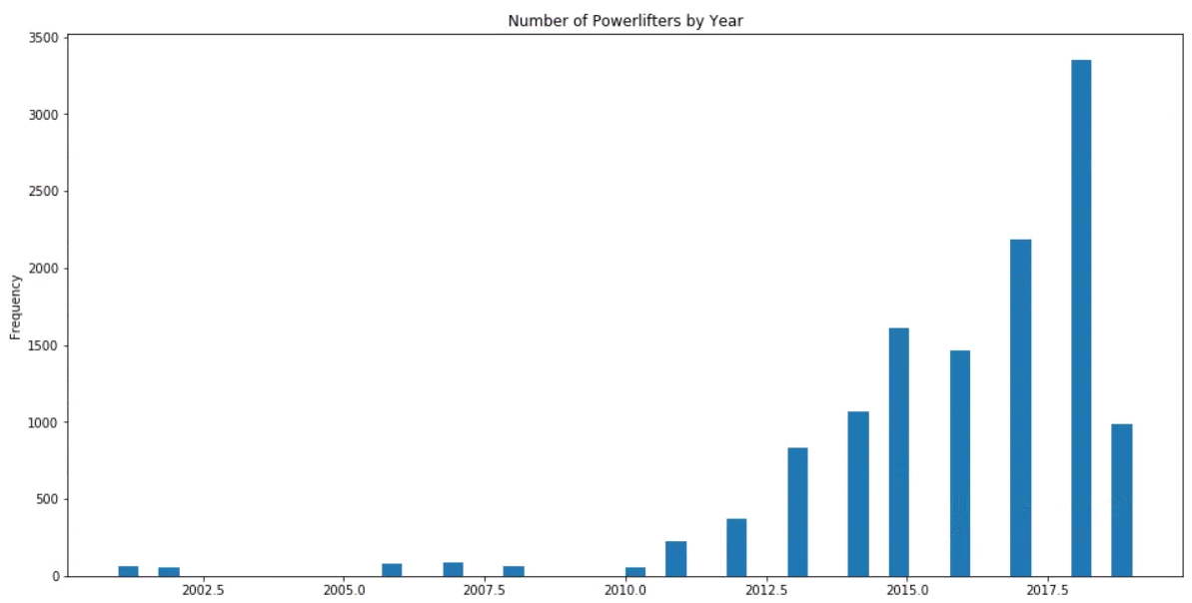
DATA EXPLORATION

Slide 7
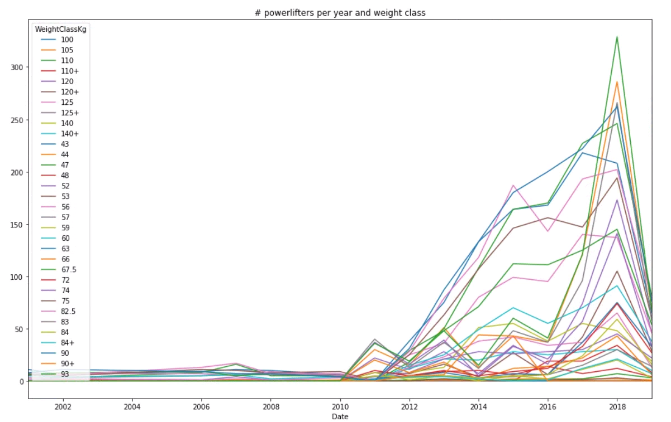
DATA EXPLORATION

Slide 8
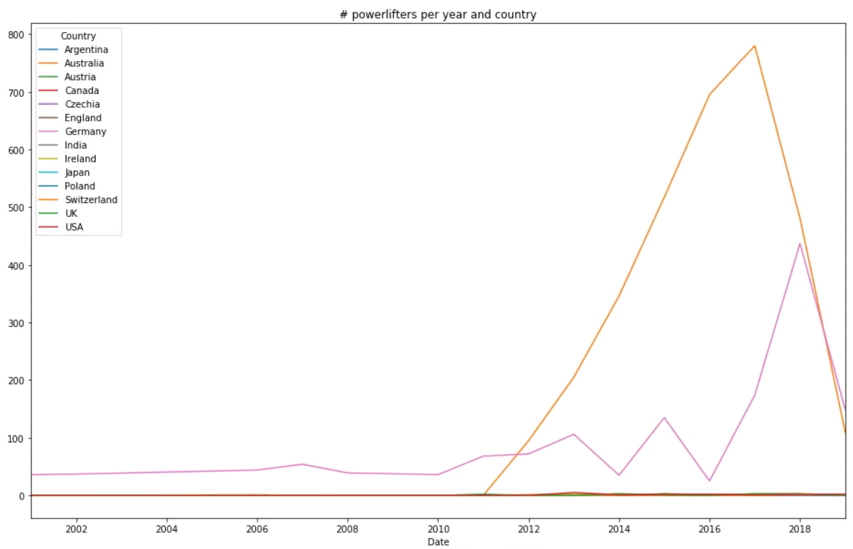
DATA EXPLORATION

Slide 9
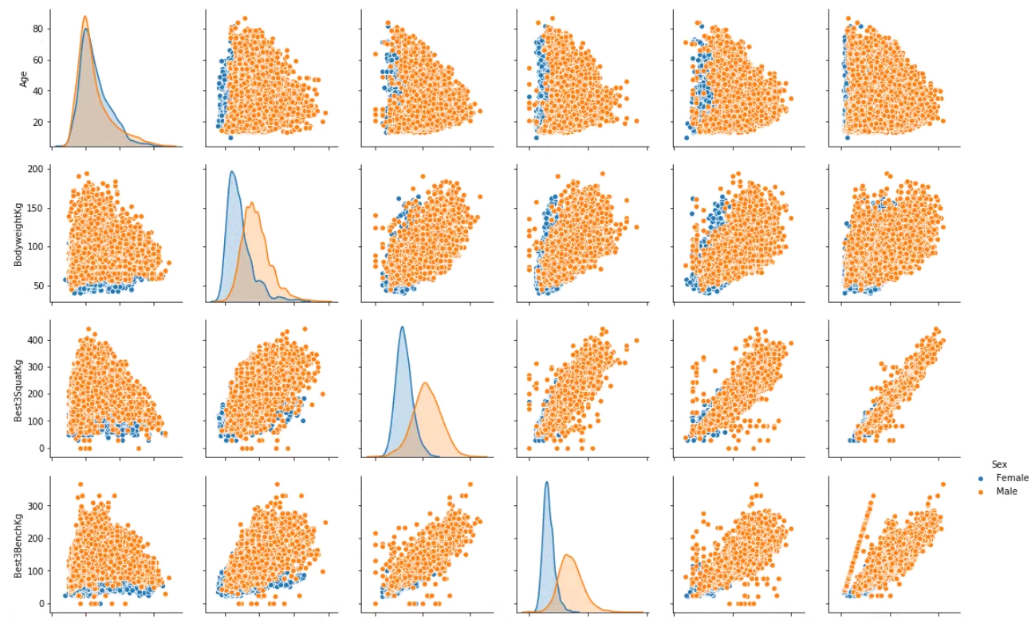
DATA EXPLORATION

Slide 10
Feature Selection
Identified features that are not needed in the analysis
Features required: ‘Age’, ‘Sex’, ‘Equipment’, ‘Best3DeadliftKg’
Using the best of the 4 lifts

Slide 11
Methods & Improvements

Slide 12
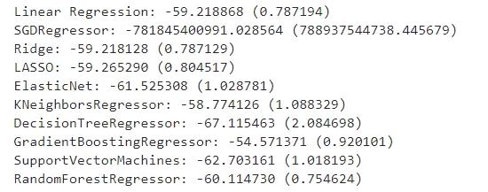
Regression Algorithms
Performed Spot Checking with algorithms
Algorithm chosen: GradientBoostingRegressor

Slide 13
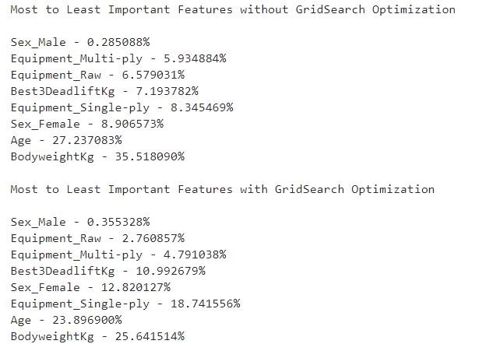
Improvements: GridSearch
Utilized GridSearch to improve parameter tuning
Identified important features before and after GridSearch with appropriate weighting in %

Slide 14
Results & Analysis

Slide 15
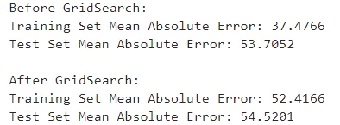
Prediction
Predicting the estimated raw deadlift in kg for a 21 year old male with 80kg bodyweight.
Training Set and Test Set Mean Absolute Error before and after

Slide 16
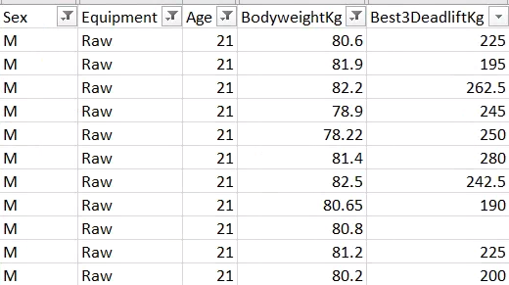
Conclusion
Allows user to find out what weight they might be able to lift excluding other factors

Slide 17
References
Topic
Source
1
Spot Checking Algorithms
https://machinelearningmastery.com/spot-check-regression-machine-learning-algorithms-python-scikit-learn/
2
Powerlifting Database
https://www.kaggle.com/open-powerlifting/powerlifting-database/
3
Matplotlib
https://matplotlib.org/

Slide 18

THANK YOU!
Any questions?

