Slide 1
Microsoft Project

Slide 2
Business problem
Microsoft would like to venture into the business of movie production. Data is provided for analysis to help Microsoft to decide on which movie to produce in order to make profits based on the findings from the data.

Slide 3
Micr
Microsoft see all the big companies crating video content, they want to get in to the business.
They have decided to create a new movie studio, but they don’t know anything about creating movies.
Exploring what types of films are currently doing the best at the box office.
Translate those findings into actionable insights that the head of Microsoft's new movie studio can use to help decide what type of films to create.

Slide 4
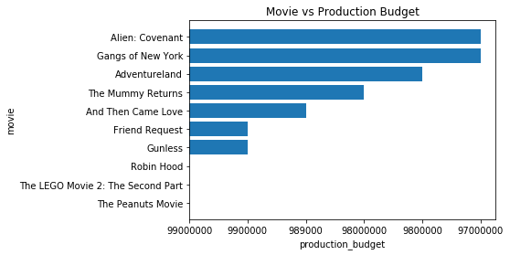

Slide 5
Most of the movies had a budget that was below 200 million dollars. we have different categories of the movies so as we are able to see which movie made profits and so Microsoft will be able to determine which movie to produce. From the image below, we have the highest profit generating movie is the Avater. some of the movies made loses like the Phoenx and Lone Ranger.

