Slide 1
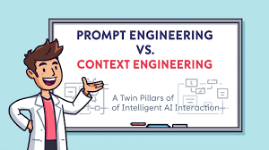

Slide 2

Prompt Engineering —
Crafting the Perfect Question
• Clear, structured prompts to guide AI responses
• Focuses on how you ask
• Uses keywords, examples, roles, or formats
• Example: 'Explain photosynthesis like a teacher for 10-year-olds.'

Slide 3

Context Engineering —
Shaping What the AI Already Knows
• Provides background knowledge to AI systems
• Focuses on what AI already knows
• Ensures consistency across multiple interactions
• Example: Uploading a policy document before HR-related
queries

Slide 4
