Slide 1
HACKATHON PROJECT (BOOK ONE-WAY OUTSTATION CAB AND DISPLAY THE LOWEST CHARGES) WANDERERS
Team Members:
Barath Aakaash L.A. (2091184)
Nupur Arora (2088635)
Bhushan Patil (2091461)
Gokul P(2091250)
Rachita Jingade (2090966)
Chanchal Kumawat (2091496)

Slide 2
Project Idea
Website Used:- https://www.makemytrip.com
Book one way outstation cab, From Delhi to Manali, Himachal Pradesh, give future date & time & Car type should be SUV; Display the lowest charges
Find Group Gifting in Gift Cards, fill card details & give invalid email; capture & display the error message
On the Hotel booking page, extract all the numbers for Adult persons and store in a List; Display the same

Slide 3
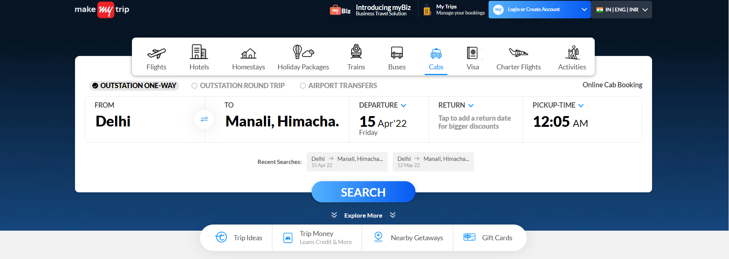

Slide 4
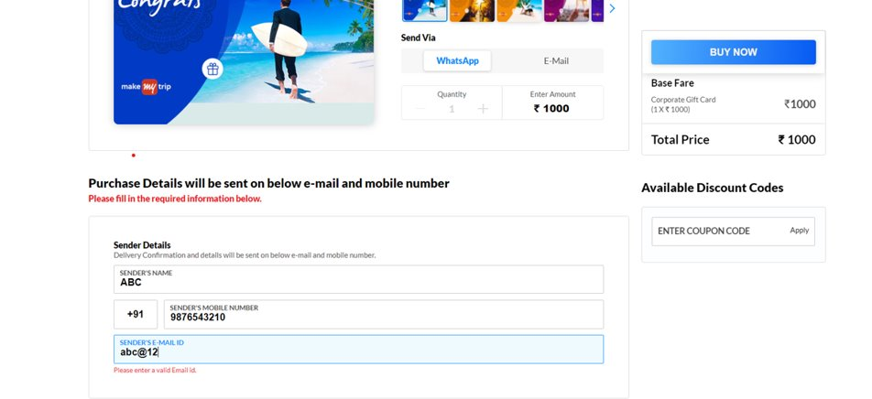
ERROR MESSAGE SCREENSHOT

Slide 5
1st STAGE DELIVERABLES
Tested the provided hackathon project idea manually.
Created a schedule.
Produced naming conventions, code comment standards, indentation guidelines to be used.
Identified the IDE & number of browsers going to support.
Preparation of reports like requirement document, test plan, test cases and test summary.

Slide 6
2nd STAGE DELIVERABLES
Verified whether the website can be tested through automation.
Creation of reusable functions required for the project.
Creation of config property file to keep URL, BROWSER.
Creation of Page Object Model.
Creation of Data Driven Library using Apache POI.

Slide 7
3rd STAGE DELIVERABLES
Implemented TestNG annotations for the suites.
Create Test Scripts for the identified Smoke and regression suite.
Integrated with Maven to simplify the build process and dependency

Slide 8
^{4th STAGE DELIVERABLES}
Fixed the errors, failures
Tested the entire automation script on multiple browsers (like Chrome and Firefox).

Slide 9
LEARNING EXPERIENCE
Gained responsibility and commitment for the project.
Gained more knowledge on automation testing through real time project implementation.
Worked as a team, shared each others doubts, listened to each others feedback.

Slide 10
THANK YOU

