Slide 1
Testing
Image Extraction

Slide 2

Slide 1
Rain Image

Slide 3
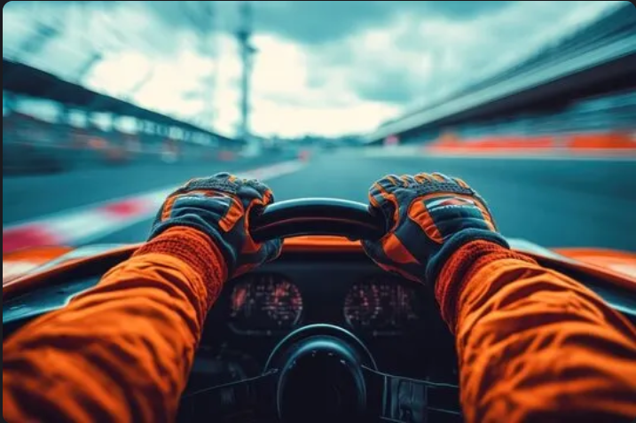
Slide 2
Car Image

