Slide 1

MARTIAL WORLD
SARAN S KRISHNAN
MES24MCA2049
Department of Computer Applications
MES College of Engineering, Kuttippuram
21/08/2025

Slide 2
PRODUCT OWNER BALACHANDRAN KP ASSOCIATE PROFESSOR DEPARTMENT OF COMPUTER APPLICATIONS MES COLLEGE OF ENGINEERING, KUTTIPPURAM

Slide 3
TABLE OF CONTENTS
Introduction
Objective
Existing System
Proposed System
Motivation
Functionalities
Module Description
Developing Environment
Sprint Backlog
Product Backlog
User Story
Project Plans
Data Flow Diagrams
ER Diagram

Slide 4
MARTIAL WORLD
Martial World is a platform for martial artists who practices martial arts or admire martial artists.
This platform includes e-commerce, entertainment and management of martial arts related contents.
This project includes:
Martial Mart: An e-commerce platform that only sells products related to all kind of martial arts.
Martial Connect: A social media platform that helps to share, connect, follows martial related contents.
Martial Track: A platform to track our progresses and syllabus

Slide 5
MARTIAL WORLD
These helps an martial artists so much as there isn’t any platform separately build for martial artists.
This organize every need of a martial artists into an single platform.
This platform also create a community among martial artists and can acknowledge about the martial arts trends,competitions,products etc…

Slide 6
OBJECTIVES
The objective of this project is to design and develop a comprehensive web-based platform that enables martial artists to find good products needed for their practice, track progress, and engage with a global community through a social media platform for martial artists.

Slide 7
EXISTING SYSTEM
There are no specific platforms that focuses on martial artists.
Some platforms offers martial artists what they need but not in a convenient way.
And there is no platforms that offers e-commerce, entertainments and progress tracking under the same umbrella.

Slide 8
PROPOSED SYSTEM
Martial World is an another level web based platform for martial artists.
Martial world contain e-commerce platform for products needed for martial art practice, social media platform to connect all martial artists and share their techniques and skills, and a progress tracking and syllabus following section to keep and follow your progress.

Slide 9
MOTIVATIONS
As a martial arts practitioner for over a decade and as an instructor, I faced challenges of accessing training resources and finding martial arts contents in every social media platforms and also keeping track of my martial arts progress. So I come with the idea of an web-based platform for martial artists called Martial World.

Slide 10
FUNCTIONALITIES
E-commerce platform that only have products needed for martial artists.
Social media platform for martial artists which they can posts photos and videos of martial arts techniques and anyone can follow other martial arts practitioners.
Progress tracking or syllabus for physical development.

Slide 11
MODULE DESCRIPTION
User Authentication
E-commerce
Video Management
Progress Tracker
Admin Dashboard

Slide 12
DEVELOPING ENVIRONMENT
Operating System: Windows,Linux
Front End: html, css, javascript
Back End: javascript(Node.js),Express.
Database: SQLite/Firebase
IDE: Visual Studio Code

Slide 13
SPRINT BACKLOG
Backlog item | Status And Completion Date | Original Estimation in Hours | Day 1 hrs | Day 2 hrs | Day 3 hrs | Day 4 hrs | Day 5 hrs | Day 6 hrs | Day 7 hrs | Day 8 hrs | Day 9 hrs | Day 10 hrs
SPRINT1
User Profile designing | 22/8/2022 | 2 | 1 | 1 | 0 | 0 | 0 | 0 | 0 | 0 | 0 | 0
Style implimentation | 25/8/2022 | 3 | 1 | 1 | 1 | 0 | 0 | 0 | 0 | 0 | 0 | 0
Coding | 29/8/2022 | 3 | 1 | 1 | 1 | 0 | 0 | 0 | 0 | 0 | 0 | 0
SPRINT 2
Build seller gear listing | 2/9/2022 | 7 | 1 | 1 | 1 | 1 | 1 | 1 | 1 | 0 | 0 | 0
Data processing | 9/9/2022 | 7 | 1 | 1 | 1 | 1 | 1 | 1 | 1 | 0 | 0 | 0

Slide 14
SPRINT BACKLOG
Backlog item | Status And Completion Date | Original Estimation in Hours | Day 1 hrs | Day 2 hrs | Day 3 hrs | Day 4 hrs | Day 5 hrs | Day 6 hrs | Day 7 hrs | Day 8 hrs | Day 9 hrs | Day 10 hrs
SPRINT3
Implement buyer checkout | 16/9/2022 | 7 | 1 | 1 | 1 | 1 | 1 | 1 | 1 | 0 | 0 | 0
Impliment connection | 25/9/2022 | 7 | 1 | 1 | 1 | 1 | 1 | 1 | 1 | 0 | 0 | 0
SPRINT 4
Admin dashboard | 3/10/2022 | 7 | 1 | 1 | 1 | 1 | 1 | 1 | 1 | 0 | 0 | 0
Testing | 10/10/2022 | 7 | 1 | 1 | 1 | 1 | 1 | 1 | 1 | 0 | 0 | 0
TOTAL |  | 50 | 9 | 9 | 8 | 6 | 6 | 6 | 6

Slide 15
PRODUCT BACKLOG
ID | NAME | PRIORITY <high/medium/low> | ESTIMATE (Hours) | STATUS <Planned/In progress/Completed>
1 | REGISTRATION | High | 5 | PLANNED
2 | LOGIN | High | 5 | PLANNED
3 | MARTIAL MART | High | 20 | PLANNED
4 | MARTIAL CONNECT | Medium | 10 | PLANNED
5 | MARTIAL TRACK | Low | 10 | PLANNED

Slide 16
USER STORY
User Story ID | As a type of User | I want to <Perform some task> | So that i can <Achieve Some Goal>
1 | ADMIN | Login | login successful with correct username and password
2 | ADMIN | Upload contents | Make item available in the system
3 | ADMIN | View and manage | View contents and manage users
4 | ADMIN | List items | Sell the products to buyers
5 | USER | Register | Can users register
6 | USER | Login | login successful with correct username and password
7 | USER | View Profile | View users profile in application

Slide 17
USER STORY
User Story ID | As a type of User | I want to <Perform some task> | So that i can <Achieve Some Goal>
8 | User | Browse and purchace gear | Get quality equipment from trusted sellers
9 | Martial Artists | Track my training progress | Stay motivated and measure improvement

Slide 18
PROJECT PLAN
User StoryID | Task Name | Start Date | End Date | Days | Status
1 | Sprint 1 | 22/08/2022 | 24/08/2022 | 3 | Planned
2 |  | 25/08/2022 | 28/08/2022 |  | Planned
3 |  | 29/08/2022 | 01/09/2022 |  | Planned
4 | Sprint 2 | 02/09/2022 | 08/09/2022 | 7 | Planned
5 |  | 09/09/2022 | 15/09/2022 |  | Planned
6 | Sprint 3 | 16/09/25 | 24/09/25 | 7 | Planned
7 |  | 25/09/25 | 02/10/25 |  | Planned

Slide 19
PROJECT PLAN
User StoryID | Task Name | Start Date | End Date | Days | Status
8 | SPRINT 4 | 03/10/2022 | 09/10/2022 | 7 | Planned
9 |  | 10/10/2022 | 10/10/2022 |  | Planned

Slide 20
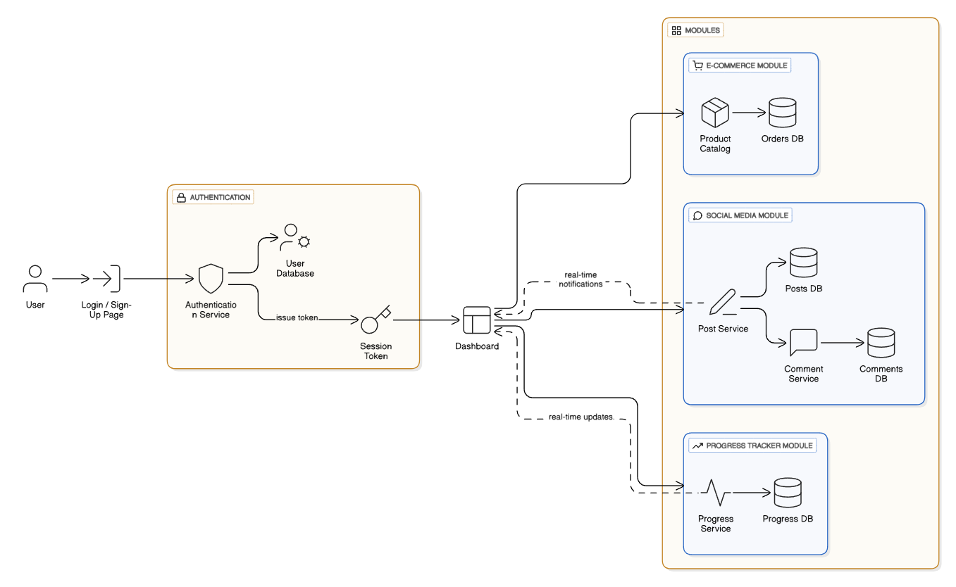
DATA FLOW DIAGRAM
LEVEL 1

Slide 21
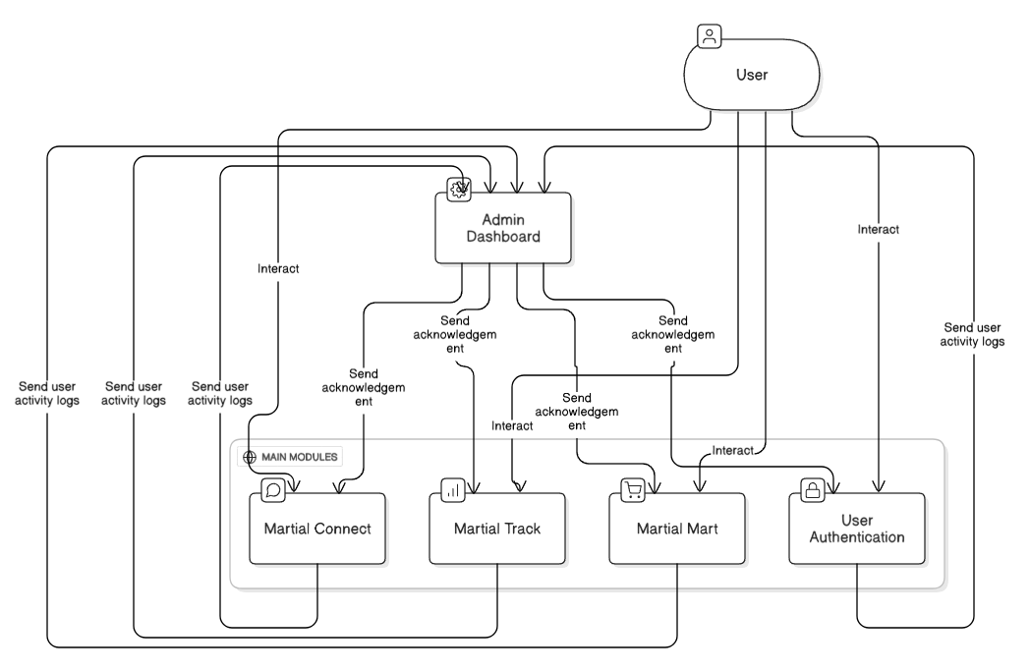
DATA FLOW DIAGRAM
Level 1.1

Slide 22
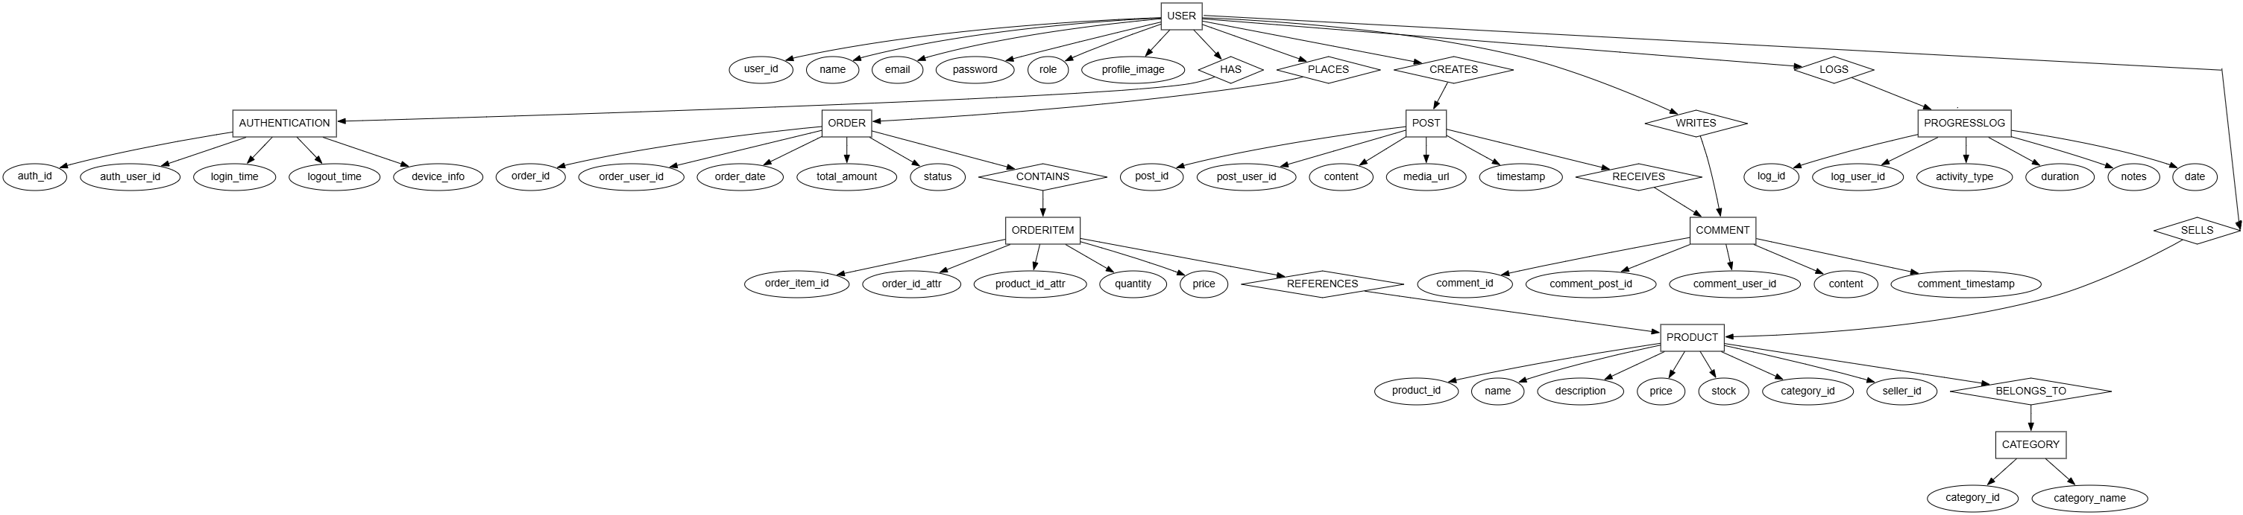
ER DIAGRAM

Slide 23
THANK YOU

