Slide 1
Bridge Design Pattern
Pallavi Desai - 62
Neeraj Padarthi - 37
Harish Tata - 50
Saran Akkiraju - 2

Slide 2
Context
The normal method of dealing with an abstraction having several implementations is through inheritance.
However, this permanently binds the implementation to the abstraction.
This is not always flexible enough. You may want to modify or extend the abstraction or implementations independently.
The Bridge Pattern decouples an abstraction from its implementation.

Slide 3
Applicability
Selection or switching of implementation is at run-time rather than design time.
Abstraction and implementation should both be extensible by subclassing.
You want to isolate implementation changes from clients.
You want to share an implementation among multiple objects and this should be hidden from the client.

Slide 4
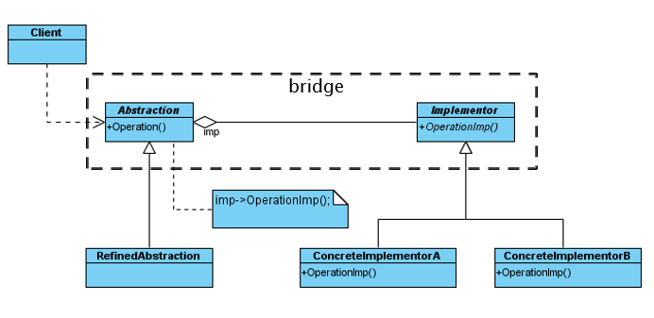
Pattern Structure

Slide 5
Story
Create a system that shows menu item for canteen in UMKC canteen.
Three types of meal should be available American, Italian an French.
There should be appetizer, beverage and desert available for every type of meal
There should be snacks, lunch and five course meals available in the menu.
Implement the model using bridge design pattern.

Slide 6
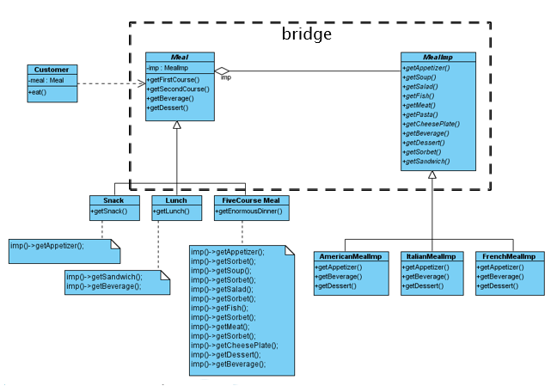
Class Diagram

Slide 7
Code of Abstraction
public class Meal {
protected MealImp imp;
public Meal() {
imp = new AmericanMealImp();
}
public Meal(String type) {
if (type.equals("American"))
imp = new AmericanMealImp();
if (type.equals("Italian"))
imp = new ItalianMealImp();
if (type.equals("French"))
imp = new FrenchMealImp();
}
public void getDessert() {
imp.getDessert();
}
public void getFirstCourse() {
imp.getAppetizer();
}
public void getSecondCourse() {
imp.getMeat();
}
public void getBeverage() {
imp.getBeverage();
}
}

Slide 8
Code of Abstraction
public class Snack extends Meal {
public void getSnack() {
imp.getAppetizer();
}
}
public class FiveCourseMeal extends Meal {
public void getEnormousDinner() {
imp.getAppetizer();
imp.getSorbet();
imp.getSoup();
imp.getSorbet();
imp.getSalad();
imp.getSorbet();
imp.getFish();
imp.getSorbet();
imp.getMeat();
imp.getSorbet();
imp.getCheesePlate();
imp.getDessert();
imp.getBeverage();
}
}
public class Lunch extends Meal {
public void getLunch() {
imp.getSandwich();
imp.getBeverage();
}
}

Slide 9
Code of Implementor
public interface MealImp {
public abstract void getAppetizer();
public abstract void getSoup();
public abstract void getSalad();
public abstract void getFish();
public abstract void getMeat();
public abstract void getPasta();
public abstract void getCheesePlate();
public abstract void getBeverage();
public abstract void getDessert();
public abstract void getSorbet();
public abstract void getSandwich();
}
public class AmericanMealImp implements MealImp {
public void getAppetizer() {
System.out.println("Appetizer: nachos"); }
public void getSoup() {}
public void getSalad() {}
public void getFish() {}
public void getMeat() {
System.out.println("Meat: steak"); }
public void getPasta() {}
public void getCheesePlate() {}
public void getBeverage() {
System.out.println("Beverage: beer"); }
public void getDessert() {
System.out.println("Dessert: apple pie"); }
public void getSorbet() {}
public void getSandwich() {}
}

Slide 10
Code of Implementor
public class ItalianMealImp implements MealImp {
public void getAppetizer() {
System.out.println("Appetizer: anti pasti"); }
public void getSoup() {}
public void getSalad() {}
public void getFish() {}
public void getMeat() {
System.out.println("Meat: chicken piccata"); }
public void getPasta() {}
public void getCheesePlate() {}
public void getBeverage() {
System.out.println("Beverage: cappuccino"); }
public void getDessert() {
System.out.println("Dessert: gelato"); }
public void getSorbet() {}
public void getSandwich() {}
}
public class FrenchMealImp implements MealImp {
public void getAppetizer() {
System.out.println("Appetizer: escargot"); }
public void getSoup() {}
public void getSalad() {}
public void getFish() {}
public void getMeat() {
System.out.println("Meat: coq au vin"); }
public void getPasta() {}
public void getCheesePlate() {}
public void getBeverage() {
System.out.println("Beverage: bordeaux"); }
public void getDessert() {
System.out.println("Dessert: creme brulee"); }
public void getSorbet() {}
public void getSandwich() {}
}

Slide 11
Code of Client
public class Customer {
private Meal meal;
public Customer(Meal aMeal) { meal = aMeal; }
public void eat() {
meal.getFirstCourse();
meal.getSecondCourse();
meal.getBeverage();
meal.getDessert();
}
public static void main(String[] args) {
Meal aMeal = null;
// Read the input to see if we do American, Italian or French
if (args.length == 0) {
// create default Meal
aMeal = new Meal();
}
else if (args.length == 1) {
// see if arg is NOT American, Italian or
French
if (!(args[0].equals("American")) && !(args[0].equals("Italian")) && !(args[0].equals("French"))) {
System.err.println("1 arg given but not recognized");
System.err.println("usage: java Customer [American|Italian|French]");
System.exit(1);
}
else {
aMeal = new Meal(args[0]);
}
}
else { // error
System.err.println("wrong number of args");
System.err.println("usage: java Customer [American|Italian|French]");
System.exit(1);
}
Customer c = new Customer(aMeal);
c.eat();
}
}

Slide 12
Quiz
Does abstract class maintains the Implementor reference ?
Do you think Inheritance concept and Bridge design pattern both will have same level of abstraction?
If different , how ?
The bridge pattern can also be thought of as how many layers of abstraction ?

