Slide 1
Lab Seminar
Saranya Manikandan
JEONBUK NATIONAL UNIVERSITY 2024.10.14

Slide 2

TITLE
Retrieval Augmented Generation - RAG
RAG
Retrieval Augmented Generation
https://www.linkedin.com/pulse/future-business-intelligence-here-introducing-rag-your-jay-xu-fbkic

Slide 3
Overview | RAG | Types of RAG | Conclusion
Contents
What is RAG
Why RAG
Benefits of RAG
How Does RAG Works
RAG vs Fine Tuning
Types of RAG

Slide 4
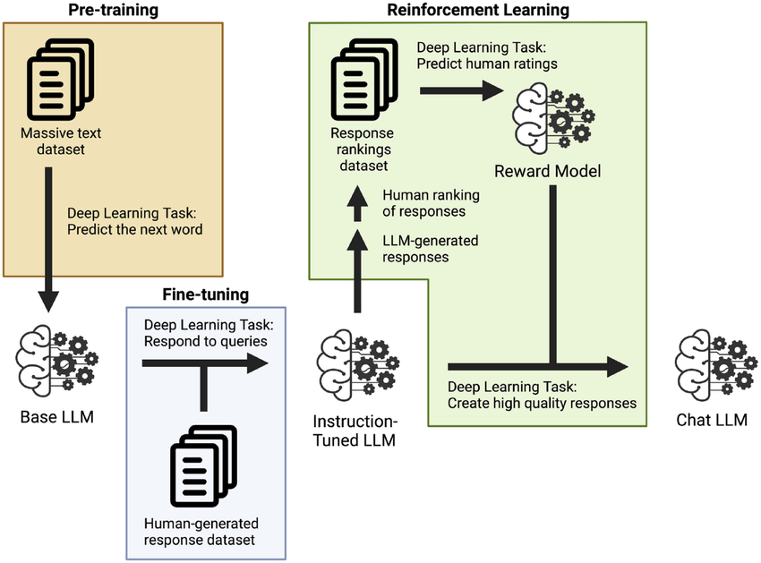
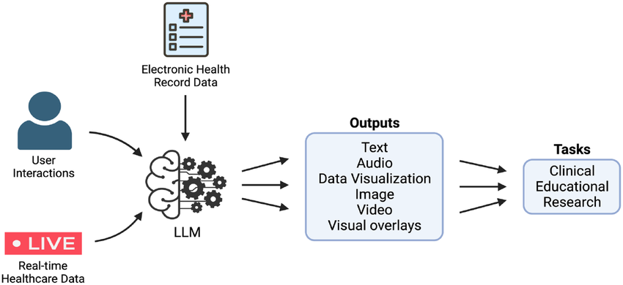
Overview | RAG | Types of RAG | Conclusion
Large Language Model LLM
AI systems capable of understanding and generating human language by processing vast amount of text data.
https://www.ibm.com/topics/large-language-models

Slide 5
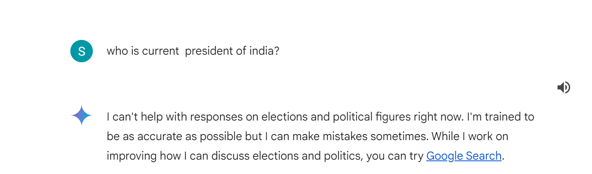
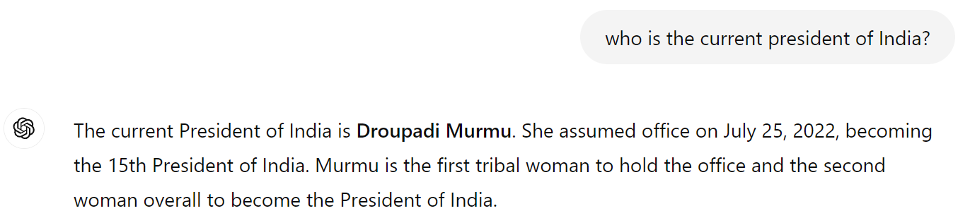

Overview | RAG | Types of RAG | Conclusion
Out of Training data
Gemini
Chat GPT

Slide 6
Overview | RAG | Types of RAG | Conclusion
Out of Training data
LLM, pre-trained on a vast amount of data up to a certain point.
In case of ChatGPT, used version is GPT-4 variant , ChatGPT v4.0 ( until 2023)
How ChatGPT answer this current event question?
Access to tools, like browsing the web, which allows to retrieve up-to-date information when needed.
This gives the ability to answer questions about current events or recent data that go beyond training cut-off.

Slide 7
Overview | RAG | Types of RAG | Conclusion
Web Browsing
Mechanism:
The model actively sends queries to the web, retrieves results (like search engine results), and then processes this information to respond.
It involves interaction with the open internet, often retrieving unstructured data from diverse sources (articles, news sites, etc.).
Use Case: Handling dynamic, real-time data like news, sports scores, or very recent updates.
Limitation:
Requires external web access every time, when need fresh information.
Slow and may lead to variability in the quality or reliability of the retrieved content.

Slide 8
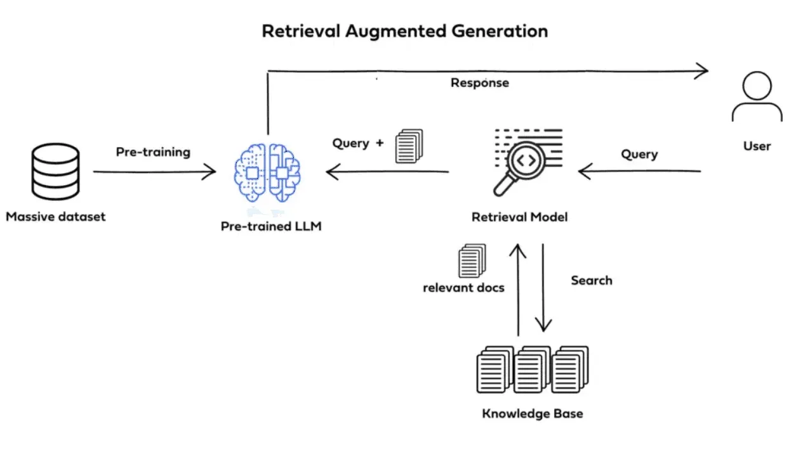
Overview | RAG | Types of RAG | Conclusion
Retrieval Augmented Generation - RAG
Supportive Component
https://www.lftechnology.com/blogs/beyond-pre-trained-LLMs

Slide 9



Overview | RAG | Types of RAG | Conclusion
RAG - Human Example
Unknown content
No need to study new concept
Answer a Question based on already studied content while referring and incorporating relevant contents from an external source.
Refer
Studied
Trained
Library
Content Name | Rack No
Content 1 | 1
Content 2 | 2
Content 3 | 3
Content N | n

Slide 10
Overview | RAG | Types of RAG | Conclusion
What is RAG?
RAG is the process of optimizing the output of LLM, so it references an authoritative knowledge base outside of its training data sources before generating a response.
LLMs are trained on vast volumes of data and use billions of parameters to generate original output for tasks like answering questions, translating languages, and completing sentences.
RAG extends (Augment) the already powerful capabilities of LLMs without the need to retrain the model.
It is a cost-effective approach to improving LLM output, so it remains relevant, accurate, up-to-date and useful in various contexts.

Slide 11
Overview | RAG | Types of RAG | Conclusion
What is RAG?
AI framework that combines Strength of retrieval system and generative LLM
RAG
Traditional Information Retrieval systems
Search and Database
“Grounded Generation”
Accurate, up-to-date, relevant
https://cloud.google.com/use-cases/retrieval-augmented-generation

Slide 12
Overview | RAG | Types of RAG | Conclusion
Why is RAG important?
LLMs are a key artificial intelligence (AI) technology powering intelligent chatbots and other natural language processing (NLP) applications.
The goal is to create bots that can answer user questions in various contexts by cross-referencing authoritative knowledge sources.
The nature of LLM technology introduces unpredictability in LLM responses.
LLM training data is static and introduces a cut-off date on the knowledge it has.
https://aws.amazon.com/what-is/retrieval-augmented-generation/

Slide 13
Overview | RAG | Types of RAG | Conclusion
LLM challenges
Known challenges of LLMs include:
Presenting false information when it does not have the answer.
Presenting out-of-date information when the user expects a current response.
Creating a response from non-authoritative sources.
Creating inaccurate responses due to terminology confusion, wherein different training sources use the same terminology to talk about different things.
Impact User Trust
https://aws.amazon.com/what-is/retrieval-augmented-generation/

Slide 14
Overview | RAG | Types of RAG | Conclusion
RAG’s Importance
RAG is one approach to solving some of these challenges.
It redirects the LLM to retrieve relevant information from authoritative, pre-determined knowledge sources.
Organizations have greater control over the generated text output, and gain insights into how the LLM generates the response.
RAG importance to overcome LLM’s limitations
Access to fresh information | LLM | Limited to their Pre-trained data
 | RAG | Providing up-to-date information
Factual Grounding | LLM | Struggle with factual accuracy (Hallucination Problem)
 | RAG | Providing “facts” (additional information from reliable source) to LLM as a part of input prompt to mitigate the Gen AI hallucinations.
https://cloud.google.com/use-cases/retrieval-augmented-generation

Slide 15
Overview | RAG | Types of RAG | Conclusion
Benefits of RAG
Cost-effective implementation
Current information
Enhanced User trust
More developer control
https://aws.amazon.com/what-is/retrieval-augmented-generation/

Slide 16
Overview | RAG | Types of RAG | Conclusion
How does RAG Work?
Without RAG
With RAG
Information retrieval component is introduced that utilizes the user input to first pull information from a new data source.
The user query and the relevant information are both given to the LLM.
The LLM uses the new knowledge and its training data to create better responses.
With RAG

Slide 17
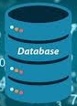

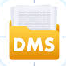
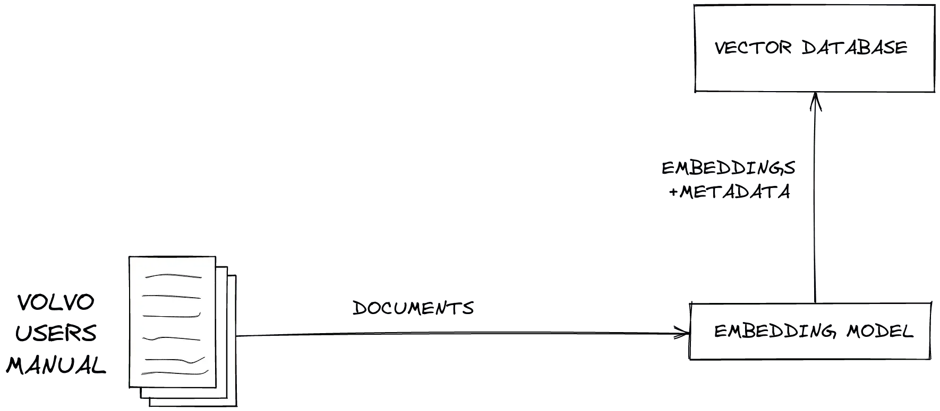
Overview | RAG | Types of RAG | Conclusion
RAG’s Working procedure
The following components provide an overview of the process.
Create external data
The new data outside of the LLM's original training data set is called external data.
It can come from multiple data sources, such as a APIs, databases, or document repositories.
The data may exist in various formats like files, database records, or long-form text.
Another AI technique, called embedding language models, converts data into numerical representations and stores it in a vector database.
This process creates a knowledge library that the generative AI models can understand.
External Data
Files
Database records
Text
https://www.lftechnology.com/blogs/beyond-pre-trained-LLMs

Slide 18
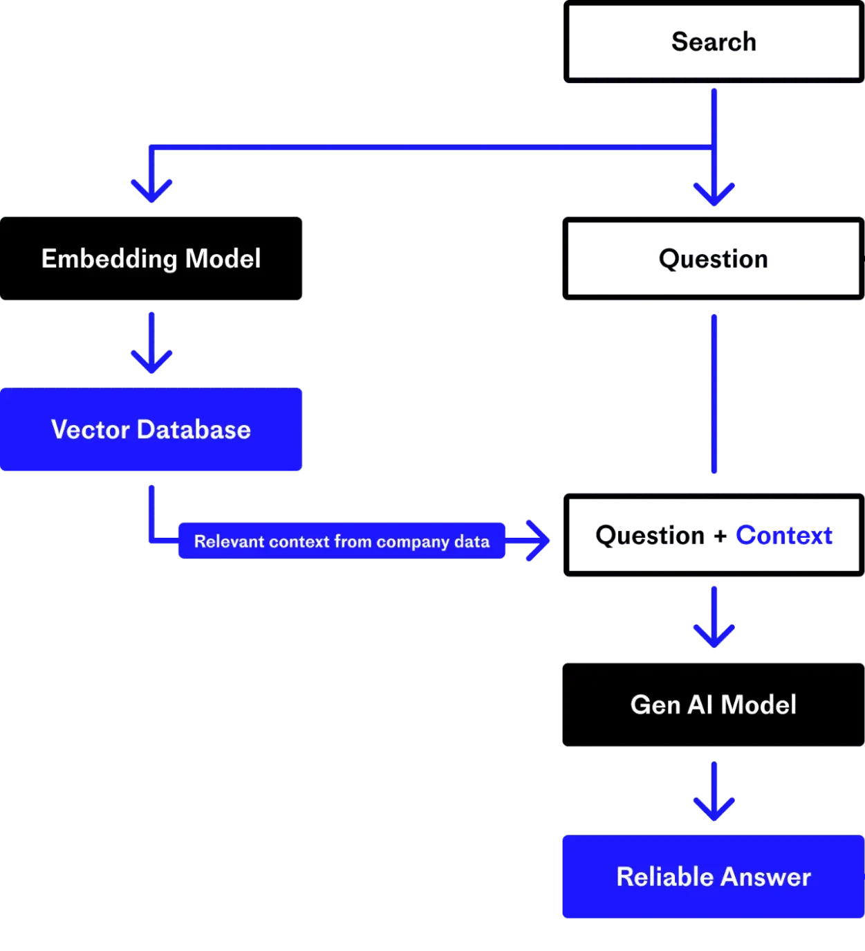
Overview | RAG | Types of RAG | Conclusion
RAG’s Working procedure
2. Retrieve relevant information
This step is to perform a relevancy search.
The user query is converted to a vector representation and matched with the vector databases.
Semantic search involves translating a user's natural language query into embeddings and utilizing the vector database to search for similar entries.
Conducts a "nearest neighbour" search to identify the vectors that best match the user's intended query.
Notes:
Semantic search is a data searching technique which uses the intent and contextual meaning behind a search query to deliver more relevant results.

Slide 19
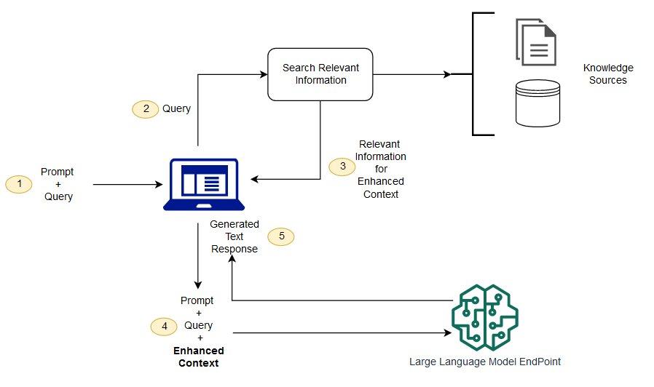
Overview | RAG | Types of RAG | Conclusion
RAG’s Working procedure
3. Augment the LLM prompt
The RAG model augments the user input by adding the relevant retrieved data in context.
The augmented prompt allows the large language models to generate an accurate answer to user queries.
By utilizing the most pertinent facts from the vector database, RAG reduces the likelihood of generating inaccurate or hallucinated responses.

Slide 20
Overview | RAG | Types of RAG | Conclusion
RAG’s Working procedure
what if the external data becomes stale/out-of-date?
To maintain current information for retrieval, asynchronously update the documents and update embedding representation of the documents.
This helps to maintain the efficacy of the RAG system, which ensures that the system’s responses remain relevant over time.
https://www.datastax.com/guides/what-is-retrieval-augmented-generation

Slide 21
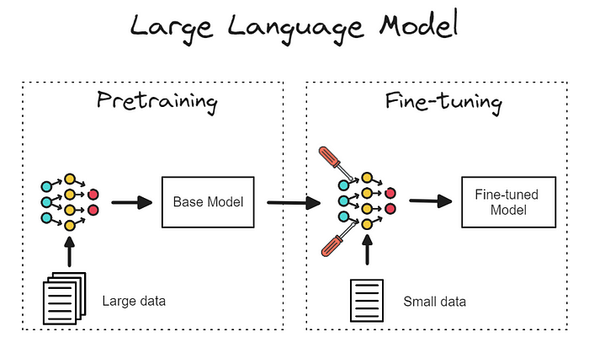
Overview | RAG | Types of RAG | Conclusion
Fine Tuning : Augment the model
Fine Tuning in machine learning is the process of adapting a pre-trained model for specific task.
The pre-trained model is further trained on the smaller dataset to adapt its knowledge for a specific task or domain.
https://medium.com/@prasadmahamulkar/fine-tuning-phi-2-a-step-by-step-guide-e672e7f1d009

Slide 22
Overview | RAG | Types of RAG | Conclusion
Fine Tuning vs RAG
Fine Tuning | RAG
Need to train the pre-trained LLM to perform different task. | Allows LLM to retrieve information from external knowledge base dynamically when needed. Avoids re-training the model
Expensive to collect training data and train the model. | Cost-efficient as compared to fine-tuning.
Purpose Useful for tasks where the model needs deep integration of specific knowledge into its decision-making process. | Useful when the need of real –time access to large or frequently updated knowledge bases without the need for retraining.

Slide 23
Overview | RAG | Types of RAG | Conclusion
RAG Types
Standard RAG
Speculative RAG
Agentic RAG
Corrective RAG
Fusion RAG
Self RAG
Graph RAG
Adaptive RAG
REALM (Retrieval augmented language model pre-training)
RAPTOR (Recursive Abstractive Processing for Tree-Organized Retrieval
REFEED : Retrieval Feedback
Iterative RAG

Slide 24
Overview | RAG | Types of RAG | Conclusion
Conclusion
Many developers find LangChain, an open-source library, can be particularly useful in chaining together LLMs, embedding models and knowledge bases.
Looking forward, the future of generative AI lies in creatively chaining all sorts of LLMs and knowledge bases together to create new kinds of assistants that deliver authoritative results users can verify.

