Slide 1

SOFTWARE DEFECT PREDICTION
SDP
Saranya Manikandan

Slide 2
SDP Overview
Predict fault-proneness (susceptible to bugs) of software prior to testing stage.
Why SDP?
To ensure the Software Quality Assurance (SQA)
Developed software meets the standardized quality specifications.
SQA includes Evaluation, code inspection, s/w testing and fault prediction
( time consuming process).
SDP helps to allocate limited SQA resources in cost effective.
Software Faults | Software Failure
Bug in the software code. | In-ability of Software to perform its behavior.
Internal (not directly observable) | External (observable by users)
Does not always lead to a software failure. | Software failure always originates from a pre-existing software fault
Goals of SDP
Testing cost reduction
Early flaw detection.

Slide 3
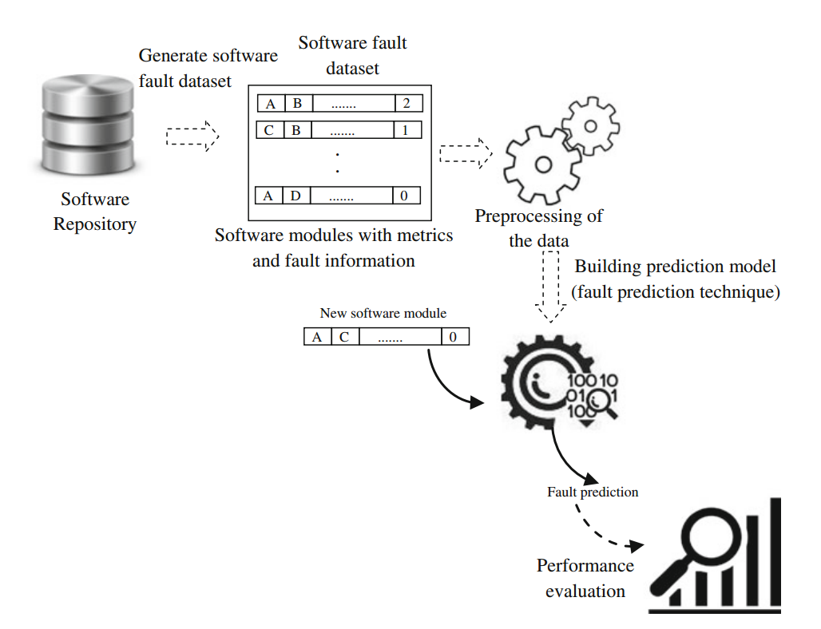
SDP Model
Learn from historic fault data stored in s/w repositories, having info about previous s/w versions.
The learned SDP models are then used to predict the fault-proneness of s/w modules of current release of s/w project.
BUILD FAULT PREDICTION MODEL:
Collecting bugs info + Extracting features(s/w metrics*) = Create training data set
Build Prediction Model : ML or statistical tech used to build model using training set.
Assessment: To evaluate fault prediction model separate data set used besides training dataset.
*Diagram from SFP Book
S/W metrics: Quantifiable measures of various characteristics of a software product or process.
Eg: LOC (Product) , development time (Process) , budget utilization (project)

Slide 4
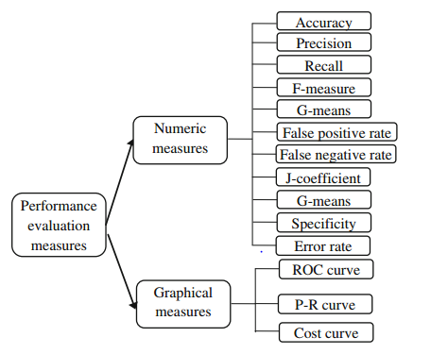
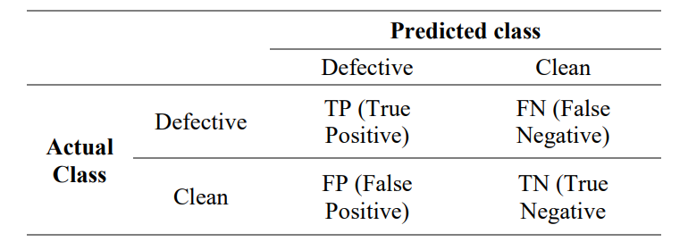
SDP Components
SDP Components | Definition | Contains
Software Fault Data Set | Software modules with metrics and fault information | Set of s/w metrics, Fault info (faulty or not) No of faults per module & meta info about s/w project.
Software Metrics | Valuable tool for understanding, measuring and improving software development process. | Lines Of Code Function Points Program Length
Performance Evaluation Metrics:
Used to assess the performance of fault prediction model.
Confusion Matrix:
Helps understand how well the classification model performs by comparing its predicted classifications with the actual classifications of the data it's tested on.

Slide 5
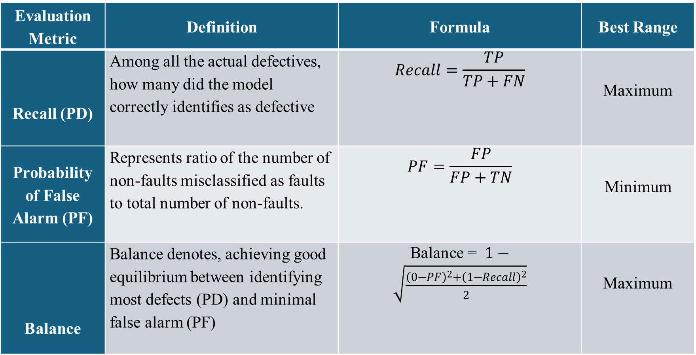
Performance Evaluation metrics
Evaluation Metric | Definition | Formula | Best Range
Recall (PD) | Among all the actual defectives, how many did the model correctly identifies as defective | $$Recall=\frac{TP}{TP+FN}$$ | Maximum
Probability of False Alarm (PF) | Represents ratio of the number of non-faults misclassified as faults to total number of non-faults. | $$PF=\frac{FP}{FP+TN}$$ | Minimum
Balance | Balance denotes, achieving good equilibrium between identifying most defects (PD) and minimal false alarm (PF) | Balance = $1−\sqrt{\frac{{\left(0−PF\right)}^{2}+{\left(1−Recall\right)}^{2}}{2}}$ | Maximum

Slide 6
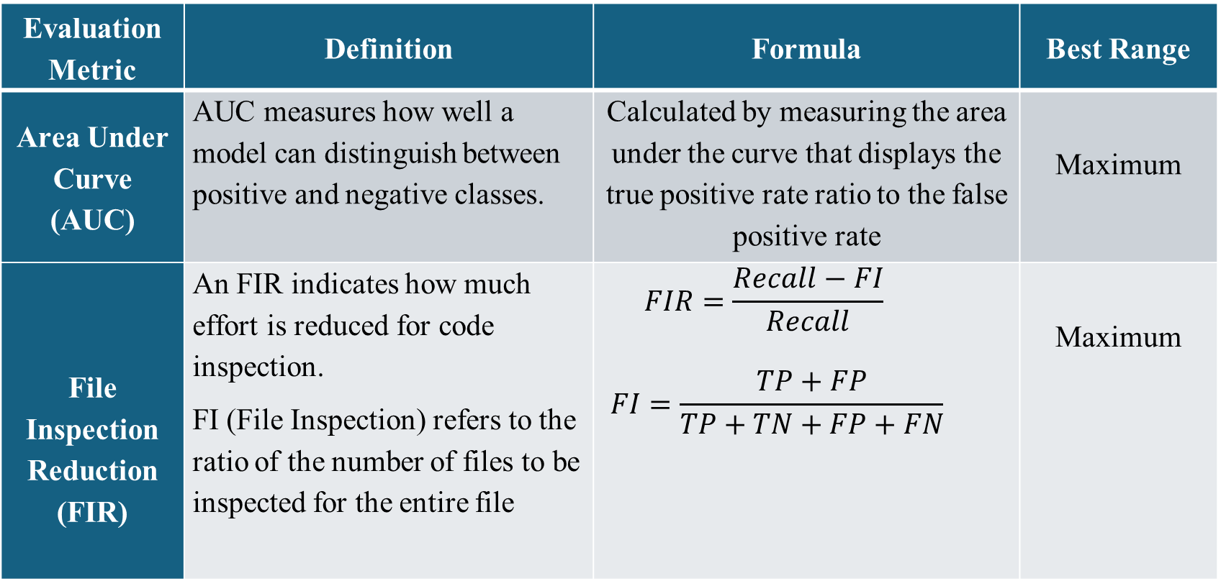
Performance Evaluation metrics
Evaluation Metric | Definition | Formula | Best Range
Area Under Curve (AUC) | AUC measures how well a model can distinguish between positive and negative classes. | Calculated by measuring the area under the curve that displays the true positive rate ratio to the false positive rate | Maximum
File Inspection Reduction (FIR) | An FIR indicates how much effort is reduced for code inspection. FI (File Inspection) refers to the ratio of the number of files to be inspected for the entire file | $$FIR=\frac{Recall−FI}{Recall}$$ $$FI=\frac{TP+FP}{TP+TN+FP+FN}$$ | Maximum

Slide 7
Thank You

