Slide 1
ID CARD GENERATOR FOR FXEC
BY SARAN E
CSE Department

Slide 2
Abstract :
The scope of this project is to generate the student ID Card as the same as that in real using Java.
What is ID card generator ?
It will get the information from the user in the module 1 and then Show those data that user give it into the Module II.
In between it store those data in the Database Server.

Slide 3
The Module I get the data from the user such us Student name , Department , Blood group , contact number.
And in the upload button it ask user to upload their image.
Once the SAVE button is clicked it get the user to the next page.
At the same time the data’s that user have entered is Automatically saved in the database
The Data’s that user entered are now visible in the Module II.

Slide 4
Software used :
Programming Language : Core java
IDE used : Visual Studio Code
Server : XAMPP server
Database : MySql

Slide 5
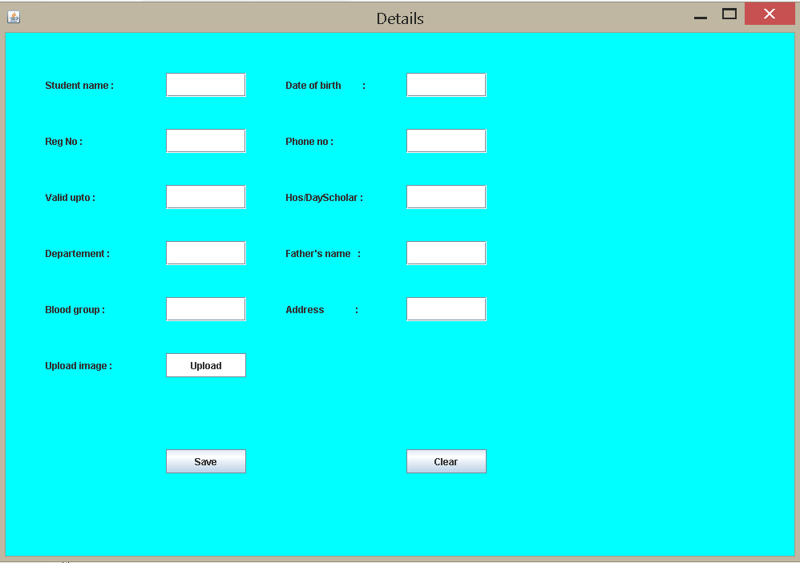
Module I :

Slide 6
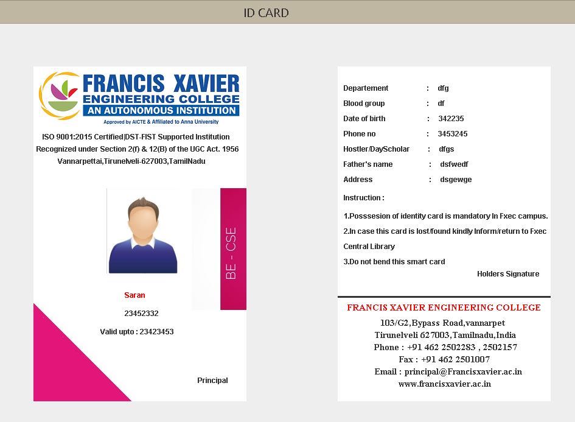
Module II :

