Slide 1

Presented by:
Gowrish
Jennith Piyush
Gouse
Bhanu
"Turning Academic Burnout into an Adventure."

Slide 2

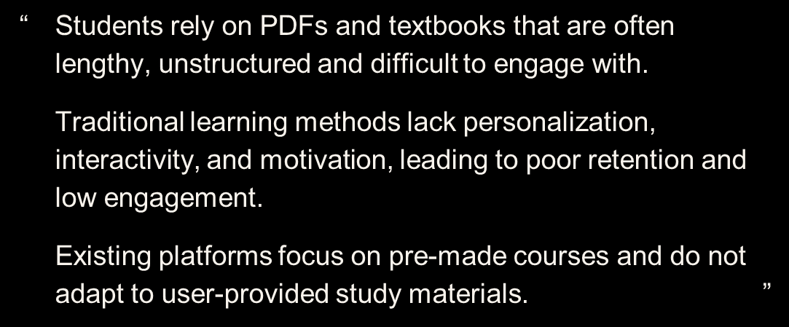

Slide 3
Why Traditional Productivity Tools Fail Students – "The Invisible Wall"
The Planning Fallacy:
The Insight:
Lack of Immediate Feedback:
The Mental Health Toll:
Research shows students spend up to 30% of their study time just organizing tasks, leading to "Decision Fatigue" before they even start the first chapter.
We don't have a lack of tools; we have a lack of incentive. Current apps track time, but they don't inspire action.
Academic rewards (grades) are delayed by months. Without immediate "dopamine hits," students lose motivation compared to the instant gratification provided by social media and gaming.
Unstructured study habits lead to the "Guilt-Procrastination Cycle," where the time spent not studying is plagued by the stress of what should be done.

Slide 4
The Forge – Document to Quest
File Ingestion: Students upload their own course PDFs, PPTs, and Docs to start their journey.
Automated Course Planning: The app analyzes the material to build a personalized route tailored to the student's specific requirements.
Defeating Decision Fatigue: We eliminate the 30% of time students waste just organizing, allowing them to start learning immediately.
Custom Campaigns: Every student follows a unique plan based on their academic load and personal pacing.
Stress-Free Start: A clear, guided path removes the mental toll of the "Guilt-Procrastination Cycle."

Slide 5

The Mastery Loop – Flashcards & MCQs
Active Revision: Before reaching the end of a module, students use AI-generated flashcards to revise key points from their uploaded docs.
The Final Challenge: Each level concludes with a simple MCQ exam to test knowledge and officially "clear" that stage.
Level-Based Progression: Completing these challenges allows the student to "Level Up" their profile and unlock the next part of their path.
Immediate Positive Feedback: Unlike delayed grades, the app provides instant points and rewards to maintain momentum.
Competency Tracking: Students must prove mastery in the MCQs to advance, ensuring real learning happens without the stress of a formal exam environment.

Slide 6
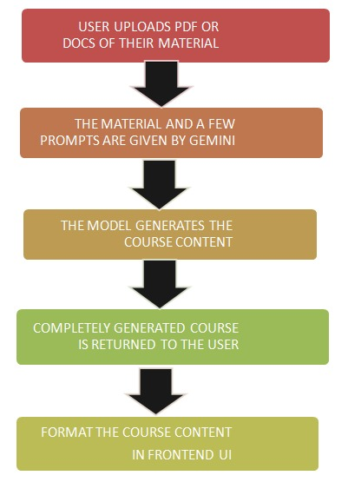
Project Architecture Diagram

Slide 7
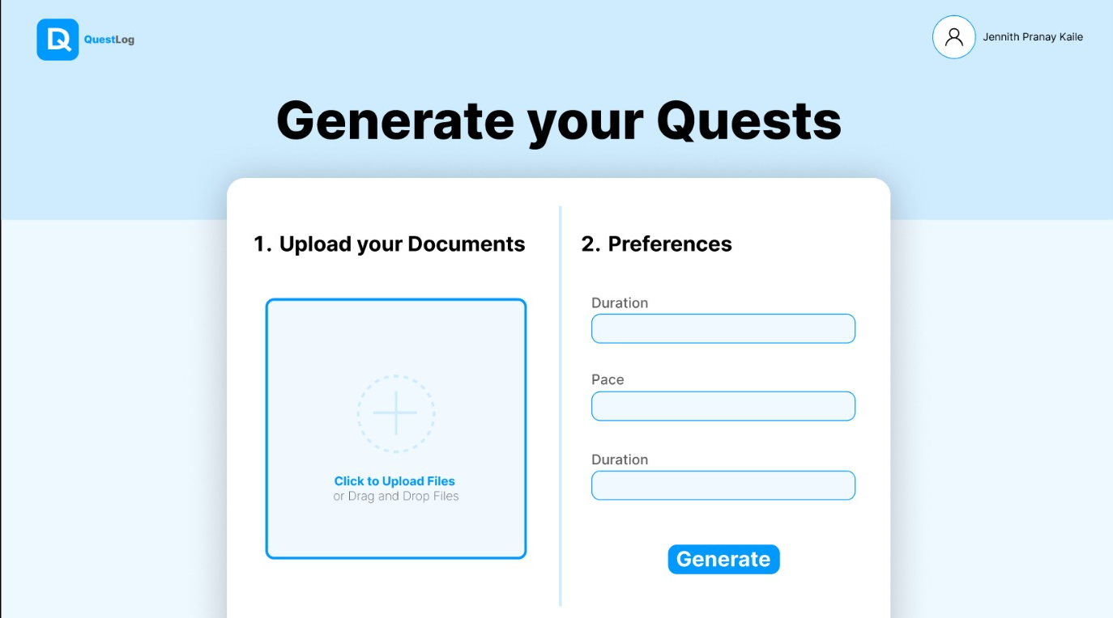
Sample Wireframe

Slide 8



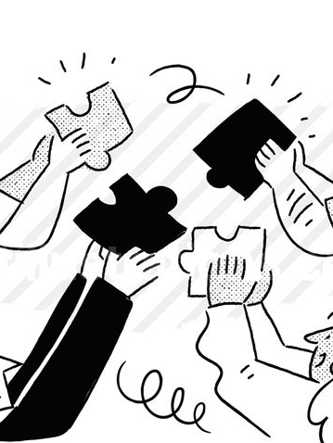
Stress-Free & Catchy Interface
Engaging UI Design: A vibrant, modern, and interesting interface designed to keep students curious rather than overwhelmed.
Positive Reinforcement: The gamification is built to keep students feeling positive and encouraged rather than creating "stress workouts."
Focus on Flow: The interface is streamlined to move the student from one task to the next with minimal friction.
Supportive Environment: Every element of the app is designed to reduce academic anxiety and foster a "can-do" attitude.

Slide 9
The X-Factor – AI & Integration
AI Adaptive Scheduling: | The app uses a "Spaced Repetition" algorithm to schedule tasks for peak alertness.
The Tech Stack: | Developed using React (vite), Node.js, Gemini API, and tailwind CSS.
Feasibility: | The prototype can be built rapidly using existing PDF-parsing APIs and gamification frameworks.

Slide 10
Impact & Future Vision
1
2
3
4
Increased Engagement:
High-Stakes Focus:
Scalable Business Model:
The Ultimate Goal:
QuestLog is projected to increase daily student engagement by 40% compared to static apps.
The primary target includes students preparing for competitive exams like JEE, NEET, and SATs
Future updates will include even more visual customization options to keep the interface fresh and personal.
Transforming academic burnout into a rewarding, stress-free, and successful adventure.

Slide 11
Thank You

