Slide 1
Exploratory Data Analysis – Mini Project
We are asked to select 20 players for a football club named “ Brussels United FC “.
To achieve this we are provided with a FIFA dataset which has details of more than 18,000 football players playing for different clubs across the globe.
On loading the dataset and doing summary stats, we found that there are 42 numerical attributes and 18 categorical attributes.
Out of which, we found some 9 columns to be useless for us as they don’t contribute much for our analysis. So they all have been dropped from the fifa dataset. Yet for future refereneces, they have been saved in a separate DataFrame called, fifa_dropped_data.

Slide 2
Refining the data for analysis
We had multiple columns in which data need to be refined. Also those columns need to be converted to adequate datatype instead of existing ‘object’ datatype.
Value, Wage, Joined, Contract_valid_until, Height, Weight and Release_clause are the names of those columns.
Then we categorized fifa dataset into numerical data and categorical data.
In numerical data, we checked for NULL values and did MEAN value imputation.

Slide 3
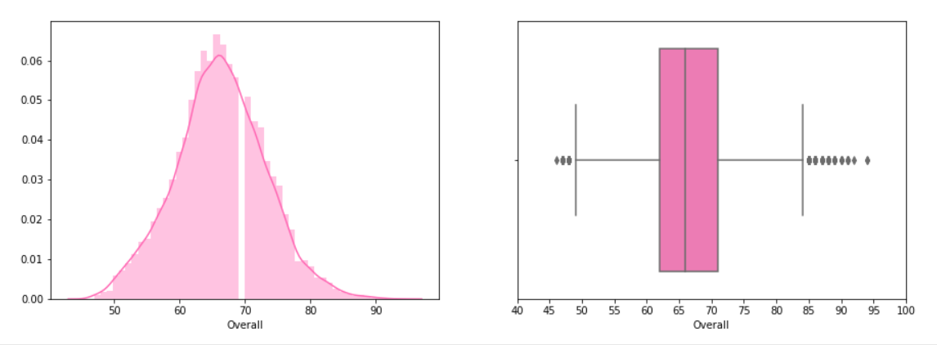
Exploratory analysis
The plot for distribution of overall rating of players was found as,
1. We can say that we have players from medium overall rating to the highest ratings. The overall rating data is also almost normally distributed.
2. Most of the players have overall rating ranging between 63 - 73(out of 100). So we can say that most of the players of the dataset are average and beyond with their skills.
3. We also have good count of players who are very good with their overall rating, it is observed that the highest rating is somewhere around 95 out of 100.
4. We also have few below average players in the dataset.

Slide 4
Generating pair plot for the following variables:
Overall, Value, Wage, International Reputation, Height, Weight and Release Clause, we observed.
1. Release_clause is highly positively correlated on Value, Wage, International_Reputation, and moderately on Overall ratings.
2. Weight doesn't depend on any of the other attributes or we can say, weight doesn't affect any other metrics of the data.
3. Very much to our surprise we found a key relation here using our data, Height and Overall points are strongly negatively correlated. The less taller a player is, more likely he has higher overall points.
4. As expected, International_Reputation is positively correlated towards Value, Wage and Release_Clause. Overall points is very slightly correlated on International_Reputation.
5. The Higher the Wage of a player is, more will be his Value and Release_Clause.
6. Higher the Overall points, more will be their Value.

Slide 5
Generated a table containing the top 20 players ranked by Overall score and whose contract expires in 2020.
The average wage for this set of players was found to be 205450.000000
The average age was found to be 30.650000
It is also observed that there is a strong positive correlation between these players overall ranking and their value.

Slide 6
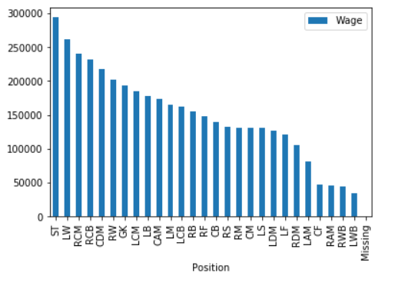
We also generated tables containing the top 5 players by Overall rating for each unique position.
There are no players appearing in more than one Table.
The average wage one can expect to pay for the top 5 in every position was described with the help of a histogram plot.
The highest 'Wage' will be given to ST followed by LW, RCM, RCB and CDM positions. Rest follows these positions with LWB being the least.

