Slide 1
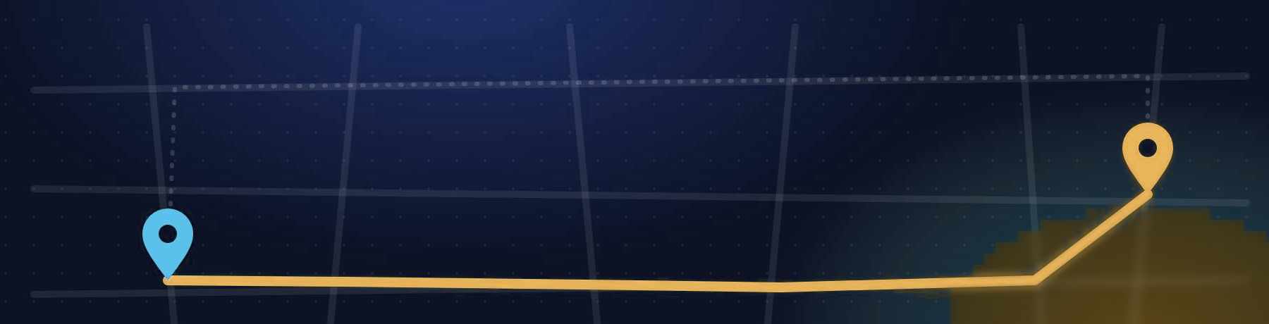
Dijkstra’s Algorithm
DESIGN AND ANALYSIS OF ALGORITHMS
Single-source shortest paths in weighted graphs
Generated using Claude
Notes:
Have you ever wondered how Google Maps finds the shortest route to your destination? The answer is Dijkstra's algorithm.

Slide 2
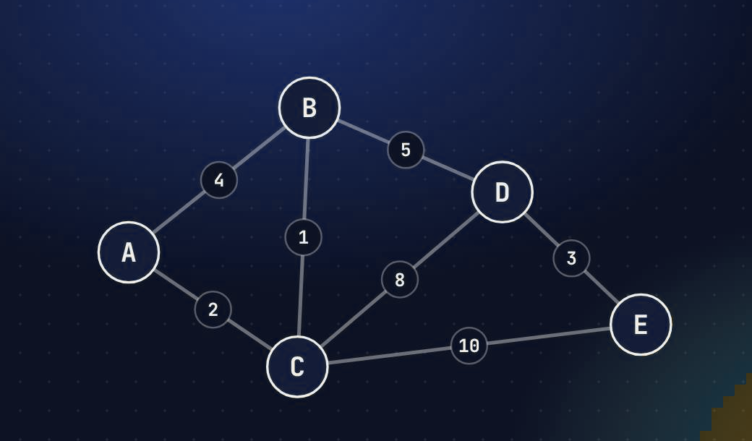




What it is
Who & when
Proposed by Edsger W. Dijkstra in 1956
Goal
Shortest path from one source to every other vertex
Requirement
All edge weights must be non-negative
The example graph used in this deck: 5 vertices, 7 undirected edges, all weights ≥ 0
Strategy
Greedy: always settle the closest unvisited vertex
Notes:
Dijkstra's algorithm, proposed by Edsger Dijkstra in 1956, finds the shortest path from one source vertex to every other vertex in a weighted graph. It works when all edge weights are non-negative, and it uses a greedy strategy.

Slide 3
How it works
1
Initialize
dist[source] = 0, all others = ∞
PSEUDOCODE
DIJKSTRA(G, w, s)
for each v in G.V
d[v] ← ∞; π[v] ← NIL
d[s] ← 0
Q ← G.V // min-priority queue
while Q ≠ ∅
u ← EXTRACT-MIN(Q)
for each v in Adj[u]
if d[u] + w(u,v) < d[v]
d[v] ← d[u] + w(u,v)
π[v] ← u
2
Pick
unvisited vertex u with the smallest dist
3
Relax
if dist[u] + w(u,v) < dist[v], update v
4
Mark
u as visited; its distance is final
5
Repeat
steps 2–4 until all vertices are visited
Notes:
First, set the source distance to zero and all others to infinity. Next, pick the unvisited vertex with the smallest distance. Then relax its neighbors: if going through this vertex gives a shorter path, update the distance. Repeat until every vertex is processed.

Slide 4
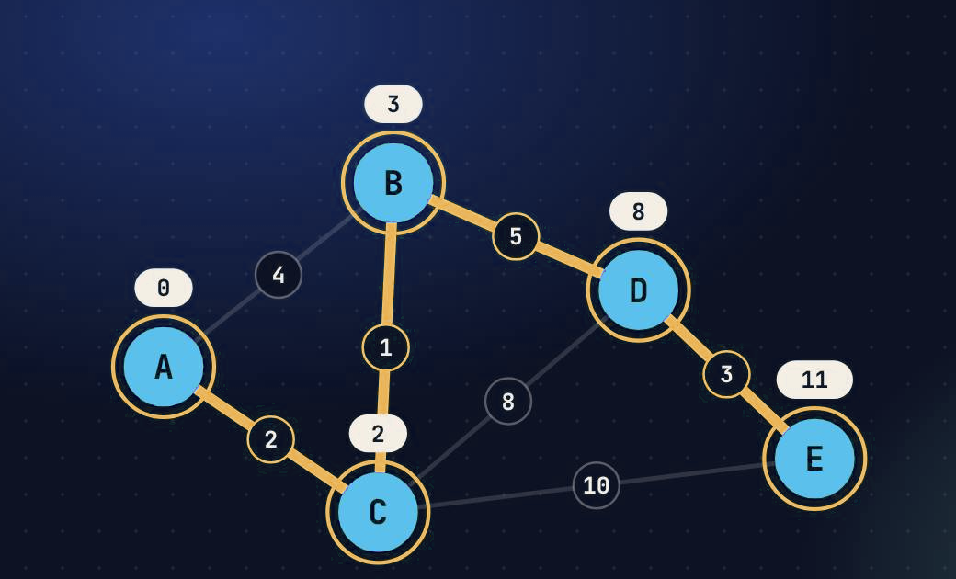
Worked example: source A
Step | Visit | A | B | C | D | E
Init | — | 0 | ∞ | ∞ | ∞ | ∞
1 | A | 0 | 4 | 2 | ∞ | ∞
2 | C | 0 | 3 | 2 | 10 | 12
3 | B | 0 | 3 | 2 | 8 | 12
4 | D | 0 | 3 | 2 | 8 | 11
5 | E | 0 | 3 | 2 | 8 | 11
Highlighted = distance improved in that step. B drops from 4 to 3 because A→C→B (2 + 1) beats the direct edge A→B (4).
A → C → B → D → E · total 11
Notes:
Take source A. The distance to C is 2. To reach B, going through C costs 3, which beats the direct edge of 4. D is then 8 and E is 11. So the shortest path from A to E is A, C, B, D, E.

Slide 5
Time complexity
SIMPLE ARRAY
BINARY HEAP (PRIORITY QUEUE)
O(V²)
O((V+E) log V)
Finding the minimum scans all V entries, and that happens V times. Good for dense graphs.
Each extract-min and each decrease-key costs O(log V). Good for sparse graphs.
Fibonacci heap
O(E + V log V)
Extra space
O(V)
Notation
V = vertices, E = edges
Notes:
With a simple array it takes O of V squared. With a priority queue built on a binary heap, it takes O of V plus E times log V.

Slide 6



Where it is used
GPS navigation
Network routing
Game pathfinding
Intersections are vertices and roads are edges weighted by distance or travel time.
Link-state protocols such as OSPF run Dijkstra to build each router’s shortest-path tree.
Grid maps for NPC movement. A* is Dijkstra plus a heuristic toward the goal.
Notes:
It powers GPS navigation, network routing and game pathfinding.

Slide 7
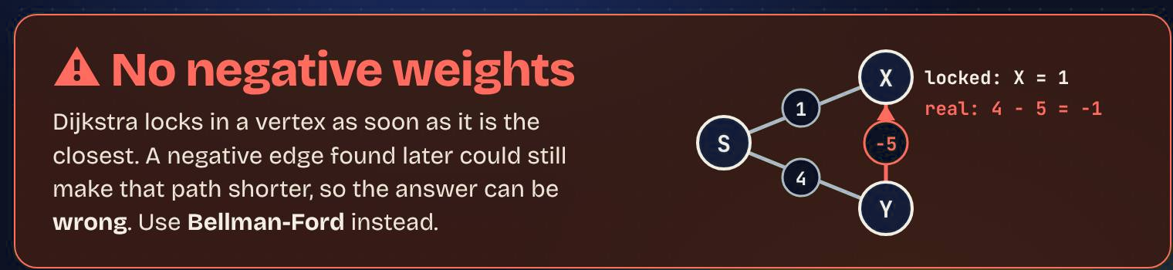
Limitation: negative edge weights
WHY IT FAILS
USE INSTEAD
X is settled at distance 1. The edge Y→X of weight −5 is seen later and gives 4 − 5 = −1, but X is already final.
Bellman-Ford · O(V·E)
Handles negative edges and detects negative cycles.
Notes:
But it fails with negative edge weights, where Bellman-Ford should be used instead. Thanks for watching!

Slide 8
DIJKSTRA’S ALGORITHM
Thank you
Greedy · non-negative weights · O((V+E) log V) with a binary heap
Generated using Claude
Companion video: dijkstra.mp4 (2:00, narrated)

