Slide 1

SALES PREDICTION
Sarang Sawant 221061080
Harsh Salunkhe 22106133
Siddhant Salunkhe 22106045
Mrunal Shejwal 22106050
Project Guide
Prof.Taruna Sharma

Slide 2
Outline
Introduction
Literature Survey of the existing systems
Problem statement
System Design
Technologies and methodologies
Implementation
Conclusion
References

Slide 3
INTRODUCTION
Sales prediction involves using Python, CSV, and HTML to analyze past sales data and make informed projections for future sales trends.
Sales prediction using machine learning is a powerful tool that businesses to forecast future sales based on historical data and other relevant factors. By analyzing patterns and trends in sales data, machine learning algorithms can help businesses make informed decisions on inventory management, marketing strategies, and overall business planning. This technology enables businesses to optimize their sales processes, improve forecasting accuracy. and ultimately drive revenue growth

Slide 4
Literature Survey of the existing system
Survey of Existing Solutions in the Real World
Numerous solutions exist in the domain of sales prediction and forecasting, catering to various industries such as retail, e-commerce, and manufacturing. Solutions range from traditional statistical methods to modern machine learning algorithms.
Analysis of Issues Present in the Surveyed Solutions
While existing solutions provide valuable insights into sales prediction, they face several challenges. One common issue is the requirement for extensive historical data, which may not always be available or reliable, especially for newly established businesses. Additionally, many models struggle to handle complex sales patterns, such as sudden spikes or dips in sales, leading to inaccurate predictions.
Survey of Users’ Requirements and Expected Improvements
Surveys conducted with users and potential users of sales prediction solutions reveal several key requirements and expected improvements. Users emphasize the importance of accuracy in predictions, especially for strategic decision-making purposes. Additionally, users express the need for user-friendly interfaces that simplify the process of inputting data and interpreting results.

Slide 5
Limitations of Existing Systems
Limited Data Availability: Many existing systems face limitations due to insufficient historical sales data, especially for newer businesses or products with limited sales history. This hampers the accuracy and robustness of predictive models.
Data Quality Issues: Inaccurate or incomplete sales data can lead to biased predictions and unreliable insights. Data cleaning and preprocessing are crucial but often challenging tasks, especially when dealing with large datasets from multiple sources.
Model Complexity and Interpretability: Some existing models, particularly those based on deep learning or ensemble methods, can be overly complex and lack interpretability. This makes it difficult for users to understand how predictions are made and to trust the results.
Complexity of Sales Dynamics: Sales patterns are influenced by a multitude of factors, including seasonality, market trends, economic conditions, and consumer behavior. Capturing and modeling these dynamics accurately remains a significant challenge.

Slide 6
Problem statement
The research will involve:
Review and Analysis of Existing Solutions: Conducting a comprehensive review and analysis of existing sales prediction and forecasting systems to identify their strengths, limitations, and areas for improvement.
Data Collection and Preprocessing: Collecting and preprocessing historical sales data from retail businesses to build a robust dataset for model training and evaluation.
Model Development and Evaluation: Developing and evaluating various machine learning models, including regression models, time series forecasting models, and ensemble methods, to identify the most suitable approach for accurate sales prediction.
Integration and Deployment: Integrating the developed models into a user-friendly web-based interface or application for easy access and interaction by retail businesses. Deployment will involve testing the system in real-world retail environments to validate its performance and usability.

Slide 7
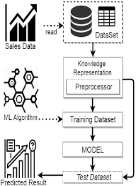
System Design

Slide 8
Technologies and methodologies
Machine Learning Algorithms:
Regression Models: Linear Regression, Polynomial Regression, Ridge Regression, Lasso Regression, ElasticNet Regression.
Time Series Forecasting Models: Autoregressive Integrated Moving Average (ARIMA), Seasonal ARIMA (SARIMA), Exponential Smoothing Methods (Holt-Winters), Prophet.
Ensemble Methods: Random Forest, Gradient Boosting Machines (GBM), XGBoost, LightGBM, CatBoost.
Domain-specific Knowledge:
Retail Analytics: Understanding retail-specific metrics, seasonality, promotional effects, and consumer behavior patterns.
Supply Chain Management: Incorporating supply chain data and logistics information into the forecasting process.

Slide 9
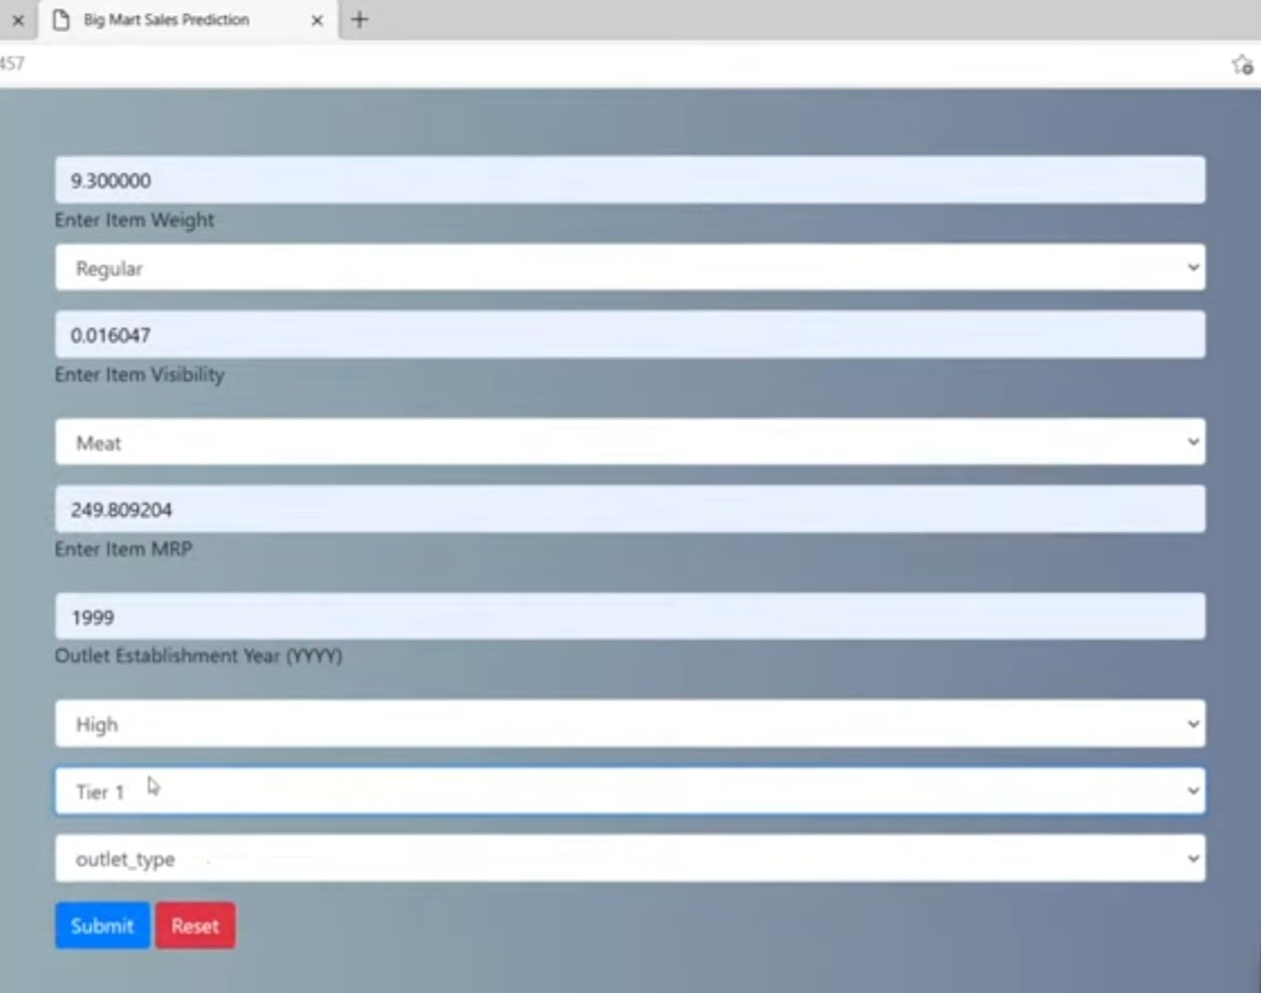

Implementation

Slide 10
Conclusion
The field of sales prediction and forecasting is vital for businesses across various industries, including retail, e-commerce, and manufacturing. Accurate sales predictions enable businesses to make informed decisions, optimize inventory management, and maximize revenue. In this research, we have explored the existing solutions, analyzed their limitations, and identified improvement possibilities to address the challenges in sales prediction and forecasting.
Through a comprehensive literature review and survey analysis, we have highlighted the common issues faced by existing systems, including limited data availability, model complexity, interpretability, and scalability concerns. Despite advancements in machine learning and data analytics, the problem of sales prediction remains challenging due to the dynamic nature of sales data and the complex interplay of market dynamics and consumer behavior.

Slide 11
References
[1]https://link.springer.com/chapter/10.1007/10720026_1
[2]https://www.sciencedirect.com/science/article/abs/pii/S0167718710000469
[3]https://www.clutejournals.com/index.php/JBER/article/view/8068
[4]https://ieeexplore.ieee.org/abstract/document/8541320
All references should be arranged based on the year of publications. With latest year on top.
All references should be in the following form.
All Author names, Title of the Project, Publisher full details, volume, page number details, year of publication. Highlight the title and the Year.
Also give the link to each paper so that you can show the paper / site.

Slide 12
Thank You...!!

