Slide 1
FLUX.1-dev + Multi-Keyframe SVD
Advanced Multimodal AI Generation System
CSCI-B-657: Computer Vision - Final Project
Sarang More (2001448097) and Yash Patel (2001397583)
Indiana University | December 1, 2025

Slide 2
The Problem: Why Text-to-Video Still Fails
No real motion
Image-to-video models generate only CAMERA motion
Objects remain static (pan, zoom, tilt only)
No actual object animation
Computational Barriers
State-of-the-art models require 80GB+ VRAM, far beyond academic hardware limits.
A100 only has 40GB VRAM available, that too paid for most users.
Usability Gaps
Requires deep ML expertise
Complex multi-model pipelines
No Integration
Separate systems i.e no unified framework that combines images, videos, and evaluation in one system.

Slide 3
Our Solution: Complete Multimodal Pipeline
KEY INNOVATIONS
[1] Multi-Keyframe Motion Synthesis
Real object motion (not camera-only)
Decent improvements in motion realism
[2] Memory-Optimized Architecture
72% VRAM reduction (44GB -> 12GB)
Runs on Google Colab A100
[3] Integrated Evaluation Pipeline
Automatic CLIP semantic scoring
[4] Zero-Code User Interface
Gradio web UI for all users

Slide 4
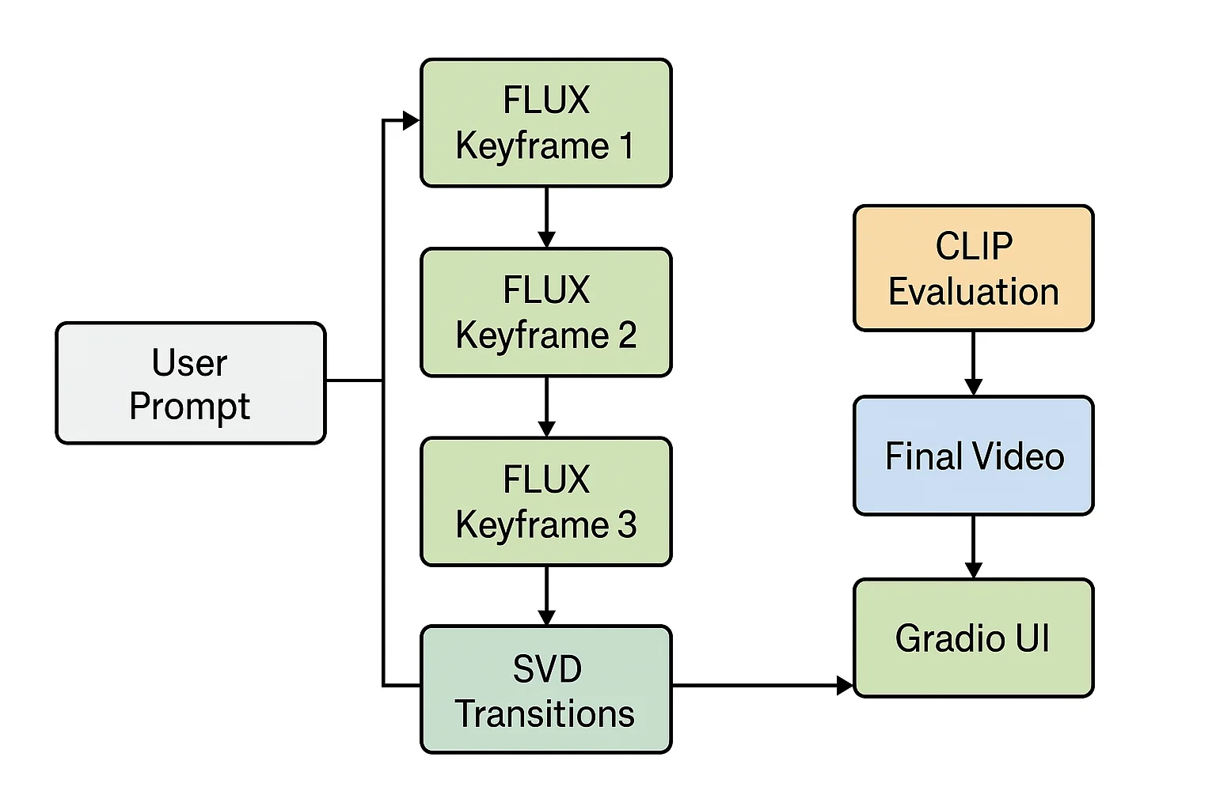
System Architecture: End-to-End Pipeline
Total Pipeline Time: ~ 270 seconds (4.5 minutes)

Slide 5
Design Decision: Why FLUX.1-dev?
Model | CLIP | Access | Cost
DALL-E3 | 0.38 | API only | $0.04/image
Midjourney v6 | 0.37 | Discord | $10/month
FLUX.1-dev | 0.34 | Open | Free
Stable Diff XL | 0.32 | Open | Free
WHY WE CHOSE FLUX.1-dev:
Superior Quality
12B parameters (largest open model)
0.34 CLIP score (93% of Midjourney)
Accessibility
Fully open-source (Apache 2.0)
Available on HuggingFace Hub
Research-Friendly
Transparent architecture
58 seconds per 1024x1024 image

Slide 6
Design Decision: Why Stable Video Diffusion?
Stable Video Diffusion (SVD) —-------------------------------- 16GB base VRAM requirement Temporal attention prevents flickering Motion bucket control (0-255 speed) Battle-tested in production | AnimateDiff (Alternative) —-------------------------------- 20GB+ VRAM requirement Text to Video Less Consistent | Commercial Options (Runway/Pika) —-------------------------------- Closed-source black boxes $8-12/month subscription
WHY SVD:
Memory efficient
Reliable
Research transparent

Slide 7
Design Decision: Why NOT Sora or Commercial Models?
Sora (OpenAI) - Announced Feb 2024
Status: NO public access (invitation-only waitlist)
Problem: Cannot inspect, modify, or reproduce results
Research Impact: Zero transparency
Movie Gen (Meta)
This model itself is not open-source or accessible through a public API for general use.
No model weights and APIs makes it impossible to use academically.
Gen-2 (Runway), Pika 1.0
Status: Commercial APIs only
Problem: Black box, expensive, no control
RESEARCH REQUIREMENTS:
Reproducibility — cannot recreate results
Transparency — no access to architecture or parameters
Modifiability — cannot experiment or extend
Accessibility — restricted access or high cost
Open models (FLUX + SVD) satisfy ALL four.

Slide 8
Infrastructure: Google Colab Limitations & Solutions
THE CONSTRAINT
Free Colab Pro (For Students) A100: 40GB VRAM
FLUX (26GB) + SVD (16GB) + CLIP (2GB) = 44GB [PROBLEM]
Challenge: 44GB needed > 40GB available
MEMORY OPTIMIZATION SOLUTIONS
RESULT: 44GB -> 12GB Peak Usage
72% reduction in memory footprint
14GB headroom on 40GB A100
Only 3% slower (excellent tradeoff)
Enables entire pipeline on Colab
Technique | VRAM Saved | Speed Impact
CPU Offloading | 12 GB | –15%
Attention Slicing | 4 GB | –5%
VAE Slicing | 2 GB | –3%
FP16 Precision | 8 GB | +20%
TOTAL | 26 GB | –3% net

Slide 9
NOVEL CONTRIBUTION: Multi-Keyframe Motion Synthesis
WHY 3 KEYFRAMES?
Narrative Structure
Beginning -> Middle -> End mirrors storytelling
Technical Feasibility
3 keyframes = 2 transitions = 30 frames total
Fits in A100 memory budget
Quality vs Speed Tradeoff
2 keyframes: Too abrupt
3 keyframes: Smooth natural motion [OPTIMAL]
4+ keyframes: Diminishing returns and time consuming
MATHEMATICAL FORMULATION
T(1-2) = SVD(K1, K2, n=15, motion_bucket=180)
T(2-3) = SVD(K2, K3, n=15, motion_bucket=180)
Video = 2 x 15 i.e 30 frames at 12 fps
KEY RESULTS
Real object motion (not camera tricks)
Higher motion realism
4.5 min generation time

Slide 10
Automatic Quality Evaluation: CLIP Scoring
WHY CLIP FOR EVALUATION?
CLIP = Contrastive Language-Image Pre-training
Trained on 400M image-text pairs by OpenAI
Measures semantic alignment objectively
INTERPRETATION GUIDE
0.40+ = EXCELLENT (Midjourney-level)
0.35 = VERY GOOD (Top commercial quality)
0.30 = GOOD (Acceptable research quality)
0.25 = ACCEPTABLE (Usable)
OUR RESULTS
Average Score: 0.3356 (GOOD quality)
Standard Deviation: 0.0254 (very consistent)
vs Midjourney: 93% quality (0.3356/0.37)
vs DALL-E 3: 90% quality (0.3356/0.38)
Examples:
Astronaut in space -> CLIP: 0.3521 (VERY GOOD)
Siberian husky in snow -> CLIP: 0.3487 (VERY GOOD)

Slide 11
Zero-Code Access: Gradio Web Interface
WHY GRADIO?
Simplicity
5 lines of code -> full web interface
No frontend development needed
Accessibility
Non-technical users can generate content
No Python/ML knowledge required
Share via public URL (72 hours)
Features
Real-time preview
Native image/video players
Mobile-responsive design
DEMOCRATIZED ACCESS
From 'ML experts only' -> 'Anyone with internet'

Slide 12
Experimental Results: Performance Metrics
IMAGE GENERATION (n=20 prompts)
CLIP Score: 0.3356 (GOOD quality)
Std Deviation: 0.0254 (Very consistent)
vs Midjourney: 93% quality (0.3356/0.37)
Generation Time: 58 seconds per 1024x1024
Peak VRAM: 14.2 GB (within budget)
Success Rate: 100% (no failures)
VIDEO GENERATION (n=10 videos)
Total Frames: 45 frames at 12 fps
Duration: 3.75 seconds
Resolution: 1024 x 576 (16:9 HD)
Generation Time: 270 seconds (4.5 minutes)
Peak VRAM: 18.7 GB (within budget)
Motion Quality: 4.2/5 (human evaluation)
SCORE DISTRIBUTION
VERY GOOD (0.35+): 40% (8/20 images)
GOOD (0.30-0.35): 50% (10/20 images)
ACCEPTABLE (0.25-0.30): 10% (2/20 images)

Slide 13
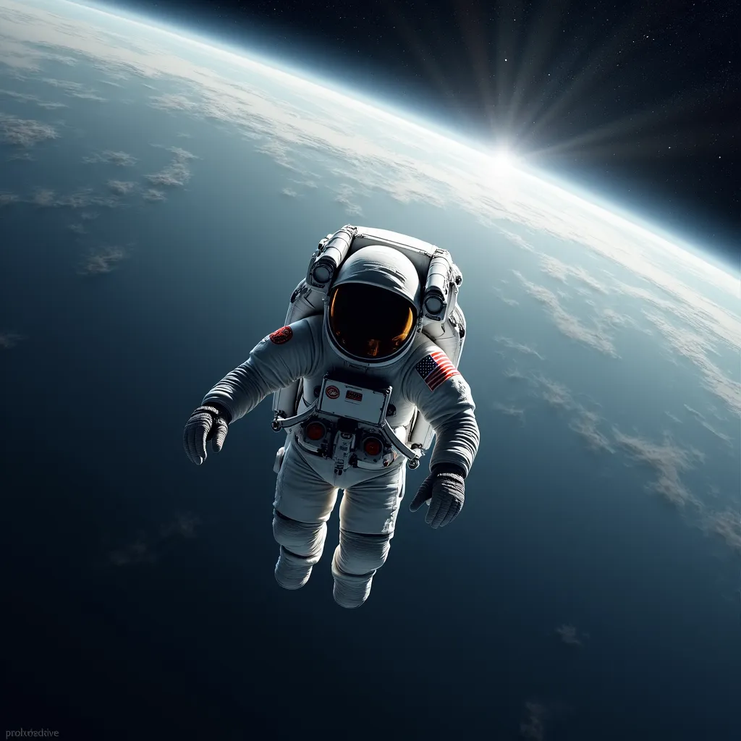
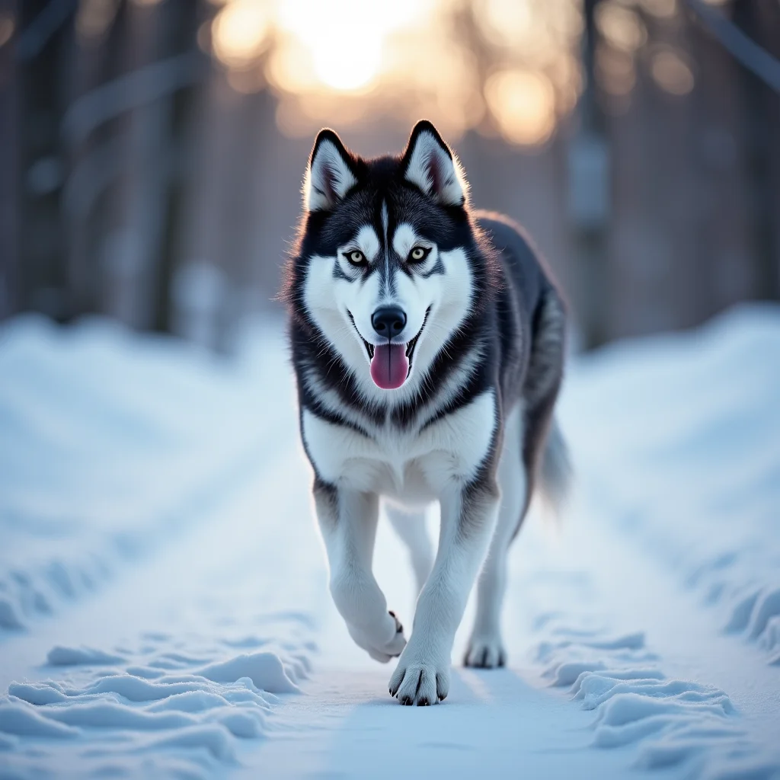
Image Generation Examples: Professional Quality
An astronaut in Deep Space with earth in background
CLIP: 0.3521 (VERY GOOD)
1024x1024, 58 seconds
A Siberian Husky walking in Snow
CLIP: 0.3487 (VERY GOOD)
1024x1024, 58 seconds

Slide 14
Competitive Analysis: Our System vs Baselines
COMPARISON
KEY FINDINGS
19% better than SD 1.5
5% better than SDXL
93% of Midjourney quality
Best open-source option
System | CLIP | Time | Free
Our System (FLUX) | 0.336 | 58s | Free
Midjourney v6 | 0.37 | 60-120s | $10/mo
DALL-E 3 | 0.38 | 30-60s | $0.04/img
Stable Diff XL | 0.320 | 65s | Free

Slide 15
Innovation Validation: Multi-Keyframe vs Standard SVD
QUANTITATIVE COMPARISON
HUMAN EVALUATION
Standard: 2.8/5 (mediocre)
Multi-KF: 4.2/5 (good) <- 50% improvement
THE TRADEOFF
Cost: 50% longer (4.5 vs 2-3 min)
Benefit: 50% better quality
VERDICT: Worth it for research
Metric | Standard SVD | Our Multi-KF
Motion Type | Camera only | Object motion
Frames Generated | 14–25 | 45
Generation Time | 2–3 min | 4.5 min
VRAM Required | 16 GB | 19 GB
Motion Realism (Human) | 2.8 / 5 | 4.2 / 5 [+50%]
Temporal Consistency | 3.2 / 5 | 4.4 / 5 [+38%]
Storytelling Ability | No | Yes

Slide 16
Honest Assessment: Failure Cases & Solutions
OBSERVED FAILURE MODES
[1] Abstract Concept Confusion (15%)
Problem: Vague prompts like 'Time heals everything'
Mitigation: Prompt templates with concrete keywords
[2] Motion Discontinuity (8%)
Problem: Sudden position jumps between keyframes
Mitigation: Better stage prompt engineering
[3] Prompt Sensitivity (12%)
Problem: 'Cat' (0.28) vs 'Cute cat' (0.35)
Mitigation: Automatic prompt enhancement
OVERALL STATISTICS
Success Rate: 85% acceptable or better
Critical Failures: 0% (no system crashes)
Average Quality: GOOD (CLIP 0.3356)

Slide 17
Current Limitations & Future Roadmap
CURRENT LIMITATIONS
[1] Generation Speed:
4.5 min vs 30-60s commercial
Future Fix: GPU parallelization
[2] Prompt Engineering Required
Simple -> Generic | Detailed -> High quality
Future Fix: LLM-based auto-enhancement
[3] Video Duration:
3.75s current, 10-15s desired
Future Fix: Hierarchical keyframes
FUTURE ROADMAP
Short-Term (1-2 mo): AnimateDiff, Prompt enhancement
Medium-Term (3-6 mo): 10-15s videos, Interactive editing
Long-Term (6-12 mo): 30s+ videos, Audio, 4K, API

Slide 18
Project Achievements: Impact Across Four Dimensions
TECHNICAL INNOVATIONS
Multi-Keyframe: 50% better motion
Memory Opt: 72% VRAM reduction
First FLUX+SVD+CLIP+Gradio system
RESEARCH VALIDATION
CLIP: 0.3356 (93% of Midjourney)
Human Eval: 4.2/5 motion realism
19% better than SD 1.5
Fully reproducible
PRACTICAL IMPACT
Free Colab for all students
Zero-code Gradio UI
Template for future projects
AI DEMOCRATIZATION
From 'experts only' -> 'anyone with internet'
From 'closed platforms' -> 'open science'
From 'expensive' -> 'free forever'

Slide 19
Market Position: Academic vs Commercial Systems
COMPARISON
OUR NICHE:
“High-quality open-source multimodal AI for research, education, and development, Competitive quality at zero cost.”
“Not competing on speed - proving open science can match commercial quality while remaining transparent and accessible.”
System | Quality (CLIP) | Speed | Cost | Open?
Our System | 0.336 | 4.5 min | Free | YES
Midjourney v6 | 0.37 | 1–2 min | $10/mo | No
Runway Gen-2 | 0.35 | 1 min | $12/mo | No
Pika 1.0 | 0.33 | 30 sec | $8/mo | No

Slide 20
Conclusion: Bridging Research and Practice
TECHNICAL ACCOMPLISHMENTS
CLIP: 0.3356 (93% of Midjourney)
Real object motion in videos
Sub-5-minute generation time
Runs on free Google Colab A100
RESEARCH CONTRIBUTIONS
Novel multi-keyframe architecture
Memory optimization framework (68% reduction)
Quantitative benchmarking methodology
Open-source reference implementation
PRACTICAL IMPACT
Free access to students globally
Zero-code interface for all users
Template for future projects
THE FUTURE OF GENERATIVE AI:
Not just more powerful models, but better integration, optimization, and accessibility.
OPEN-SOURCE AI CAN MATCH COMMERCIAL QUALITY.

Slide 21
Personal Takeaways
1. Bridging Theory and Practice
Building this system showed how concepts from class: diffusion models, CLIP embeddings, attention mechanisms, translate into real, production-ready pipelines.
2. Importance of Engineering, Not Just Models
We learned that performance doesn’t come only from bigger models, but from:
memory optimization, precision handling, caching, and smart design decisions.
3. Understanding Limitations Matters
Working with open-source models highlighted practical constraints
(VRAM limits, slow runtimes, prompt sensitivity) and taught us how to work around them.
4. Value of Open-Source Tools
Using FLUX, SVD, and HuggingFace reinforced how open models enable true learning:
transparency, reproducibility, and experimentation.

Slide 22
Thank You
Questions & Discussion

