Slide 1

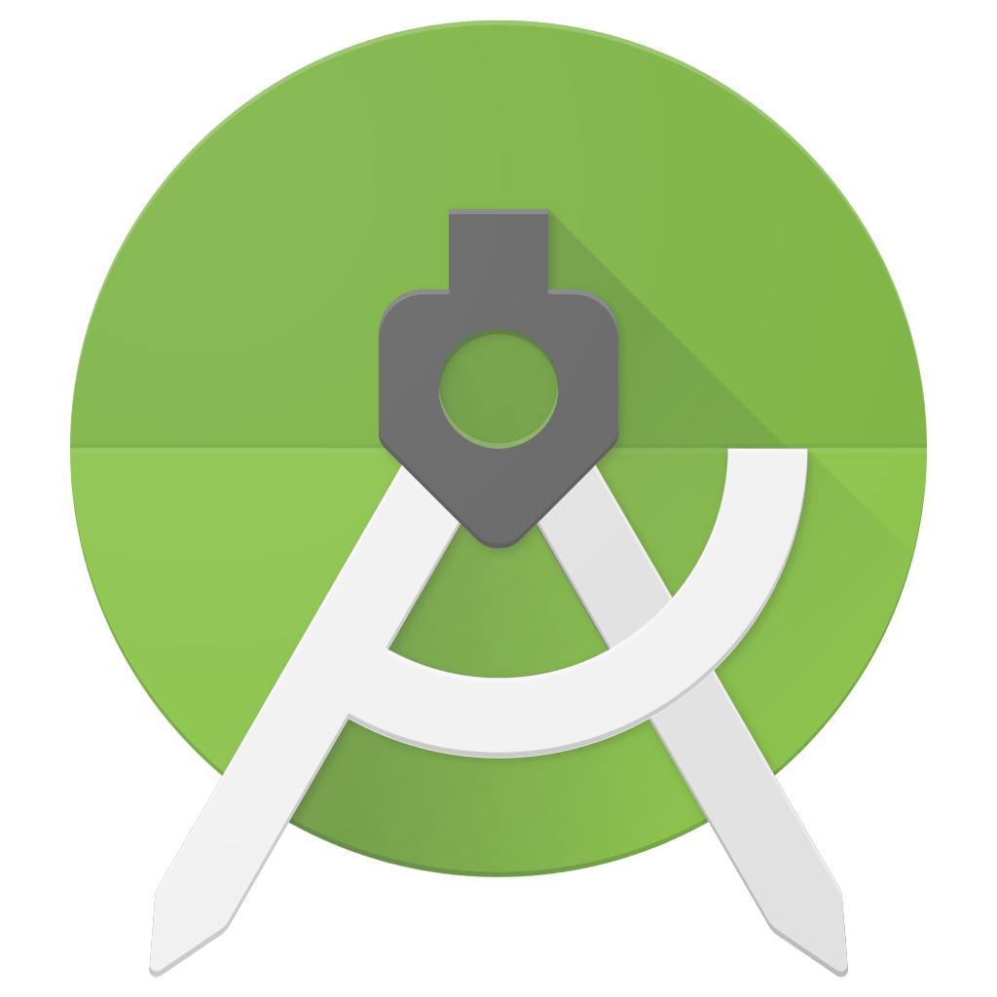
Android studio
Installation and Setup

Slide 2
System Requirements
Android Studio need the following system specifications to run properly:
Operating System: Windows 7/8/10, Mac OSX (>=10.10), Linux Ubuntu 16.04/18.04 or similar Linux distros.
At least 4 GB RAM ( 8 GB recommended ).
2-4 GB of Disk space.
Running on Linux or Mac may provide better user experience than Windows under similar system specifications, but not that much of an issue.
Be comfortable with the OS you are using.

Slide 3
Getting the Files
We’ll be installing Android Studio 3.4, but any version above 3 should suffice.
https://developer.android.com/studio/index.html#downloads
Select the appropriate variant according to your OS and Download.
The setup file will be of size around 750 MB.
Alternatively, you may get the setup from DC++ intranet hub, or we will be providing you with the setup files.

Slide 4
Please Note
Android Studio requires Internet Connectivity at most of the times including the installation for functioning smoothly.
So ensure that your device has proper network connectivity while running the setup and the installation.
Not having proper connectivity may cause problems with installer in downloading the extra files it needs.
The installation might take some time depending upon your system and network.
You may still run into some random errors, so please be patient.

Slide 5
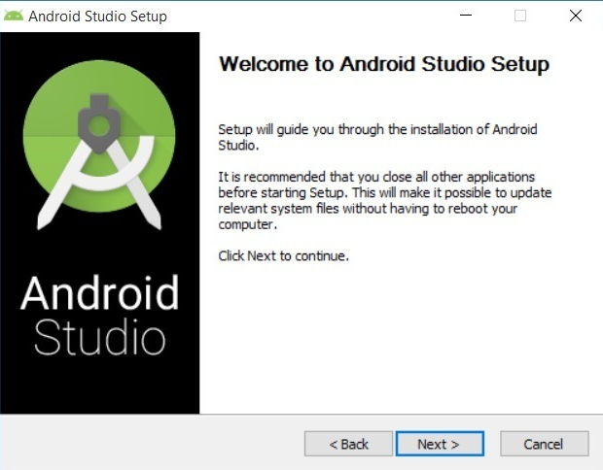
Running the Setup ( Windows )
Open the setup file.
The Install Wizard will open.
Click Next.

Slide 6
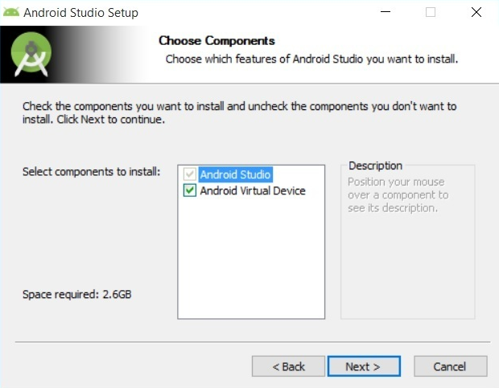
Running the Setup ( Windows ) Cont.
You can opt to install Android Virtual Device or not.
Default is recommended.
Click Next.

Slide 7
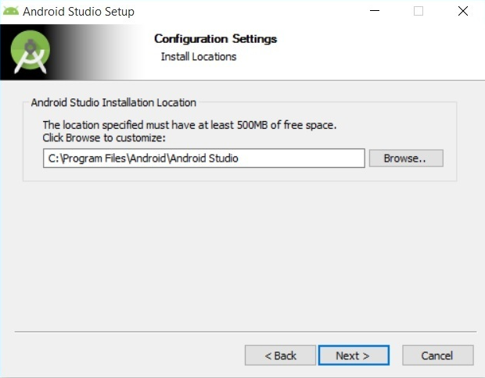
Running the Setup ( Windows ) Cont.
Choose the Install Location.
Default is recommended.
Click Next.

Slide 8
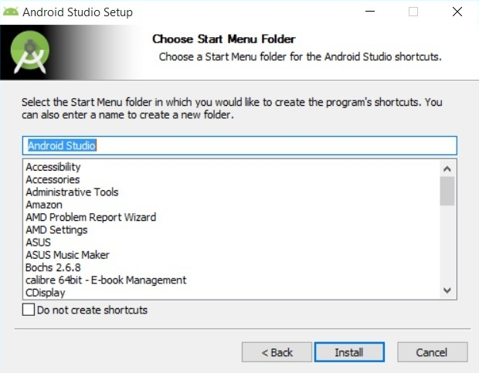
Running the Setup ( Windows ) Cont.
Choose whether to create Start Menu shortcut.
Default is recommended.
Click Install.

Slide 9
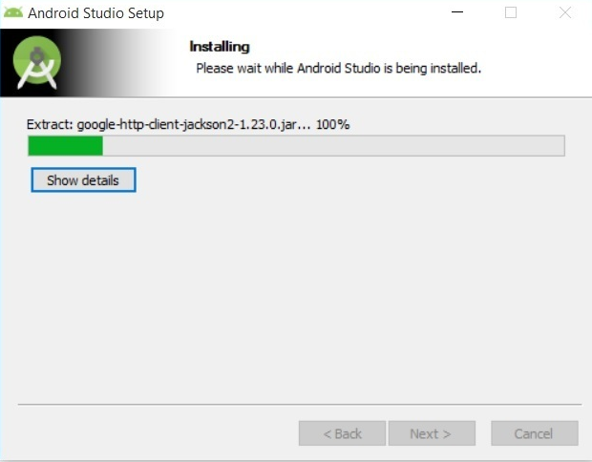
Running the Setup ( Windows ) Cont.
The setup will install Android Studio.
Wait till it completes.
Click Next.

Slide 10

Running the Setup ( Windows ) Cont.
Select Start Android Studio
Click Finish.
Android Studio is installed in your system now.

Slide 11
Continuing Installation
When Android Studio starts, select not to import previous settings and press OK.
Select Next > Standard Installation > Next > Next > Finish.
Android Studio may install multiple files required for its functioning.
Wait till the downloads completes.
The Android Studio will open when installation completes successfully.

Slide 12
Installing on Linux Ubuntu
Steps might differ a bit based on the Linux Distro.
Install Libraries required to run Android Studio smoothly.
Navigate to Android Studio folder and install it.

Slide 13
Installing on Linux Ubuntu Cont.
Install Libraries
Open Linux terminal by pressing Ctrl+Alt+t.
Install by the following command
sudo apt update
sudo apt-get install libc6:i386 libncurses5:i386 libstdc++6:i386 lib32z1 libbz2-1.0:i386
The libraries should get installed properly.

Slide 14
Installing on Linux Ubuntu Cont.
Install Android Studio
Unpack the downloaded setup file to a appropriate folder. For eg. /usr/local/
Open Linux terminal by pressing Ctrl+Alt+t.
Navigate to the folder you extracted to earlier by cd command.
Next navigate to android-studio/bin/
Execute the studio.sh file.
Select not to import previous settings and click Ok.
Android Studio Setup will open in a window.
Click Next > Standard Installation > Next > Next > Finish.
The setup will install Android Studio in a while.
The Android Studio will open when installation completes successfully.

Slide 15
Installing on Mac
Launch the Android Studio DMG file.
Drag and drop Android Studio into the Applications folder, then launch Android Studio.
Select not to import previous Android Studio settings, then click OK.
Android Studio Setup will open in a window.
Click Next > Standard Installation > Next > Finish.
The setup will install Android Studio in a while.
The Android Studio will open when installation completes successfully.

Slide 16
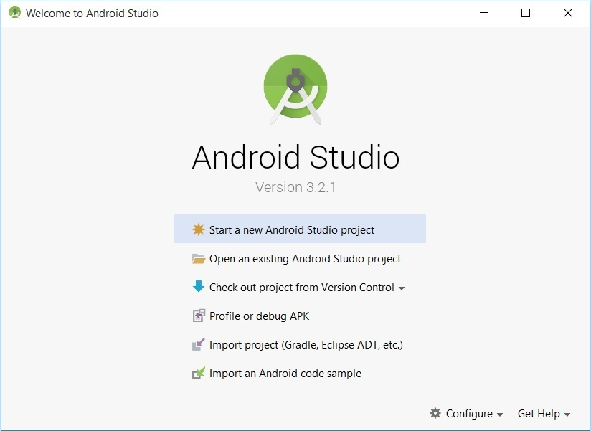
Setup Complete
When the setup completes, you will be greeted by the following window.
Next Time: Getting started with Android Studio.

