Slide 1

Forecasting Onion Market Trends and Prices
Our project aims to revolutionize onion farming by implementing innovative and sustainable strategies.
Team Members :
Akash Mali
Sarang Kale
Harshal Walke
Under the Supervision of
Mrs. Shilpa H.

Slide 2
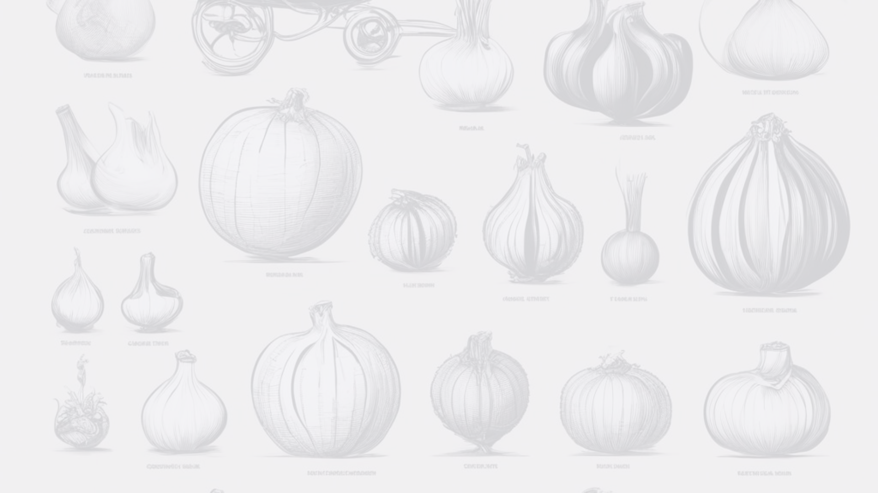
Introduction
1
Ancient Origins
Onion farming dates back to ancient civilizations, playing a significant role in culinary and medicinal practices.
2
Technological Advancements
Over time, traditional farming methods have evolved, allowing for greater efficiency and larger yields.
3
Current Landscape
Today, onion farming is a vital part of agricultural production, contributing to local and global economies.

Slide 3
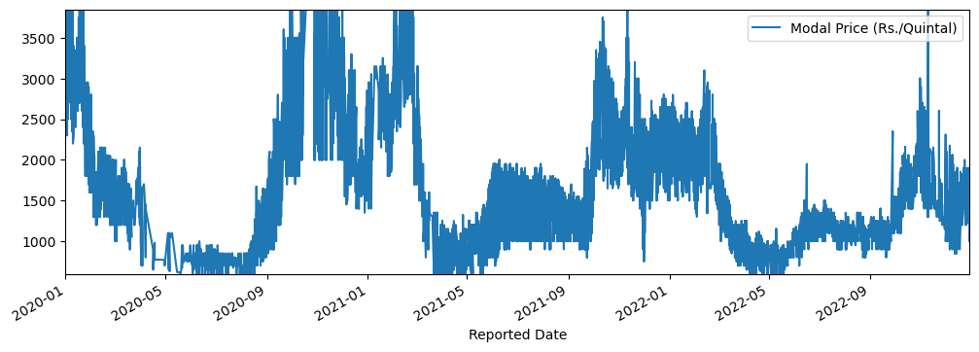
Problem Statement:
Challenge :
Uncertainties in onion farming, leading to potential losses due to low prices.
Objective :
Provide actionable insights to farmers for optimal timing of sowing and selling to maximize profits.

Slide 4
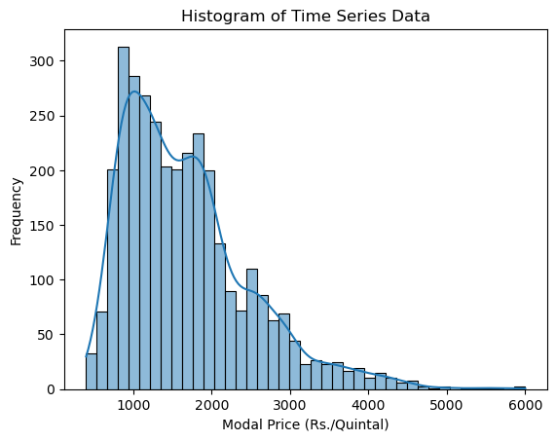
Data Visualization :

Slide 5
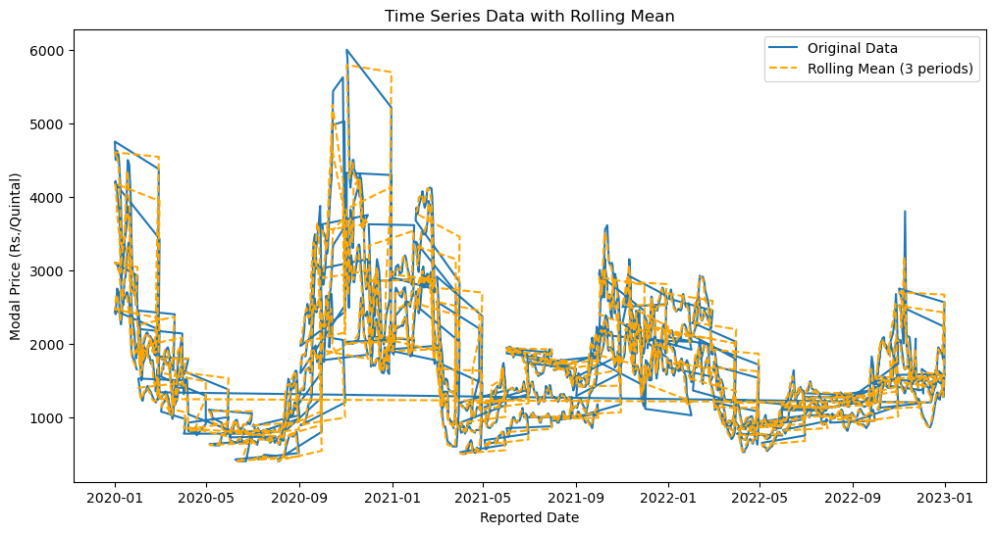
Rolling Mean :

Slide 6
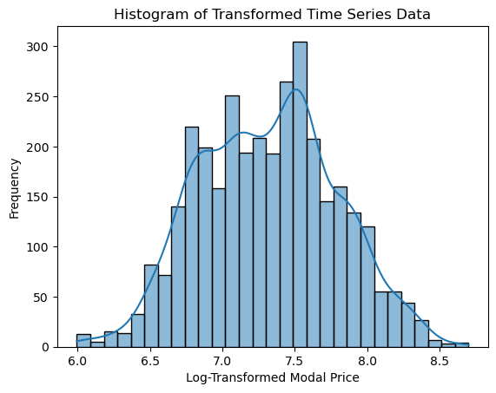
Transformed Data :

Slide 7
1
Utilize time series forecasting with the ARIMA model to predict future onion prices.
Solution
2
Convert forecasted log-transformed values back to the original scale for practical use.
Solution
Utilize time series forecasting with the ARIMA model to predict future onion prices.
Convert forecasted log-transformed values back to the original scale for practical use.
Evaluate model performance using Mean Absolute Error (MAE).
3
Evaluate model performance using Mean Absolute Error (MAE).

Slide 8
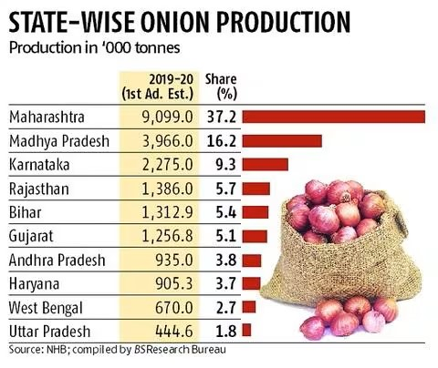
Data Source
Collect daily onion price data from reputable sources such as Agmarknet and MSAMB.

Slide 9
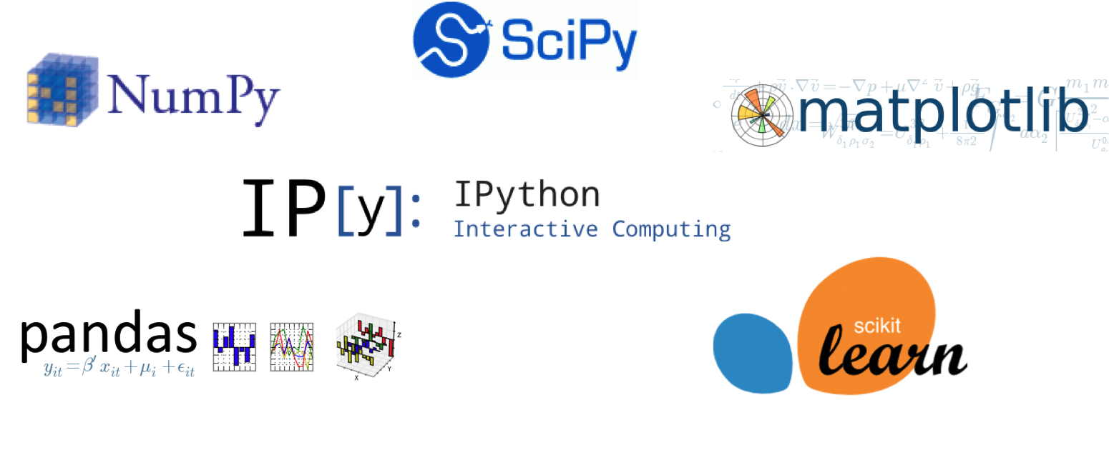

Library and Tools:
Tools: Python programming.
Libraries : pandas, matplotlib, stats models, scikit-learn.

Slide 10
Algorithm Used (ARIMA)
1
Advantages:
2
Disadvantages:
3
Scope of Improvement:
Effective for time series forecasting.
Handles seasonality and trends in data.
Assumes stationarity in the data.
Sensitive to outliers.
Explore advanced time series models.
Consider incorporating external factors influencing onion prices.

Slide 11
Current Challenges in Onion Farming
1
Soil Degradation
2
Pest Infestation
3
Market Competition
Poor soil conditions are hindering crop growth, impacting the overall yield and quality of onions.
Constant battle against pests is threatening the durability of onion plants and causing significant losses.
The market is highly competitive, and onion farmers face challenges in terms of pricing and distribution.

Slide 12
Acknowledgement:
Data Collection:
- Directorate of Marketing & Inspection (DMI), Ministry of Agriculture and Farmers Welfare, Government of India.
References from Wikipedia https://en.wikipedia.org/wiki/Agriculture_in_India.

Slide 13
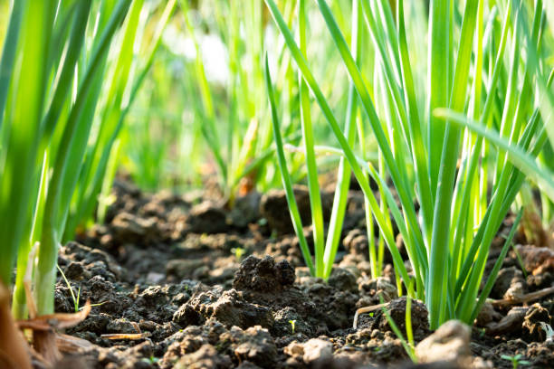

THANK YOU !

