Slide 1

  FPGA MINI-PROJECT
  FPGA Implementation of Memory Efficient Explicit Model Predictive Controller for Electric Vehicle Battery Management System
Presented in partial fulfilment of FPGA Lab (EC257)
by BATCH 3:-
23ECB0A07:-Ramanuj Sharma
23ECB0A08:-Kulkarni Sarang Sunilrao
23ECB0A09:-Kanduri Vivek Kumar
Performed under Guidance of
Dr P. Prithvi Mam
Dr V.Narendra Sir
Department of Electronics and Communication Engineering
NATIONAL INSTITUTE OF TECHNOLOGY , WARANGAL
2024-2025

Slide 2
INDEX
1.Abstract
2.Introduction
3.a)Problem statement
b)Motivation
c)Novelty
d)Objectives
e)Implementation flow
4.Theory
5.Results and conclusion
6.Future work

Slide 3
Abstract
Problem:
  Nowadays Explicit Model Predictive Control (EMPC) is go to controller for most tasks but faces scalability issues due to exponential memory growth with system size.
  In systems like EV battery management, high memory and power consumption hinder the efficiency and scalability.
Solution:
  We are introducing posit number system for arithmetic operations as a memory-efficient alternative to IEEE 754 floating-point numbers.
Implementation:
  Use MATLAB to formulate EMPC model and generate PWA(Piecewise affine) Function.
  Verilog implementation of PLA(Point Location Algorithm) and posit number ALU (Arithmatic logic Unit) to calculate appropriate control action
Results:
  Achieve 60% to 80% memory reduction compared to IEEE 754 floats.
  Validate the approach through hardware-in-the-loop (HIL) co-simulation.

Slide 4
Introduction
Model Predictive Control (MPC):
  A control strategy used in various applications, including electric vehicles (EVs), industrial automation, and renewable energy systems.
  Solves constrained optimization problems at each sampling instant to compute optimal control actions.
Explicit MPC (EMPC):
  Pre-computes control laws offline using multi-parametric programming (mp-QP).
  Stores control laws in lookup tables (LUTs) for real-time evaluation, reducing online computational burden.
Challenges:
  High memory requirements for storing control regions and feedback laws.
  Exponential growth in memory demand with increasing states, inputs, and prediction horizons.
  IEEE 754 floating-point numbers are inefficient for embedded systems due to high memory and power consumption.
Objective:
  Develop a memory-efficient EMPC using posit number format for FPGA-based EV battery management.
  Reduce memory footprints and power consumption while maintaining control performance.

Slide 5
Problem statement
Issue:
  Traditional EMPC implementations rely on IEEE 754 floating-point numbers, which are memory-intensive and power-hungry.
  High memory requirements hinder scalability in embedded systems, especially for EV battery management systems with multiple states and long prediction horizons.
Proposed Solution:
  Use posit number format to replace IEEE 754 floating-point numbers.
  Posit numbers offer dynamic bit allocation for better precision and range with fewer bits.
  Develop a posit-based ALU for FPGA to enable memory-efficient EMPC.
Impact:
  Enable real-time, energy-efficient control for EV battery management.
  Reduce memory and power consumption, making EMPC feasible for resource-constrained embedded systems.

Slide 6
Motivation
Why This Work?
  EV battery management is critical for maximizing energy efficiency, extending battery life, and ensuring safe operation.
  Real-time EMPC is challenging due to high memory and computational requirements.
  IEEE 754 floating-point numbers are inefficient for embedded systems, leading to high power consumption and memory usage.
Applications:
  Campus electric vehicles (e-bikes, shuttle buses, service carts).
  Maximizing Battery Life: Smart predictive control optimizes charging and discharging cycles, preventing premature battery degradation.
  Improving Energy Efficiency: Reduced computational overhead enables real-time optimization of power usage, leading to longer operating hours.
  Enhancing Sustainability: Lower power consumption and efficient battery usage contribute to a greener campus transportation system.
  Reducing Maintenance Costs: Predictive control helps prevent battery failures and reduces the frequency of replacements, lowering overall operational costs.

Slide 7
Novelty
This project introduces a novel EV battery management approach by integrating Explicit Model Predictive Control (EMPC) and posit arithmetic on FPGA-embedded systems.
Unlike traditional floating-point implementations with high memory and power consumption, our method leverages the efficiency of posit numbers in order to provide significant memory savings without loss of computational precision.
This is possible without loss of performance in real-time predictive control within power-limited and memory-restricted environments. Furthermore, our end-to-end automated system makes the integration of posit-based arithmetic into EMPC simpler, thus providing a scalable and energy-efficient battery management solution for electric vehicles.
This innovation makes the use of EMPC in real-world applications for electric vehicles more practical, particularly in the context of extreme power and memory-restricted embedded systems.

Slide 8
Objectives
Develop a Memory-Efficient EMPC Framework:
  Reduce memory requirements using posit numbers.
  Enable real-time control for EV battery management.
Optimize Energy Efficiency:
  Improve battery life and reduce energy losses.
  Ensure stable operation under varying conditions.
Minimize Memory Requirements for Embedded Implementation:
  Reduce the complexity of lookup tables (LUTs) and precomputed control laws.
  Enable EMPC for resource-constrained embedded systems.
Enable Real-Time Control on FPGA:
  Implement a fast region-search algorithm in Verilog.
  Ensure low computational overhead for real-time control.
Verify Performance Using Simulation and FPGA Implementation:
  Simulate the EMPC controller in MATLAB.
  Validate the FPGA implementation through hardware-in-the-loop (HIL) co-simulation.

Slide 9
Implementation Steps
System Modeling in MATLAB:
  Model the EV battery management system as a discrete-time linear time-invariant (LTI) system.
  Define system dynamics using matrices A and B and state/input constraints.
MPC Controller Design:
  Construct an MPC controller with a prediction horizon N.
  Define quadratic cost functions to balance control performance and energy efficiency.
Convert MPC to Explicit MPC (EMPC):
  Transform the MPC controller into an explicit form using multi-parametric programming.
  Partition the state space into polyhedral regions, each associated with a precomputed control law.
Partition Critical Regions and Control Laws:
  Define polyhedral regions and affine control laws for each region.
  Store control laws in lookup tables (LUTs) for real-time evaluation.
Implement Region Search in Verilog:
  Use a sequential search algorithm to identify the appropriate region based on the system state.
Control Action Generation in FPGA:
  Compute control actions in real-time using posit-based ALU.
  Validate the control actions through hardware-in-the-loop (HIL) co-simulation.

Slide 10
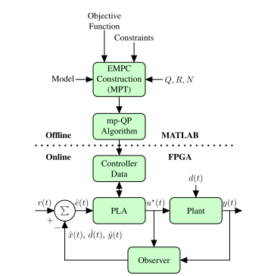
Implementation Workflow

Slide 11
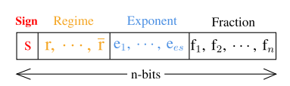
Theory:-Posit number system
Posit Number Format:
  Posit numbers use a dynamic regime field that allows the bit allocation between the exponent and fraction to vary based on the magnitude of the number.
  Four Sub-Fields:
    Sign (s): 1 bit to indicate positive or negative.
    Regime (r): A variable-length field that determines the scale of the number. It consists of consecutive 1s or 0s, terminated by the opposite bit or the end of the posit.
    Exponent (e): A fixed-length field that provides additional scaling within the regime.
    Fraction (f): The remaining bits represent the fractional part of the number.

Slide 12
Theory:-Posit number system
Advantages of Posit
Higher Accuracy:
  Posits allocate more bits to the fraction for smaller numbers and more bits to the exponent for larger numbers. This ensures higher precision across a wide range of values.
  Unlike IEEE 754, posits do not waste bits on special cases like NaN or infinity.
  So they allow more bits to be used for meaningful data.
Simpler Hardware Implementation:
  Posits do not require hardware for handling exceptions like NaN, infinity, or denormalized numbers, so ALU doesn’t need to handle these edge cases ; this reduces the complexity.
  The two's complement negation used in posits simplifies arithmetic operations compared to the sign-magnitude representation in IEEE 754.

Slide 13
POSIT ALU implementation
Posit Addition/Subtraction
Overview:
  Posit addition and subtraction are fundamental operations in the posit arithmetic unit (ALU). These operations are more efficient than their IEEE 754 counterparts due to the dynamic regime field and simpler exception handling.
Steps:
  Decompose Posit Numbers:
    Break down the input posit numbers (X and Y) into their components: sign (s), regime (r), exponent (e), and fraction (f).
    The sign bit indicates whether the number is positive or negative.
    The regime field determines the scale of the number.
    The exponent provides additional scaling within the regime.
    The fraction represents the fractional part of the number.
  Align Fractions:
    Compare the exponents of X and Y to determine the difference (E_diff).
    Shift the fraction of the smaller number to align it with the larger number's exponent.
  Perform Arithmetic:
    Add or subtract the aligned fractions based on the sign bits.
    If the sign bits are the same, perform addition.
    If the sign bits differ, perform subtraction.
  Normalize the Result:
    If the result of the addition or subtraction produces an overflow (carry bit), shift the fraction right and adjust the exponent.
    If subtraction produces leading zeros, shift the fraction left and adjust the exponent.
  Reconstruct the Posit:
    Combine the sign, regime, exponent, and normalized fraction to form the final posit result.
Advantages:
  Posit addition/subtraction avoids overflow and underflow, ensuring robust performance.
  The dynamic regime field allows for high precision and range with fewer bits.

Slide 14
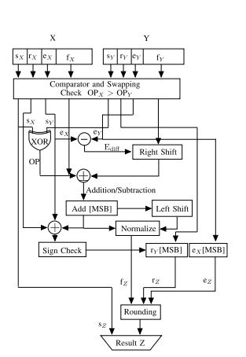
POSIT ALU implementation
Posit Addition/Subtraction Flowchart

Slide 15
POSIT ALU implementation
Posit Multiplication
Overview:
  Posit multiplication is another key operation in the ALU. It involves multiplying the fractions, adding the exponents, and normalizing the result.
Steps:
  Decompose Posit Numbers:
    Break down the input posit numbers (X and Y) into their components: sign (s), regime (r), exponent (e), and fraction (f).
  Multiply Fractions:
    Multiply the fractions of X and Y using a binary multiplier.
    Check for overflow in the product. If overflow occurs, shift the fraction right and adjust the exponent.
  Add Exponents:
    Add the exponents of X and Y to determine the new exponent.
    If the sum of the exponents exceeds the maximum allowed value, adjust the regime field.
  Normalize the Result:
    Normalize the fraction and adjust the exponent and regime fields to ensure the result is within the valid posit range.
  Reconstruct the Posit:
    Combine the sign, regime, exponent, and normalized fraction to form the final posit result.
Advantages:
  Posit multiplication is simpler and more efficient than IEEE 754 multiplication due to the absence of complex exception handling.
  The dynamic regime field ensures high precision and range without overflow or underflow.

Slide 16
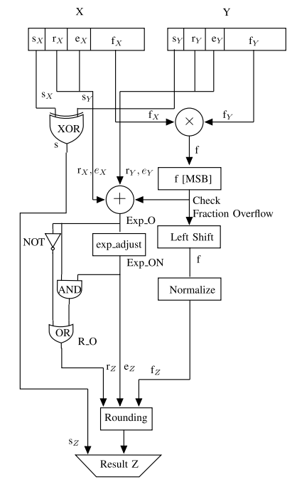
POSIT ALU implementation
Posit Multiplication Flowchart

Slide 17
Theory : Model Predictive Control
Optimization-Based Control
  MPC predicts future system behavior and computes optimal control actions while respecting constraints.
  Only the first control input is applied, and the process repeats with updated states.
Feedback and Adaptation
  Continuously updates predictions based on measured outputs and disturbances.
  Ensures optimal performance despite uncertainties.
Constraint Handling & Performance
  Explicitly considers system constraints while optimizing control actions.
  Balances reference tracking and safety in applications like robotics, automotive, and energy management.

Slide 18
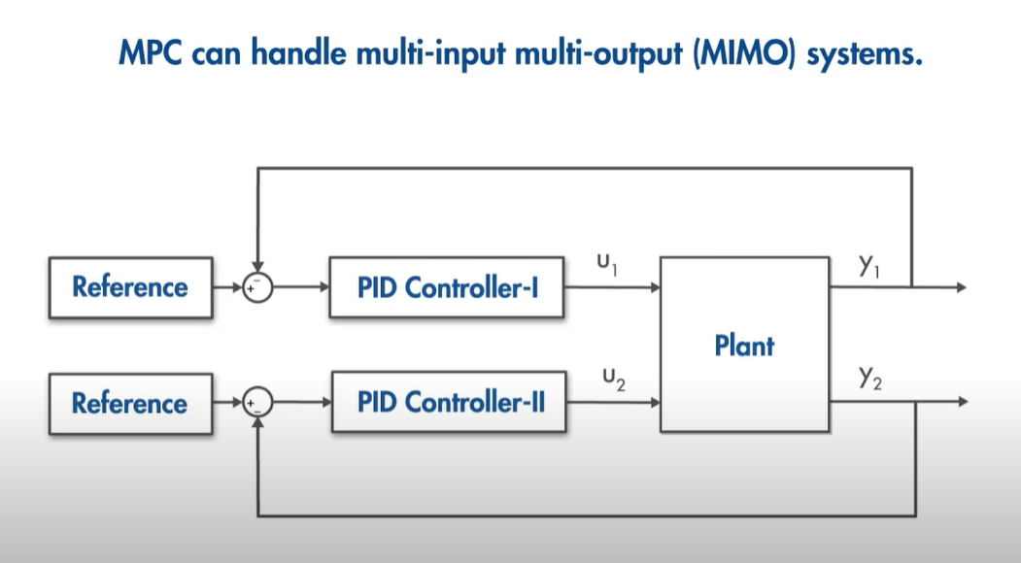
Theory : Model Predictive Control
  Why MPC over other controllers ?

Slide 19
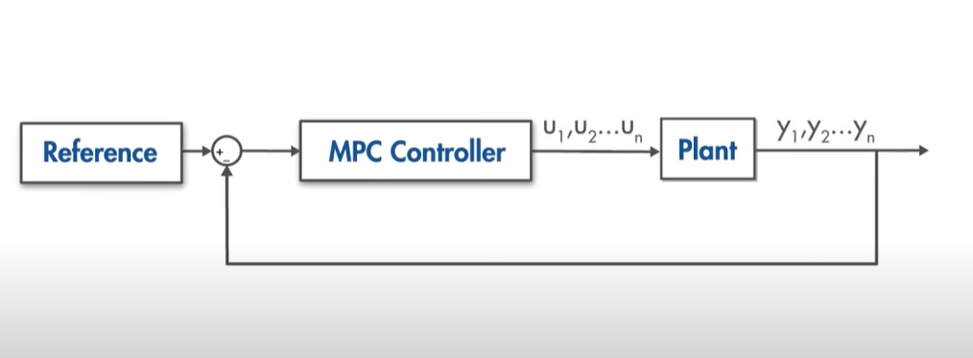
Theory : Model Predictive Control
  Why MPC over other controllers ?

Slide 20
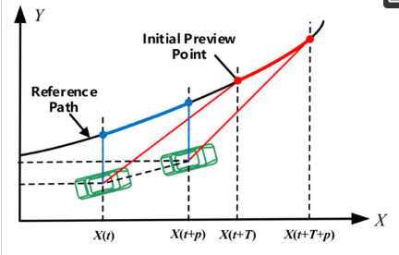
Theory : Model Predictive Control
  Why MPC over other controllers ?
Preview Capability (Prediction-Based Control)
  MPC predicts future system behavior using a model, optimizing control inputs proactively.
  PID reacts only to current errors, lacking the ability to anticipate future disturbances.

Slide 21
Theory : Model Predictive Control
  Explicit Model Predictive Control (Explicit MPC)
  It is a precomputed version of MPC where the control law is represented as a piecewise affine function of the system state. Instead of solving an optimization problem at each time step, Explicit MPC evaluates a precomputed solution, making it highly efficient for real-time applications.
  In Online mode , this PWA is used to select appropriate region the current state is at and where it should head to next using point location algorithm.
  As there is no need to find whole solution of mpc at each sample time , Explicit mpc is best suited for real time FPGA – based embedded systems.

Slide 22

Implementation of EMPC using MATLAB and Verilog
EMPC Formulation in MATLAB
Matlab comes with Model Predictive Control Tools package which can formulate desired MPC problem within given inputs and constraints
We use this model to extract PWA function that looks like following:
So in online mode, problem boils to finding k(x).

Slide 23
Implementation of EMPC using MATLAB and Verilog
Point Location Algorithm :
In EMPC, we need to find the critical region in which the current state belongs to; then it evaluates the control action as the PWA function associated with that region, which tends to be irregular; this problem of determining the regions is known as the PLA.
In this work, we used the SS(Sequential Search) algorithm as a PLA, which is the most direct way of finding the index, i of the region R corresponding to the current state, x0.
After getting the index of the region, the optimal control action is obtained by evaluating the corresponding PWA function .
We store all the data related to regions and PWA function, i.e., (Zi, zi, Li, gi) in the form of LUTs for the online synthesis of EMPC.

Slide 24
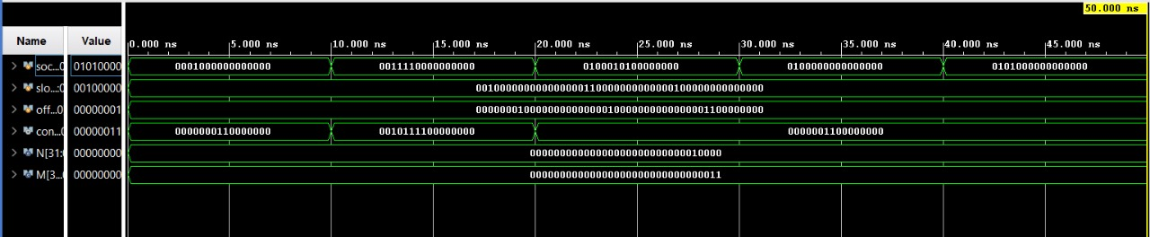
Results and conclusion
Output waveform

Slide 25
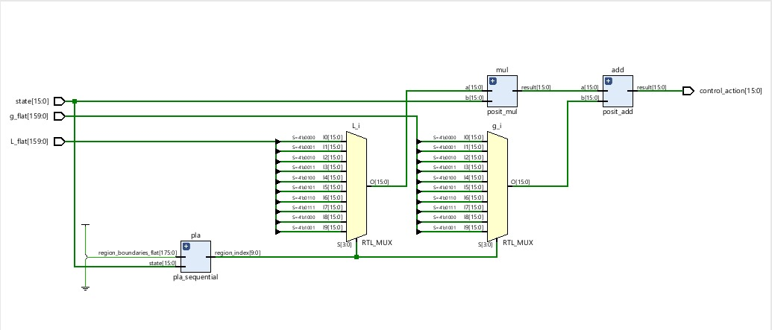
Results and conclusion
Implemented Design in VIVADO Xilinx

Slide 26
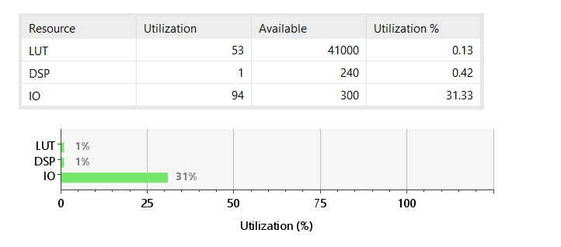
Results and conclusion
Posit Number System : Memory footprint

Slide 27
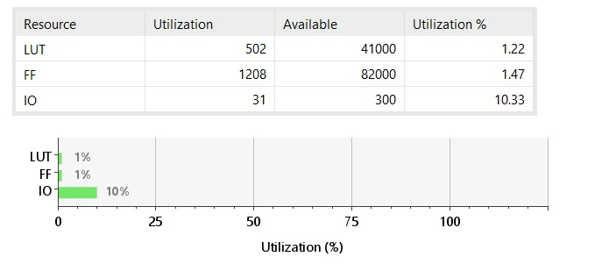
Results and conclusion
Floating point Number System : Memory footprint

Slide 28
Future work
Extensions:
  Apply posit-based EMPC to other real-time control applications.
  Optimize posit ALU for further resource reduction.
  Explore posit-based online MPC implementations.
  Use BST as a PLA algorithm instead of SS
Long-Term Goals:
  Develop standardized posit arithmetic libraries for FPGAs.
  Investigate posit-based implementations in machine learning and AI.

Slide 29
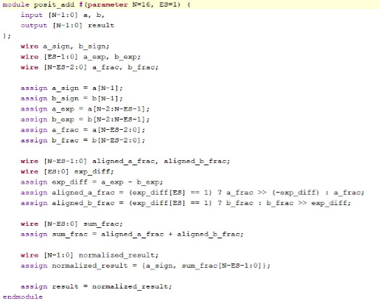
Code Snippets : Posit Addition

Slide 30
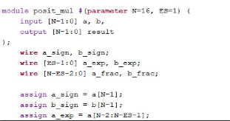
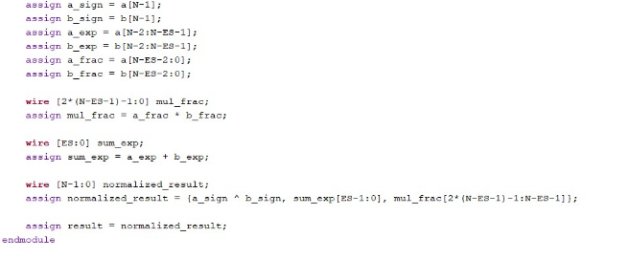
Code Snippets : Posit Multiplication

Slide 31
Code Snippets : Posit Addition

Slide 32
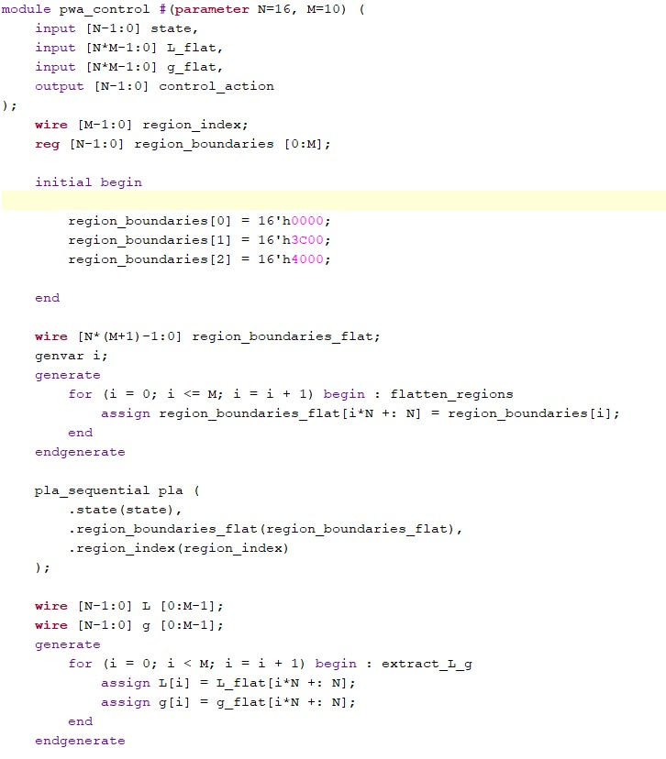
Code Snippets : PWA control

Slide 33
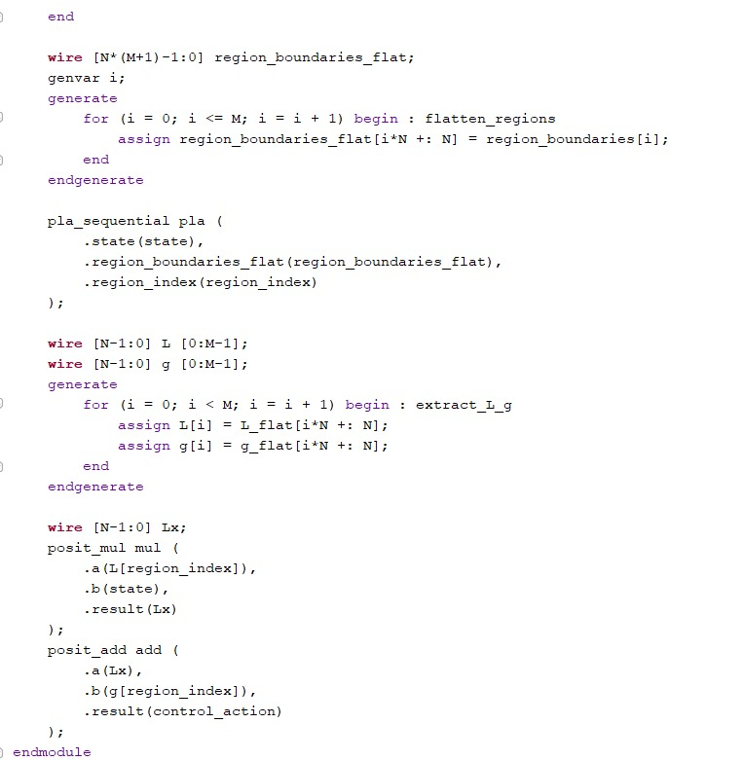
Code Snippets : PWA control

