Slide 1

News Headline Generation
04.07.2018
Final Project:
INFO 7374 Cognitive Computing and Deep Neural Networks
Naini Shah
Vighnesh Venkatakrishnan

Slide 2
Overview
Newspaper plays a significant role in our day to day life.
In a news article, readers are attracted towards headline.
Headline creation is very important while preparing news.
Our goal is to implement text summarization by generating headline for a news body using recurrent neural networks.
Our app can help journalists, bloggers quickly come up with the headline for the article they are writing
It can also help proof readers to quickly understand the summary of an article and whether the headline describes the summary appropriately

Slide 3
Data Preprocessing
We have used “all the news dataset” from Kaggle
The data set consisted of approximately 1,50,000 articles. we extracted only title and content from the dataset
We preprocessed our data from csv file by removing punctuations, stop words and converting the text to lower case. later, we tokenized the title, content and saved it as a pickle file.
We divided our data set into train (100000 articles), validation (29999 articles) and test validation (12567 articles) sets respectively.
We are using google news word2vec file to map words in our data to vectors and to initialize weights in the model

Slide 4
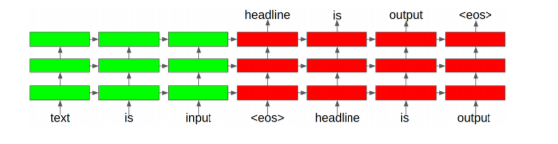
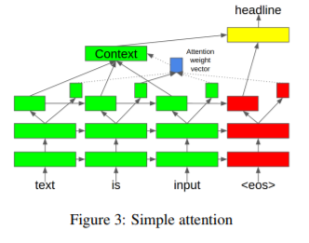
Model Architecture

Slide 5
Training
In a batch size of 128 from the training pickle file, get headlines and descriptions
Convert words to vectors less than max size
Perform padding/trimming and add <eos> at the end of desc in X and head in y
X contains head + description, Y has generated description (which is actual description while training)
Flip random words in y with prev word of generated headline instead of actual headline
Perform one hot encoding on generated headline
Fit model and calculate bleu score, save model weights if current epoch better than previous one

Slide 6
Testing
Load saved weights
Get headlines and descriptions from pickle file (or do real time using app)
Perform beam search to calculate most frequently occurring words
Convert list to string and display sentence

Slide 7
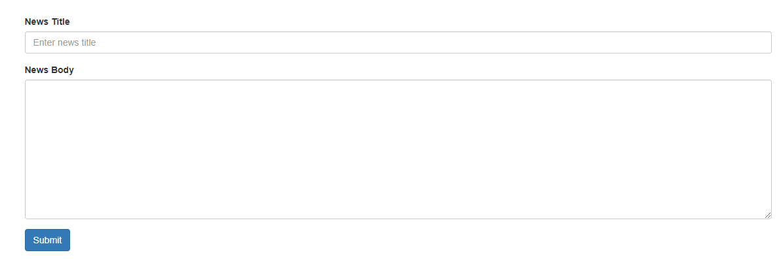
Web app (INPUTS)

Slide 8
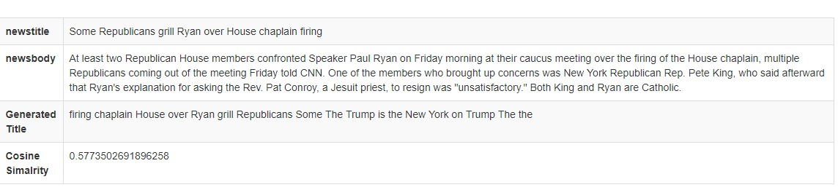
Output

Slide 9
Challenges faced
Web scrapping/ preprocessing the data
Resource exhaustion – large word2vec, large batch size, attention mechanism, etc
Time taken to train model with bleu score
Integrating with web app/ training web app on AWS
Words like “Trump”, “New York Times” appear in every result since the model is trained heavily on Trump articles from NYT

Slide 10
Future Work
One can try using gru based model instead of lstm and train for more epochs.
Bi-directional rnn can also be considered since it provides more information to the model

Slide 11
Conclusion
We successfully implemented news headline generation app with encoder-decoder architecture along with attention mechanism. our model generated headline that has cosine similarity of up to 0.5 while comparing it with original headline.

Slide 12
References
Research Paper: https://arxiv.org/pdf/1512.01712.pdf
Reference Code: https://github.com/kabrapratik28/DeepNews
RNN: https://machinelearningmastery.com/how-does-attention-work-in-encoder-decoder-recurrent-neural-networks/
DESC REVERSING: https://arxiv.org/pdf/1409.3215.pdf

