Slide 1
E –COMMERCE APPLICATION IBM CLOUD FOUNDRY

Slide 2


Slide 3
What is e-commerce? E-commerce (electronic commerce) is the buying and selling of goods and services, or the transmitting of funds or data, over an electronic network, primarily the internet
E-COMMERCE

Slide 4
What is Cloud Foundry
Cloud Foundry is the premier industry standard Platform-as-a-Service (PaaS) that ensures the fastest, easiest, and most reliable deployment of cloud-native apps.

Slide 5


IBM CLOUD PAK SYSTEM

Slide 6
CREATE APP ON IBM CLOUD
When you create an app in IBM Cloud, you can begin with a starter. A starter is a template that includes predefined services and app code that is configured with a particular buildpack.
A runtime is the set of resources that is used to run an app. IBM Cloud provides runtime environments as containers for different types of apps. The runtime environments are integrated as buildpacks into IBM Cloud, are automatically configured for use, and require little to no maintenance.

Slide 7
CLOUDANT DATABASE USE
IBM Cloudant is a document database that uses a JSON document store. This schemaless database is useful for operations powered by unstructured data such as big data analytics and artificial intelligence. In this guided project, you will work with database operations from the IBM Cloudant dashboard.

Slide 8
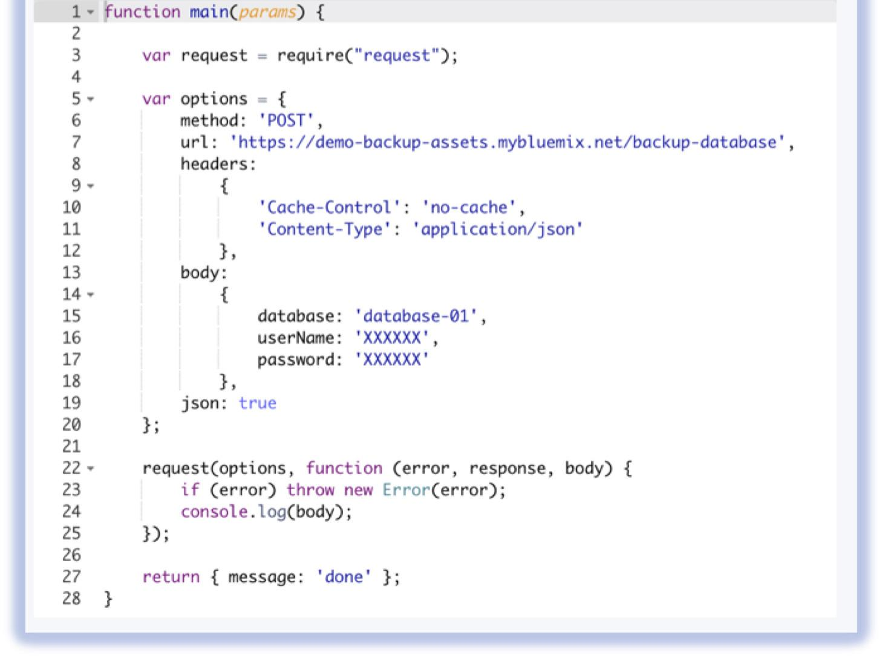

Slide 9
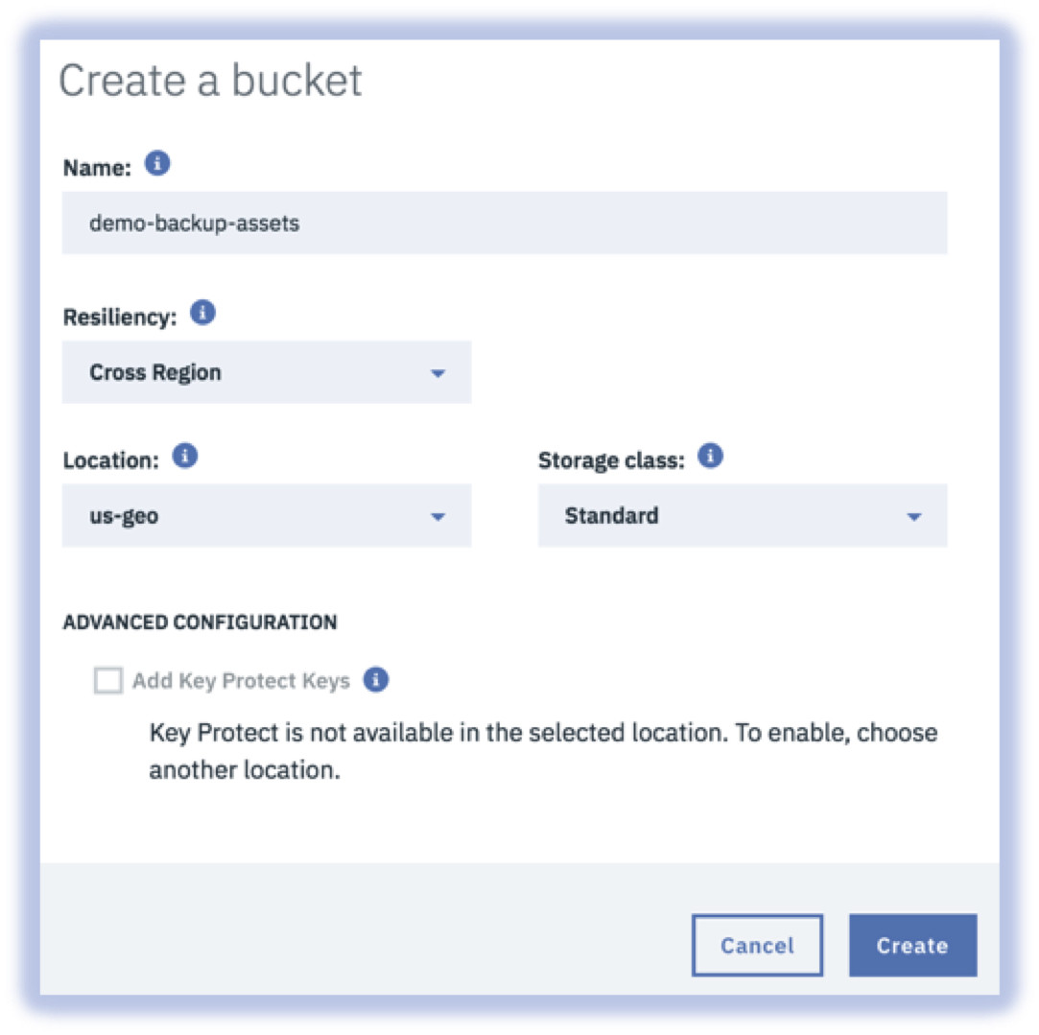
Setup Cloud Object Storage Object Storage is a highly scalable cloud-based storage service within IBM Cloud that is designed for resiliency, durability, and security. The service can be managed via the self-service portal or through a robust set of REST-based APIs.

Slide 10
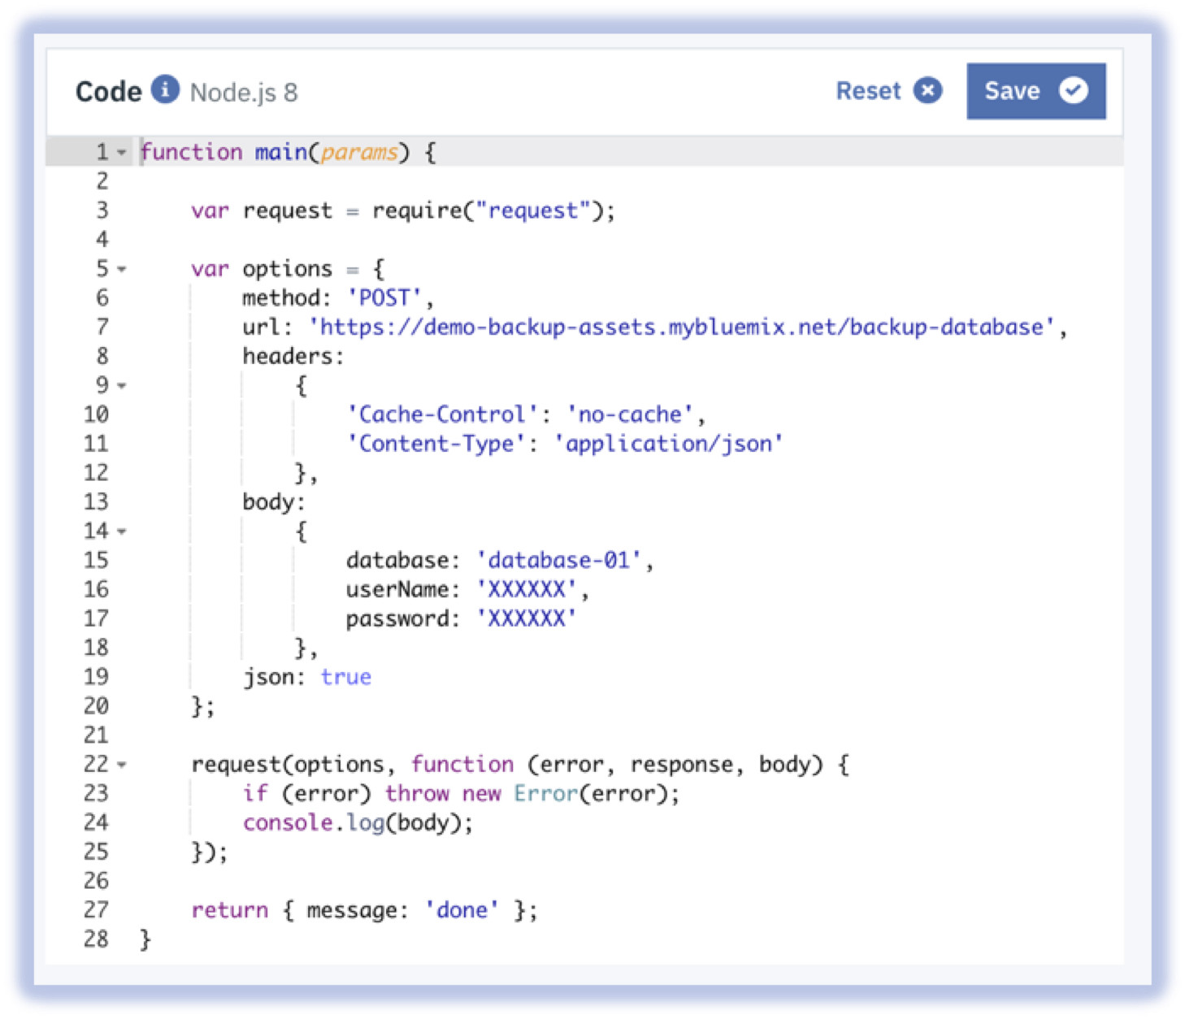
Setup actions and a trigger in Cloud Functions. Cloud Functions is Function-as-a-Service (FaaS) platform within IBM Cloud that is built on top of Apache OpenWhisk. Similar to the serverless offerings like AWS Lambda and Azure Functions, it provides the ability to execute lightweight code in response to events in a cost-effective manner (i.e. you incur costs only when the code is executing).

Slide 11
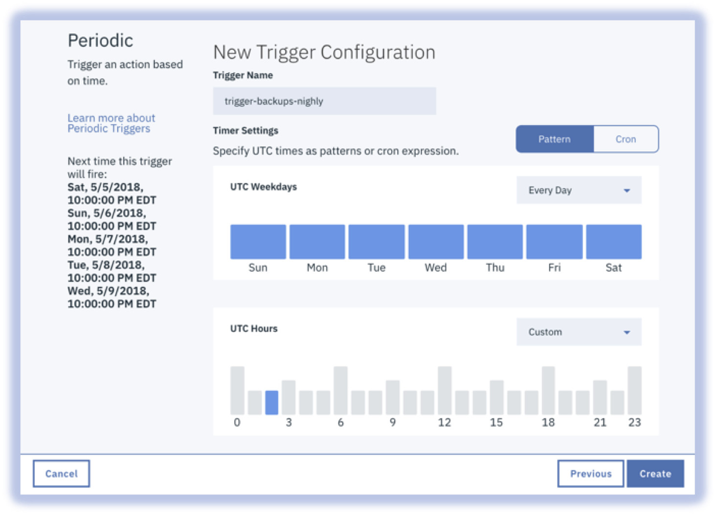

Slide 12
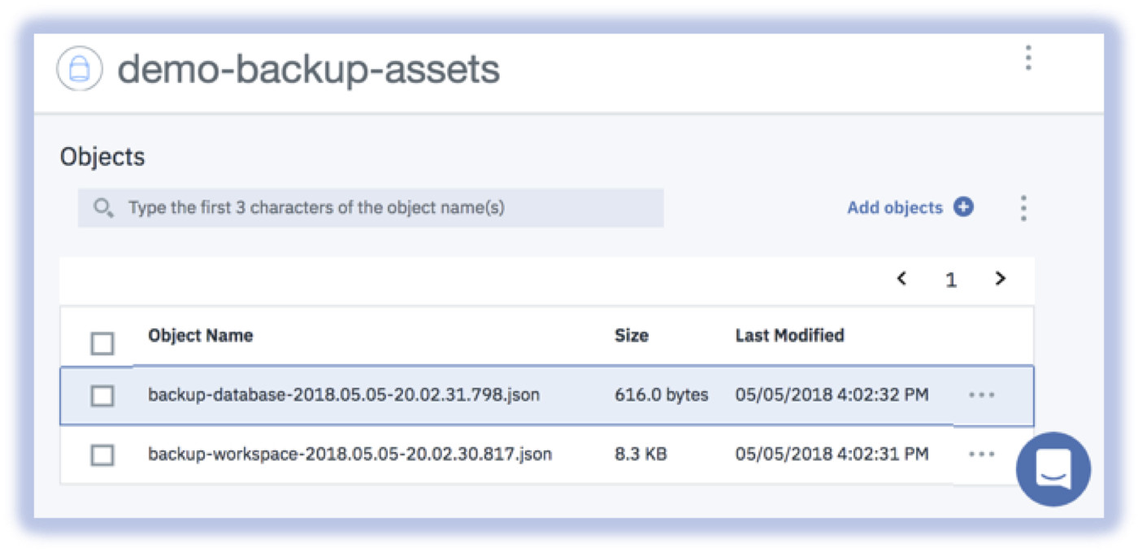
Verify the end to end process is working

Slide 13
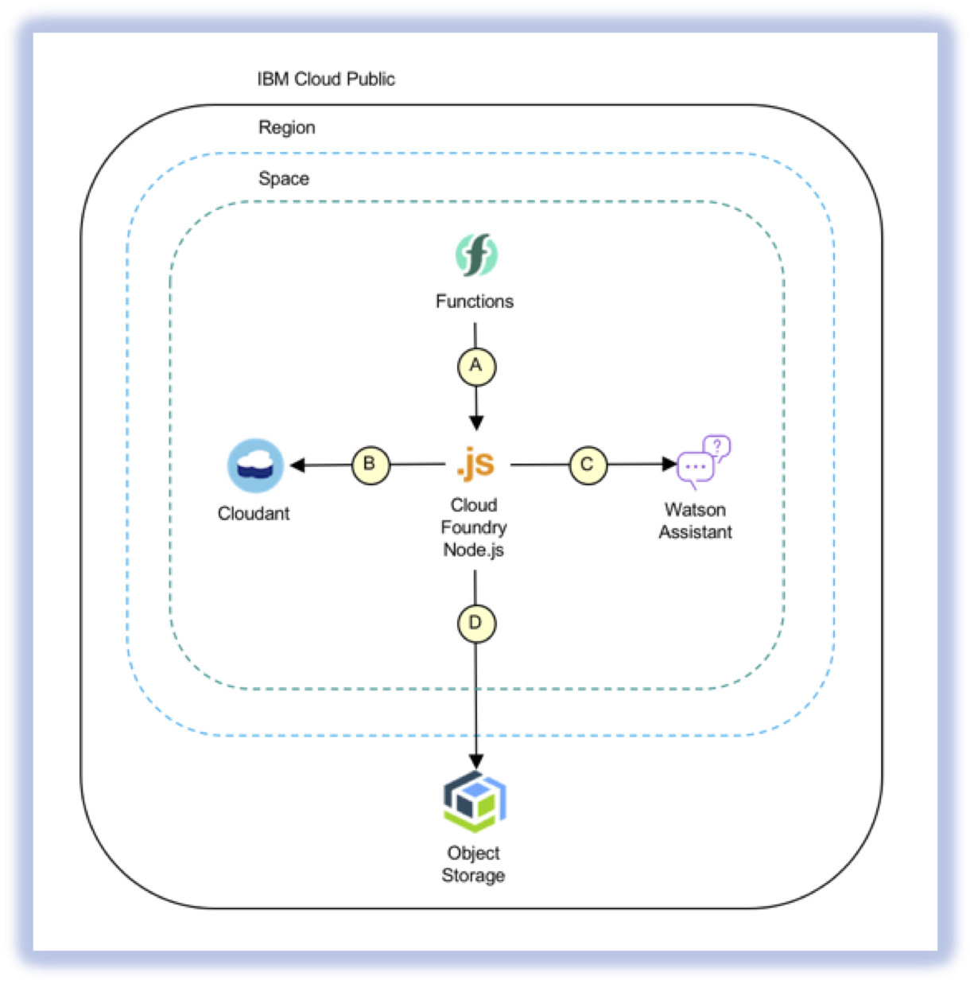
CONCLUSION:

Slide 14
Concepts Three components are required to deploy an application as a cloud service in Azure: Service Definition The cloud service definition file (.csdef) defines the service model, including the number of roles. Service Configuration The cloud service configuration file (.cscfg) provides configuration settings for the cloud service and individual roles, including the number of role instances. Service Package The service package (.cspkg) contains the application code and configurations and the service definition file.

Slide 15
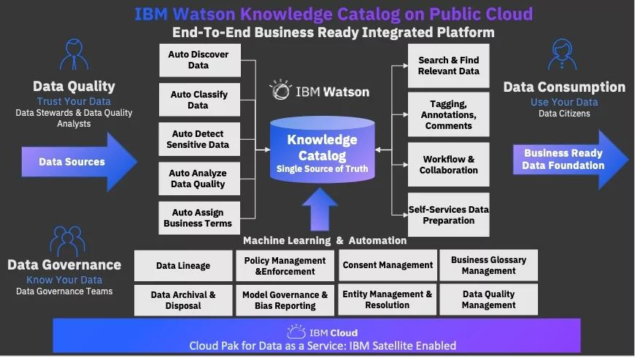
IBM WATSON KNOWLEDGE CATALOG

Slide 16
IBM uses Red Hat OpenShift on IBM Cloud, the market-leading hybrid cloud container platform for hybrid solutions that enables you to build once and deploy anywhere

Slide 17
In general, PaaS solutions have three main parts: Cloud infrastructure including virtual machines (VMs), operating system software, storage, networking, firewalls.

Slide 18
Which cloud has highest demand? Conclusion. Today, Amazon Web Services is leading the public cloud market and is continuing to grow. At the same time, Microsoft Azure and Google Cloud Platform are also progressing to gain market share. Many companies which have already finished moving to the cloud are now considering a multi-platform approach.

Slide 19
Kubernetes The future of cloud computing is very exciting. With the advent of Kubernetes, we will see more and more companies move to the cloud. Kubernetes is a game changer because it makes it easy to manage and deploy applications in the cloud. With Kubernetes, you can scale application up or down as needed.

Slide 20

Developers use Cloud Foundry across every stage of the application development life-cycle, a container-based architecture suited for a multi-cloud environment. That portability translates to an ability to utilize the cloud platform that is the best fit for the app, without refactoring the app itself.

