Slide 1


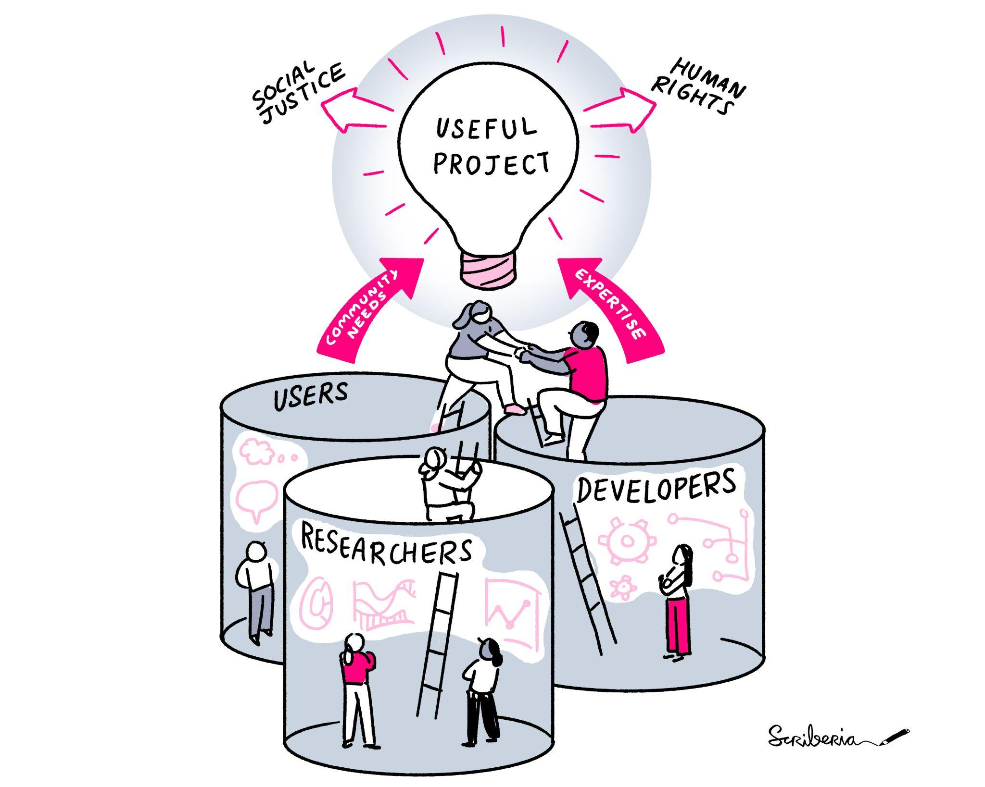

Research Software Engineering initiative in Asia region
Saranjeet Kaur Bhogal https://saranjeetkaur.github.io/About-Me/
Illustration used under a CC-BY licence DOI: 10.5281/zenodo.3332807

Slide 2





About myself
Statistician
Indian
Saranjeet Kaur Bhogal (She/ her) @qwertyquesting @SaranjeetKaur https://saranjeetkaur.github.io/About-Me/
Project Lead
Founding Committee Member

Slide 3

Society of Research Software Engineering (RSE)
https://society-rse.org/
Founded on the belief that a world which relies on software must recognise the people who develop it.
Logo of the Society of Research Software Engineering

Slide 4
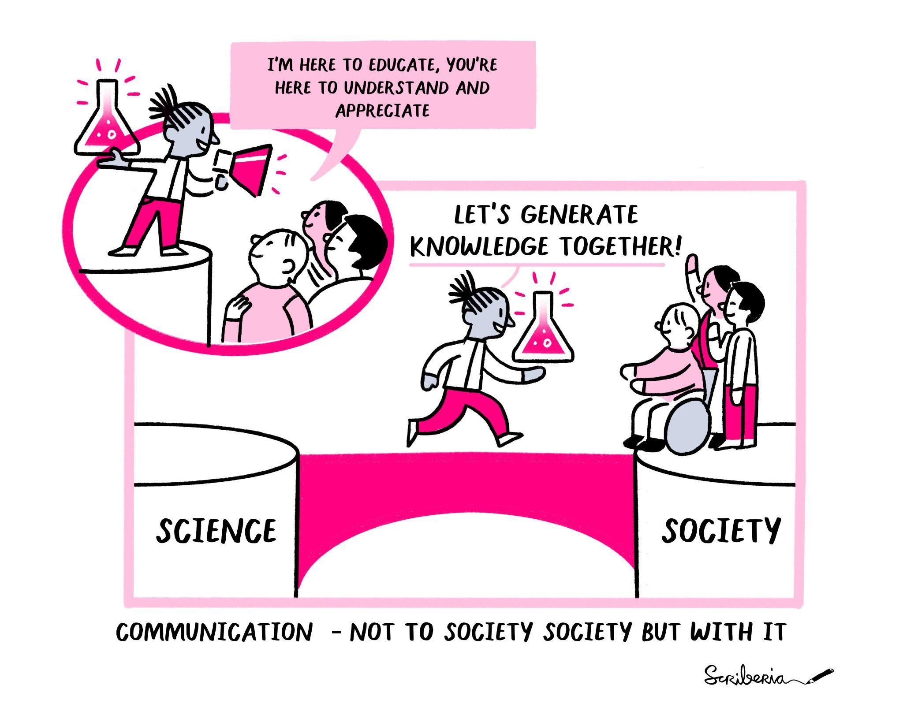
Society of RSE: Mission
To establish a research environment that recognises the vital role of software in research.
Illustration used under a CC-BY licence DOI: 10.5281/zenodo.3332807

Slide 5
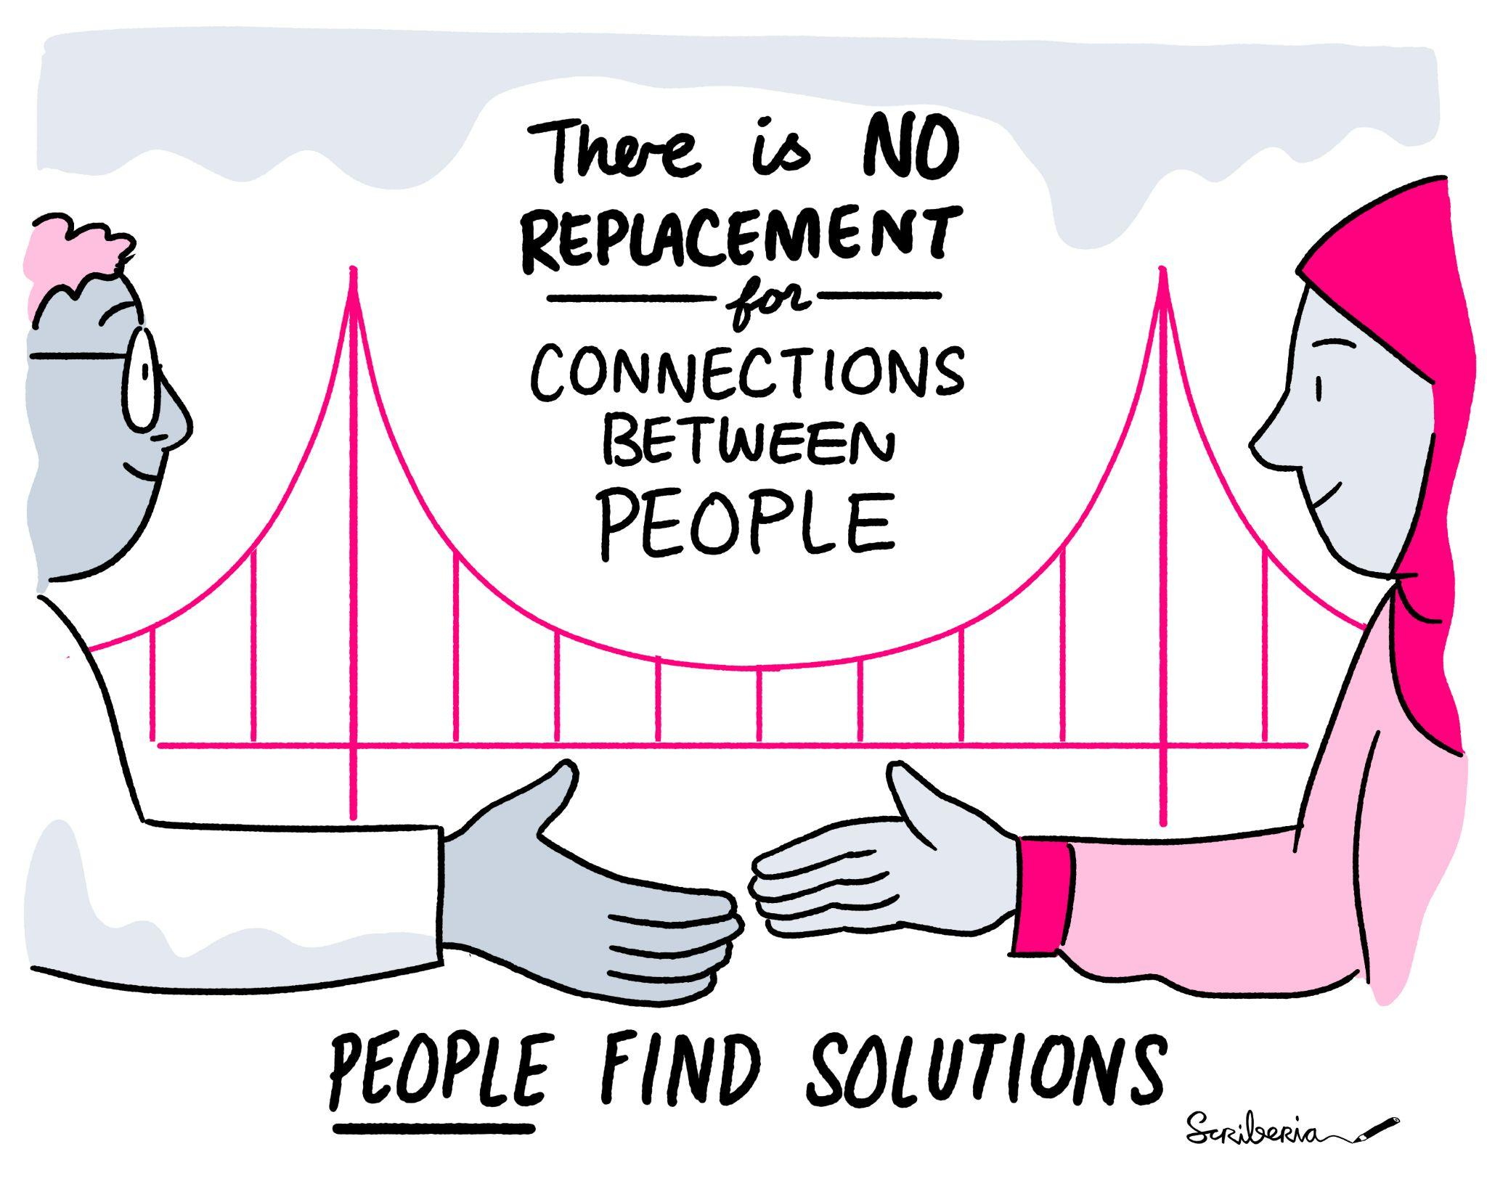
Lack of RSE in global south
RSE movements concentrated in the global north so far
Lack of the movements in the global south
Hence the need for RSE Asia association
Illustration used under a CC-BY licence DOI: 10.5281/zenodo.3332807

Slide 6

RSE Asia Association and Open Life Science (OLS)
Open Life Science is a programme to build Open Science ambassadors
Build RSE Asia Association during Cohort-4 of this Programme
It was a joint work with Jyoti Bhogal ( @JyotiBhogal7) and was mentored by Anne Fouilloux ( @AnneFouilloux)
Launch RSE Asia on the first international RSE day (October 2021)
Logo of the Open Life Science

Slide 7
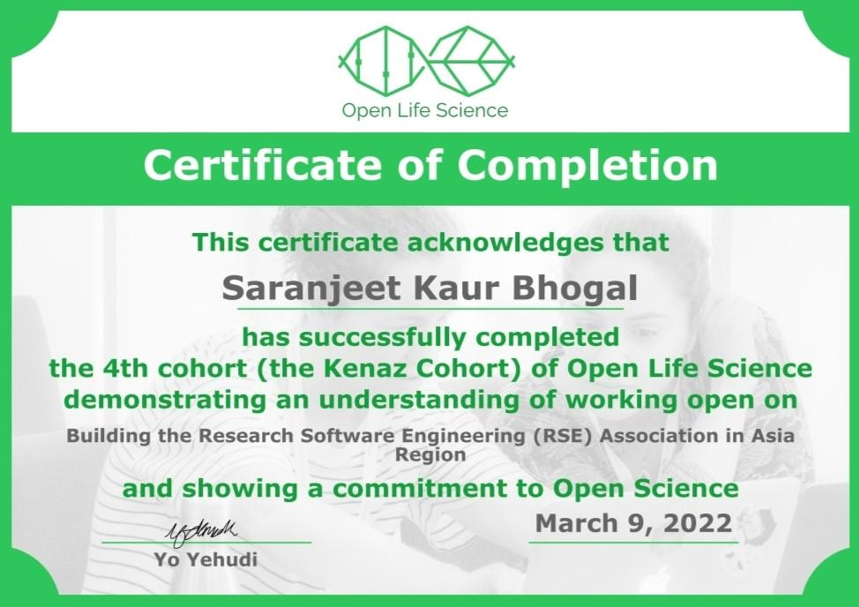
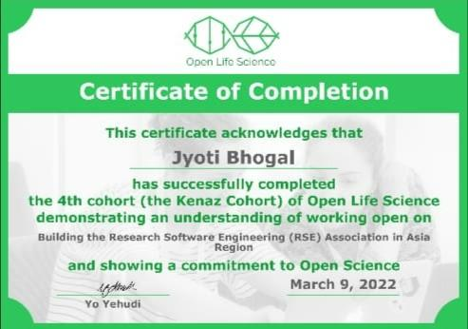
Open Life Science Cohort-4 Graduates
@qwertyquesting
@JyotiBhogal7

Slide 8
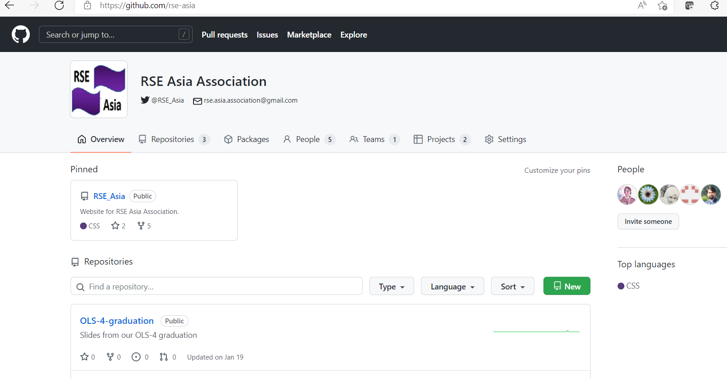
RSE Asia Association
Website: RSE Asia Association
@RSE_Asia
Join our community by filling a short Membership Form
I represent the RSE Asia Association as an observer at the meetings of the International Council of RSEs
Image of RSE Asia Association on GitHub organization

Slide 9
Ongoing work
I’m a mentee at the Pilot Mentoring Programme of the Society of RSE, mentored by Michelle Barker ( @Michelle1Barker) – working on strategies for the community building aspect of the RSE Asia Association
Jyoti Bhogal ( @JyotiBhogal7) is working in OLS-5 under the mentorship of Malvika Sharan ( @MalvikaSharan) – for the project “Building Pathways for Onboarding to Research Software Engineering (RSE) Asia Association and Adoption of Code of Conduct”
Aim to conduct awareness and participatory activities at the RSE Asia Association

Slide 10
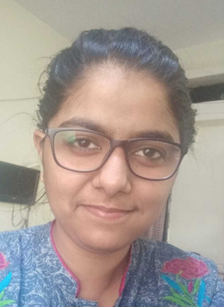
Thank you!
Saranjeet Kaur Bhogal
https://saranjeetkaur.github.io/About-Me/
@qwertyquesting, @RSE_Asia
Slides of this talk Also available on GitHub

