Slide 1



Accelerating the paradigm shift towards Open Science and Data Sharing in Pandemic times and beyond
Saranjeet Kaur Bhogal Lead, Research Software Engineering (RSE) Asia Association
Personal website: https://saranjeetkaur.github.io/About-Me/

Slide 2



I am a Statistician by training and Lead of the RSE Asia Association
I am based in India
Reach out to me at: Twitter: @qwertyquesting LinkedIn: saranjeet-kaur-48ab769b e-mail: kaur.saranjeet3@gmail.com Personal website: https://saranjeetkaur.github.io/About-Me/

Slide 3
Open source contributions since 2020:
Volunteer: R-Ladies Global team
Completed Google Summer of Code 2020
Written the R Development Guide
Work on the Outreach of the R Development Guide
Presented my open-source work at several conferences
Launched the RSE Asia Association through the Open Life Science Cohort-4 programme
Joined the Society of Research Software Engineering as an Observer
Mentee at the pilot mentorship programme of the Society of Research Software Engineering
Selected in the NumFOCUS Project Incubator Founding Committee
For details refer: https://saranjeetkaur.github.io/About-Me/

Slide 4
The paradigm shift that I experienced:
Meetups going online/virtual
International conferences going online
Conferences, workshops, training sessions becoming accessible to a wider audience
Chance to participate and learn from all over the globe
Made so many friends across the globe!

Slide 5
What all I can do due to this paradigm shift:
I started using GitHub
I host a personal website now!
I have contributed to open source work
I’ve presented talks at useR! 2021, JuliaCon 2021, PackagingCon 2021, LatinR 2021, and now at APAN53!
I got to launch the RSE Asia Association

Slide 6
RSE Asia Association
Launched in October 2021
Through the Open Life Science Cohort-4 programme
To become a Community Member, please fill this short membership form:
People from all regions of the world are welcome to become a community member, irrespective of whether they belong to or are located in the Asian region.
https://forms.gle/KAh8dqiMLtFurfkL8

Slide 7
Follow RSE Asia Association
Twitter: @RSE_Asia
Website: https://rse-asia.github.io/RSE_Asia/ E-mail: rse.asia.association@gmail.com

Slide 8
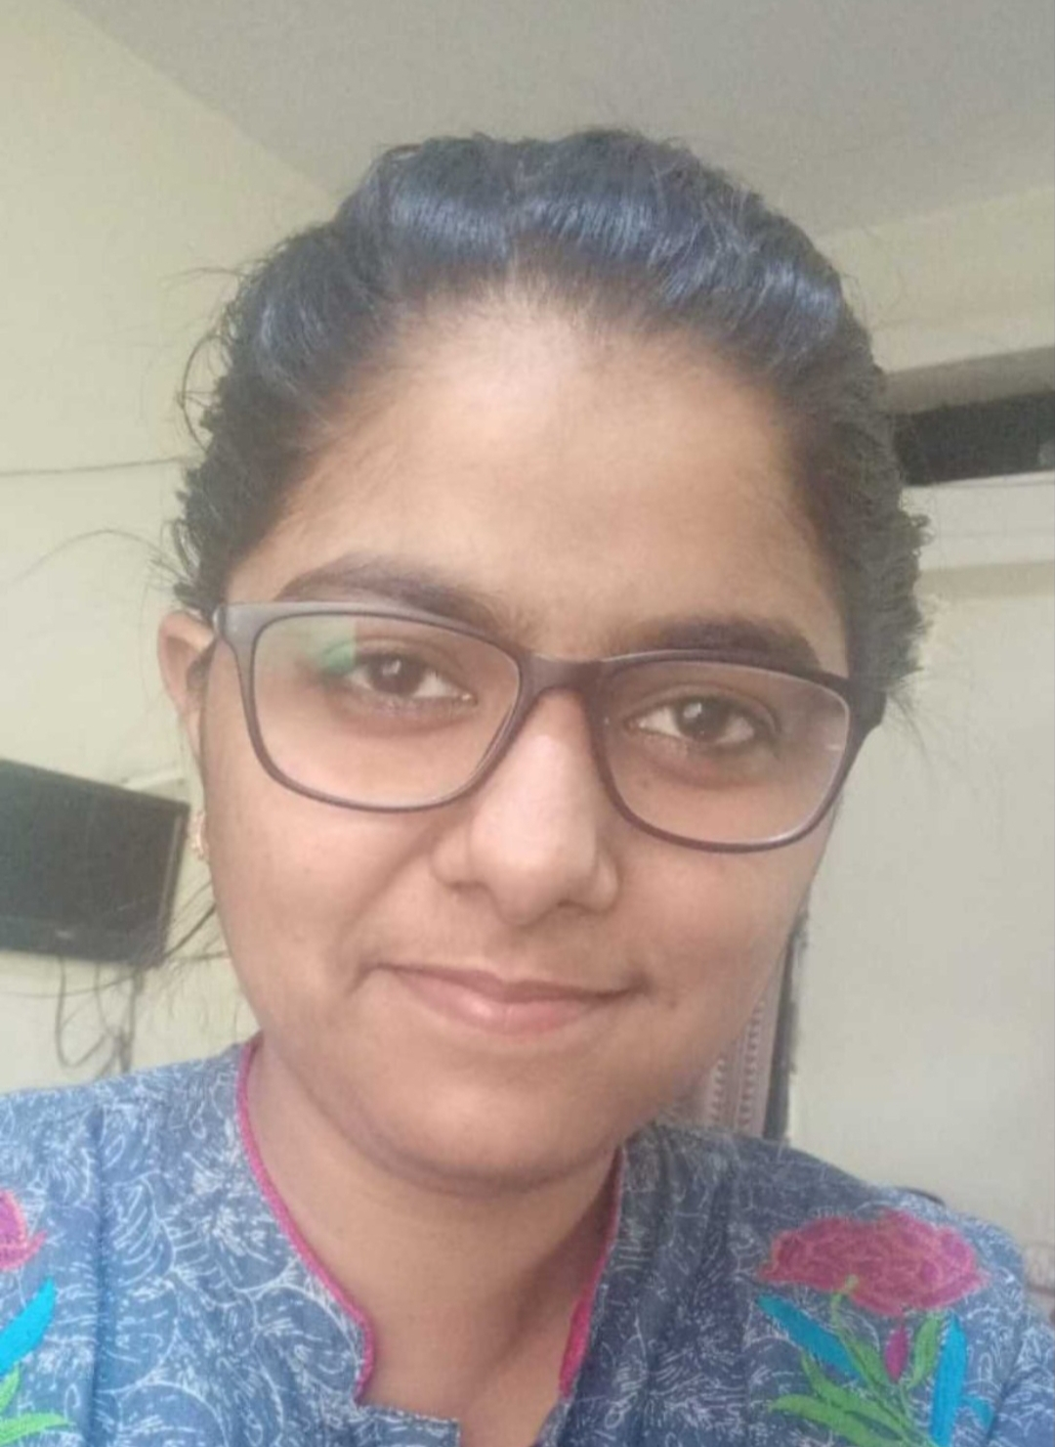
Myself
Saranjeet Kaur Bhogal https://saranjeetkaur.github.io/About-Me/
Links to all work shared in this presentation are available on my website shared above.
See you around!

