Slide 1



SUSTAIN-A-THON (2.0) 2026
SPINDEX — Spin Determination by INDEX of Reflected Light
Problem Statement Title- Spin-state determination of uncooperative orbital debris
Theme- Space Technology & Sustainability
PS Category- Hardware
Team ID- S080
Team Name- ZEIT v1.0 Team Lead- Sarthak Tyagi

Slide 2
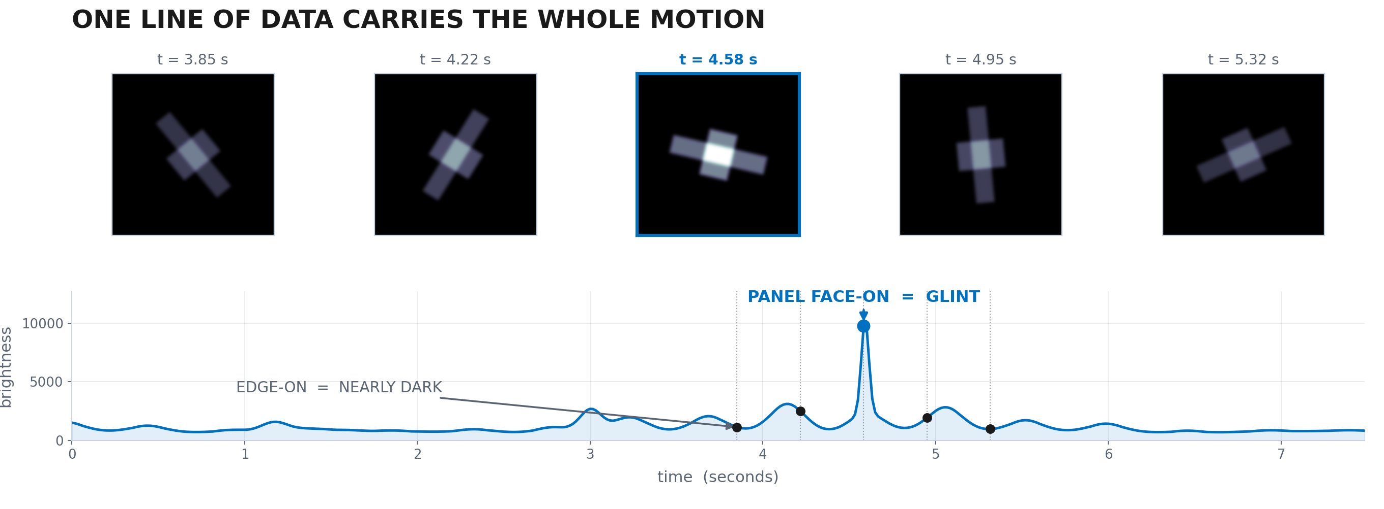
SPINDEX — SPIN FROM REFLECTED LIGHT
Proposed Solution
Reflected sunlight rises and falls as the target turns
That light curve carries rotation, precession and cone angle
Passive — no transponder, no cooperation, no contact
Scored against a firmware-commanded rate, so it is falsifiable
Rendered target at five rotation phases — the flash at t = 4.58 s is a panel turning face-on

Slide 3
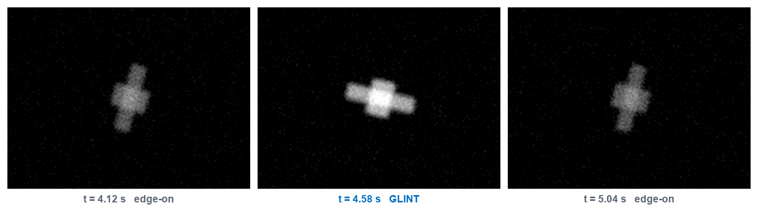
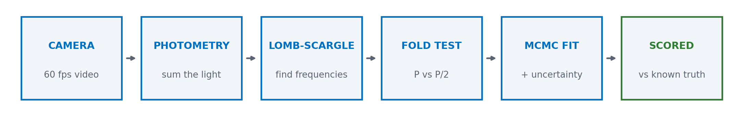
TECHNICAL APPROACH
Technologies and Methodology
Software — Python, NumPy, SciPy, OpenCV, emcee
Hardware — Arduino Uno, CNC Shield V3, 2 x NEMA-17, 10 W LED
Photometry → Lomb-Scargle → fold test → MCMC fit
Lomb-Scargle, not FFT: live capture is unevenly sampled
Frames from a recorded run
60 fps in — spin rate, precession and cone angle out, with error bars
Six-stage inversion pipeline, running live on arriving frames

Slide 4
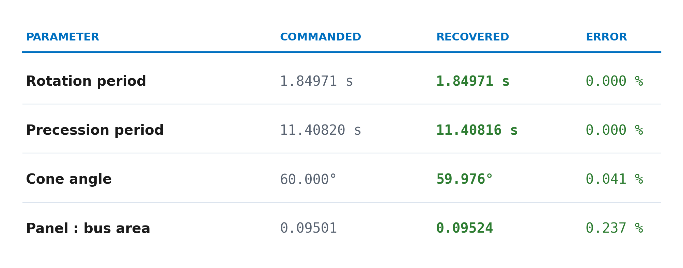
FEASIBILITY AND VIABILITY
Feasibility, Risks and Mitigation
Working prototype already built for ₹13,850
78 / 80 robustness runs and 44 / 44 unit tests pass
Driver cogging → TMC2209 with 256-step interpolation
Auto-exposure → locked, verified by a pixel-response test
P vs P/2 ambiguity → sub-harmonic fold walk
Fitted to a light curve measured through real video compression — not to the model's own output

Slide 5
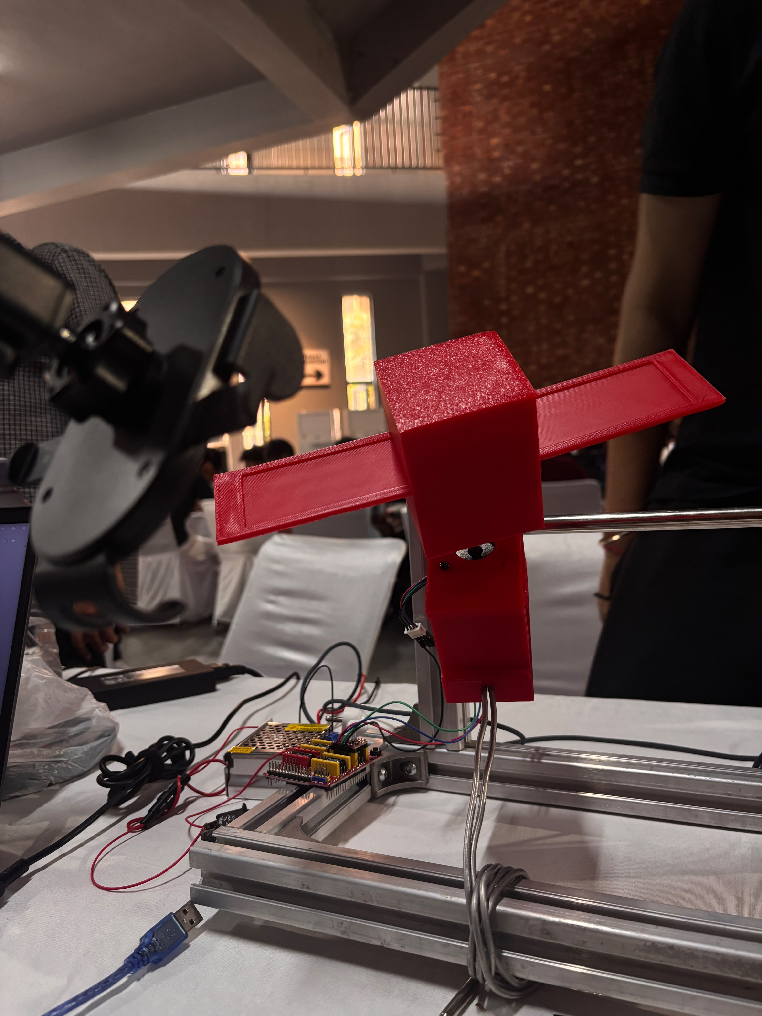
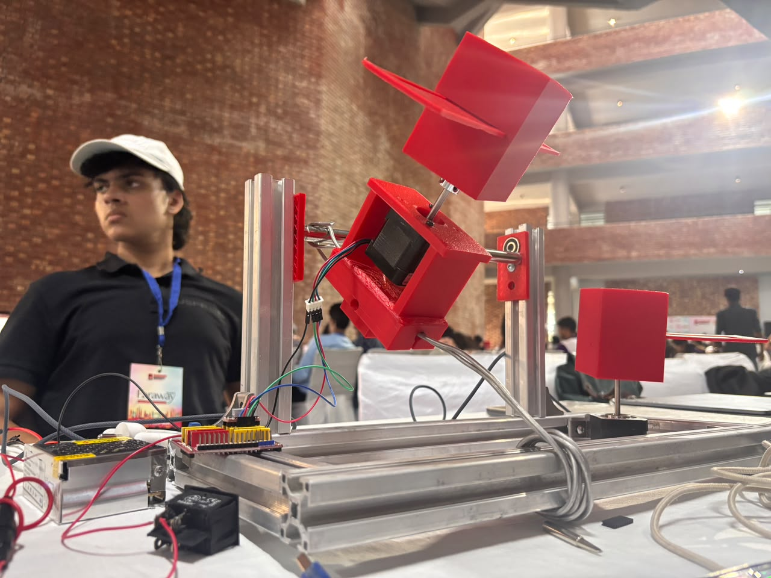
IMPACT AND BENEFITS
Impact and Benefits
36,000+ tracked objects; 5–10 must be removed each year
Almost none of them has a known spin state today
Environmental — prevents fragmentation during capture
Economic — one camera screens a catalogue, not one object
Users — servicers, SSA agencies, satellite operators
Box-wing target on the spin axis
Cradle carrying the spin motor

Slide 6
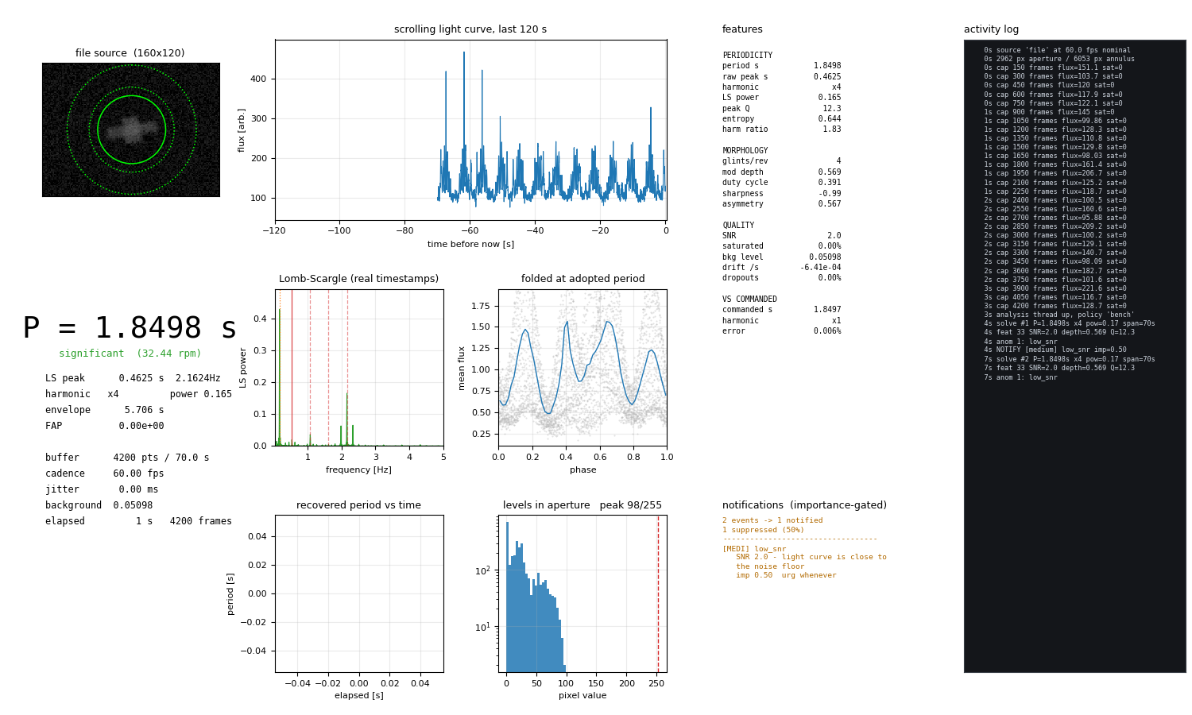
RESEARCH AND REFERENCES
Research and References
Zechmeister & Kürster (2009) — Generalised Lomb-Scargle. A&A 496, 577
Stellingwerf (1978) — Phase dispersion minimisation. ApJ 224, 953
Foreman-Mackey et al. (2013) — emcee. PASP 125, 306
ESA Space Environment Report — debris population statistics
Astroscale ADRAS-J (2024) — rendezvous with a spent upper stage
Source and results — github.com/Sarthakk1407/SPINDEX
Live monitor — light curve and running period estimate

