Slide 1
FINANCE ANALYTICS
Credit Card Customer
& Transaction Analysis
Executive-level insights across customer behavior,
transaction performance, credit risk & revenue optimization.
Presented by: Saransh Goyal

Slide 2
TABLE OF CONTENTS
01
Project Overview
04
Key Business Insights
Objectives, scope & methodology
Sales, customers, risk & spending
02
5-Step Approach
05
Challenges & Limitations
Data pipeline from raw to insight
Data gaps & performance constraints
03
Dashboard Walkthrough
06
Strategic Action Plan
Customer & transaction dashboards
Recommendations & next steps

Slide 3
PROJECT OVERVIEW
WHAT IS THIS PROJECT?
PRIMARY OBJECTIVES
Executive-level dual dashboard consolidating customer behavior, transaction patterns & credit risk exposure.
Analyze customer demographics & credit behavior
Transforms raw transactional & customer data into actionable strategic insights.
Track revenue, profit & transaction trends by period
Assess credit utilization & financial risk exposure
Integrates demographics, financial metrics, and usage trends for a 360° business view.
Identify high-value segments for targeted marketing
Built to drive marketing, risk management & revenue optimization decisions.
Enable data-driven decision-making at executive level

Slide 4
5-STEP METHODOLOGY
1
2
3
4
5
Understand
& Clean
Requirement
Gathering
Prototype
Design
Modeling &
Transformation
Visualization
& Delivery
Reviewed data structure & scope
Defined business objectives
Designed wireframe layouts
Built data model relationships
Consistent teal color theme
Identified key fields & metrics
Gathered KPI & visual requirements
Structured KPI cards & slicers
Created KPI measures & columns
Executive-level KPI cards
Handled data quality issues
Created stakeholder user stories
Evaluated chart types for clarity
Bookmarks & interactivity

Slide 5
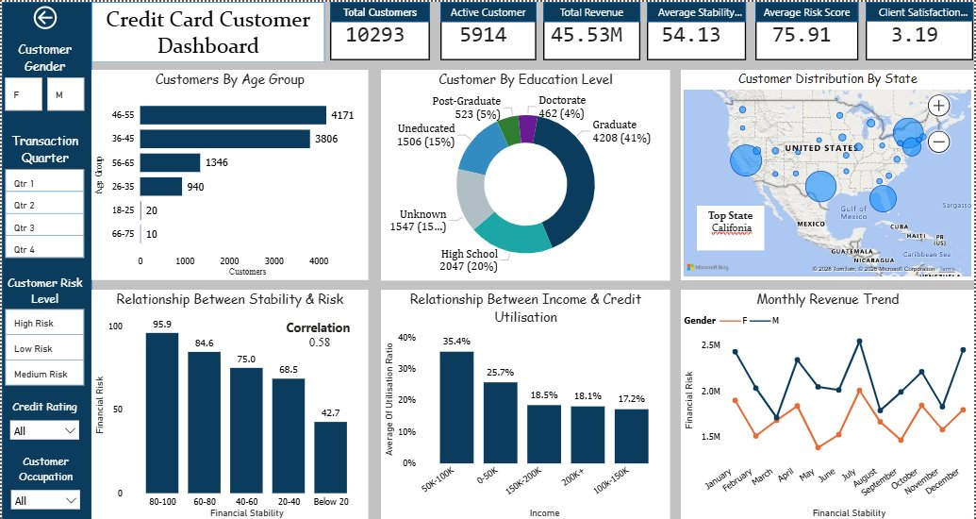
DASHBOARD 1 — CREDIT CARD CUSTOMER OVERVIEW
10,293
Total Customers
5,914
Active Customers
$45.53M
Total Revenue
3.19 / 5
Client Satisfaction

Slide 6
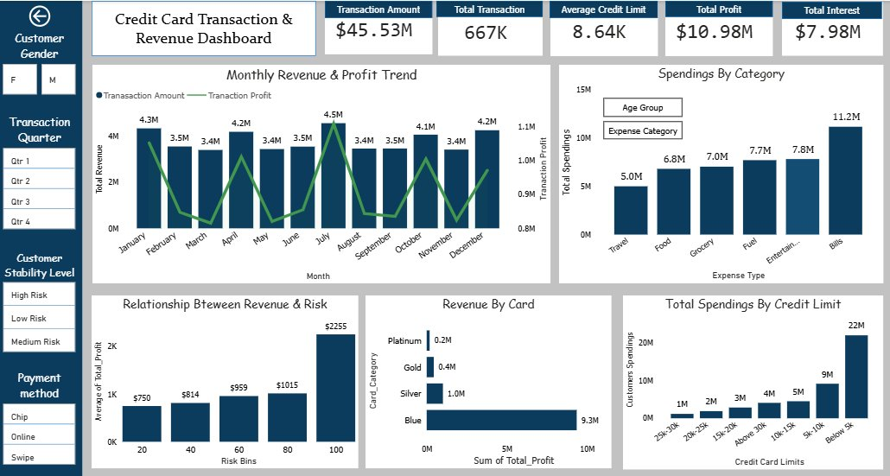
DASHBOARD 2 — TRANSACTION & REVENUE OVERVIEW
$45.53M
Transaction Amount
667K
Total Transactions
$10.98M
Total Profit
$7.98M
Total Interest

Slide 7
KPI PERFORMANCE SUMMARY
10,293
$45.53M
$10.98M
75.91
Total Customers
Total Revenue
Total Profit
Avg Risk Score
5,914 Active (57%)
667K Transactions
72% from Interest
$8.64K Avg Credit Limit

Slide 8
KEY BUSINESS INSIGHTS
Sales & Profitability
Customer Demographics
Spending peaks at mid-month — prime campaign window
80% of customers aged 36–55 — peak earning cohort
~0.8 correlation: customer spend drives company profit
Female customers represent 58% of the base
$10.98M total profit — 72% directly from interest income
Only 57% of cards activated — 43% untapped revenue
Bills ($11.2M) is the #1 spending category
Middle-class ($50K–$100K) dominates activations
Risk & Credit Utilization
Spending & Transaction Behavior
Middle-income group shows highest utilization (~40%)
$11.2M spent on bills — largest single expense
Financial stability & risk correlate positively (0.58)
70% of customers prefer Swipe payment method
High-risk customers hold major stake in total base
Blue card holders generate highest profit ($9.3M)
Lower stability = higher risk exposure
Revenue & risk positively correlated across risk bins

Slide 9
CHALLENGES & LIMITATIONS
Key constraints encountered during data analysis & dashboard development
01
Data Quality Issues
HIGH
Critical columns missing or incomplete — client total loan, granular location data & detailed revenue breakdown — limited depth of segment-level analysis.
02
Performance Bottlenecks
MEDIUM
Large row/column count slowed dashboard load times. Complex DAX measures & calculated columns required careful optimization to maintain acceptable query performance.
03
Limited Behavioral Trend Data
MEDIUM
Absence of longitudinal data restricted the ability to track individual customer behavioral trends and build predictive churn or spending models.
04
Low Activation Rate Gap
LOW
With only 57% card activation, nearly half the customer base remains analytically invisible — limiting revenue forecasting accuracy and targeted campaign reach.

Slide 10
STRATEGIC ACTION PLAN
1
Mid-Month Campaign Activation
REVENUE
Launch targeted EMI offers & promotions during peak mid-month windows to maximize transaction volume and revenue capture.
2
Tighten Credit Risk Monitoring
RISK MGMT
Implement real-time utilization alerts & strategically price interest to balance profitability against default risk exposure.
3
Card Activation Drive
GROWTH
Target the 43% inactive customer base with personalized outreach and onboarding incentives to unlock significant untapped revenue.
4
Loyalty & Credit Enhancement Program
RETENTION
Design tiered credit limit upgrades and reward structures for high-engagement customers to increase retention and grow wallet share.
5
Utility Provider Partnerships
PARTNERSHIP
Partner with utility & bills providers for card-exclusive rewards — leveraging the $11.2M bills category to drive transaction frequency.

Slide 11
CONCLUSION
& KEY TAKEAWAYS
Thank
The dual dashboards consolidate critical financial, behavioral & risk insights — enabling segment-level strategy and executive-level decision making.
Revenue–risk correlation enables smarter interest rate pricing
You!
Mid-month spending peaks = clear campaign timing opportunity
43% inactive base represents significant untapped revenue
Bills & utilities dominate spend — ideal for partner rewards
Saransh Goyal
Finance Analytics | Credit Card Customer & Transaction Dashboard

