Slide 1


Slide 2

COMPANY BACKGROUND
AN ONLINE RETAIL STORE LAUNCHED WITH THE AMBITIONS OF CLEARING THOUSANDS OF DOUBTS RELATED TO FASHION & LIFESTYLE, WE INSPIRE CONSUMERS TO MAKE FASHION AND LIFESTYLE CHOICES THAT BEST SUIT THEM.
WE HAVE A WIDE ASSORTMENT OF OFFERINGS ACROSS ESTABLISHED NATIONAL BRANDS, INTERNATIONAL BRANDS, LUXURY BRANDS, AND EMERGING LABELS AND DESIGNERS.
OUR MISSION IS TO IMPROVE THE FASHION SENSE OF PEOPLE BY
PROVIDING NEW LASTEST FASHION AT REASONABLE PRICE.

Slide 3
PROBLEM STATEMENT
THE COMPANY IS FACING MULTIPLE OPEARTIONAL CHALLENGES THAT CREATE HINDRANCE IN ACHIEVING THEIR OWN GOAL.
THE COMPANY IS CURRENTLY EXPERIENCING OPERATIONAL GAPS ACROSS MULTIPLE AREAS, INCLUDING FINANCIAL, LOGISTICS, PRODUCT MANAGEMENT, AND CUSTOMER SATISFACTION.
TO DRILL DOWN INTO THESE ISSUES, THE COMPANY IS LEVERAGING DATA-DRIVEN INSIGHTS TO OPTIMIZE OPERATIONS.

Slide 4
PROJECT INTRODUCTION
THIS PROJECT FOCUSES ON ANALYZING AN E-COMMERCE COMPANY’S DATA TO UNDERSTAND ITS OVERALL PERFORMANCE.OUR AIM TO UNCOVER KEY ISSUES, UNDERSTAND BUSINESS TRENDS, AND PROVIDE DATA-DRIVEN RECOMMENDATIONS.
DATA ANALYSIS TOOLS
MS-EXCEL- IT HELPS IN OPENING THE CSV FILE AND UNDERSTANDING THE DATA STRUCTURE.
PYTHON LIBRARIES- PANDAS WAS USED FOR TRANSFORMING THE RAW DATA, HANDELING THE MISSING VALUES AND CREATING THE NEW COLUMNS.
POWER BI- THROUGH THE POWER BI WE HAVE MADE THE INTERACTIVE DASHBOARD WHICH IS EASIER TO ANALYZE SALES TRENDS, PRODUCT PERFORMANCE AND CUSTOMER BEHAVIOR.

Slide 5
DATA CHALLENGES
DATA QUALITY ISSUE
DATA QUALITY WERE BAD, FORMAT WERE NOT ARRANGED PROPERLY, VALUE WERE INCONSISRENT AND MISSING, COLUMNS WERE NOT CATEGORISED FOR ANALYSIS.
HIGH VOLUME OF DATA
DATA CONSISTS OF 128949 ROWS AND 22 COLUMNS WHICH MAKES IT VERY LARGE DATASET.IT REQUIRES EFFECIENT TOOL AND HIGH PROCESSING POWER TO ANALYSE THAT.
INCOMPLETE COLUMN
DATA DID’NT HAVE KEY CUSTOMER’S DEMOGRAPHIC COLUMNS SUCH AS WHO PURCHASE ORDER, THEIR NAME, AGE, GENDER, LOCATION, ANNUAL INCOME.THIS LIMIT OUR ABILITY TO ANALYZE BUYING BEHAVIOR OF CUSTOMERS.
LACK OF GUIDIANCE
DATA CLEANING PROCESS TOOKS LOTS OF TIME OF US DUE TO LACK OF CLEAR GUIDIANCE FROM OUR CORDINATOR LEADS TO EXTENDED DATA-CLEANING EFFORTS AND LONGER ANALYSIS TURNAROUND TIME.

Slide 6
KEY OPERATIONAL CHALLENGES
DECLINING SALES TREND
ABNORMAL DISTRIBUTION OF PRODUCT
POOR ORDER FULLFILLMENT
LOWER SALES IN NORTH SIDE STATES
UNEXPECTED DEMAND FROM TIER-TWO METRO CITIES

Slide 7
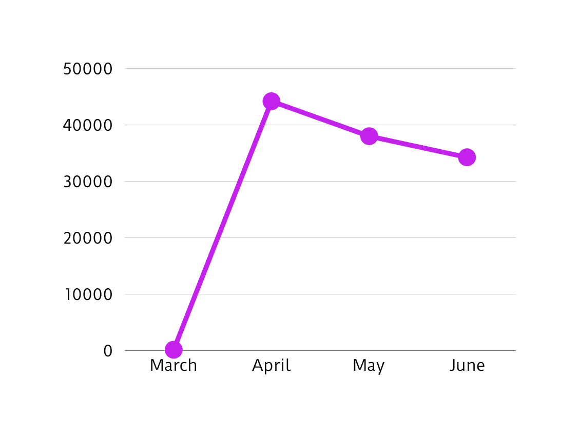
SALES GROWTH TREND
APRIL RECORDED THE HIGHEST SALES, FOLLOWED BY MAY AND THEN JUNE.
THE FIRST FOUR DAYS OF MAY (1ST–4TH) RANKED AMONG THE TOP FIVE HIGHEST SALES DAYS.
29 JULY MARKED THE LOWEST SALES DAY IN THE OBSERVED PERIOD.

Slide 8
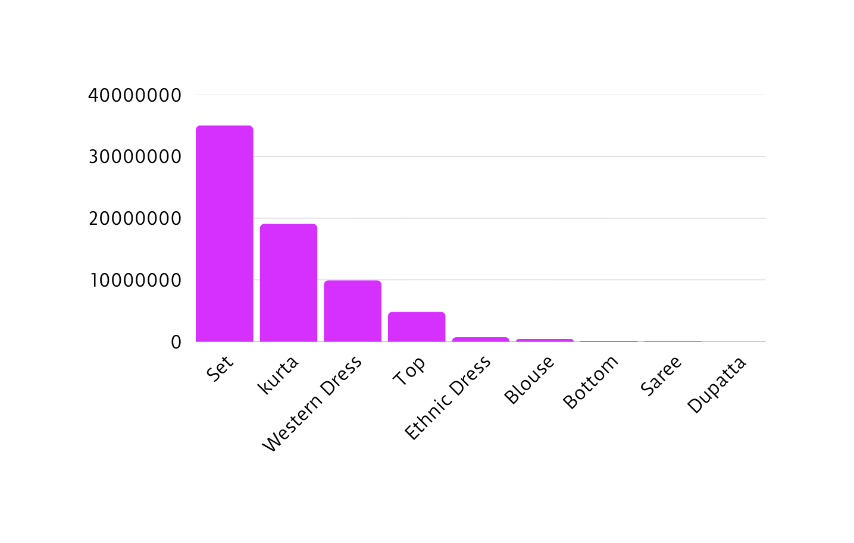
PRODUCT
PERFORMANCE
SETS AND KURTAS EMERGED AS THE TOP-SELLING CATEGORIES.
SAREES, BOTTOMS, DUPATTAS, AND TOPS RECORDED THE LOWEST SALES PERFORMANCE.

Slide 9
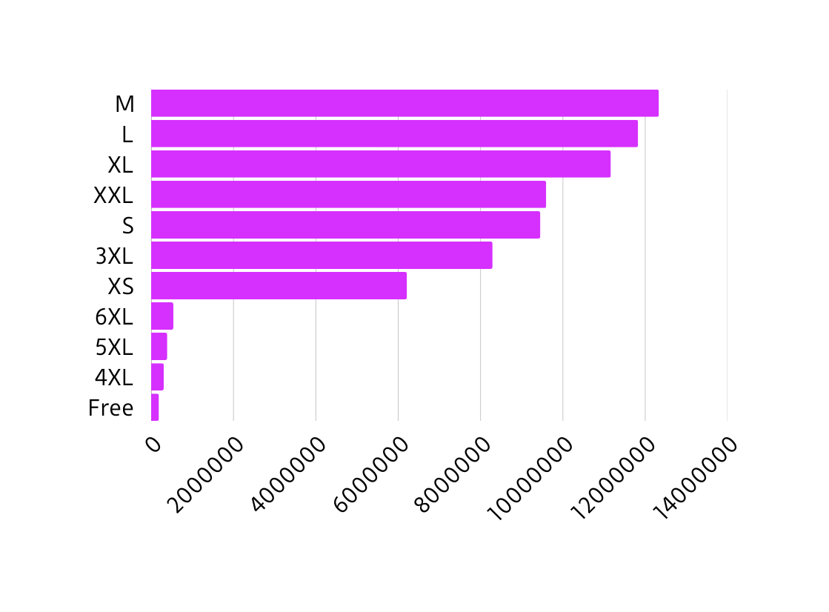
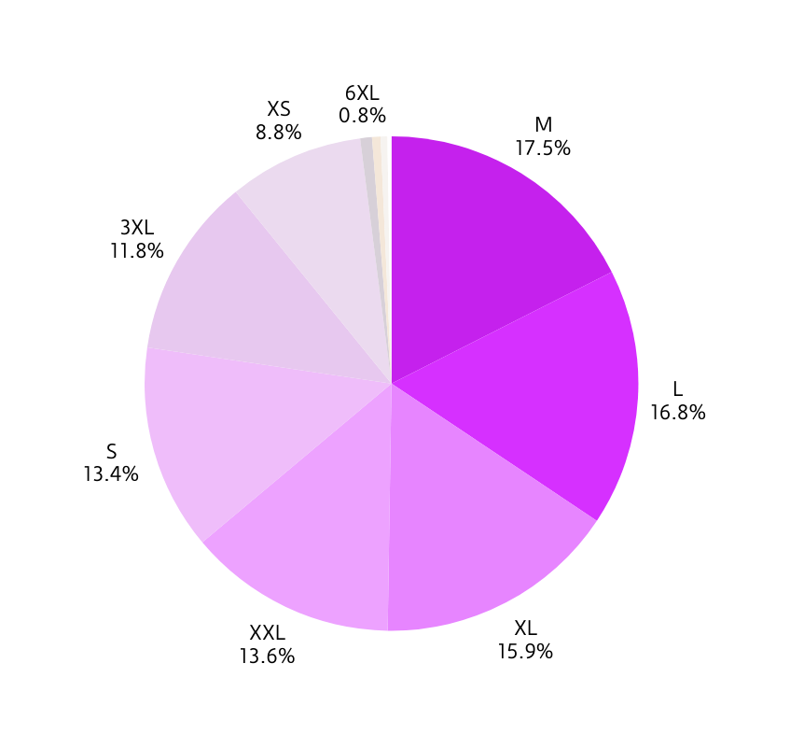
M SIZE RECORDED THE HIGHEST SALES AMONG ALL SIZES.
M, L, AND XL TOGETHER CONTRIBUTED NEARLY 50% OF TOTAL SALES.
XXL, S, AND 3XL SHOWED MODERATE SALES PERFORMANCE.
5XL, 6L, AND 4L SIZES REGISTERED THE LOWEST SALES.

Slide 10
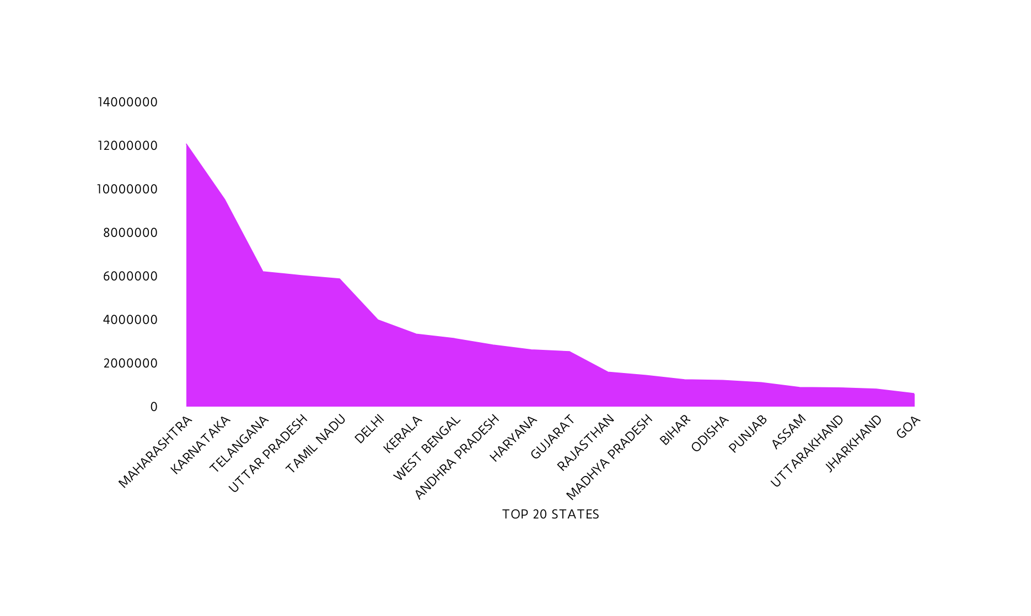
STATE PERFORMANCE
MAHARASHTRA RECORDED THE HIGHEST SALES AMONG ALL INDIAN STATES.
AMONG THE TOP FIVE STATES, FOUR WERE FROM SOUTH INDIA, HIGHLIGHTING STRONG REGIONAL DEMAND.

Slide 11
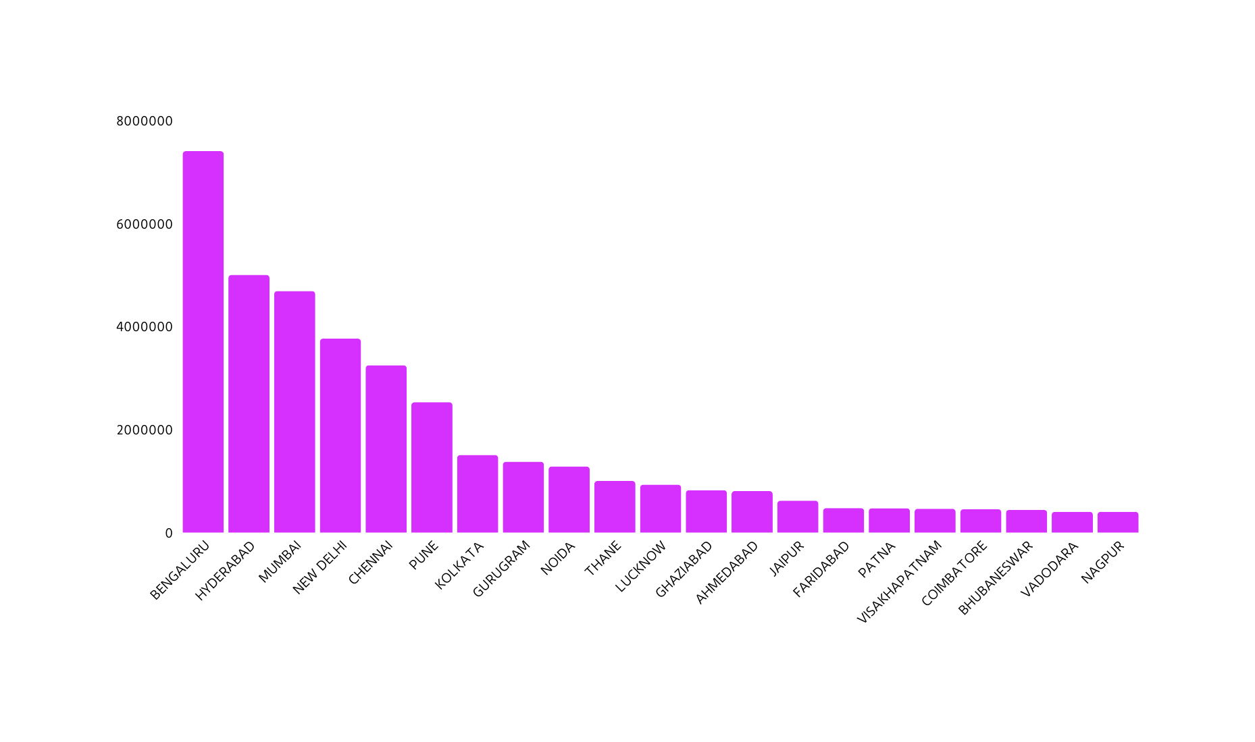
REGIONL PERFORMANCE
BENGALURU RECORDED THE HIGHEST SALES AMONG ALL CITIES.
MAJORITY OF SALES CAME FROM TIER-1 METRO CITIES.
THE TOP 10 CITIES WERE MAJOR INDUSTRIAL AND FINANCIAL HUBS, ATTRACTING PEOPLE FOR JOBS AND EDUCATION.

Slide 12
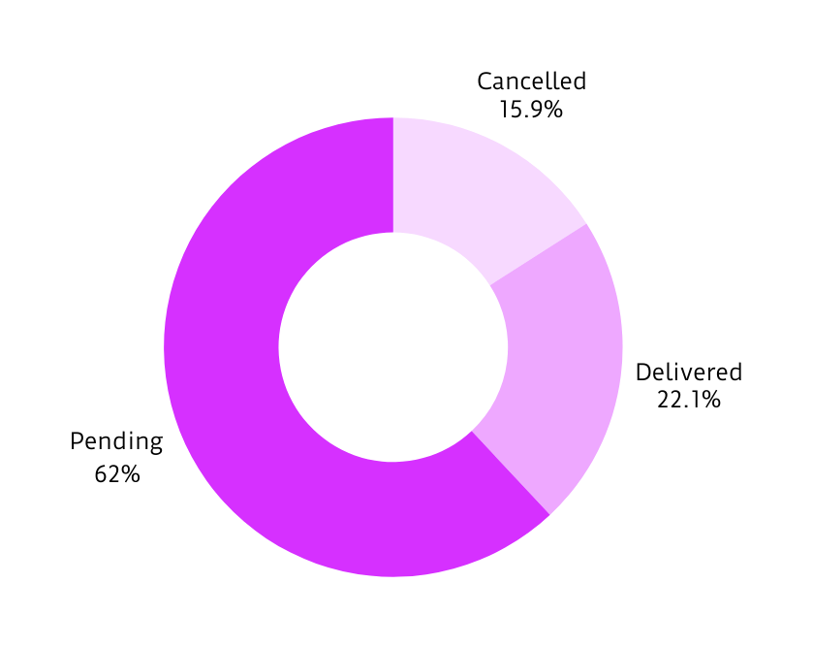
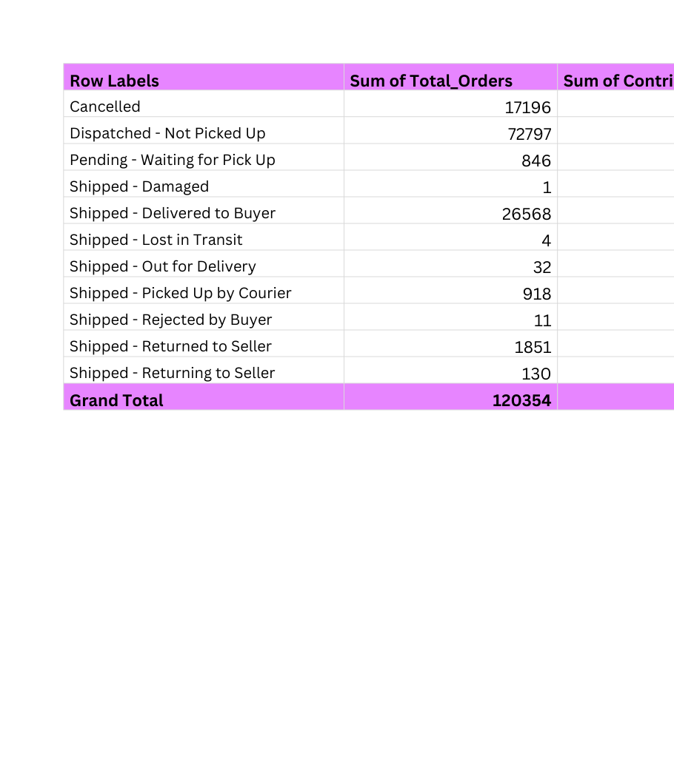
LOGISTIC PERFORMANCE
62% OF ORDERS ARE PENDING, 16% CANCELLED, AND THE REST DELIVERED.
APRIL ORDERS WERE SUCCESSFULLY DELIVERED, WHILE MAY AND JUNE ORDERS REMAIN PENDING.

Slide 13

PRODUCT MANAGEMENT
EXPAND
MARKET SHARE
Conduct a deep-dive analysis into the reasons for the low sales of "Saree," "Dupatta," and "Top" .
Expand marketing and supply chain focus in North India to maximize sales growth.
RECOMENDATIONS
IMPROVE ORDER SERVICES
TARGET TIER-1 METRO CITIES
Focus on Tier-1 metros with targeted campaigns; expand gradually into Tier-2 cities.”
“Accelerate order fulfillment and resolve May–June backlog to reduce cancellations and improve customer trust.”

Slide 14
CONCLUSIONS
OUR ANALYSIS HIGHLIGHTS SIGHNIFICANT OPERATIONAL GAP IN KEY BUSINESS AREA INCLUDING FINANCE, LOGISTICS AND PRODUCT. KEY FINDINGS SUCH AS ABNORMAL PRODUCT DISTRIBUTION, POOR ORDER STATUS, ONE-SIDED FOCUSES ON REGION ARE THE CONTRIBUTING FACTORS TO DECLINE IN OVERALL SALES PERFORMANCE.
THESE FACTORS CREATING NEGATIVELY IMPACT PRODUCT SALES, CUSTOMER SATISFACTION, REGIONAL PERFORMANCE AND OVERALL DEMAND OF PRODUCT.
CORRECTIVE ACTION THAT COMPANY SHOULD TAKE ARE IMPOROVE DELIVERY TIME, PRIORITIZING HIGH-POPULATED STATES, MAKING STRATEGY TO INCREASE THE DEMAND OF LOW SELLING ITEMS ETC.
BY IMPLEMENTING THESE CORRECTIVE ACTIONS, THE COMPANY CAN EXPECT IMPROVED DELIVERY EFFECIENCY, HIGHER CUSTOMER SATISFACTION AND INCREASED SALES PERFORMANCE.

Slide 15





THANK
YOU
goyalsaransh61@gmail.com
SARANSH3041 (SARANSH GOYAL)
WWW.LINKEDIN.COM/IN/SARANSHGOYAL007

