Slide 1
Milestone 2: Dataset Identification & Preparation
Group 4 | Project: Action-Oriented Indoor Navigation Assistance for the Visually Impaired
Goal: Identify and prepare datasets required for the perception and interaction modules of the navigation system.
Presented By: Samyuktha Shriram, Saransh Saini, Rohit Prajapat, Prasoon Shukla & Divyang Panchasara

Slide 2



System Modules & Data Requirements
Our navigation system consists of three major modules, each requiring specific datasets for training and evaluation.
Object Detection
Depth Estimation
Speech / TTS + LLM
Detect indoor obstacles from RGB images using deep learning models
Estimate distance to obstacles using monocular images and depth mapping
Convert navigation decisions into spoken instructions through audio feedback
Milestone 2 focuses on dataset selection, quality evaluation, and preprocessing for these three critical modules.

Slide 3
Object Detection Datasets
Large-Scale Datasets
MS COCO (~118k images) - comprehensive object categories
Open Images (~9M images) - extensive labeled dataset
Custom Dataset
Indoor images collected in deployment environment
Target: 1,000–2,000 images
Indoor-Focused Datasets
Purpose: Detect common indoor obstacles relevant to navigation
Indoor Object Dataset (Kaggle)
Ultralytics YOLO datasets - optimized for real-time detection

Slide 4





Object Detection Classes & Data Quality
Furniture
Navigation Elements
Chair, couch, bed, table, desk, cabinet
Door, window, stairs, wall, floor
Appliances
Other Objects
Refrigerator, microwave, oven
Backpack, suitcase, bottle, plant
Dataset Quality Challenges
Image noise
Class imbalance
Duplicate frames
Blur, lighting variations, and camera artifacts
Uneven distribution of object categories
Redundant images in video datasets
Mitigation: Sampling and augmentation techniques, frame filtering, and custom dataset collection

Slide 5
Depth Estimation Datasets
Datasets used for training and evaluating depth estimation models that predict distance to obstacles.
NYU Depth V2
ScanNet
SUN RGB-D
1449 densely labeled indoor scenes with RGB-D pairs
Over 1,500 indoor scans with 3D reconstructions
10,000 RGB-D images across 19 indoor scene categories
Additional Datasets
DIODE
Matterport3D
High-resolution outdoor and indoor depth images
Large-scale 3D spaces with panoramic views
These datasets provide RGB images paired with ground-truth depth maps across diverse indoor environments.

Slide 6
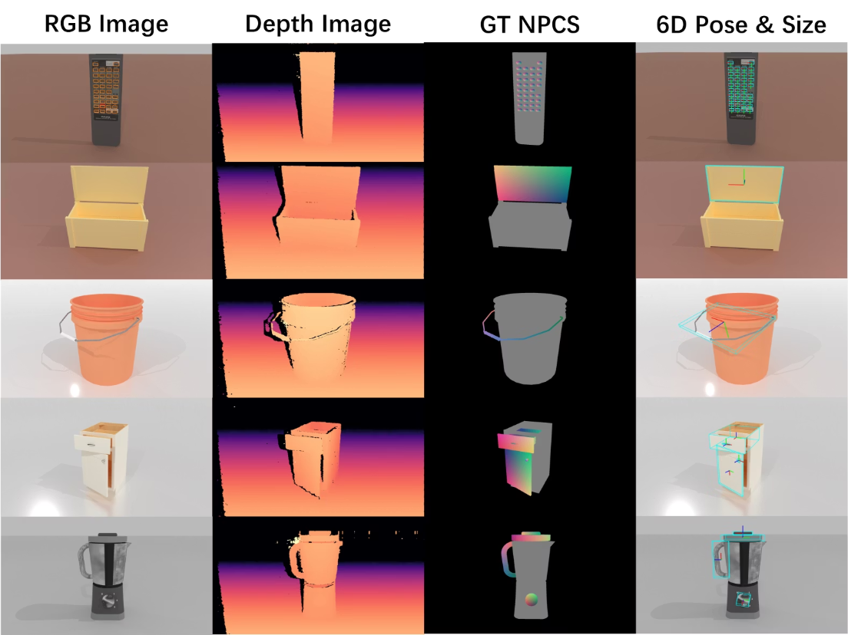
Depth Dataset Characteristics
What Depth Datasets Contain
RGB images paired with depth maps
Per-pixel distance measurements
Indoor scenes including rooms, hallways, and kitchens
Typical Properties
Resolution ranges from 480×640 to 1024×768 pixels
Purpose
Challenges
Missing depth values
Sensor noise
Reflective surfaces
Train models to estimate distance to obstacles in near-field navigation (0–3 meters)

Slide 7




Depth Data Preprocessing
Preprocessing ensures consistent input format for depth estimation models and improves robustness in real indoor environments.
Remove Invalid Pixels
Resize Images
Filter out missing or corrupted depth values
Adjust to model input resolution requirements
Normalize Values
Filter Frames
Standardize pixel intensity ranges
Remove redundant video frames
Data Augmentation Techniques
Brightness Adjustments
Scaling
Simulate varying lighting conditions
Random size variations for robustness
Slight Rotations
Noise Injection
Orientation variations within limited range
Add realistic sensor noise patterns

Slide 8





Speech / TTS Datasets
Datasets used for training speech generation and text-to-speech conversion systems.
LJ Speech
13,100 short audio clips from a single speaker with corresponding text
LibriTTS
585 hours of audiobook recordings from multiple speakers with diverse voices
Common Voice
Over 10,000 hours of crowd-sourced speech recordings in multiple languages
VCTK
109 speakers with various accents and voice characteristics
These datasets provide large-scale speech recordings with multiple speakers and diverse language samples for clear spoken navigation instructions.

Slide 9
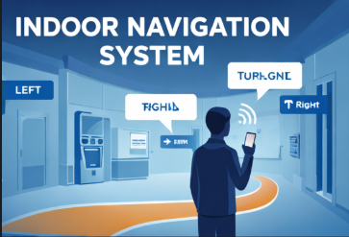


Navigation Command Dataset
STOP
Example Commands
Purpose: Evaluate how effectively the system communicates navigation decisions through audio feedback
Custom Dataset
Created specifically for navigation instructions
"Obstacle ahead"
"Turn left"
"Move forward"
"Step down"
Warning of immediate obstruction
Directional guidance instruction
Continue in current direction
Alert about elevation change

Slide 10

Dataset Split Strategy
70%
15%
15%
Training Set
Validation Set
Test Set
Model learning and parameter optimization
Hyperparameter tuning and model selection
Final unbiased evaluation
Important Consideration
Frames from the same scene remain in the same split to prevent data leakage and ensure realistic evaluation of model performance.

